Slide 1
First Aid For Children
Ciaran Darcy

Slide 2
Overview
Emergencies
Bone and Joint
Bleeding
Burns
Asthma
Allergies
Vital Signs

Slide 3
Introduction
Children hurt themselves
They Compensate for longer than adults
When they do 'go downhill', it normally is very quickly
They also may find it difficult to explain what is wrong
PARENTS SHOULD ALWAYS BE NOTIFIED

Slide 4
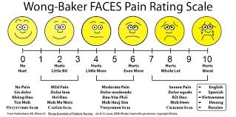
Emergencies
The above screen may help you recognise the level of pain a child who cannot describe the level of pain

Slide 5
Emergencies
Can cover a huge range of issues
Cardiac
Respiratory
Neurological
Key is Not to Panic
Call 112/999
Maintain Airway
Monitor Breathing and Circulation
Be prepared for Hands Only CPR

Slide 6
Emergencies
https://youtu.be/ILxjxfB4zNk

Slide 7
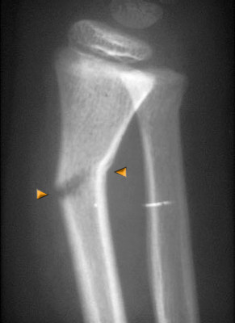
Bones, Joints and Muscle Injuries
Childrens bones are more pliable that adults
'Greenstick' fractures are commonplace
Can be difficult to distinguish from a sprain
If in doubt:
TREAT AS A FRACTURE

Slide 8
Bone, Joint and Muscle
Fractures :-Recognition
Severe Pain
Inability to move
Swelling, later Bruising
Deformity
Crepitus
May have heard or felt bone snap

Slide 9
Bone, Joint and Muscle
Fractures:- Treatment
HOSPITAL
Immobilise the limb
Comfort the patient
Inform parents

Slide 10
Bone Joint Muscle
Sprains and Strains:-
Sprain is on a Joint
Strain is Muscle related
Recognition:-
Pain
Swelling
Tenderness
Bruising
Difficulty Moving

Slide 11
Bone Joint Muscle
Sprains and Strains:- Treatment
Rest
Ice
Comfortable Support
Elevation
IF UNSURE TREAT AS A FRACTURE

Slide 12
Bleeding
3 Types of Bleeding
Arterial- from artery
- spurts
-bright red
Venous - from vein
-flows
-dark red
Capillary- from capillary
-oozes
-brick red

Slide 13
Bleeding
Bleeding Treatment:- MAJOR BLEEDING
Pressure – pressure on wound
Examine-- check for objects or fractures
Elevate – raise above heart
Posture – sit/lie down to slow heart rate
GLOVES ALWAYS
Sterile Dressing
Padding
Bandage
If seeps through put another over
If seeps through again take it all off and restart
AMBULANCE

Slide 14
Bleeding
Bleeding Treatment:- MINOR BLEEDING
Examine wound wearing gloves
Clean with cleansing wipe
Or Soap and Water
Cover with Plaster or dressing
DO NOT TALK OR BREATHE OVER WOUND

Slide 15
Burns
3 depths of burns
Superficial
Redness
Pain
Partial thickness
Blisters
Full thickness
Charring
Waxy skin
Lack of pain at site

Slide 16
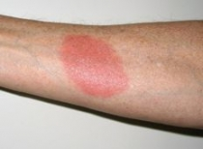
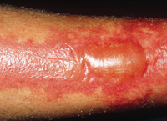
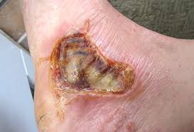
Burns

Slide 17
Burns
Burns are also classified by size
YOUR Palm and fingers is 1% of YOUR body surface area
Seeking hospital for the following:
Face, Hands, Feet, Flexion Points, Groin
Any superficial burn > 5% TSBA
Any Partial thinkness burn >1% TSBA
Any Full Thickness burn
Anything you are unsure of

Slide 18
Burns
Burns Treatment:-
COOL BURN NOT PATIENT
10 mins cold water minimum
Remove rings watches etc.
DONT REMOVE ANYTHING STUCK TO BURN
NO CREAMS, OINTMENTS ETC
Cover with clean sterile covering
NO BURSTING BLISTERS

Slide 19
Asthma
Asthma is a condition causing spasms of the lungs
Ireland has 4th Highest prevalence of Asthma in the world (Nearly 1 in 10)
5,000 hospital admissions per year
20,000 ED cases related to Asthma per Year

Slide 20
Asthma
Recognition
History of Asthma
Difficulty breathing
Wheeze
Difficulty Talking
Blueness in severe cases
Increased Breathing and pulse

Slide 21
Asthma
Treatment
DO NOT LIE DOWN
Let Patient find position of comfort
Assist with taking of inhaler
If no relief consider AMBULANCE

Slide 22
ALLERGIES
Very common
Ranging from itch to massive swelling and respiratory distress
Huge range of triggers
Pollen
Peanuts
Egg
Milk
Seafood/Shellfish

Slide 23
Allergies
https://youtu.be/yQhISQVrBXk

Slide 24
Allergies
Recognition
Itching of face and eyes
Swelling of face and airways
Vomiting
Hives
Increased pulse
Drop in blood pressure

Slide 25
Allergies
Treatment
Refer to to emergency plan
Depending on severity antihistamine
If Symptoms begin to get more serious
ADRENELIN / EPINEPHERINE
Maintain Airway
Prepare for CPR
AMBULANCE

Slide 26
Vital Signs
Not essential for minor injuries, Critical for major incidents ( serious asthma, allergies, major bleeding)
Breathing
Circulation

Slide 27
Breathing
Look
Listen
Feel
30 seconds then multiply by 2
Also depth and quality

Slide 28
Circulation
Checking pulse
Take for 15 seconds and then multiply by 4
Note Rythm and depth again
Colour , temperature and condition of skin
WRITE EVERYTHING DOWN

Slide 29
Recap
Emergencies
Breaks
Muscles/joints
Bleeding
Burns
Asthma
Allergies
Vital signs

Slide 30
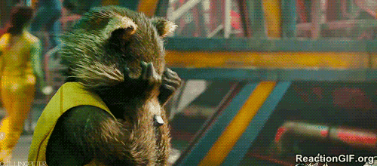
Questions?

