Slide 1
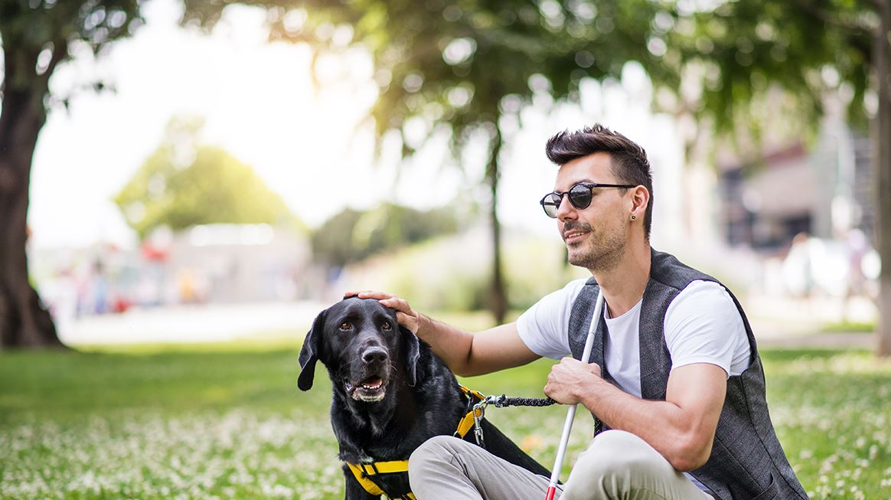
Why Dogs Are Better Than Cats: An In-Depth Comparison
Exploring the merits of canine companionship
Notes:
---
This presentation aims to explore the reasons why dogs are often considered better companions than cats. We will delve into various aspects such as companionship, training, health benefits, and the role of dogs in society.

Slide 2
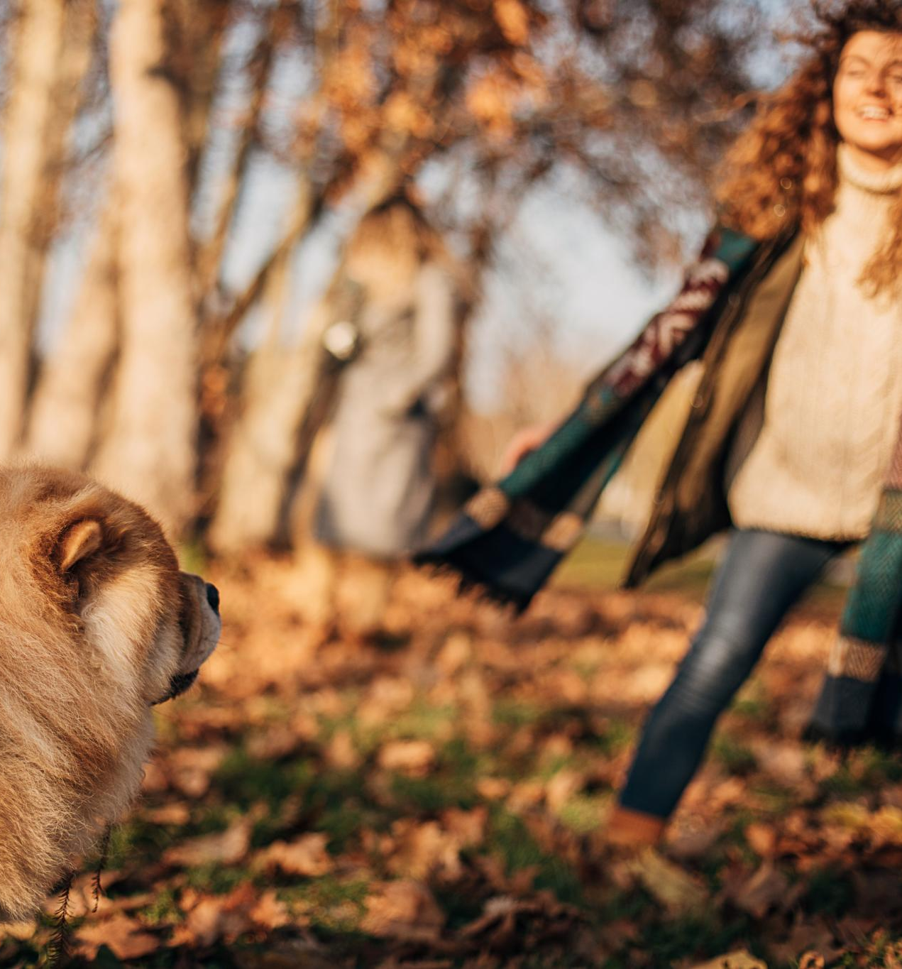
Agenda Items
Companionship and Loyalty
Training and Behavior
Hero Dogs in Movies Vs. Hero Cats in Movies
Health and Exercise Benefits
Protection and Security
Social and Emotional Impact
Notes:
We will cover key areas including the companionship and loyalty that dogs offer, their behavior and trainability, the portrayal of dogs versus cats in movies, health and exercise benefits, dogs' protective roles, and their emotional impact on humans.

Slide 3
Companionship and Loyalty
Notes:
Dogs are renowned for their affectionate and loyal nature, making them unique companions. Their instinct to bond with humans sets them apart in the pet world.

Slide 4

Affectionate and Loyal Nature of Dogs
Unwavering Loyalty
  Dogs are renowned for their loyalty, often standing by their owners through thick and thin, showcasing their devoted nature.
Expressing Affection
  Dogs express affection in various ways, such as wagging tails and cuddling, strengthening their bond with humans.
Strengthening Bonds
  The companionship of dogs enhances the human-animal bond, fostering emotional connections and mutual trust.
Notes:
Dogs are known for their unwavering loyalty and affection towards their owners. Their ability to express love and companionship enhances the human-animal bond.

Slide 5
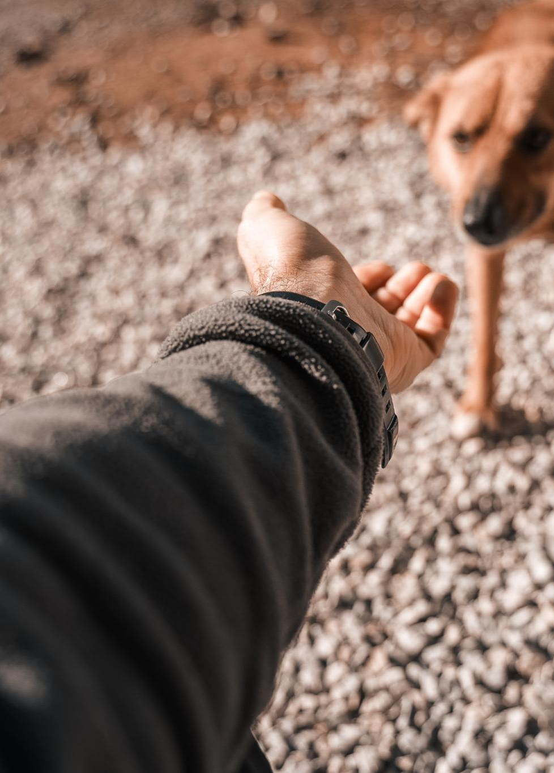
Dogs as Social Companions
Social Interaction
  Dogs naturally seek social interaction, forming strong bonds with their owners and enhancing their emotional well-being.
Promoting Engagement
  The sociable nature of dogs encourages owners to engage more frequently, creating a vibrant and active lifestyle.
Lively Environment
  Having a dog promotes a lively atmosphere in the home, enriching the lives of both the pets and their owners.
Notes:
Dogs thrive on social interaction and often seek out companionship from their owners. This sociable behavior encourages owners to engage more frequently, promoting a lively environment.

Slide 6
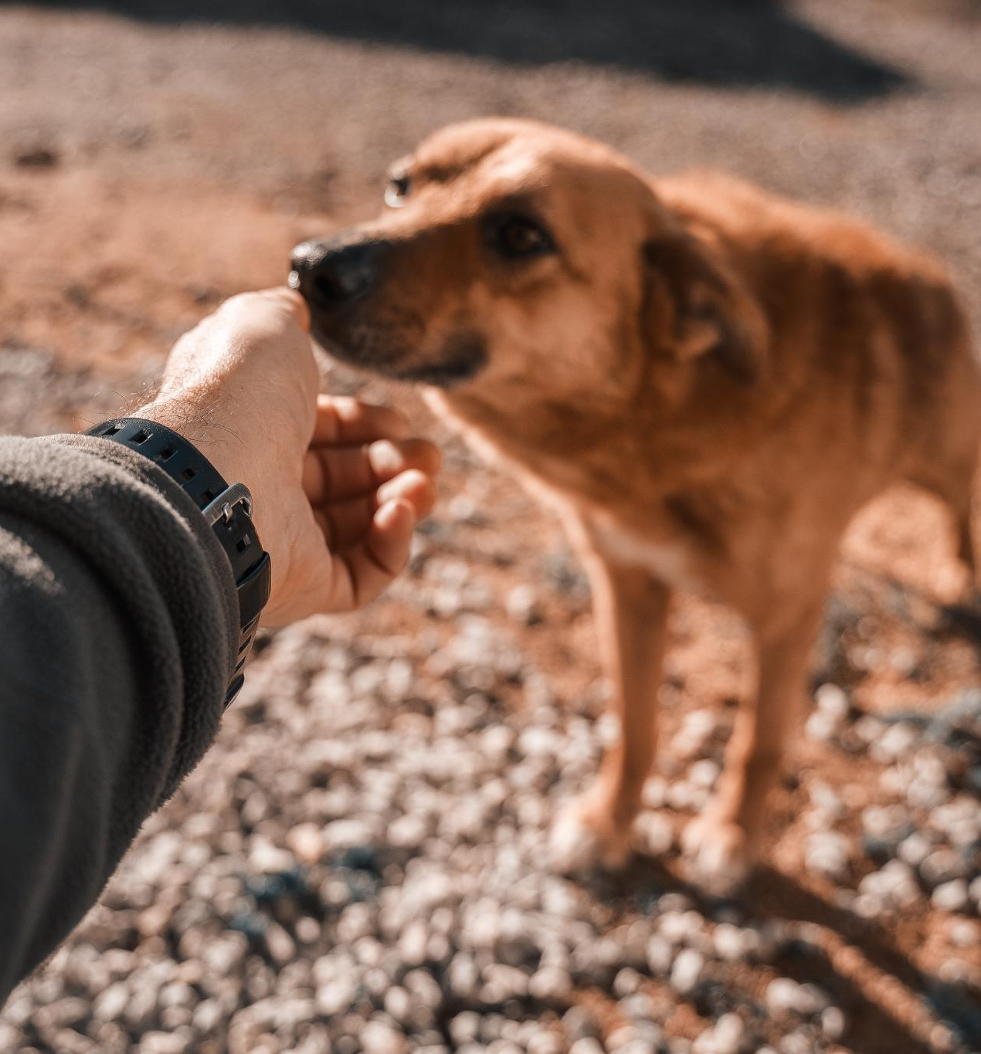
Dogs' Ability to Form Strong Bonds with Humans
Emotional Bonds
  Dogs possess an extraordinary skill to form deep emotional bonds with humans, enhancing companionship and trust.
Mutual Trust
  The bond between dogs and humans fosters a strong sense of mutual trust, making them loyal companions.
Notes:
Dogs have an extraordinary ability to form deep emotional bonds with humans. This connection leads to a strong sense of attachment and mutual trust.

Slide 7
Training and Behavior
Notes:
Training is an essential aspect of dog ownership. Dogs are generally easier to train than cats, which enhances their role as reliable companions and working animals.

Slide 8
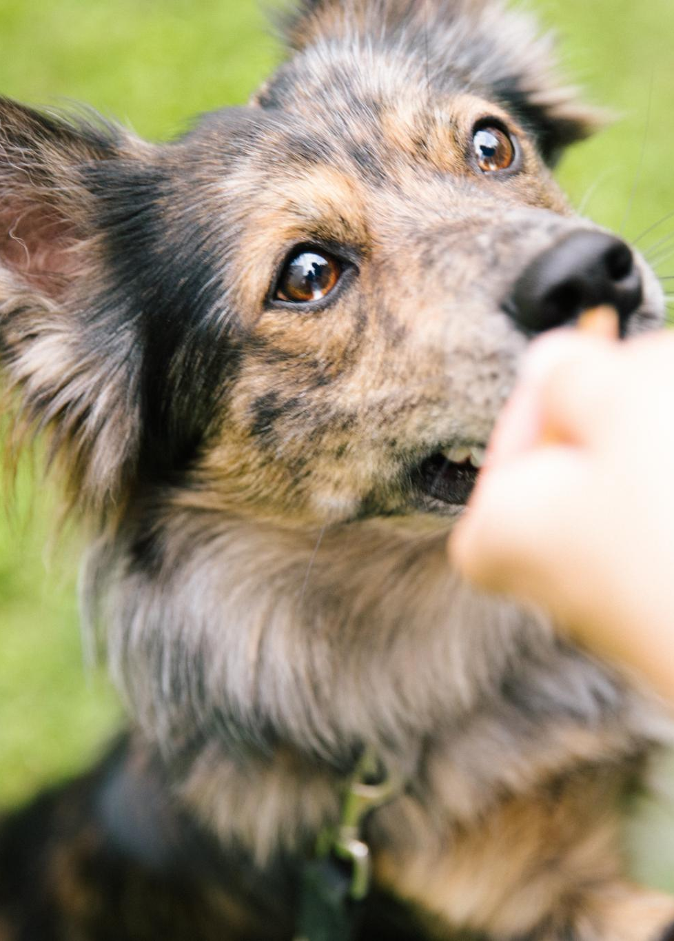
Ease of Training Dogs
Eager to Please
  Dogs have an innate desire to please their owners, which significantly enhances their training experience.
Better Obedience
  Due to their eagerness, dogs tend to show better obedience and responsiveness to commands in various situations.
Positive Behavior
  Training helps dogs display positive behavior, leading to harmonious interactions in different environments.
Notes:
Dogs are typically eager to please their owners, making them more receptive to training. This eagerness results in better obedience and behavior in various environments.

Slide 9

Obedience and Predictability
Easier Management
  The predictable behavior of dogs allows for easier management and training, making them ideal companions.
Willingness to Learn
  Dogs' eagerness to learn commands enhances their ability to follow rules, contributing to a safe environment.
Safety and Harmony
  Obedient dogs foster a harmonious home environment, enhancing safety for both pets and people.
Notes:
The predictable nature of dogs makes them easier to manage. Their willingness to learn commands and follow rules enhances safety and fosters a harmonious home.

Slide 10
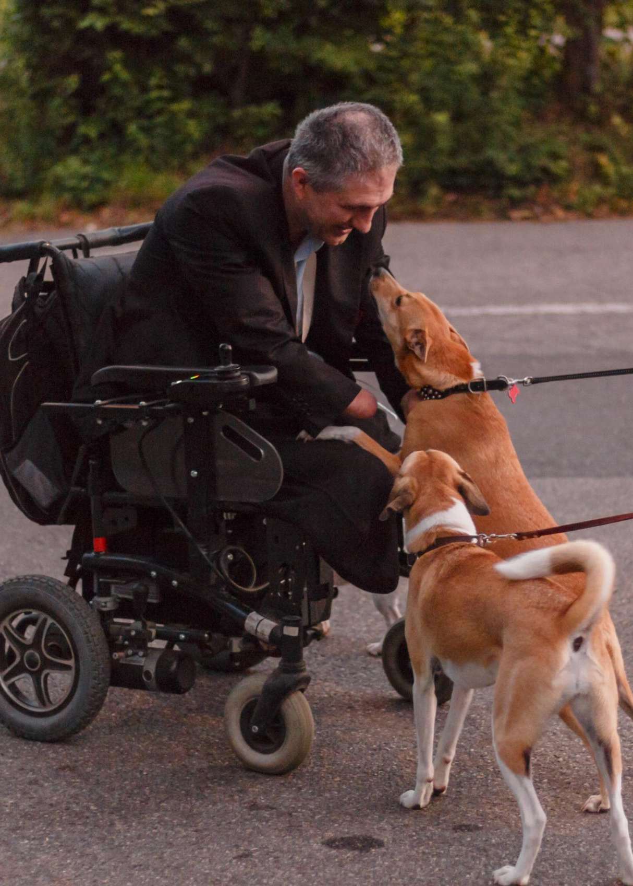
Service and Working Dogs: Roles and Responsibilities
Service Animals
  Service dogs assist individuals with disabilities, providing essential support and improving their quality of life.
Therapy Dogs
  Therapy dogs provide comfort and emotional support in hospitals, schools, and during traumatic events, promoting healing and well-being.
Working Dogs
  Working dogs perform specific tasks such as search and rescue, detection of substances, and herding, showcasing their intelligence and training.
Notes:
Dogs serve critical roles in society as service animals, therapy dogs, and working dogs. Their abilities to assist humans in various capacities demonstrate their value beyond companionship.

Slide 11
Hero Dogs in Movies Vs. Hero Cats in Movies
Notes:
The portrayal of dogs in cinema often highlights their heroism, bravery, and loyalty, contrasting with the more independent nature of cats in film representations.

Slide 12
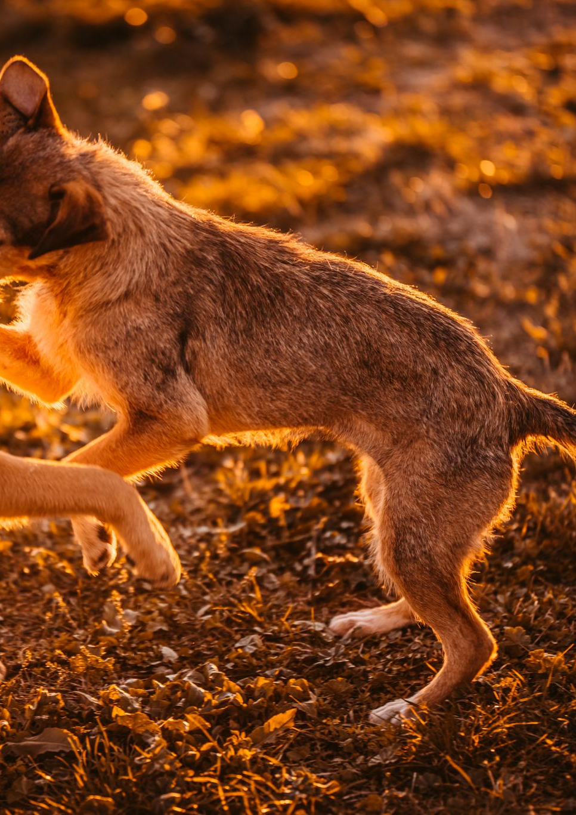
Popularity of Hero Dogs in Cinema
Loyal Companions
  Hero dogs are often portrayed as loyal companions, standing by their human friends in times of need.
Bravery and Adventure
  These dogs undertake daring adventures, showcasing their bravery and determination to save the day.
Emotional Resonance
  The stories of hero dogs resonate emotionally with audiences, highlighting themes of courage and friendship.
Notes:
Hero dogs have gained immense popularity in films, often depicted as loyal companions saving the day. Their stories resonate deeply with audiences, emphasizing their bravery.

Slide 13
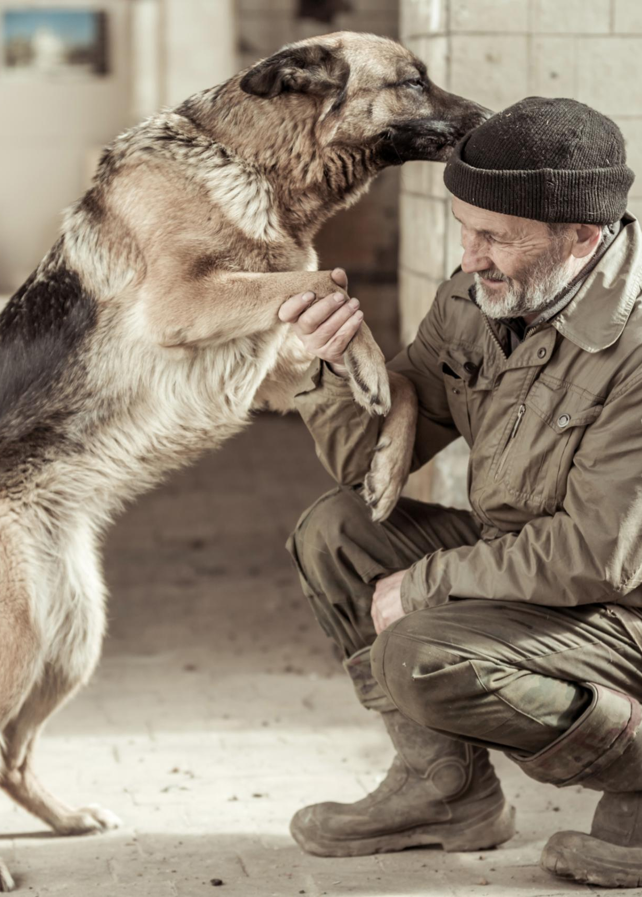
Iconic Hero Dog Movies
Lassie's Legacy
  The movie 'Lassie' portrays the adventures of a heroic collie, emphasizing loyalty and bravery in the face of challenges.
Hachi's Story
  'Hachi: A Dog's Tale' highlights the unwavering loyalty of a dog, showcasing its emotional bond with its owner.
Celebration of Canine Valor
  These movies celebrate the unique bond between dogs and humans, capturing their courage and devotion.
Notes:
Movies featuring heroic dogs, such as 'Lassie' and 'Hachi: A Dog's Tale,' have left lasting impressions on viewers. These films celebrate the valor and loyalty of dogs.

Slide 14
Comparative Analysis: Hero Dogs Vs. Hero Cats
Cultural Perception
This analysis highlights the cultural preference for dogs as heroes in contrast to cats, which are portrayed differently.
Emotional Connection
Hero dogs tend to evoke stronger emotional connections with audiences compared to hero cats, influencing their portrayal in stories.
Representation in Media
Heroic dogs are frequently depicted in films and literature, while hero cats often play secondary or comedic roles.
Notes:
While hero cats appear in films, they often lack the same level of emotional connection and heroism portrayed by dogs. This analysis reveals a cultural preference for canine heroism.

Slide 15
Health and Exercise Benefits
Notes:
Owning a dog carries numerous health benefits, including increased physical activity and improved mental well-being. These aspects contribute to a healthier lifestyle for dog owners.

Slide 16
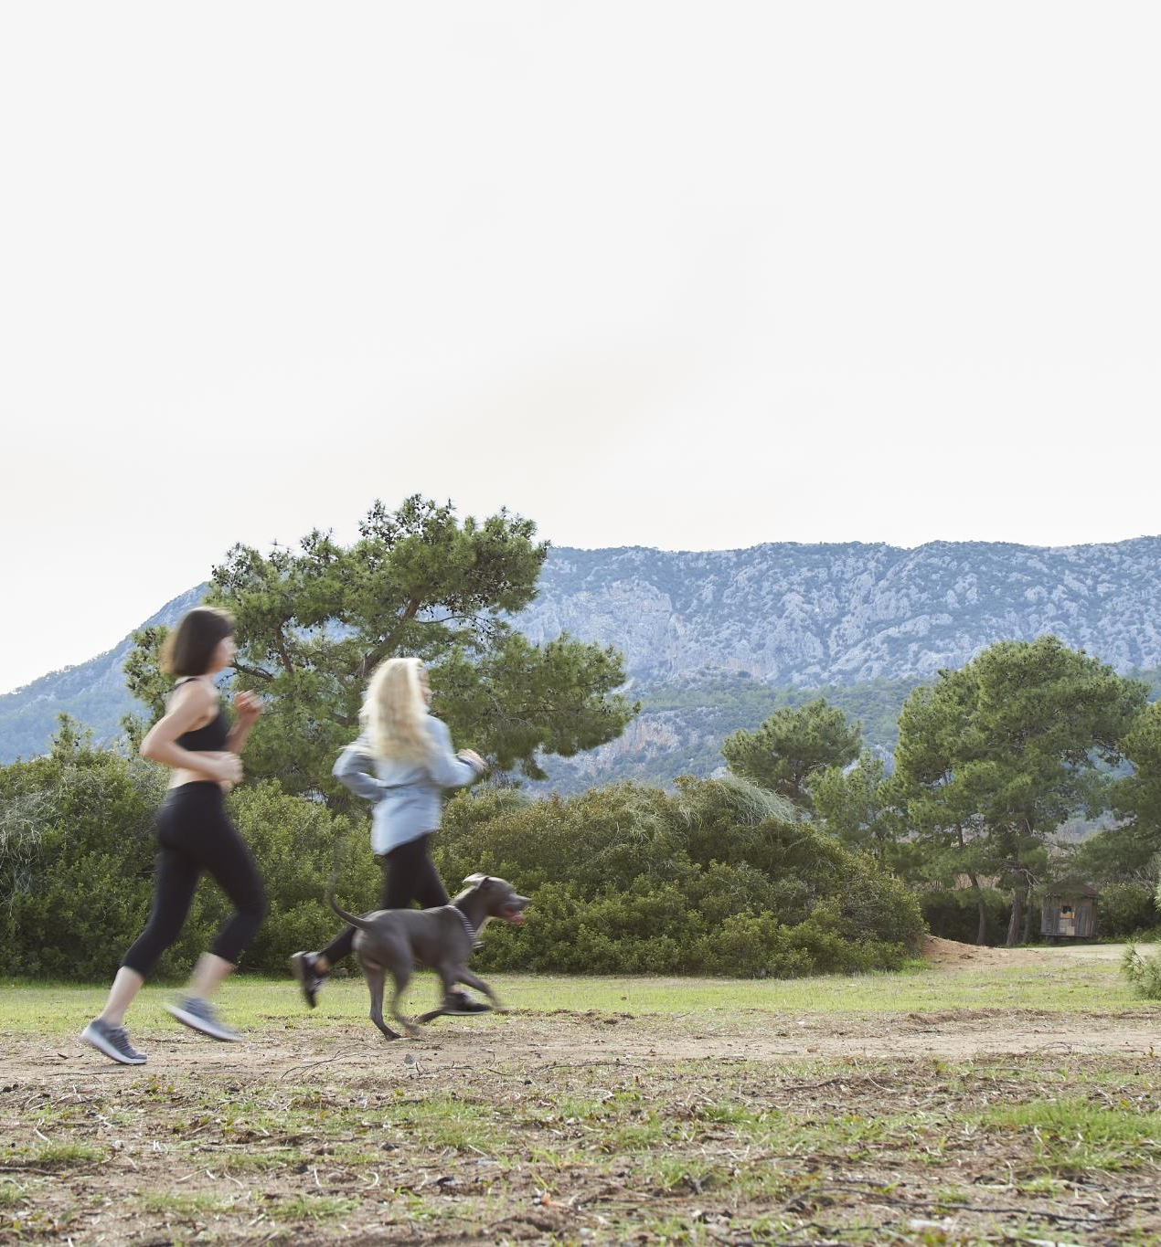
Dogs Encourage Physical Activity
Regular Walks
  Taking dogs for regular walks encourages owners to increase their physical activity levels, promoting a healthier lifestyle.
Health Benefits
  Engaging in regular walks with dogs can lead to improved cardiovascular health and overall fitness for both pets and their owners.
Notes:
Dogs require regular walks, which encourages their owners to engage in physical exercise. This routine can lead to a healthier lifestyle for both the dog and the owner.

Slide 17
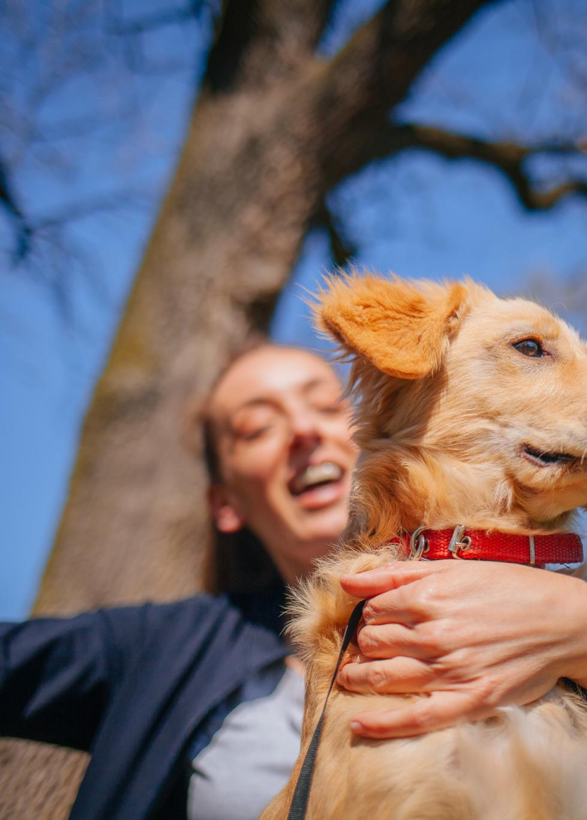
Therapeutic Benefits of Dog Ownership
Stress Reduction
  Owning a dog has been shown to lower stress levels, contributing to overall mental health and well-being.
Improved Mood
  The companionship of a dog can enhance mood and provide emotional support, leading to greater happiness.
Combatting Loneliness
  Having a dog can significantly reduce feelings of loneliness and provide a sense of purpose.
Notes:
Dog ownership has been linked to therapeutic benefits, including lower stress levels and improved mood. The presence of a dog can provide comfort and reduce feelings of loneliness.

Slide 18

Mental Health Advantages
Companionship
  Owning a dog provides companionship, which can alleviate feelings of loneliness and isolation.
Reducing Anxiety
  Dogs can help reduce anxiety levels through their playful nature and the calming effect they have on their owners.
Combating Depression
  The affection and interaction provided by dogs can play a significant role in combating depression and improving overall mood.
Notes:
Research indicates that owning a dog can significantly enhance mental health by providing companionship, reducing anxiety, and combating depression through affection and interaction.

Slide 19
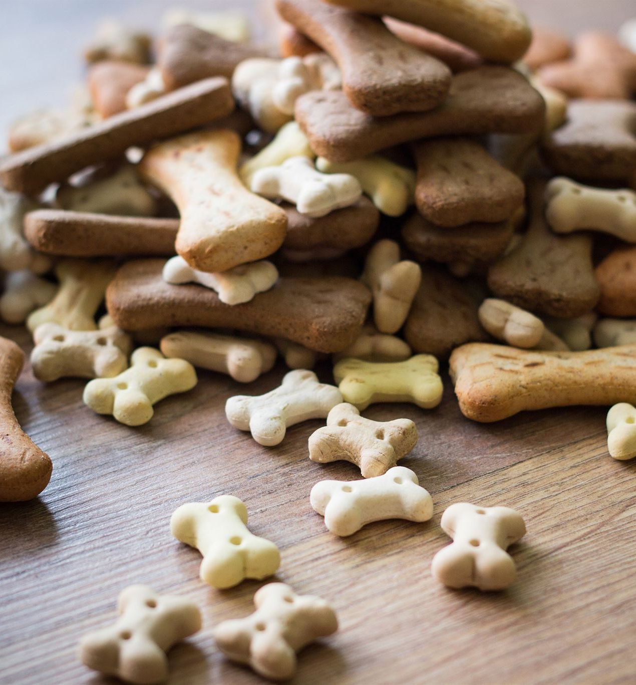
Cost Comparison: Dog Food vs. Cat Food
Dog food generally costs less than cat food on average.
Bulk purchasing options for dog food can lead to additional savings.
The ingredients in dog food can sometimes be less expensive than those in cat food.
Notes:
When comparing the costs of dog food and cat food, dog food often comes out as the more economical choice. Factors such as bulk purchasing options and the types of ingredients used play a significant role in the price difference. Understanding these aspects can help pet owners make informed decisions based on their budget and their pets' needs.

Slide 20
Protection and Security
Notes:
Dogs serve as effective protectors, offering security and peace of mind to their owners. Their natural instincts play a crucial role in safeguarding homes and families.

Slide 21

Dogs as Protectors and Guardians
Protective Instincts
  Certain dog breeds possess strong protective instincts, making them natural guardians for families and homes.
Loyal Companions
  Dogs are known for their loyalty, often forming strong bonds with their families and providing unwavering support.
Deterring Intruders
  The mere presence of a dog can deter intruders, providing an added layer of security for homes.
Notes:
Many dog breeds are instinctively protective and loyal, making them ideal guardians for homes and families. Their presence alone can deter intruders.

Slide 22

Detection Abilities (E.g., Drugs, Explosives, Medical Conditions)
Exceptional Olfactory Abilities
  Dogs have highly developed sense of smell, which allows them to detect various substances effectively.
Detection of Drugs
  Trained dogs are widely used in law enforcement to detect illegal drugs, enhancing safety and security.
Explosives Detection
  Dogs are essential in detecting explosives, playing critical roles in security at events and transportation hubs.
Medical Condition Detection
  Some dogs can alert humans to medical conditions like low blood sugar or seizures, showcasing their unique capabilities.
Notes:
Dogs possess exceptional olfactory abilities that allow them to detect drugs, explosives, and even medical conditions such as low blood sugar. This skill is invaluable in various roles.

Slide 23
Social and Emotional Impact
Notes:
The presence of dogs in our lives significantly influences social interactions and emotional well-being, highlighting their importance as companions.

Slide 24
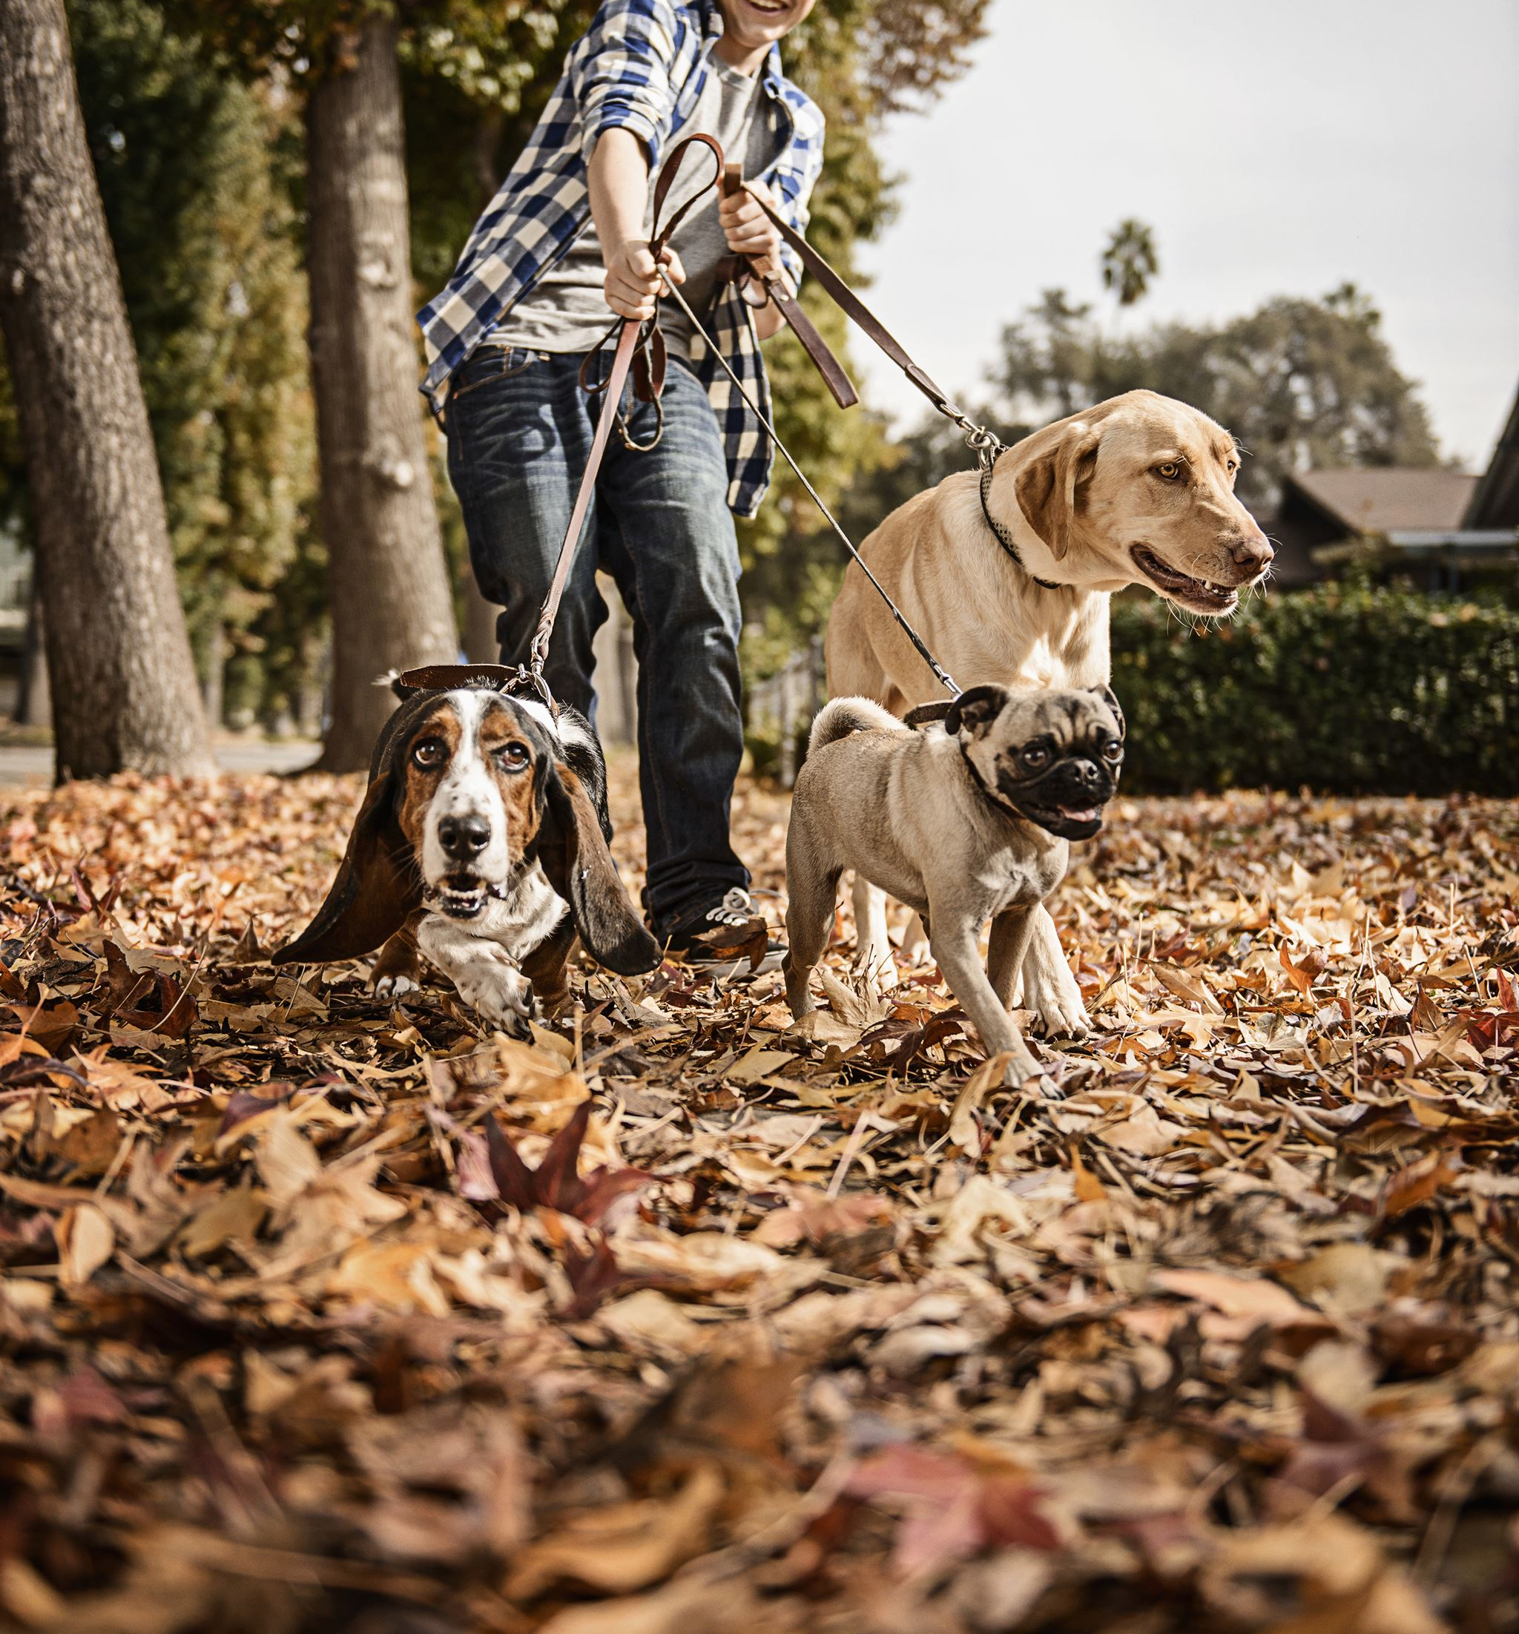
Dogs' Impact on Social Interactions
Facilitating Connections
  Dogs serve as social catalysts, helping people connect and form friendships in various social settings.
Shared Experiences
  Dog ownership often leads to shared experiences among owners, creating common ground for deeper connections.
Notes:
Dogs facilitate social interactions among people, leading to new friendships and connections. Dog owners often bond over shared experiences and love for their pets.

Slide 25

Emotional Support and Comfort
Companionship During Hard Times
  Dogs offer unwavering companionship, providing comfort and reducing feelings of loneliness during difficult moments.
Enhancing Emotional Resilience
  The affectionate nature of dogs helps their owners build emotional resilience, fostering a sense of security and stability.
Notes:
Dogs provide emotional support and comfort to their owners, offering companionship during difficult times. Their affectionate nature can enhance emotional resilience.

Slide 26
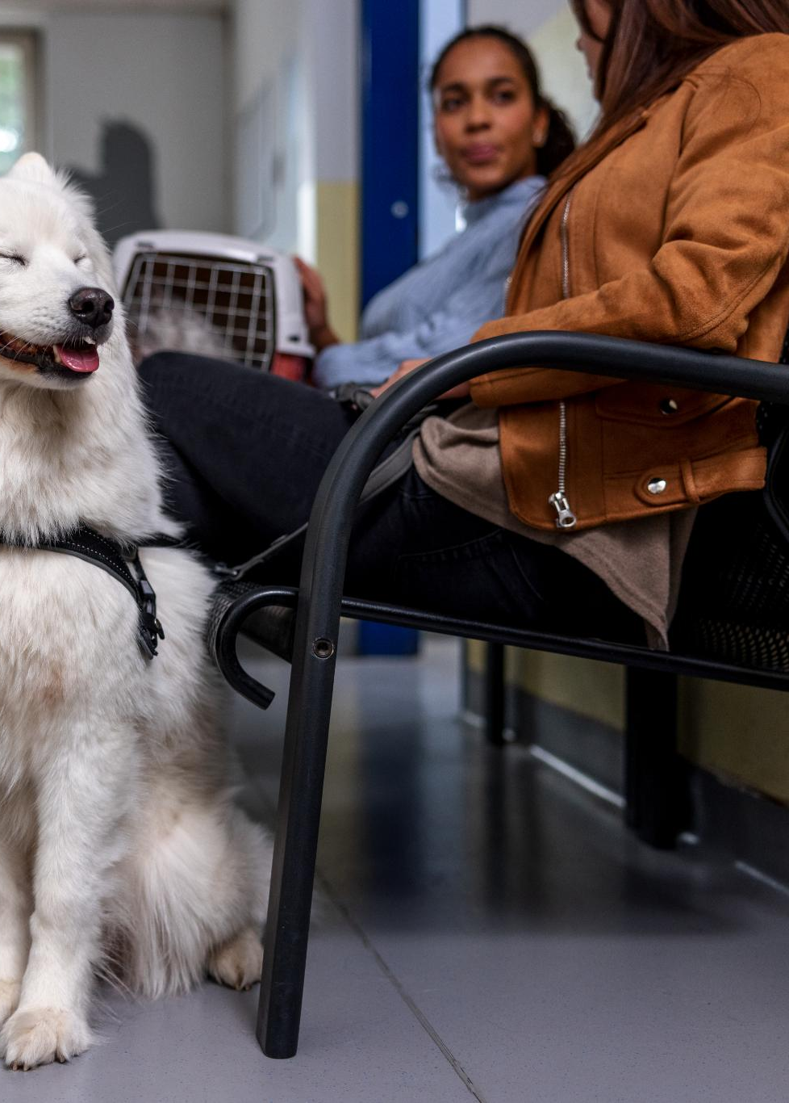
Dogs in Therapy and Support Roles
Role of Therapy Dogs
  Therapy dogs provide comfort and emotional support to individuals in various environments, enhancing mental well-being.
Benefits of Canine Companionship
  Canine companionship has proven emotional benefits, helping to alleviate stress and anxiety in individuals.
Settings for Therapy Dogs
  Therapy dogs operate in various settings, including hospitals, schools, and nursing homes, providing vital support.
Notes:
Therapy dogs play a vital role in providing comfort and support to individuals in various settings, including hospitals and schools, proving the emotional benefits of canine companionship.

Slide 27
Conclusion
Unmatched Companionship
Dogs provide unparalleled companionship, enhancing our emotional well-being and bringing joy into our lives.
Loyalty and Support
The loyalty of dogs is unmatched, offering support during challenging times and fostering strong bonds.
Roles Beyond Pets
Dogs serve as trained helpers, emotional support animals, and integral family members, enhancing our daily lives.
Notes:
In conclusion, dogs offer unparalleled companionship, loyalty, and support. Their roles in our lives extend beyond simple pets; they are trained helpers, emotional support providers, and beloved family members.

