Slide 1
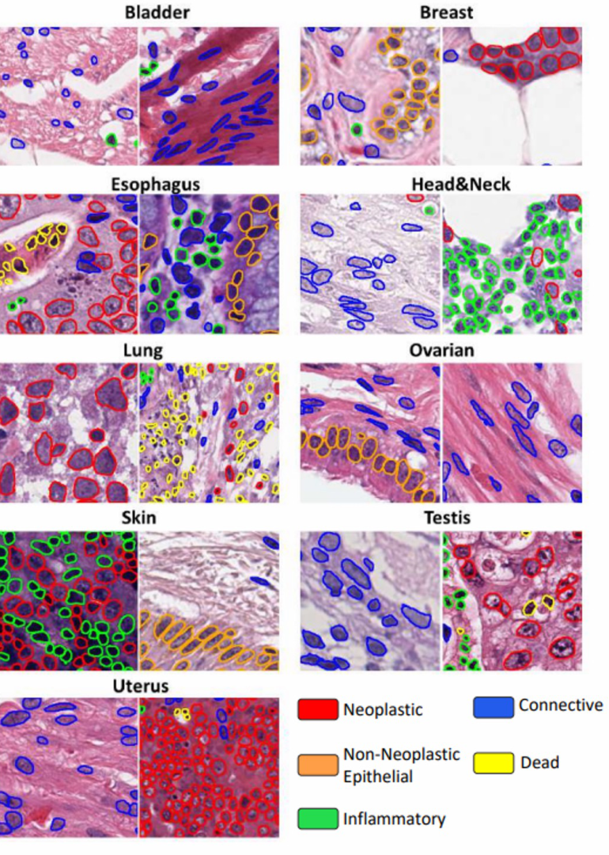
BIOMEDICAL DATA DESIGN I
Nuclei instance
segmentation across
diverse tissues
One optimization route:
resolution-aware instance decoding
Results through October 5, 2026
Zhiyu Song, Yuchen Ai, Xinhao Jin, Zheng Jian
Notes:
Good afternoon. //
Our project studies / nuclei instance segmentation / across different tissue types. //大家下午好。我们的项目研究跨不同组织类型的细胞核实例分割。
In our previous analysis, / we found that Dead nuclei / were frequently missed / during foreground detection. //
In this presentation, / I will focus on one optimization route : / increasing the working resolution / and adjusting the instance decoder / to match that resolution. //在之前的分析中，我们发现许多死亡细胞核在前景检测阶段就被漏掉了。这次汇报将集中介绍一条改进路线：提高工作分辨率，并同步调整实例解码器。
Our main question is / whether more working pixels / can improve Dead nucleus detection / without causing unacceptable damage / to overall instance quality. //我们的核心问题是：增加工作像素能否改善死亡细胞核检测，同时避免整体实例分割质量出现不可接受的下降。

Slide 2
QUESTION AND EXPERIMENT
Can more working pixels reduce missed Dead nuclei?
Why test resolution?
One training change
Dead nuclei are small:
median area 107 native px²
versus 368 px² for other classes.
Same CellViT-UNI recipe.
Working image: 256 × 256 → 512 × 512.
Evaluate instances on the original 256 grid.
All result tables: 3-split means, seed 19, no test-time augmentation (TTA).
Shared evaluator; decode parameters selected on validation only.
Upsampling changes the working grid; it does not add new acquisition detail.
Test the resolution change, then examine both small-nucleus detection and instance quality
Notes:
We tested resolution / because Dead nuclei are usually smaller / than the other nucleus classes. //我们测试分辨率，是因为死亡细胞核通常比其他类别更小。
In the original / 256 pixel coordinate system, / the median area of a Dead nucleus / is 107 square pixels, / compared with 368 square pixels / for the other classes. //在原始256像素坐标系中，死亡细胞核的面积中位数为107平方像素，而其他类别为368平方像素。
Small objects contain fewer pixels, / so their shape and texture / may be difficult / for the model to recognize. //小型目标包含的像素更少，因此模型可能难以识别它们的形状和纹理。
We kept the CellViT-UNI training recipe unchanged / and changed only the working image size / from 256 by 256 / to 512 by 512. //
We then mapped the predictions back / to the original 256 grid / for evaluation. //我们保持CellViT-UNI的训练方案不变，只把工作图像从256乘256调整为512乘512。评估时，再把预测结果映射回原始256坐标系。
This is important / because upsampling does not create new information / from the scanner. //It simply interpolates the data / onto a denser computational grid. //Therefore, / higher resolution alone / does not equal better feature quality. // 这一点很重要，因为上采样不会产生扫描仪原本没有采集到的新信息。它只是把现有数据插值到了一个更密集的计算网格上。因此，单纯提高分辨率并不等于提升了特征质量。

Slide 3
INITIAL RESULT
512 helps Dead PQ, but lowers overall instance quality
Working resolution | mPQ | bPQ | Dead PQ
256 baseline | 0.4995 | 0.6653 | 0.1760
512, original decoder | 0.4791 | 0.6413 | 0.1816
Difference (512 − 256) | −0.0204 | −0.0240 | +0.0056
mPQ
bPQ
Dead PQ
Overall quality with types
Instance quality, ignoring types
Instance + type quality for Dead
The Dead-specific score rises slightly while overall quality falls; inspect the errors
Notes:
The result / showed a clear performance trade-off / between overall quality / and dead-cell accuracy. // 结果显示，整体质量与死亡细胞准确率之间存在明显的性能权衡。
At the baseline resolution, / the model achieved better overall instance quality / for both general and tissue-type nuclei. // 在原始分辨率下，模型在通用细胞核和组织类型细胞核上表现出更好的整体实例质量。
When we increased the working resolution / without tuning the decoder, / the detection performance for Dead nuclei improved slightly. // 当我们提高工作分辨率且不调整解码器参数时，死亡细胞核的检测性能有了小幅提升。
However, / the overall instance quality scores dropped noticeably // 然而，整体的实例质量指标出现了明显的下降。
This trade-off suggested / that higher resolution benefited certain Dead nuclei, / but created new errors in other areas. // 这种权衡说明，更高分辨率虽然有益于某些死亡细胞核，但也在其他区域引入了新的错误。
We therefore analyzed the prediction errors directly// 因此，我们直接分析了具体的预测错误。
P-Q, or Panoptic Quality, / combines detection quality / with segmentation quality. //
m-P-Q calculates P-Q for each nucleus class / and then takes the average, / so it includes classification performance. //
b-P-Q ignores the nucleus types / and evaluates only whether each nucleus / is correctly detected and segmented. //
Dead P-Q applies the same metric / specifically to the Dead nucleus class. //

Slide 4
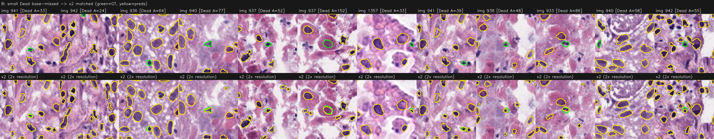
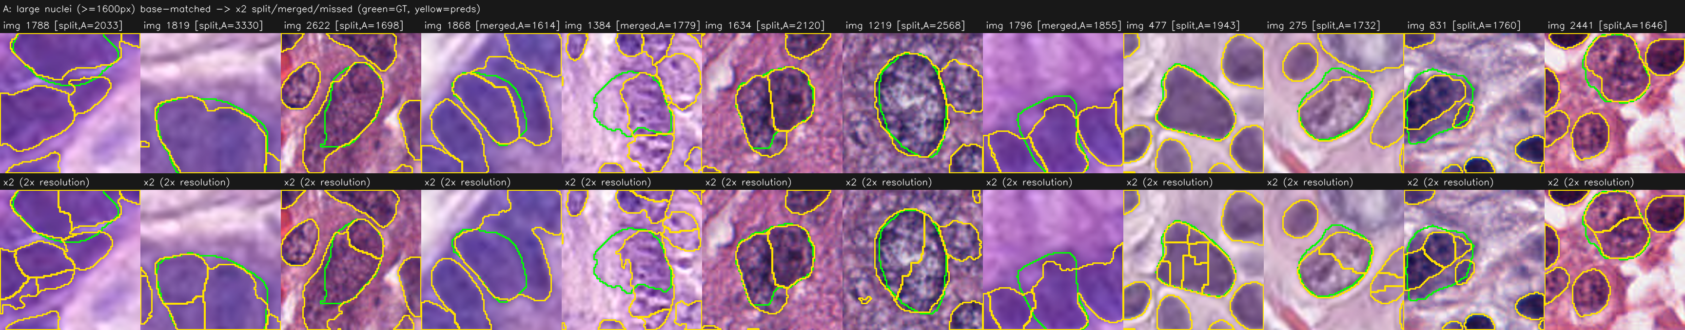
ERROR DIAGNOSIS
Small nuclei appear; some large nuclei break into fragments
Small-nucleus gain — each pair: 256 above, 512 below
Large-nucleus damage — multiple predictions inside one GT outline
Better small-object detection can coexist with worse separation of larger objects
Notes:
The visual analysis revealed / two effects / occurring at the same time. //视觉分析显示，两种现象同时发生。
In these images, / the green outlines represent the ground truth, / and the yellow / represent model predictions. //在这些图像中，绿色轮廓表示真实标注，黄色轮廓表示模型预测。
In the upper examples, / the 256 resolution model / missed several small nuclei. //At 512 resolution, / some of these nuclei / received matched predictions. //在上方示例中，256分辨率模型漏掉了一些小型细胞核；在512分辨率下，其中一部分得到了匹配预测。
This confirms / that a denser working grid / can improve small-object detection. //这证实了更密集的工作网格能够改善小目标检测。
However, / the lower examples show the opposite problem / for large nuclei. //At 512 resolution, / one large ground-truth nucleus / was sometimes divided / into several predicted instances. //但是，下方示例展示了大型细胞核上的相反问题。在512分辨率下，一个大型真实细胞核有时会被切成多个预测实例。
This is / an over-splitting / or fragmentation error. //这被称为over-splitting（过度分割）或fragmentation（碎裂）错误。
The important point is / that better detection of small nuclei / coexists with worse separation / of large nuclei. //关键在于：小型细胞核检测变好，可以与大型细胞核分离效果变差同时发生。

Slide 5
DECODER CORRECTION
Scale the decoder together with the working resolution
Decoder setting | 256 baseline | 512, unchanged | 512 + du2
Minimum object / marker area | 10 px² | 10 px² = 2.5 native px² | 40 px² = 10 native px²
Sobel aperture | 21 px | 21 px ≈ 10.5 native px | 41 px ≈ 20.5 native px
At 2× resolution: multiply area thresholds by 4 and length scales by about 2.
Re-decode the existing 512 predictions; no further training.
Keep the effective decoder scale comparable when testing a new working resolution
Notes:
Then we examined / whether the performance loss / came entirely from the model, / or partly from the decoder. //接下来，我们研究性能下降究竟完全来自模型，还是部分来自解码器。
The decoder contains settings / measured in pixels. //Two examples are / the minimum object or marker area, / and the Sobel filter / used to identify boundaries / between nuclei. //解码器包含一些以像素为单位的参数，例如最小目标或标记区域面积，以及用于识别细胞核边界的Sobel窗口尺寸。
At the baseline, / the minimum object area / was 10 square pixels. //
If we keep it at 10/ after doubling the resolution, / it represents only 2.5 square pixels / in the original coordinate system. //在256基线中，最小目标面积为10平方像素。如果分辨率加倍后仍然使用10平方像素，那么它在原始坐标系中只相当于2.5平方像素。
This makes the decoder more permissive / and allows very small fragments / to survive. //这会让解码器变得更加宽松，使非常小的碎片被保留下来。
To keep the same effective scale, / area thresholds should be multiplied by four, / because area grows / with the square of the resolution factor. //
Length parameters should be multiplied / by approximately two. //
为了保持相同的有效尺度，由于面积随分辨率倍率的平方增长，面积阈值应该乘以4；长度参数则应该乘以约2。
We call this corrected configuration / D-U-two. //It changes only the decoding step. //We reused the existing 512 predictions / and did not retrain / the neural network. //我们把这种修正后的配置称为du2。它只改变解码步骤，直接重新处理已有的512预测，不需要重新训练神经网络。
Sobel operator：
The Sobel operator / detects changes in the horizontal and vertical maps. //
These changes help identify boundaries / between touching nuclei. //
The Sobel aperture controls / how large an area the decoder examines / when detecting these boundaries. //

Slide 6
RECOVERY AFTER CORRECTION
du2 recovers 50% of the mPQ loss and 71% of the bPQ loss
Configuration | mPQ | bPQ | Dead PQ
256 baseline | 0.4995 | 0.6653 | 0.1760
512, original decoder | 0.4791 | 0.6413 | 0.1816
512 + du2 | 0.4894 | 0.6583 | 0.1831
50%
71%
+0.0071
mPQ loss recovered
bPQ loss recovered
Dead PQ vs baseline
Most of the decoder-related loss is recovered, but a residual aggregate penalty remains
Notes:
After applying du2, we recovered about half of the lost mPQ and about 71 percent of the lost bPQ. This means that much of the initial performance drop came from decoder parameters that were not scaled with resolution. And some performance loss remained.
应用du2后，我们恢复了大约一半的mPQ损失，以及约71%的bPQ损失。这说明初始性能下降中有很大一部分来自没有随分辨率缩放的解码参数。但是，仍然存在一部分无法恢复的性能损失。
【50%和71%如何计算】
原始mPQ损失是0.4995−0.4791＝0.0204，修正带回0.4894−0.4791＝0.0103；0.0103÷0.0204约等于50%。原始bPQ损失是0.6653−0.6413＝0.0240，修正带回0.6583−0.6413＝0.0170；0.0170÷0.0240约等于71%。这两个百分比描述“收回原来损失的比例”，不是模型准确率提高50%或71%。

Slide 7
BENEFIT AND REMAINING COST
Dead miss rate falls by 7 percentage points; PQ still has a cost
Endpoint | 256 baseline | 512 + du2 | Difference
Interior Dead miss | 37.2% | 30.2% | −7.0 pp
mPQ | 0.4995 | 0.4894 | −0.0101
bPQ | 0.6653 | 0.6583 | −0.0070
Dead PQ | 0.1760 | 0.1831 | +0.0071
Interior miss: non-border Dead GT without a matched prediction. pp = percentage points.
The detection benefit is clearer than the small, seed-sensitive increase in Dead PQ
Notes:
The clearest benefit appears / in the interior Dead miss rate. //最清楚的收益体现在内部Dead漏检率上。
This metric measures / non-border Dead ground-truth nuclei / that do not have / a matched prediction. //该指标衡量不接触图像边缘、并且没有匹配预测的真实死亡细胞核。
The miss rate decreased / from 37.2 percent / at the baseline, / to 30.2 percent / with 512 pixels / plus D-U-two. //漏检率从256基线的37.2%下降到512加du2配置下的30.2%。
But after the correction, / m-P-Q and b-P-Q / remained below the baseline. //Dead P-Q increased slightly, / but the change was small / and sensitive to the random seed. //Therefore, / the method detected more Dead nuclei, / but still reduced overall instance quality. //修正之后，mPQ和bPQ仍然低于基线。Dead PQ略有提高，但提升幅度较小，而且会受到随机种子的影响。因此，这种方法检测到了更多死亡细胞核，但整体实例质量仍然有所下降。

Slide 8
CONCLUSION
Working resolution and decoder scale must be considered together
1
Detection benefit
Corrected 512 reduces interior Dead miss:
37.2% → 30.2%.
2
Method finding
Scale pixel-based decoder settings with resolution.
du2 recovers most of the initial aggregate loss.
3
Remaining work
Reduce residual large-nucleus fragmentation
while keeping the decoder scale controlled.
A measured detection improvement with a remaining cost in overall instance quality
Notes:
To conclude, / working resolution and decoder scale / must be considered together. //总结来说，工作分辨率和解码器尺度必须同时考虑。并且我们知道了：如果要调整工作分辨率，也要随之调整解码器尺度。
First, / the corrected high-resolution model / reduced the Dead miss rate / from 37.2 to 30.2 percent. //
第一，修正后的高分辨率模型把Dead漏检率从37.2%降低到30.2%。
Second, / decoder settings must be scaled / with the working resolution. //
第二，解码器参数必须随工作分辨率同步调整。
However, / some large nuclei were still fragmented, / and overall instance quality remained below the baseline. //
但是，一些大型细胞核仍然会被切碎，而且整体实例质量仍低于基线。
Based on this trade-off, / we are considering a class-aware detection strategy. //基于这种性能权衡，我们正在考虑采用类别感知的检测策略。
The original 256-resolution branch / would continue to detect general nuclei, / while an additional high-resolution branch / would focus on recovering missed Dead nuclei. //原始256分辨率分支继续检测普通细胞核，而额外的高分辨率分支专门用于找回被漏掉的Dead候选。
This may preserve overall instance quality / while keeping the detection benefit / for small Dead nuclei. //这种方法可能在保留整体实例质量的同时，维持对小型死亡细胞核的检测收益。
The main challenge / will be controlling false-positive Dead predictions. /这种方法的主要挑战是控制Dead假阳性预测。

