Slide 1
Tutorial 10: Paging(Address Translation)
CSCI3150 Introduction to Operating Systems, Spring 2026
DENG Yangtao
March 26, 2024

Slide 2
Reminder
Assignment 3
Due at 23:59:59 p.m., Mar 29
Assignment 4
Release next week

Slide 3
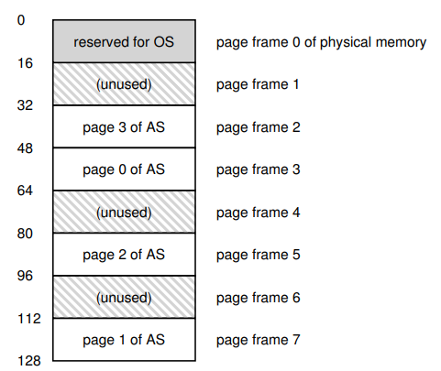
Paging
Convenient for free space management
Reduce the wasted fragmentation
(not larger than one page size)
Allowing the memory space of one process
discontinuous
Creating large virtual memory space within
small memory

Slide 4
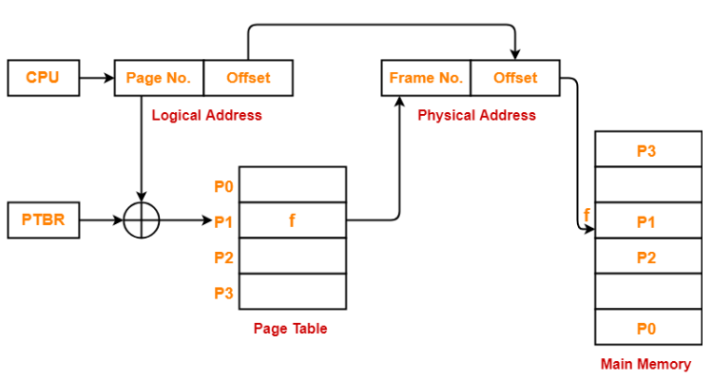
Page Table Mechanism
Page Table Function:
logical addresses -> physical addresses
Each process has its own page table
How the Translation works:
Logical Address Components:
• Page Number + Offset.
Translation Process:
• Page Number + page table + PTBR -> Frame Number.
• Frame Number + Offset -> Physical Address.
Page Table Base Register

Slide 5
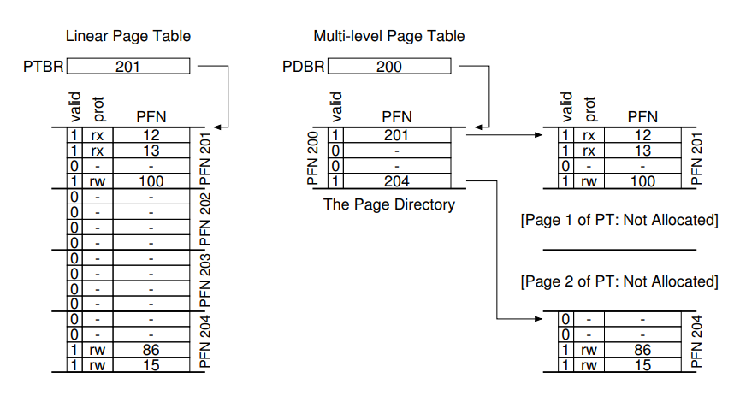
Multi-level Page Tables
Linear vs. Multi-level Page Tables:
Linear Page Table:
• large memory consumption.
Multi-level Page Table:
• Saving memory.
Linear Page Table
Multi-level Page Table

Slide 6
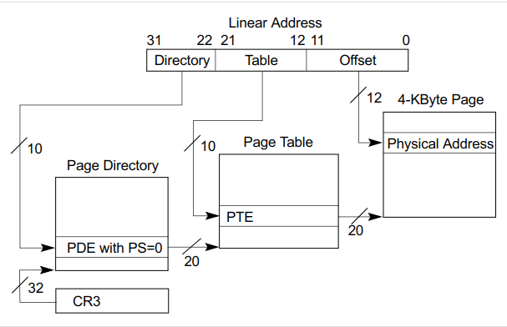
Multi-level Page Tables Example
The two level page table in x86 (32-bit machine)
10
10
12

Slide 7
Practice
Suppose a machine uses the word addressing (A physical address uniquely identify one word in the memory) and two-level paging. The word length of the machine is 32 bits. The page size is 32 bytes, the page directory has 4 entries, and the page table (PT) has 8 entries. You need to answer the following questions.
a)
What is the size of the virtual address space?
How many bits does a virtual address have?
How many bits should be reserved for the page directory index, page table index and the offset respectively?

Slide 8

Practice
The bits for page directory index: $\log_{2}{4=2}$
The bits for page table index: $\log_{2}{8=3}$
32 bytes/4 bytes = 8
The bits of offset: $\log_{2}{8=3}$
The bits for virtual address: $2+3+3=8$
Virtual address space size: $2^{8}$
Word Length | 32 bits
Page Size | 32 bytes
Page Directory | 4 entries
Page Table | 8 entries

Slide 9
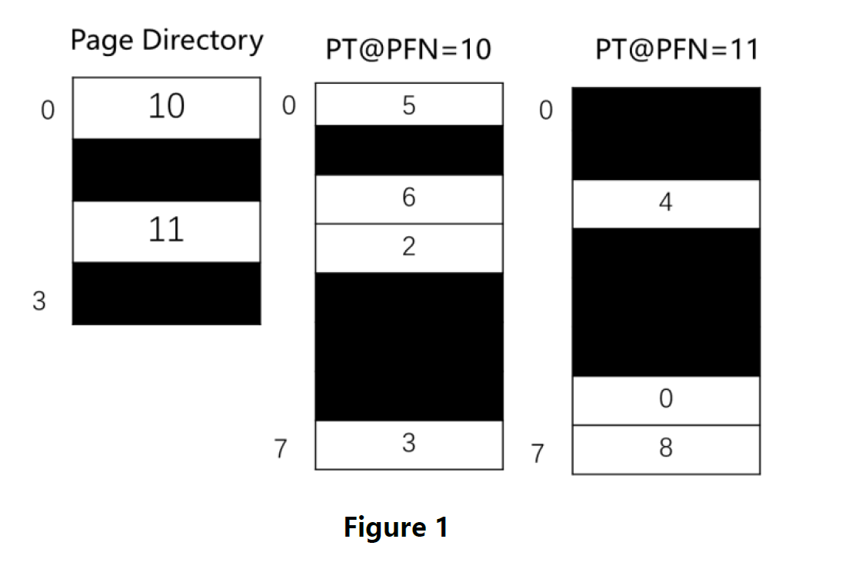
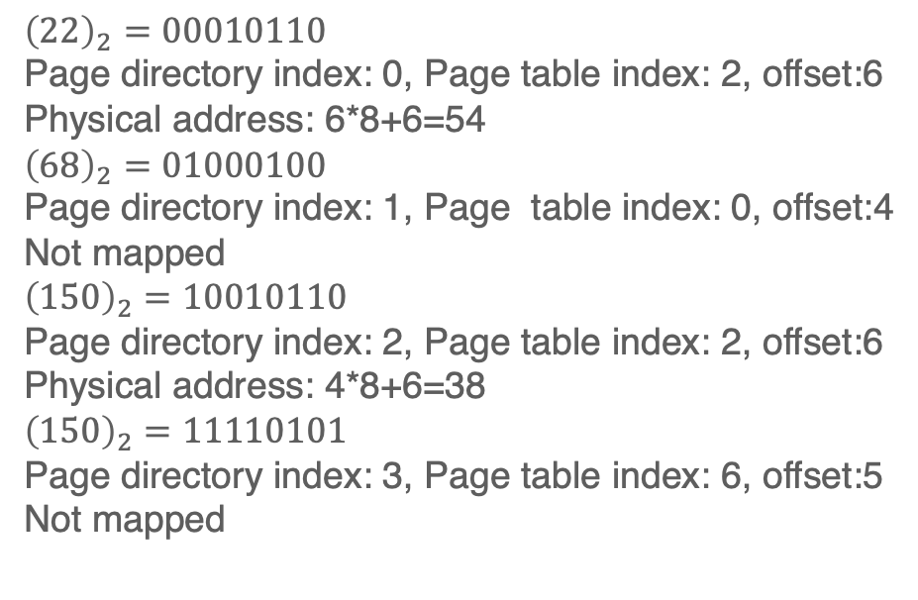
Practice
$$Physical Address=Page Frame Number∗Page Size+Offset$$
b) For virtual address space defined by the two level page table as shown in Figure1, given the following virtual addresses: 22, 68, 150, 245. Which of the above addresses would be mapped? If the virtual address is mapped, what is its corresponding physical address?
$${\left(22\right)}_{2}=00010110$$
Page directory index: 0, Page table index: 2, offset:6
Physical address: 6*8+6=54
$${\left(68\right)}_{2}=01000100$$
Page directory index: 1, Page table index: 0, offset:4
Not mapped
$${\left(150\right)}_{2}=10010110$$
Page directory index: 2, Page table index: 2, offset:6
Physical address: 4*8+6=38
$${\left(150\right)}_{2}=11110101$$
Page directory index: 3, Page table index: 6, offset:5
Not mapped

Slide 10
Q & A

