Slide 1
CSCI3150 Introduction to Operating Systems
Lecture 13: File Systems
Part I: I/O Devices, HDD

Slide 2
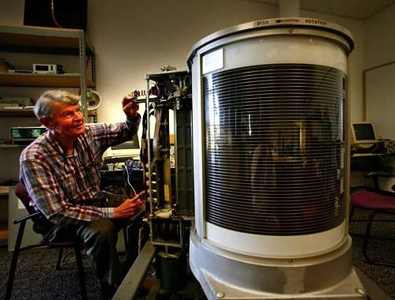
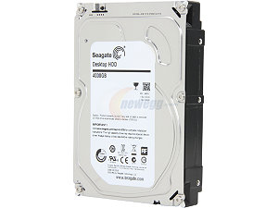
What problems are we solving?
Persistent data storage and access
Fast-growing industry
1956, IBM, 24 inches, 3.75MB, 1KB/sec, >$150k
2015, Seagate, 3.5 inches, 5TB, 6GB/sec, <$200

Slide 3
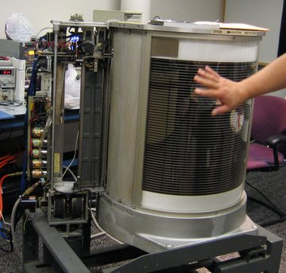
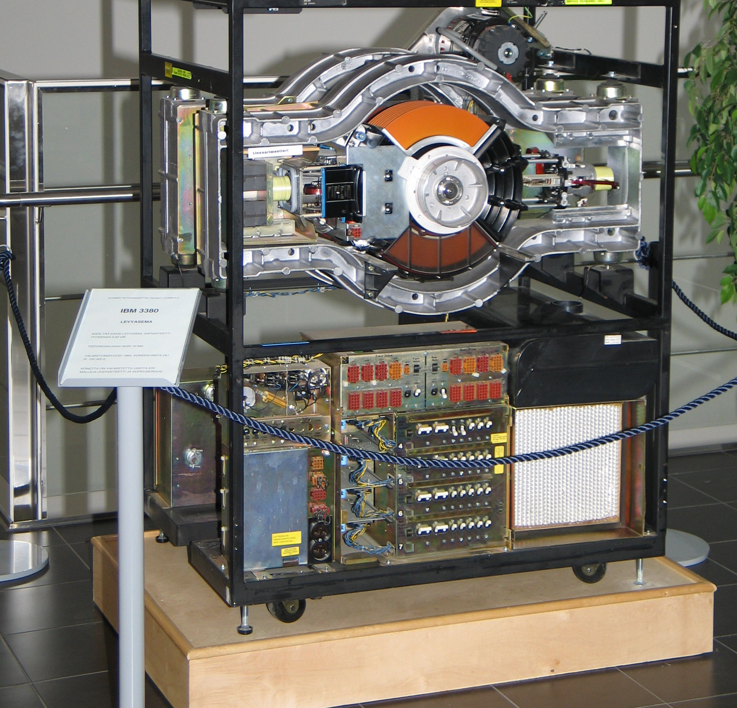
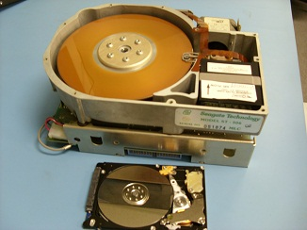
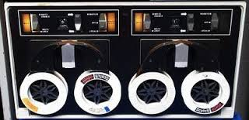
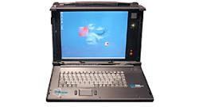
History of storage technology
1956: IBM 350, 24 inches,
3.75MB, 1KB/sec, > $150,000
1980: IBM 3380, first GB
disk (1.26G), > $100K
1980: ST-560, first 5.25
inch drive, 5MB, $1500
NextCom notebook 2006: first
laptop w/ SSD as storage
Tape (DECtape): primary storage for
main-frames and mini-computers (1950 ~ 70s)

Slide 4
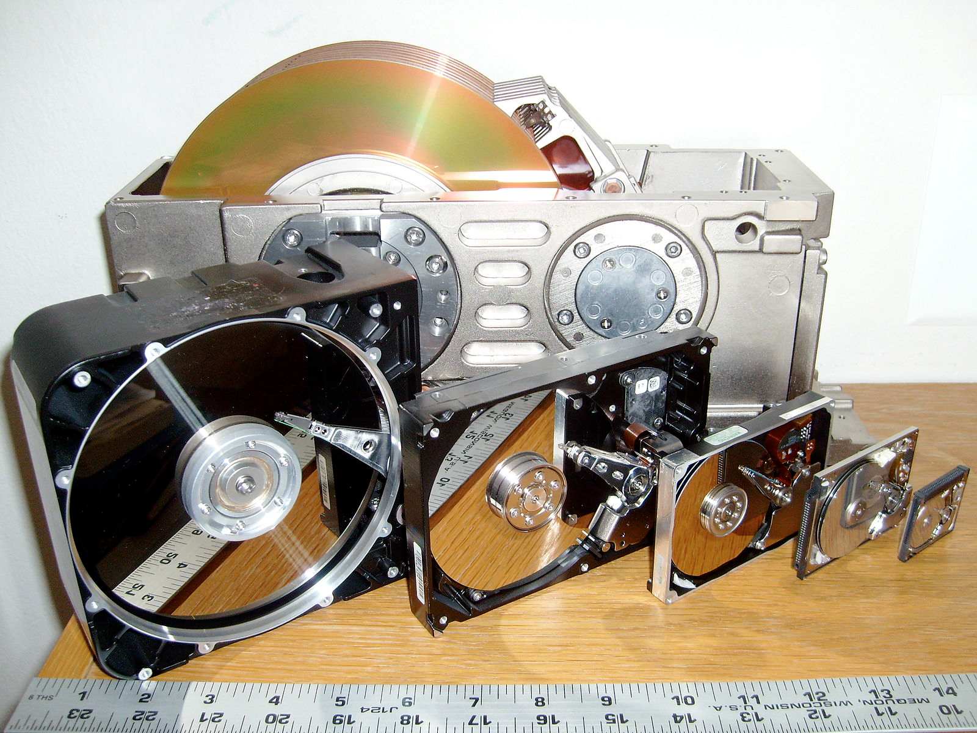
History is heavy…
Source: https://en.wikipedia.org/wiki/File:SixHardDriveFormFactors.jpg/

Slide 5
File systems: Agenda
First we will discuss “generic I/O devices and abstractions”…
… and properties of physical hard disks
Then we will discuss how we build file systems on them
Files, directories
Sharing, protection
File system layout, design
…

Slide 6
I/O Devices

Slide 7
I/O Devices
Input/Output, I/O, is critical to interact with computer systems
Issues:
How should I/O be integrated into systems?
What are the general mechanisms?
How can we make it efficiently?

Slide 8
Structure of I/O Devices
CPU
Memory
Memory Bus
(proprietary)
General I/O Bus
(e.g., PCIe)
NIC
Peripheral I/O Bus
(e.g., SCSI, STAT, USB)
Prototypical System Architecture
CPU is attached to the main memory of the system via some kind of memory bus.
Some devices are connected to the system via a general I/O bus.

Slide 9
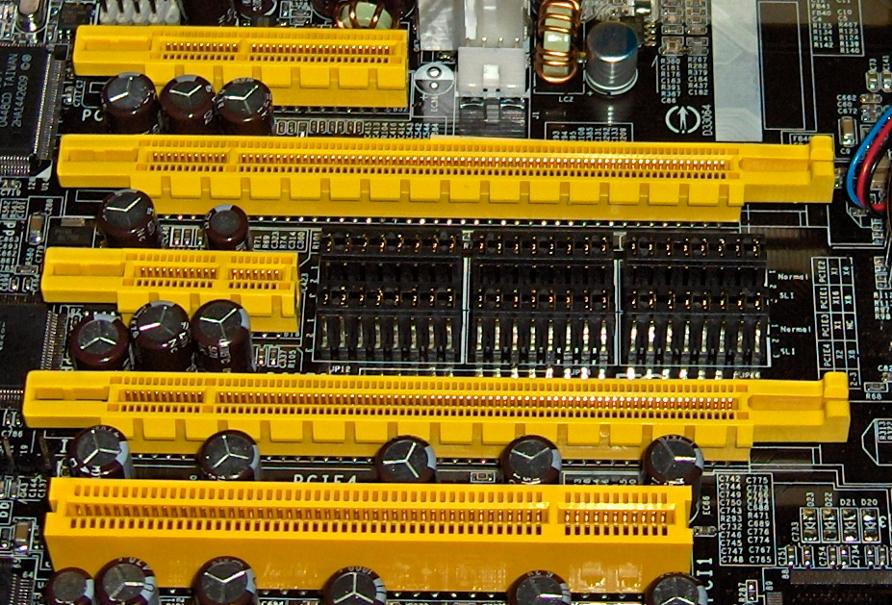
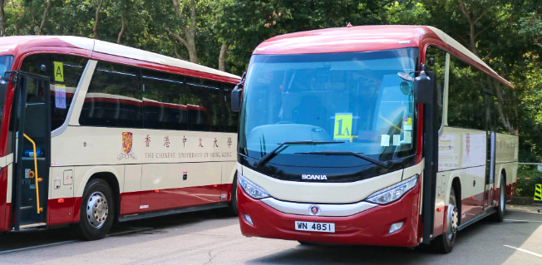
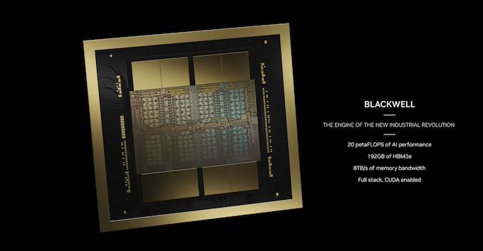
I/O Architecture
Buses
Data paths to enable information exchange between CPU, RAM, and I/O devices.
I/O bus
Data path that connects a CPU to an I/O device.
I/O bus is connected to I/O devices by three hardware components: I/O ports, interfaces and device controllers.
Not this bus…
PCIe

Slide 10
Canonical Device
A Canonical Device has two important components.
Hardware interface allows the system software to control its operation.
Internals which are implementation specific.
Registers:
Status
Command
Data
interface
Micro-controller (CPU)
Memory (DRAM or SRAM or both)
Other hardware-specific chips
internals
Canonical Device

Slide 11
Hardware interface of the canonical device
status register
See the current status of the device
command register
Tell the device to perform a certain task
data register
Pass data to the device, or get data from the device
By reading and writing above three registers,
the operating system can control device behavior.

Slide 12
Hardware interface of the canonical device (Cont.)
Typical interaction
while (STATUS == BUSY)
; //wait until device is not busy
write data to data register
write command to command register
(doing so starts the device and executes the command)
while (STATUS == BUSY)
; //wait until device is done with your request

Slide 13
Polling
Operating system waits until the device is ready by repeatedly reading the status register.
Simple; responsive
However, it wastes (lots of!!) CPU time just waiting for the device
Switching to another ready process is better in terms of utilizing the CPU.
“waiting IO”
1
P
: task 1
: polling
CPU
.1 | 1 | 1 | 1 | 1 | p | p | p | p | p | 1 | 1 | 1 | 1 | 1
Disk
1 | 1 | 1 | 1 | 1
Diagram of CPU utilization with polling

Slide 14
Interrupts
Put the process waiting on I/O to sleep and context-switch to another
When the I/O finishes, wake up the sleeping process by interrupts
Enable CPU and the disk to be better utilized
1
2
: task 1
: task 2
CPU
1 | 1 | 1 | 1 | 1 | 2 | 2 | 2 | 2 | 2 | 1 | 1 | 1 | 1 | 1
Disk
1 | 1 | 1 | 1 | 1
Diagram of CPU utilization with interrupts

Slide 15
Polling vs interrupts
Interrupt is not always the best solution
If, device performs very quickly, interrupts will “slow down” the system
Because context switch is expensive (switching to another process)
If a device is fast → polling is better.
If it is slow → interrupt is better.

Slide 16
CPU is once again over-burdened
CPU wastes a lot of time to copy a large chunk of data from memory to the device.
Programmed I/O (PIO)
1
2
“over-burdened”
: task 1
: task 2
C
: copy data from memory
CPU
1 | 1 | 1 | 1 | C | C | C | 2 | 2 | 2 | 2 | 2 | 1 | 1 | 1
Disk
1 | 1 | 1 | 1 | 1
Diagram of CPU utilization

Slide 17
DMA (Direct Memory Access)
Copy data in memory by knowing “where the data lives in memory, how much data to copy”
When completed, DMA raises an interrupt, I/O begins on disk
1
2
: task 1
: task 2
C
: copy data from memory
CPU
1 | 1 | 1 | 1 | 2 | 2 | 2 | 2 | 2 | 2 | 2 | 2 | 1 | 1 | 1
DMA
C | C | C
Disk
1 | 1 | 1 | 1 | 1
Diagram of CPU utilization by DMA

Slide 18
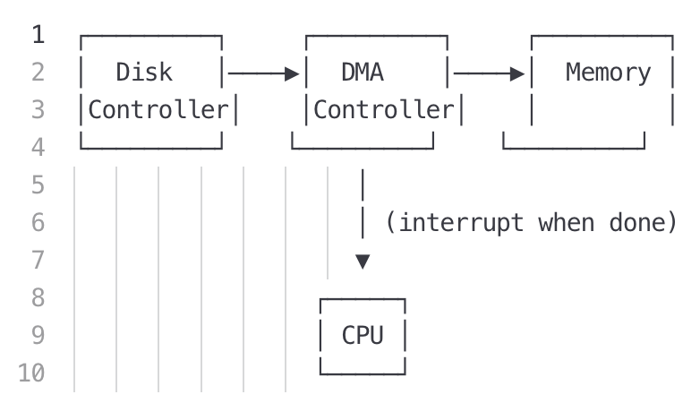
DMA (Direct Memory Access)
Allow hardware subsystems (disk controllers, NICs, GPUs) to perform memory I/O independent of CPU
CPU sets up transfer
Source addr. (disk buffer), dest. addr. (proc. buf in DRAM)
# bytes to transfer
Direction
CPU initiates transfer (and goes to do other work)
DMA controller handles the work
DMA signals completion w. interrupt
CPU handles the interrup

Slide 19
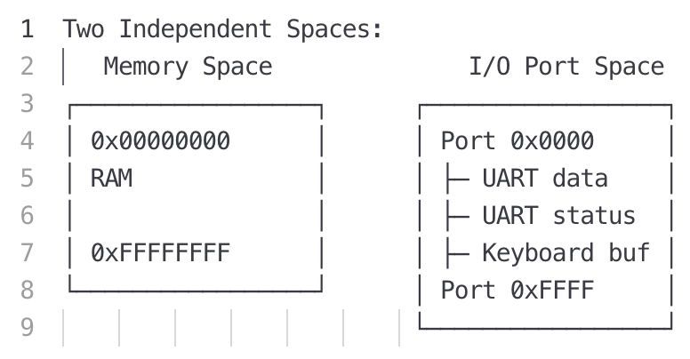
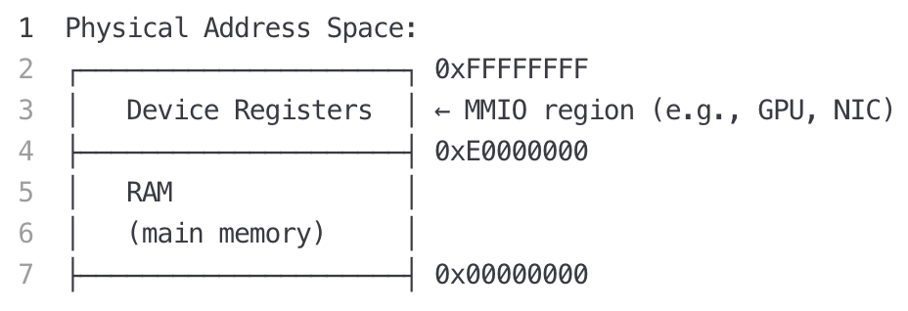
Device interaction
How the OS communicates with the device?
Solutions
I/O instructions: a way for the OS to send data to specific device registers.
in and out instructions on x86
memory-mapped I/O
Device registers available as if they were memory locations.
The OS load (to read) or store (to write) to the device instead of main memory.

Slide 20
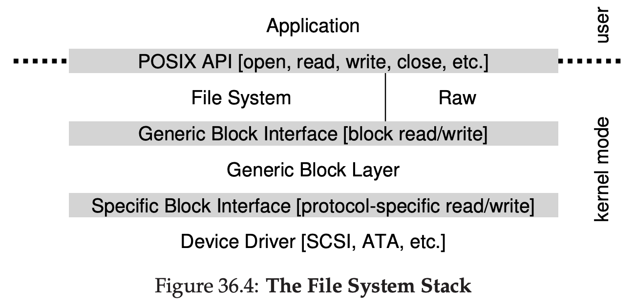
Device interaction (Cont.)
How the OS interact with different types of interfaces?
Build a file system that worked on top of SCSI disks, IDE disks, USB keychain drivers, and so on.
Solution: Abstraction
Encapsulate specifics of device interaction

Slide 21
Summary
To save the CPU cycles for IO
Interrupt
DMA
To access the device registers
Memory-mapped IO
Explicit IO instructions

Slide 22
Hard Disk Drive (HDD)

Slide 23
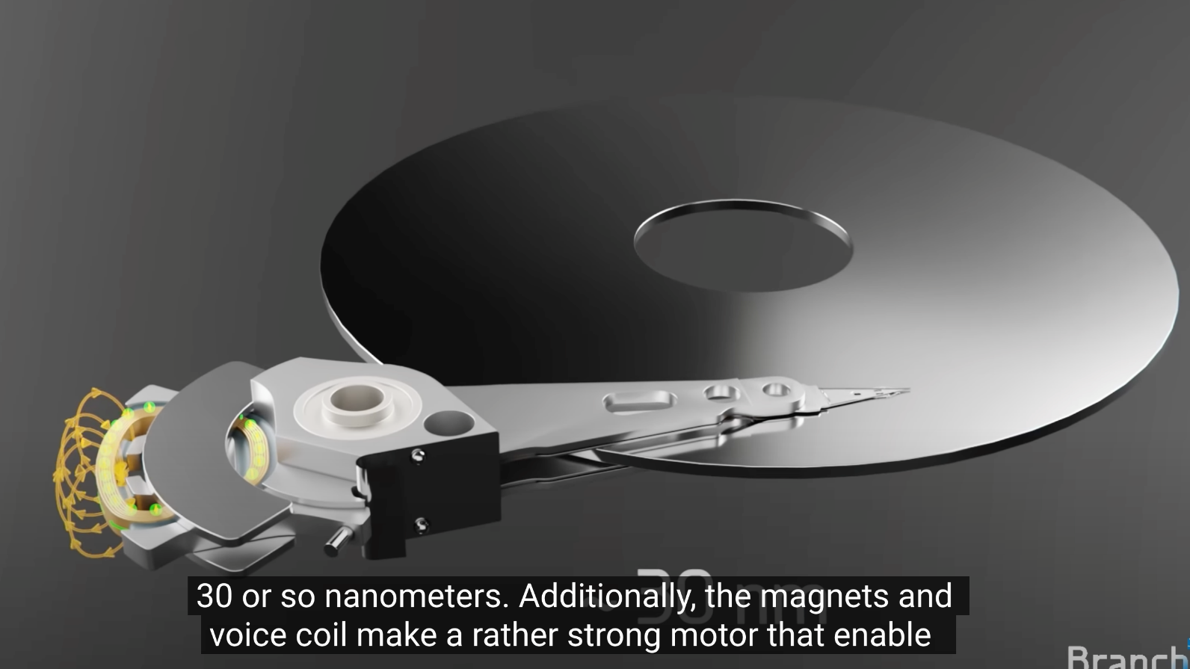
How does it work?
Physics, electro-magnetic field
https://www.youtube.com/watch?v=wteUW2sL7bc (physics)
https://www.youtube.com/watch?v=wtdnatmVdIg (components)

Slide 24
Basic Geometry
Disk arm
Spindle
Disk head
Platter
Surface
Surface

Slide 25
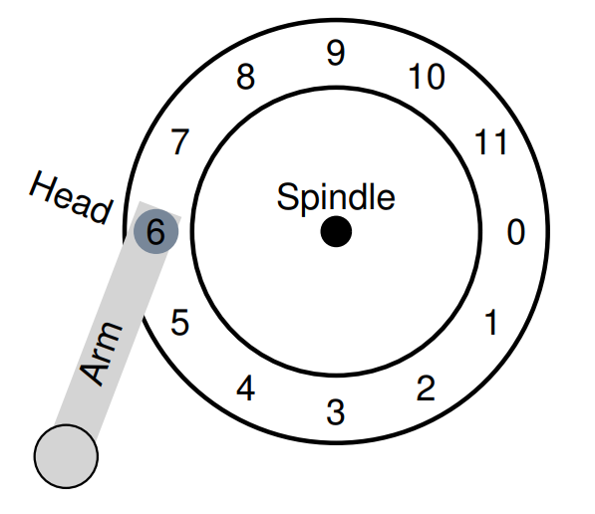
Basic Geometry (Cont.)
Track
Sector
(512 Byte)

Slide 26
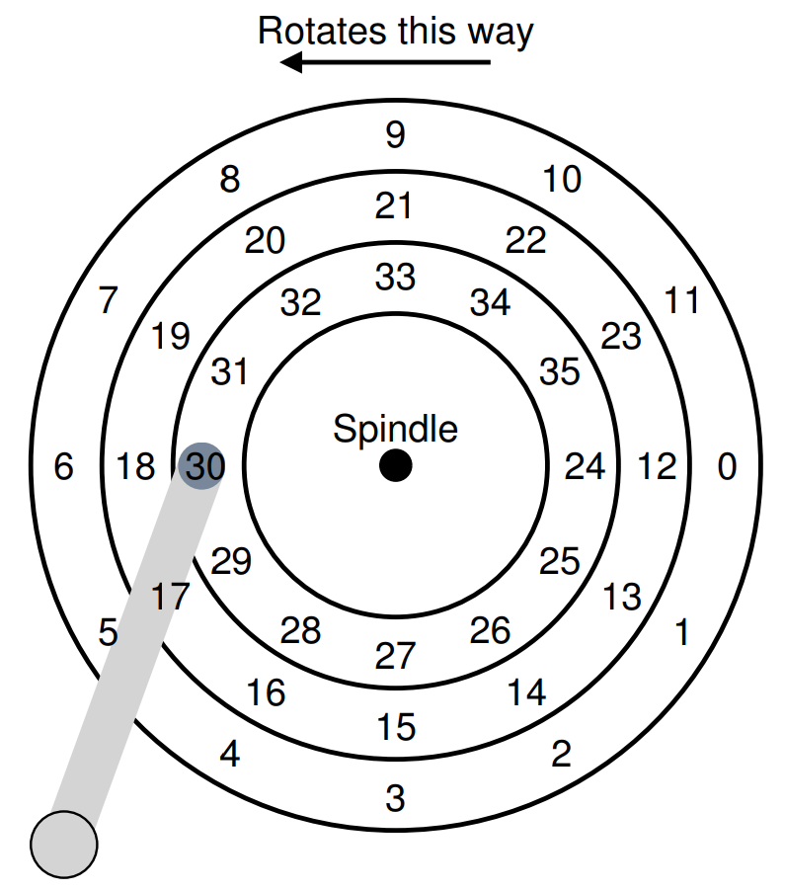

A Simple Disk Drive
Rotation Delay
RPM, rotations per minute
7200 to 15000 RPM
10000 RPM -> ~6ms per rotation
If the full rotation delay is R,
the rotation delay of (30→24) is $\frac{R}{2}$

Slide 27
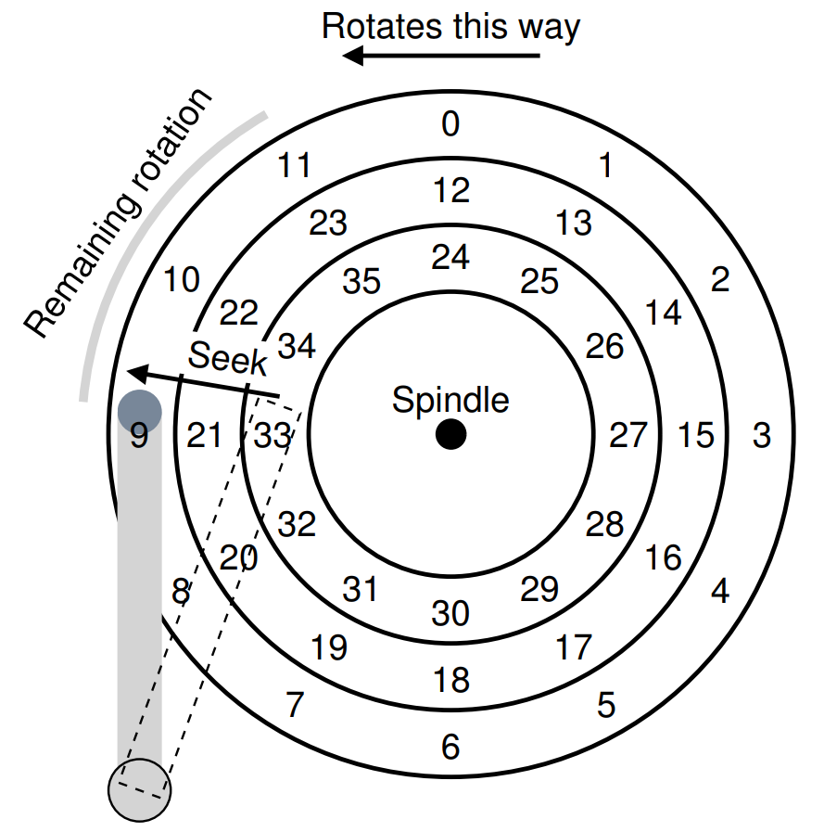
A Simple Disk Drive (Cont.)
Seek Time
To read sector 11
9
Phases of seek
Acceleration
→
Coasting
→
Deceleration
→
Settling time
(about 0.5~2 ms)

Slide 28
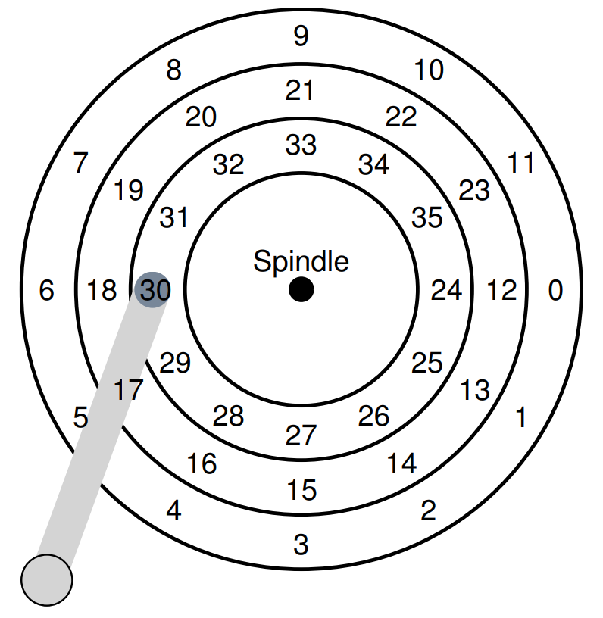
A Simple Disk Drive (Cont.)
Cache (Track buffer)
30
22
10
4
27
…
Small amount of memory
(usually around 8 or 16MB)
Hold data read from or written to the disk
Allow the drive to quickly respond to requests

Slide 29
A Simple Disk Drive (Cont.)
Cache (Track buffer)
Write-Back
30
22
10
4
27
…
Acknowledge the write has completed when it has put the data in its memory
Write-Through
Acknowledge after the write has actually been written to disk

Slide 30
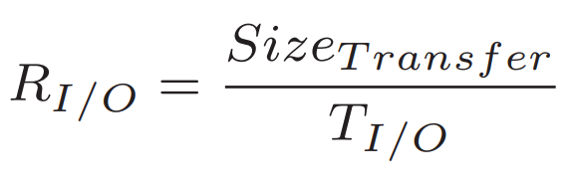
I/O Time: Doing The Math
I/O Time
I/O Rate

Slide 31
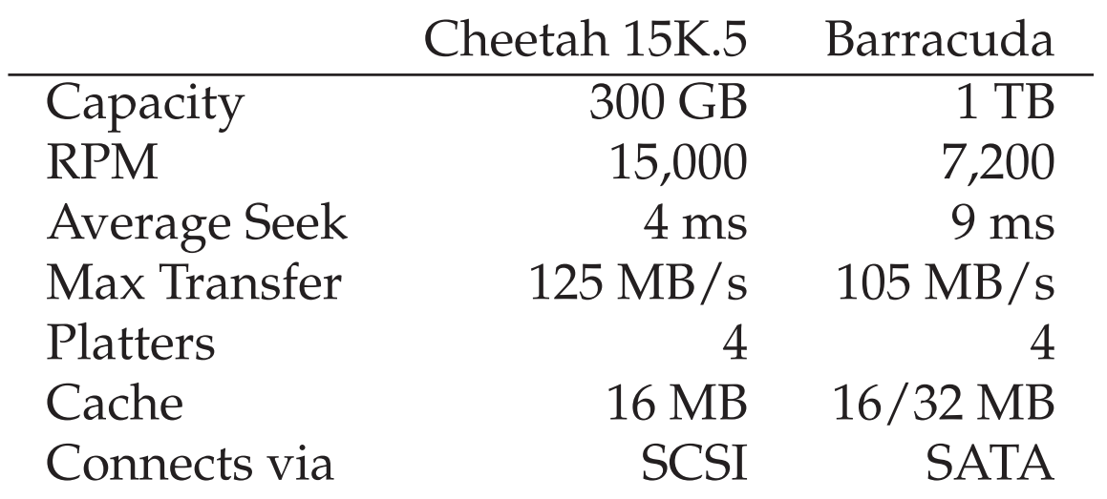
I/O Time: Doing The Math (Cont.)
4KB Random Write Example
= 4ms
= 15,000 RPM(= 250RPS = 4ms / 1 rotation) / 2
= 2ms
= 4KB / 125(MB/s)
= 30us
= 4ms + 2ms + 30us ≒ 6ms
= 4KB / 6ms = 0.66MB/s

Slide 32
I/O Time: Doing The Math (Cont.)
4KB Random Write Example (Cont.)
= 9ms
= 7,200 RPM(= 120RPS = 8ms / 1 rotation) / 2
= 4ms
= 4KB / 105(MB/s)
= 38us
= 9ms + 4ms + 38us ≒ 13ms
= 4KB / 13ms = 0.31MB/s

Slide 33
I/O Time: Doing The Math (Cont.)
Sequential Write Example
= 4ms
= 15,000 RPM(= 250RPS = 4ms / 1 rotation) / 2
= 2ms
= 100MB / 125(MB/s)
= 800ms
= 4ms + 2ms + 800ms = 806ms ≒ 800ms
= 100MB / 800ms = 125MB/s

Slide 34
I/O Time: Doing The Math (Cont.)
Sequential Write Example (Cont.)
= 9ms
= 7,200 RPM(= 120RPS = 8ms / 1 rotation) / 2
= 4ms
= 100MB / 105(MB/s)
= 950ms
= 9ms + 4ms + 950ms = 963ms ≒ 950ms
= 100MB / 950ms = 105MB/s

Slide 35
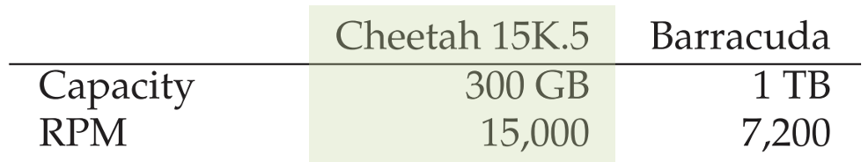
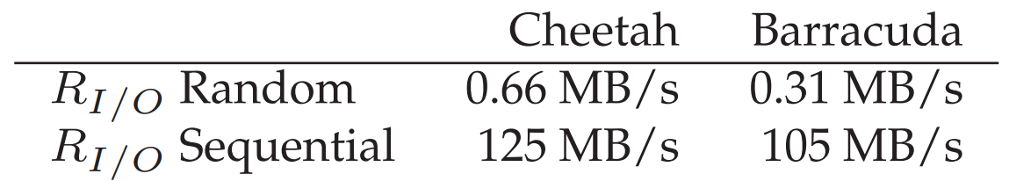
I/O Time: Doing The Math (Cont.)
Performance
vs
Capacity
Random Write
vs
Sequential Write

