Slide 1
Semaphores in C
CSCI3150 Introduction to Operating Systems, Spring 2026
FENG, Yicheng
yichengfeng@link.cuhk.edu.hk
Feb. 11, 2026

Slide 2
Reminder
Assignment 2
Invitation URL: https://classroom.github.com/a/RKvPmvxf
Deadline: 23:59:59 p.m., Sun, Mar 1st, 2026
Submission: Github classroom (refer to the Assignment 1 guide: https://piazza.com/class/mjxsr09gf91dw/post/11)

Slide 3
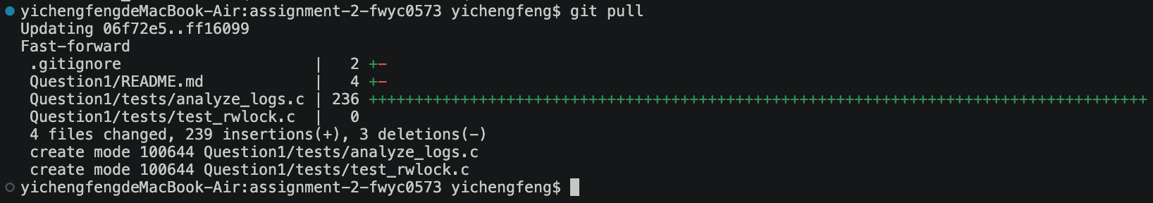
Reminder
Assignment 2
For students who have already accepted asg2, please run git pull to update

Slide 4

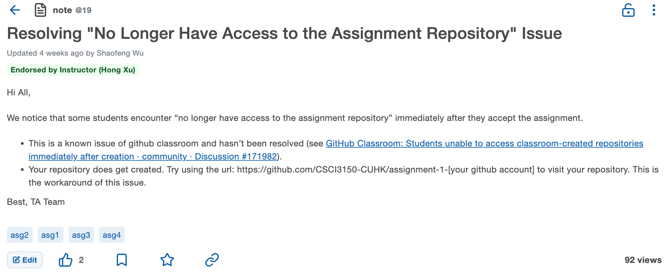
Reminder
Assignment 2
If you can't access asg2 via this URL, please try the solution also mentioned in asg1:
https://piazza.com/class/mjxsr09gf91dw/post/19

Slide 5
Overview
Tutorial this week
Semaphore usage in C
Interfaces in <semaphore.h>
How to use inter-process semaphores
All examples used in this tutorial:
https://github.com/henryhxu/CSCI3150/...

Slide 6
Semaphores in <semaphore.h>
The semaphore.h is a powerful tool for creating and managing semaphores in C. It defines the sem_t type, used in performing semaphore operations. See also https://pubs.opengroup.org/onlinepubs/7908799/xsh/semaphore.h.html
To use it: #include <semaphore.h>
Interfaces:
int sem_close(sem_t *);
int sem_destroy(sem_t *);
int sem_getvalue(sem_t *, int *);
int sem_init(sem_t *, int, unsigned int); ✔
sem_t *sem_open(const char *, int, ...);
int sem_post(sem_t *); ✔
int sem_trywait(sem_t *);
int sem_unlink(const char *);
int sem_wait(sem_t *); ✔

Slide 7
1. sem_init
Purpose: initialize an unnamed semaphore.
Syntax:
int sem_init(sem_t *sem, int pshared, unsigned int value);
Parameters:
sem: pointer to the semaphore variable.
pshared: whether the semaphore is shared between processes (0 for no sharing).
value: semaphore initial value.
Example:
#define BUFFER_SIZE 5
int buffer[BUFFER_SIZE];
sem_t empty;
sem_init(&empty, 0, BUFFER_SIZE);

Slide 8
2. sem_open
Purpose: initialize and open a named semaphore (inter-process).
Syntax:
sem_t *sem_open(const char *name, int oflag);
sem_t *sem_open(const char *name, int oflag, mode_t mode, unsigned int value);
Parameters:
name: must start with / (e.g. /mysemaphore)
oflag: 0, O_CREAT, O_CREAT | O_EXCL.
mode: permission bits.
Permission bits control access to files or objects and are represented as a three- or four-digit number. Each digit represents permissions for the owner, group, and others, respectively.
Common values include:
4: Read (r)
2: Write (w)
1: Execute (x)
These values can be combined, such as 6 for read and write (rw-).
The first digit (e.g., 0) can set special permissions like SUID or SGID.
value: initial value.

Slide 9
2. sem_open
Example:
sem_t *sem;
const char *sem_name = "/mysemaphore";
sem = sem_open(sem_name, O_CREAT | O_EXCL, 0644, 1);
O_CREAT | O_EXCL: If the semaphore already exists, the function call fails.
0644:
6: The owner (the user who created the semaphore) has read and write permissions (4 + 2 = 6, i.e. rw-).
4: The group user (other users who belong to the same user group as the creator) has only read permission (4 = 4, i.e. r--).
4: Other users (other users who do not belong to the same group) have only read permission (4 = 4, i.e. r--).

Slide 10
3. sem_trywait
Purpose: it is useful in cases where you don't want the process or thread to block while waiting for the semaphore.
sem_trywait is a non-blocking function that attempts to decrease the value of a semaphore. If the semaphore’s value is greater than 0, it decrements the value and proceeds. However, if the semaphore's value is 0 (unavailable), it returns immediately with a failure and sets errno to EAGAIN.
Syntax:
int sem_trywait(sem_t *sem);
Parameters:
sem: pointer to the semaphore variable.
Example:
if (sem_trywait(&sem) == 0) {
printf("Semaphore acquired!\n");
} else {
if (errno == EAGAIN) {
printf("Semaphore unavailable, do other things.\n");
}
}

Slide 11
4. sem_destroy
Purpose: used to destroy the unnamed semaphore.
Only a semaphore that was created using sem_init() may be destroyed using sem_destroy().
Syntax:
int sem_destroy(sem_t *sem);
Parameters:
sem: pointer to the semaphore variable.
Example:
sem_destroy(&sem);

Slide 12
5. sem_close
Purpose: used to indicate that the calling process is finished using the named semaphore.
You cannot call sem_close() for an unnamed semaphore (one created by sem_init()).
Syntax:
int sem_close(sem_t *sem);
Parameters:
sem: pointer to the semaphore variable.
Example:
sem_close(&sem);

Slide 13
6. sem_unlink
Purpose: remove the named semaphore.
If one or more processes have the semaphore open when sem_unlink() is called, destruction of the semaphore is postponed until all references to the semaphore have been closed by calls to sem_close(), or the process exits.
Syntax:
int sem_unlink(const char *name);
Parameters:
name: the semaphore name.
Example:
sem_unlink(“/sem”);

Slide 14
Example: Semaphores in Process Synchronization
Problem: How to use <semaphore.h> to implement inter-process semaphores?
Background:
Threads share the same memory space, allowing direct access to semaphore variables of other threads.
However, processes have separate memory spaces. A process cannot access the semaphore variables of other processes.
Solution:
Named semaphores: use sem_open() to create or open a named semaphore.
Unnamed semaphore: the semaphore needs to be placed in shared memory, and the pshared parameter of sem_init() is set to non-zero (usually 1).

Slide 15
Example: Named Semaphore
#include <stdio.h>
#include <semaphore.h>
#include <fcntl.h>
#include <unistd.h>
int main() {
// Create a semaphore
sem_t *sem = sem_open("/mysem", O_CREAT, 0644, 1);
sem_wait(sem);
printf("Process A enters the critical section.\n");
sleep(5);
printf("Process A leaves the critical section.\n");
sem_post(sem);
sem_close(sem);
return 0;
}
#include <stdio.h>
#include <semaphore.h>
#include <fcntl.h>
#include <unistd.h>
int main() {
// Open the semaphore created in Process A
sem_t *sem = sem_open("/mysem", 0);
sem_wait(sem);
printf("Process B enters the critical section.\n");
sleep(5);
printf("Process B leaves the critical section.\n");
sem_post(sem);
sem_close(sem);
return 0;
}
a.c
b.c
Tip: We can use ./a & ./b to run a and b concurrently.
However, & is not a binary operator. It is a unary postfix operator (i.e. one coming after a command) and instructing the shell to run the specified command in the background.
E.g. ./a & ./b means that a runs from the background, while b runs from foreground.

Slide 16
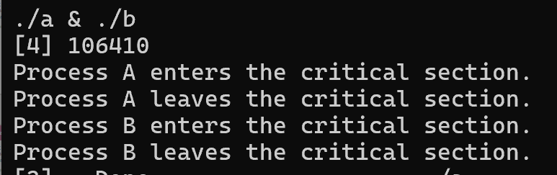
Example: Named Semaphore
a.c and b.c works.
Only one process enters critical section

Slide 17
Example: Named Semaphore
But what if we change the initial value of the semaphore to 2？We want both process A and B to enter the critical section.
sem_t *sem = sem_open("/mysem", O_CREAT, 0644, 2);
Let’s change the value and re-compile it.
Still only one process enters critical section. Our change does not work.

Slide 18
Example: Named Semaphore
Why didn't our changes take effect?
Because even though our program ends, the named semaphore is still exist in memory.
Where it is? /dev/shm. If you do not delete it, it persists until shutdown.
Thus, we need to add sem_unlink() to remove named semaphores in our code.

Slide 19
Example: Named Semaphore
#include <stdio.h>
#include <semaphore.h>
#include <fcntl.h>
#include <unistd.h>
int main() {
// Create a semaphore
sem_t *sem = sem_open("/mysem", O_CREAT, 0644, 1);
sem_wait(sem);
printf("Process A enters the critical section.\n");
sleep(5);
printf("Process A leaves the critical section.\n");
sem_post(sem);
sem_close(sem);
sem_unlink(/mysem");
return 0;
}
#include <stdio.h>
#include <semaphore.h>
#include <fcntl.h>
#include <unistd.h>
int main() {
// Open the semaphore created in Process A
sem_t *sem = sem_open("/mysem", 0);
sem_wait(sem);
printf("Process B enters the critical section.\n");
sleep(5);
printf("Process B leaves the critical section.\n");
sem_post(sem);
sem_close(sem);
return 0;
}
a.c
b.c

Slide 20
Example: Unnamed Semaphore
You can also use the unnamed semaphore to implement inter-process semaphores.
But it is harder than using named semaphore and beyond the scope of this course.
If you are interested in operating system, you can try it.

Slide 21
Thanks

