Slide 1
Multilevel Feedback Queue
CSCI3150 Introduction to Operating Systems, Spring 2026
FENG,YICHENG
yichengfeng@link.cuhk.edu.hk
02/26, 2026

Slide 2
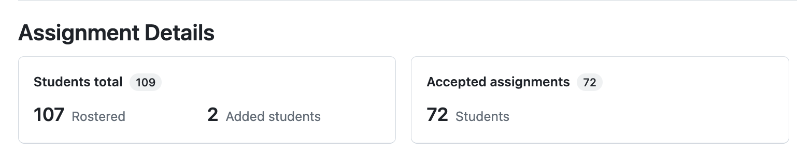
Reminder
Assignment 2
Due at 23:59:59 p.m., Sunday, March 1stask as soon as possible.
Please accept the task ASAP.
Invitation URL: https://classroom.github.com/a/RKvPmvxf
Submission: Github classroom (refer to the Assignment 1 guide: https://piazza.com/class/mjxsr09gf91dw/post/11)

Slide 3
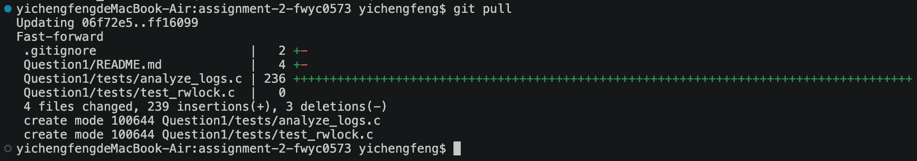
Reminder
Assignment 2
For students who have already accepted asg2, please run git pull to update

Slide 4
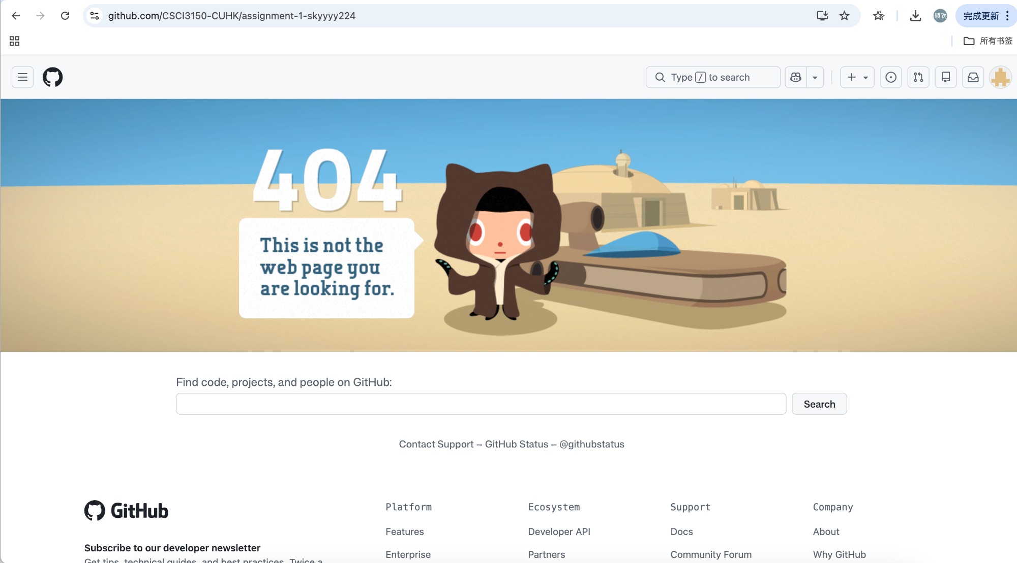
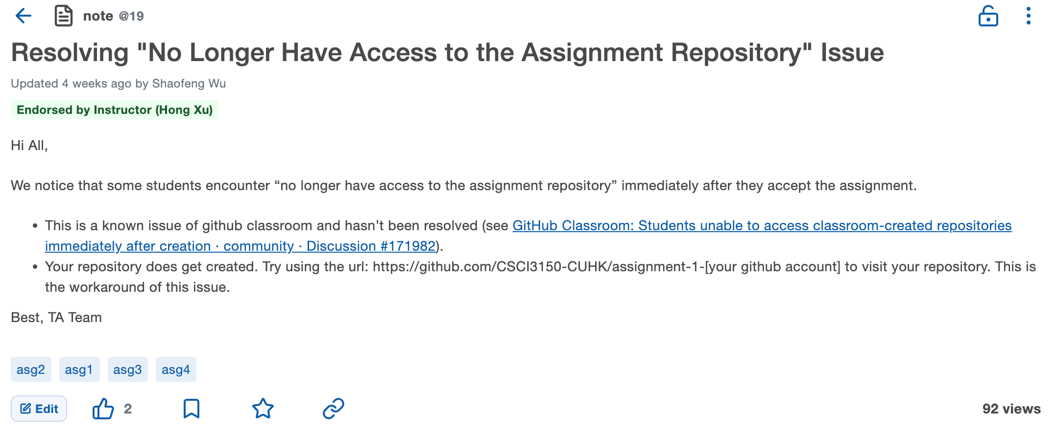
Reminder
Assignment 2
If you can't access asg2 via this URL, please try the solution also mentioned in asg1:
https://piazza.com/class/mjxsr09gf91dw/post/19

Slide 5
Reminder
Assignment 2as possible.
Autograding: https://piazza.com/class/mjxsr09gf91dw/post/57#
New update: Considering GitHub's permission security issues, we have made some adjustments to how you can view the autograding feedback:
You can continue to check the basic test results (e.g., whether the compilation passes, whether files are missing, etc.) in the Actions tab of your personal repo after pushing asg2.
Detailed results will be pushed to the Issues tab of your personal repo with a delay. However, due to the instability of GitHub's schedule triggers for automated testing (which may be dropped or delayed), it may take 10 minutes or even longer to actually receive the feedback. It is recommended to test as early as possible.

Slide 6
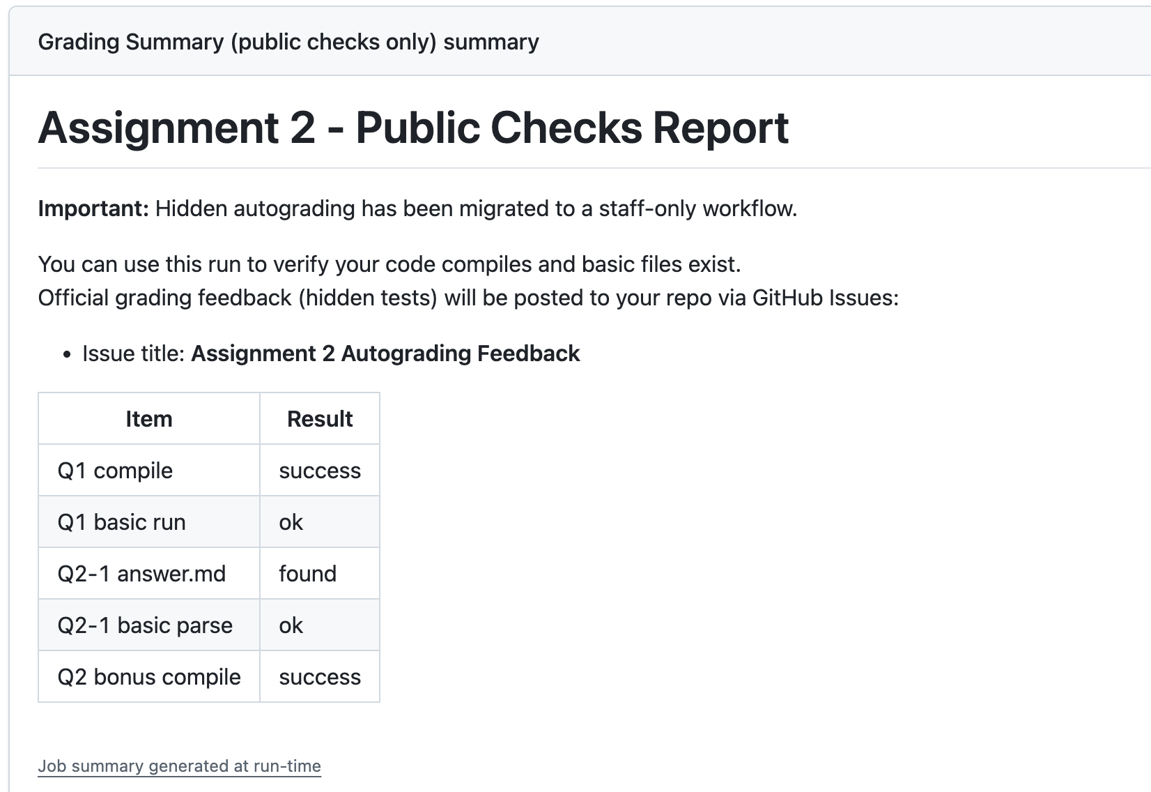
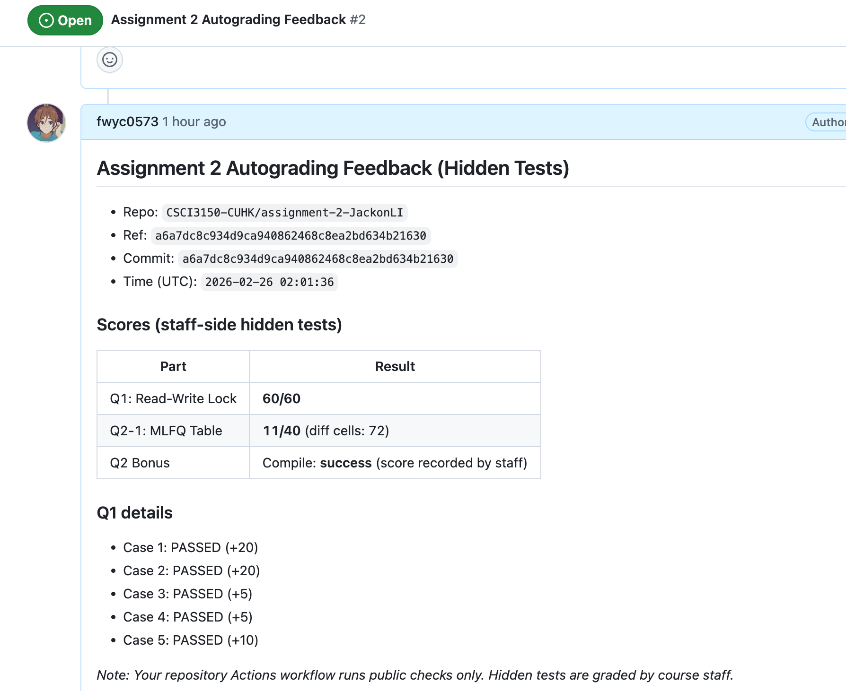
Reminder
Assignment 2as possible.
https://piazza.com/class/mjxsr09gf91dw/post/57#
Action page
Issue page

Slide 7
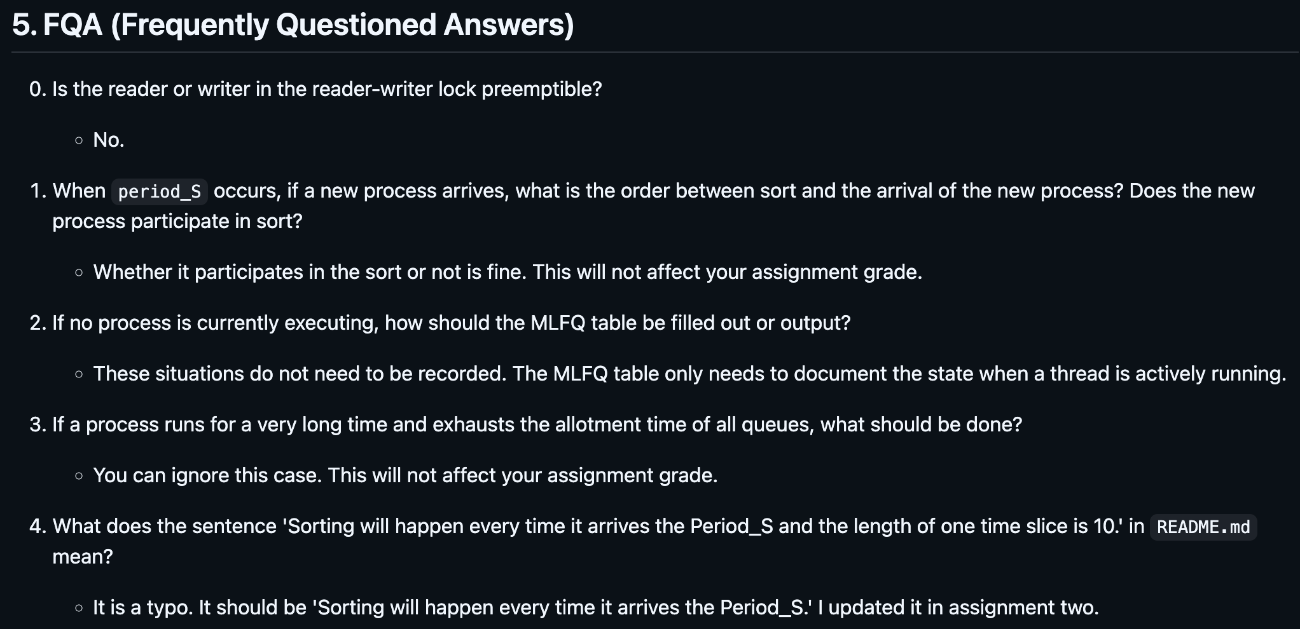
Reminder
Assignment 2
FQA

Slide 8
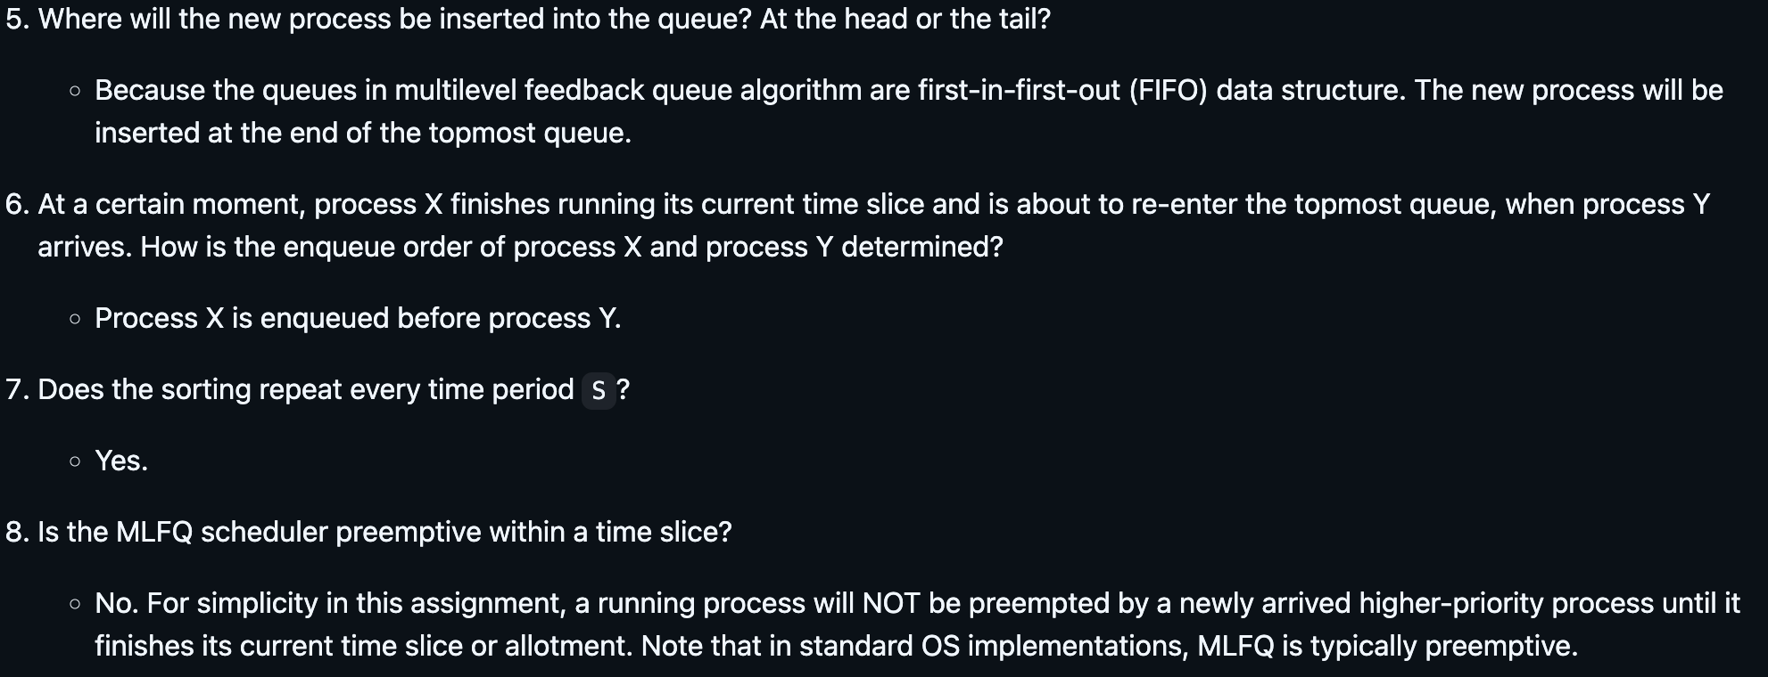
Reminder
Assignment 2
FQA

Slide 9
Overview
Tutorial this week
Multilevel feedback queue (MLFQ)
Fill the MLFQ table
All examples used in this tutorial:
https://github.com/henryhxu/CSCI3150/tree/2026-Spring/tutorial/T07

Slide 10
Recall MLFQ Rules
We have process A and process B.
Rule 1: If Priority(A) > Priority(B), A runs (B doesn’t).
Rule 2: If Priority(A) = Priority(B), A & B run in round-robin fashion using the time slice (quantum length) of the given queue.
Rule 3: When a job enters the system, it is placed at the highest priority (the topmost queue). For the jobs arriving at the same time, schedule the job with largest(or smallest) pid first.

Slide 11
Recall MLFQ Rules
We have process A and process B.
Rule 4: Once a job uses up its time allotment at a given level (regardless of how many times it has given up the CPU), its priority is reduced (i.e., it moves down one queue and will be at the tail of the target queue, which means it will be scheduled last).
Rule 5: After some time period S, move all the jobs in the system to the topmost queue, and sort all the jobs by pid. The job with the largest(or smallest) pid will be scheduled first.

Slide 12
MLFQ Table Filling
This is a common question that often appears in final exams.
In recent 3 years, it appeared in the final exams of
First term of 2023-2024
First term of 2022-2023
First term of 2021-2022
Second term of 2021-2022

Slide 13
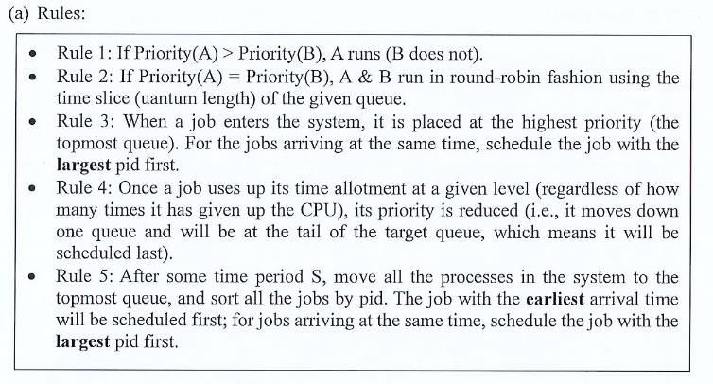
MLFQ Table Filling
This question will give you the MLFQ rules. For example, Question 3 in Course Examination 1st Term, 2023-2024
Pay attention to the details.

Slide 14
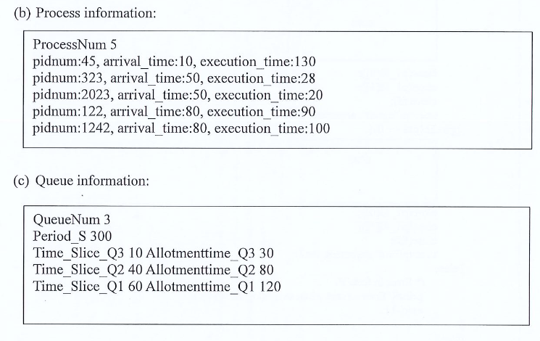
MLFQ Table Filling
Next, this question will give you the related information, such as

Slide 15
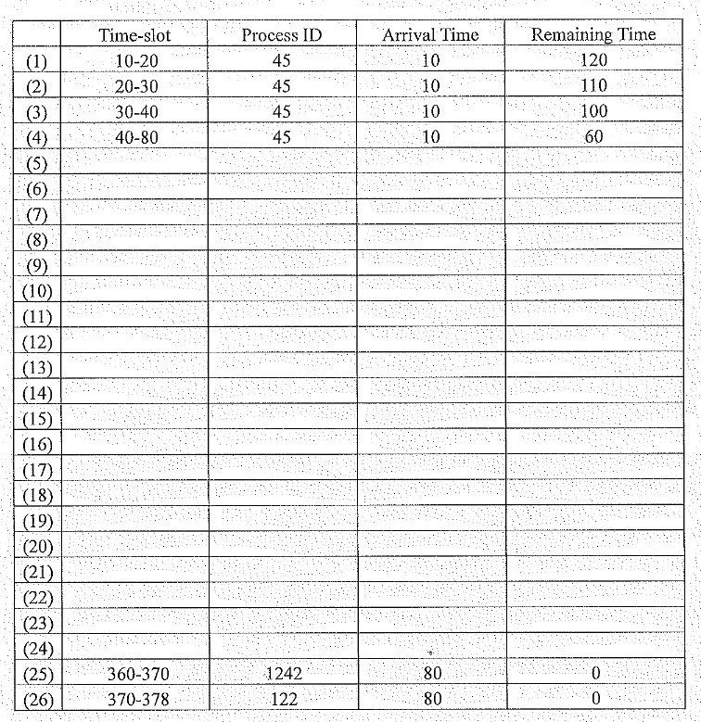
MLFQ Table Filling
Finally, you are required to fill the MLFQ table.

Slide 16
Example
Arriving at the same time → Largest pid first
After period S → Earliest, Largest pid first
pid | arrival | execution
45 | 10 | 130
323 | 50 | 28
2023 | 50 | 20
122 | 80 | 90
1242 | 80 | 100
queue | time slice | allotment
Q3 | 10 | 30
Q2 | 40 | 80
Q1 | 60 | 120
Period_S 300

Slide 17
Example
Arriving at the same time → Largest pid first
After period S → Earliest, Largest pid first
Time: 10
PID (Remaining allotment time)
Q3
45 (30)
Q2
pid | arrival | execution
45 | 10 | 130
323 | 50 | 28
2023 | 50 | 20
122 | 80 | 90
1242 | 80 | 100
Q1
 | Time | PID | Arrive time | Remaining Time
(1)
(2)
(3)
(4)
(5)
(6)
(7)
queue | time slice | allotment
Q3 | 10 | 30
Q2 | 40 | 80
Q1 | 60 | 120
Period_S 300

Slide 18
Example
Arriving at the same time → Largest pid first
After period S → Earliest, Largest pid first
Time: 20
PID (Remaining allotment time)
Q3
45 (20)
Q2
pid | arrival | execution
45 | 10 | 130
323 | 50 | 28
2023 | 50 | 20
122 | 80 | 90
1242 | 80 | 100
Q1
 | Time | PID | Arrive time | Remaining Time
(1) | 10-20 | 45 | 10 | 120
queue | time slice | allotment
Q3 | 10 | 30
Q2 | 40 | 80
Q1 | 60 | 120
Period_S 300

Slide 19
Example
Arriving at the same time → Largest pid first
After period S → Earliest, Largest pid first
Time: 30
PID (Remaining allotment time)
Q3
45 (10)
Q2
pid | arrival | execution
45 | 10 | 130
323 | 50 | 28
2023 | 50 | 20
122 | 80 | 90
1242 | 80 | 100
Q1
 | Time | PID | Arrive time | Remaining Time
(1) | 10-20 | 45 | 10 | 120
(2) | 20-30 | 45 | 10 | 110
queue | time slice | allotment
Q3 | 10 | 30
Q2 | 40 | 80
Q1 | 60 | 120
Period_S 300

Slide 20
Example
Arriving at the same time → Largest pid first
After period S → Earliest, Largest pid first
Time: 40
PID (Remaining allotment time)
Q3
Q2
45 (80)
pid | arrival | execution
45 | 10 | 130
323 | 50 | 28
2023 | 50 | 20
122 | 80 | 90
1242 | 80 | 100
Q1
 | Time | PID | Arrive time | Remaining Time
(1) | 10-20 | 45 | 10 | 120
(2) | 20-30 | 45 | 10 | 110
(3) | 30-40 | 45 | 10 | 100
queue | time slice | allotment
Q3 | 10 | 30
Q2 | 40 | 80
Q1 | 60 | 120
Period_S 300

Slide 21
Example
Arriving at the same time → Largest pid first
After period S → Earliest, Largest pid first
Time: 80
PID (Remaining allotment time)
Q3
2023 (30)
323 (30)
1242 (30)
122 (30)
Q2
45 (40)
pid | arrival | execution
45 | 10 | 130
323 | 50 | 28
2023 | 50 | 20
122 | 80 | 90
1242 | 80 | 100
Q1
 | Time | PID | Arrive time | Remaining Time
(1) | 10-20 | 45 | 10 | 120
(2) | 20-30 | 45 | 10 | 110
(3) | 30-40 | 45 | 10 | 100
(4) | 40-80 | 45 | 10 | 60
queue | time slice | allotment
Q3 | 10 | 30
Q2 | 40 | 80
Q1 | 60 | 120
Period_S 300

Slide 22
Example
Arriving at the same time → Largest pid first
After period S → Earliest, Largest pid first
Time: 90
PID (Remaining allotment time)
Q3
323 (30)
1242 (30)
122 (30)
2023 (20)
Q2
45 (40)
pid | arrival | execution
45 | 10 | 130
323 | 50 | 28
2023 | 50 | 20
122 | 80 | 90
1242 | 80 | 100
Q1
 | Time | PID | Arrive time | Remaining Time
(1) | 10-20 | 45 | 10 | 120
(2) | 20-30 | 45 | 10 | 110
(3) | 30-40 | 45 | 10 | 100
(4) | 40-80 | 45 | 10 | 60
(5) | 80-90 | 2023 | 50 | 10
queue | time slice | allotment
Q3 | 10 | 30
Q2 | 40 | 80
Q1 | 60 | 120
Period_S 300

Slide 23
Example
Arriving at the same time → Largest pid first
After period S → Earliest, Largest pid first
Time: 100
PID (Remaining allotment time)
Q3
1242 (30)
122 (30)
2023 (20)
323 (20)
Q2
45 (40)
pid | arrival | execution
45 | 10 | 130
323 | 50 | 28
2023 | 50 | 20
122 | 80 | 90
1242 | 80 | 100
Q1
 | Time | PID | Arrive time | Remaining Time
(1) | 10-20 | 45 | 10 | 120
(2) | 20-30 | 45 | 10 | 110
(3) | 30-40 | 45 | 10 | 100
(4) | 40-80 | 45 | 10 | 60
(5) | 80-90 | 2023 | 50 | 10
(6) | 90-100 | 323 | 50 | 18
queue | time slice | allotment
Q3 | 10 | 30
Q2 | 40 | 80
Q1 | 60 | 120
Period_S 300

Slide 24
Example
Arriving at the same time → Largest pid first
After period S → Earliest, Largest pid first
Time: 110
PID (Remaining allotment time)
Q3
122 (30)
2023 (20)
323 (20)
1242 (20)
Q2
45 (40)
pid | arrival | execution
45 | 10 | 130
323 | 50 | 28
2023 | 50 | 20
122 | 80 | 90
1242 | 80 | 100
Q1
 | Time | PID | Arrive time | Remaining Time
(1) | 10-20 | 45 | 10 | 120
(2) | 20-30 | 45 | 10 | 110
(3) | 30-40 | 45 | 10 | 100
(4) | 40-80 | 45 | 10 | 60
(5) | 80-90 | 2023 | 50 | 10
(6) | 90-100 | 323 | 50 | 18
(7) | 100-110 | 1242 | 80 | 90
queue | time slice | allotment
Q3 | 10 | 30
Q2 | 40 | 80
Q1 | 60 | 120
Period_S 300

Slide 25
Example
Arriving at the same time → Largest pid first
After period S → Earliest, Largest pid first
Time: 120
PID (Remaining allotment time)
Q3
2023 (20)
323 (20)
1242 (20)
122 (20)
Q2
45 (40)
pid | arrival | execution
45 | 10 | 130
323 | 50 | 28
2023 | 50 | 20
122 | 80 | 90
1242 | 80 | 100
Q1
 | Time | PID | Arrive time | Remaining Time
(4) | 40-80 | 45 | 10 | 60
(5) | 80-90 | 2023 | 50 | 10
(6) | 90-100 | 323 | 50 | 18
(7) | 100-110 | 1242 | 80 | 90
(8) | 110-120 | 122 | 80 | 80
queue | time slice | allotment
Q3 | 10 | 30
Q2 | 40 | 80
Q1 | 60 | 120
Period_S 300

Slide 26
Example
Arriving at the same time → Largest pid first
After period S → Earliest, Largest pid first
Time: 130
PID (Remaining allotment time)
Q3
323 (20)
1242 (20)
122 (20)
Q2
45 (40)
pid | arrival | execution
45 | 10 | 130
323 | 50 | 28
2023 | 50 | 20
122 | 80 | 90
1242 | 80 | 100
Q1
 | Time | PID | Arrive time | Remaining Time
(4) | 40-80 | 45 | 10 | 60
(5) | 80-90 | 2023 | 50 | 10
(6) | 90-100 | 323 | 50 | 18
(7) | 100-110 | 1242 | 80 | 90
(8) | 110-120 | 122 | 80 | 80
(9) | 120-130 | 2023 | 50 | 0
queue | time slice | allotment
Q3 | 10 | 30
Q2 | 40 | 80
Q1 | 60 | 120
Period_S 300

Slide 27
Example
Arriving at the same time → Largest pid first
After period S → Earliest, Largest pid first
Time: 140
PID (Remaining allotment time)
Q3
1242 (20)
122 (20)
323 (10)
Q2
45 (40)
pid | arrival | execution
45 | 10 | 130
323 | 50 | 28
2023 | 50 | 20
122 | 80 | 90
1242 | 80 | 100
Q1
 | Time | PID | Arrive time | Remaining Time
(4) | 40-80 | 45 | 10 | 60
(5) | 80-90 | 2023 | 50 | 10
(6) | 90-100 | 323 | 50 | 18
(7) | 100-110 | 1242 | 80 | 90
(8) | 110-120 | 122 | 80 | 80
(9) | 120-130 | 2023 | 50 | 0
(10) | 130-140 | 323 | 50 | 8
queue | time slice | allotment
Q3 | 10 | 30
Q2 | 40 | 80
Q1 | 60 | 120
Period_S 300

Slide 28
Example
Arriving at the same time → Largest pid first
After period S → Earliest, Largest pid first
Time: 150
PID (Remaining allotment time)
Q3
122 (20)
323 (10)
1242 (10)
Q2
45 (40)
pid | arrival | execution
45 | 10 | 130
323 | 50 | 28
2023 | 50 | 20
122 | 80 | 90
1242 | 80 | 100
Q1
 | Time | PID | Arrive time | Remaining Time
(4) | 40-80 | 45 | 10 | 60
(5) | 80-90 | 2023 | 50 | 10
(6) | 90-100 | 323 | 50 | 18
(7) | 100-110 | 1242 | 80 | 90
(8) | 110-120 | 122 | 80 | 80
(9) | 120-130 | 2023 | 50 | 0
(10) | 130-140 | 323 | 50 | 8
(11) | 140-150 | 1242 | 80 | 80
queue | time slice | allotment
Q3 | 10 | 30
Q2 | 40 | 80
Q1 | 60 | 120
Period_S 300

Slide 29
Example
Arriving at the same time → Largest pid first
After period S → Earliest, Largest pid first
Time: 160
PID (Remaining allotment time)
Q3
323 (10)
1242 (10)
122 (10)
Q2
45 (40)
pid | arrival | execution
45 | 10 | 130
323 | 50 | 28
2023 | 50 | 20
122 | 80 | 90
1242 | 80 | 100
Q1
 | Time | PID | Arrive time | Remaining Time
(8) | 110-120 | 122 | 80 | 80
(9) | 120-130 | 2023 | 50 | 0
(10) | 130-140 | 323 | 50 | 8
(11) | 140-150 | 1242 | 80 | 80
(12) | 150-160 | 122 | 80 | 70
queue | time slice | allotment
Q3 | 10 | 30
Q2 | 40 | 80
Q1 | 60 | 120
Period_S 300

Slide 30
Example
Arriving at the same time → Largest pid first
After period S → Earliest, Largest pid first
Time: 168
PID (Remaining allotment time)
Q3
1242 (10)
122 (10)
Q2
45 (40)
pid | arrival | execution
45 | 10 | 130
323 | 50 | 28
2023 | 50 | 20
122 | 80 | 90
1242 | 80 | 100
Q1
 | Time | PID | Arrive time | Remaining Time
(8) | 110-120 | 122 | 80 | 80
(9) | 120-130 | 2023 | 50 | 0
(10) | 130-140 | 323 | 50 | 8
(11) | 140-150 | 1242 | 80 | 80
(12) | 150-160 | 122 | 80 | 70
(13) | 160-168 | 323 | 50 | 0
queue | time slice | allotment
Q3 | 10 | 30
Q2 | 40 | 80
Q1 | 60 | 120
Period_S 300

Slide 31
Example
Arriving at the same time → Largest pid first
After period S → Earliest, Largest pid first
Time: 178
PID (Remaining allotment time)
Q3
122 (10)
Q2
45 (40)
1242 (80)
pid | arrival | execution
45 | 10 | 130
323 | 50 | 28
2023 | 50 | 20
122 | 80 | 90
1242 | 80 | 100
Q1
 | Time | PID | Arrive time | Remaining Time
(8) | 110-120 | 122 | 80 | 80
(9) | 120-130 | 2023 | 50 | 0
(10) | 130-140 | 323 | 50 | 8
(11) | 140-150 | 1242 | 80 | 80
(12) | 150-160 | 122 | 80 | 70
(13) | 160-168 | 323 | 50 | 0
(14) | 168-178 | 1242 | 80 | 70
queue | time slice | allotment
Q3 | 10 | 30
Q2 | 40 | 80
Q1 | 60 | 120
Period_S 300

Slide 32
Example
Arriving at the same time → Largest pid first
After period S → Earliest, Largest pid first
Time: 188
PID (Remaining allotment time)
Q3
Q2
45 (40)
1242 (80)
122 (80)
pid | arrival | execution
45 | 10 | 130
323 | 50 | 28
2023 | 50 | 20
122 | 80 | 90
1242 | 80 | 100
Q1
 | Time | PID | Arrive time | Remaining Time
(8) | 110-120 | 122 | 80 | 80
(9) | 120-130 | 2023 | 50 | 0
(10) | 130-140 | 323 | 50 | 8
(11) | 140-150 | 1242 | 80 | 80
(12) | 150-160 | 122 | 80 | 70
(13) | 160-168 | 323 | 50 | 0
(14) | 168-178 | 1242 | 80 | 70
(15) | 178-188 | 122 | 80 | 60
queue | time slice | allotment
Q3 | 10 | 30
Q2 | 40 | 80
Q1 | 60 | 120
Period_S 300

Slide 33
Example
Arriving at the same time → Largest pid first
After period S → Earliest, Largest pid first
Time: 228
PID (Remaining allotment time)
Q3
Q2
1242 (80)
122 (80)
pid | arrival | execution
45 | 10 | 130
323 | 50 | 28
2023 | 50 | 20
122 | 80 | 90
1242 | 80 | 100
Q1
45 (120)
 | Time | PID | Arrive time | Remaining Time
(4) | 40-80 | 45 | 10 | 60
… | … | … | … | …
(14) | 168-178 | 1242 | 80 | 70
(15) | 178-188 | 122 | 80 | 60
(16) | 188-228 | 45 | 10 | 20
queue | time slice | allotment
Q3 | 10 | 30
Q2 | 40 | 80
Q1 | 60 | 120
Period_S 300

Slide 34
Example
Arriving at the same time → Largest pid first
After period S → Earliest, Largest pid first
Time: 268
PID (Remaining allotment time)
Q3
Q2
122 (80)
1242 (40)
pid | arrival | execution
45 | 10 | 130
323 | 50 | 28
2023 | 50 | 20
122 | 80 | 90
1242 | 80 | 100
Q1
45 (120)
 | Time | PID | Arrive time | Remaining Time
(4) | 40-80 | 45 | 10 | 60
… | … | … | … | …
(14) | 168-178 | 1242 | 80 | 70
(15) | 178-188 | 122 | 80 | 60
(16) | 188-228 | 45 | 10 | 20
(17) | 228-268 | 1242 | 80 | 30
queue | time slice | allotment
Q3 | 10 | 30
Q2 | 40 | 80
Q1 | 60 | 120
Period_S 300

Slide 35
Example
Period S
Arriving at the same time → Largest pid first
After period S → Earliest, Largest pid first
Time: 300
PID (Remaining allotment time)
Q3
Q2
1242 (40)
122 (48)
pid | arrival | execution
45 | 10 | 130
323 | 50 | 28
2023 | 50 | 20
122 | 80 | 90
1242 | 80 | 100
Q1
45 (120)
 | Time | PID | Arrive time | Remaining Time
(4) | 40-80 | 45 | 10 | 60
… | … | … | … | …
(14) | 168-178 | 1242 | 80 | 70
(15) | 178-188 | 122 | 80 | 60
(16) | 188-228 | 45 | 10 | 20
(17) | 228-268 | 1242 | 80 | 30
(18) | 268-300 | 122 | 80 | 28
queue | time slice | allotment
Q3 | 10 | 30
Q2 | 40 | 80
Q1 | 60 | 120
Period_S 300

Slide 36
Example
Arriving at the same time → Largest pid first
After period S → Earliest, Largest pid first
Time: 300
PID (Remaining allotment time)
Q3
45 (30)
1242 (30)
122 (30)
Q2
pid | arrival | execution
45 | 10 | 130
323 | 50 | 28
2023 | 50 | 20
122 | 80 | 90
1242 | 80 | 100
Q1
 | Time | PID | Arrive time | Remaining Time
(4) | 40-80 | 45 | 10 | 60
… | … | … | … | …
(14) | 168-178 | 1242 | 80 | 70
(15) | 178-188 | 122 | 80 | 60
(16) | 188-228 | 45 | 10 | 20
(17) | 228-268 | 1242 | 80 | 30
(18) | 268-300 | 122 | 80 | 28
queue | time slice | allotment
Q3 | 10 | 30
Q2 | 40 | 80
Q1 | 60 | 120
Period_S 300

Slide 37
Example
Arriving at the same time → Largest pid first
After period S → Earliest, Largest pid first
Time: 310
PID (Remaining allotment time)
Q3
1242 (30)
122 (30)
45 (20)
Q2
pid | arrival | execution
45 | 10 | 130
323 | 50 | 28
2023 | 50 | 20
122 | 80 | 90
1242 | 80 | 100
Q1
 | Time | PID | Arrive time | Remaining Time
(4) | 40-80 | 45 | 10 | 60
… | … | … | … | …
(14) | 168-178 | 1242 | 80 | 70
(15) | 178-188 | 122 | 80 | 60
(16) | 188-228 | 45 | 10 | 20
(17) | 228-268 | 1242 | 80 | 30
(18) | 268-300 | 122 | 80 | 28
(19) | 300-310 | 45 | 10 | 10
queue | time slice | allotment
Q3 | 10 | 30
Q2 | 40 | 80
Q1 | 60 | 120
Period_S 300

Slide 38
Example
Arriving at the same time → Largest pid first
After period S → Earliest, Largest pid first
Time: 320
PID (Remaining allotment time)
Q3
122 (30)
45 (20)
1242 (20)
Q2
pid | arrival | execution
45 | 10 | 130
323 | 50 | 28
2023 | 50 | 20
122 | 80 | 90
1242 | 80 | 100
Q1
 | Time | PID | Arrive time | Remaining Time
(17) | 228-268 | 1242 | 80 | 30
(18) | 268-300 | 122 | 80 | 28
(19) | 300-310 | 45 | 10 | 10
(20) | 310-320 | 1242 | 80 | 20
queue | time slice | allotment
Q3 | 10 | 30
Q2 | 40 | 80
Q1 | 60 | 120
Period_S 300

Slide 39
Example
Arriving at the same time → Largest pid first
After period S → Earliest, Largest pid first
Time: 330
PID (Remaining allotment time)
Q3
45 (20)
1242 (20)
122 (20)
Q2
pid | arrival | execution
45 | 10 | 130
323 | 50 | 28
2023 | 50 | 20
122 | 80 | 90
1242 | 80 | 100
Q1
 | Time | PID | Arrive time | Remaining Time
(17) | 228-268 | 1242 | 80 | 30
(18) | 268-300 | 122 | 80 | 28
(19) | 300-310 | 45 | 10 | 10
(20) | 310-320 | 1242 | 80 | 20
(21) | 320-330 | 122 | 80 | 18
queue | time slice | allotment
Q3 | 10 | 30
Q2 | 40 | 80
Q1 | 60 | 120
Period_S 300

Slide 40
Example
Arriving at the same time → Largest pid first
After period S → Earliest, Largest pid first
Time: 340
PID (Remaining allotment time)
Q3
1242 (20)
122 (20)
Q2
pid | arrival | execution
45 | 10 | 130
323 | 50 | 28
2023 | 50 | 20
122 | 80 | 90
1242 | 80 | 100
Q1
 | Time | PID | Arrive time | Remaining Time
(17) | 228-268 | 1242 | 80 | 30
(18) | 268-300 | 122 | 80 | 28
(19) | 300-310 | 45 | 10 | 10
(20) | 310-320 | 1242 | 80 | 20
(21) | 320-330 | 122 | 80 | 18
(22) | 330-340 | 45 | 10 | 0
queue | time slice | allotment
Q3 | 10 | 30
Q2 | 40 | 80
Q1 | 60 | 120
Period_S 300

Slide 41
Example
Arriving at the same time → Largest pid first
After period S → Earliest, Largest pid first
Time: 350
PID (Remaining allotment time)
Q3
122 (20)
1242 (10)
Q2
pid | arrival | execution
45 | 10 | 130
323 | 50 | 28
2023 | 50 | 20
122 | 80 | 90
1242 | 80 | 100
Q1
 | Time | PID | Arrive time | Remaining Time
(17) | 228-268 | 1242 | 80 | 30
(18) | 268-300 | 122 | 80 | 28
(19) | 300-310 | 45 | 10 | 10
(20) | 310-320 | 1242 | 80 | 20
(21) | 320-330 | 122 | 80 | 18
(22) | 330-340 | 45 | 10 | 0
(23) | 340-350 | 1242 | 80 | 10
queue | time slice | allotment
Q3 | 10 | 30
Q2 | 40 | 80
Q1 | 60 | 120
Period_S 300

Slide 42
Example
Arriving at the same time → Largest pid first
After period S → Earliest, Largest pid first
Time: 360
PID (Remaining allotment time)
Q3
1242 (10)
122 (10)
Q2
pid | arrival | execution
45 | 10 | 130
323 | 50 | 28
2023 | 50 | 20
122 | 80 | 90
1242 | 80 | 100
Q1
 | Time | PID | Arrive time | Remaining Time
(17) | 228-268 | 1242 | 80 | 30
(18) | 268-300 | 122 | 80 | 28
(19) | 300-310 | 45 | 10 | 10
(20) | 310-320 | 1242 | 80 | 20
(21) | 320-330 | 122 | 80 | 18
(22) | 330-340 | 45 | 10 | 0
(23) | 340-350 | 1242 | 80 | 10
(24) | 350-360 | 122 | 80 | 8
queue | time slice | allotment
Q3 | 10 | 30
Q2 | 40 | 80
Q1 | 60 | 120
Period_S 300

Slide 43
Example
Arriving at the same time → Largest pid first
After period S → Earliest, Largest pid first
Time: 370
PID (Remaining allotment time)
Q3
122 (10)
Q2
pid | arrival | execution
45 | 10 | 130
323 | 50 | 28
2023 | 50 | 20
122 | 80 | 90
1242 | 80 | 100
Q1
 | Time | PID | Arrive time | Remaining Time
(23) | 340-350 | 1242 | 80 | 10
(24) | 350-360 | 122 | 80 | 8
(25) | 360-370 | 1242 | 80 | 0
queue | time slice | allotment
Q3 | 10 | 30
Q2 | 40 | 80
Q1 | 60 | 120
Period_S 300

Slide 44
Example
Arriving at the same time → Largest pid first
After period S → Earliest, Largest pid first
Time: 378
PID (Remaining allotment time)
Q3
Q2
pid | arrival | execution
45 | 10 | 130
323 | 50 | 28
2023 | 50 | 20
122 | 80 | 90
1242 | 80 | 100
Q1
 | Time | PID | Arrive time | Remaining Time
(23) | 340-350 | 1242 | 80 | 10
(24) | 350-360 | 122 | 80 | 8
(25) | 360-370 | 1242 | 80 | 0
(26) | 370-378 | 122 | 80 | 0
queue | time slice | allotment
Q3 | 10 | 30
Q2 | 40 | 80
Q1 | 60 | 120
Period_S 300

Slide 45
Q & A

