Slide 1
CSCI 4430 - Fall 23
Tutorial 11

Slide 2
Intra-Domain Routing
Routing Protocols
Link-State (LS) Routing
Open Shortest Path First (OSPF)
Dijkstra’s Algorithm
Distance-Vector (DV) Routing
Routing Information Protocol (RIP)
Bellman-Ford Algorithm
* Routing Protocols are used by routers to exchange network information about topology and routing, but not the encapsulated protocols and payload inside data packets.

Slide 3
Q1 True/False
Link-State (LS) routing involves broadcasting its local knowledge of the network to everyone.
True; uses Dijkstra’s for computation (OSPF).
Conversely, Distance-Vector routing involves telling only neighbors about its global view.
True; uses Bellman-Ford for computation (RIP).
Both routing methods involve finding least-cost paths to all other nodes.
True; both are the shortest path calculation algorithm that allows easy metric to avoid loops.

Slide 4
Q2 Link-State Routing: Dijkstra
1 Initialization:
2 N' = {u}; D(u) = 0
3 for all nodes v
4 if v adjacent to u
5 then D(v) = c(u,v)
6 else D(v) = ∞
7
8 Loop
9 find w not in N' such that D(w) is a minimum
10 add w to N'
11 update D(v) for all v adjacent to w and not in N':
12 D(v) = min( D(v), D(w) + c(w,v) )
13 /* new cost to v is either old cost to v or known
14 least path cost to w plus cost from w to v */
15 until all nodes are in N'
If adjacent, set to its cost;
If not, set to infinity
Insert current min cost node, update costs,
Until all nodes inserted

Slide 5
Q2 Link-State Routing: Dijkstra
Init: if v adjacent to u then D(v) = c(u,v) else D(v) = ∞
Update: D(v) = min( D(v), D(w) + c(w,v) )
Calculate shortest paths start from a to all nodes
Step | N’ | D(b), p(b) | D(c), p(c) | D(d), p(d) | D(e), p(e)
0 | a
1
2
3
4

Slide 6
Q2 Link-State Routing: Dijkstra
Init: if v adjacent to u then D(v) = c(u,v) else D(v) = ∞
Calculate shortest paths start from a to all nodes
Step | N’ | D(b), p(b) | D(c), p(c) | D(d), p(d) | D(e), p(e)
0 | a | 10,a | ∞,a | 30,a | 100,a
1 | a,b
2
3
4

Slide 7
Q2 Link-State Routing: Dijkstra
W = b
Update: D(v) = min( D(v), D(w) + c(w,v) )
Calculate shortest paths start from a to all nodes
Step | N’ | D(b), p(b) | D(c), p(c) | D(d), p(d) | D(e), p(e)
0 | a | 10,a | ∞,a | 30,a | 100,a
1 | a,b |  | 60,b | 30,a | 100,a
2 | a,b,d
3
4

Slide 8
Q2 Link-State Routing: Dijkstra
W = d
Update: D(v) = min( D(v), D(w) + c(w,v) )
Calculate shortest paths start from a to all nodes
Step | N’ | D(b), p(b) | D(c), p(c) | D(d), p(d) | D(e), p(e)
0 | a | 10,a | ∞,a | 30,a | 100,a
1 | a,b |  | 60,b | 30,a | 100,a
2 | a,b,d |  | 50,d |  | 90,d
3 | a,b,d,c
4

Slide 9
Q2 Link-State Routing: Dijkstra
W = c
Update: D(v) = min( D(v), D(w) + c(w,v) )
Calculate shortest paths start from a to all nodes
Step | N’ | D(b), p(b) | D(c), p(c) | D(d), p(d) | D(e), p(e)
0 | a | 10,a | ∞,a | 30,a | 100,a
1 | a,b |  | 60,b | 30,a | 100,a
2 | a,b,d |  | 50,d |  | 90,d
3 | a,b,d,c |  |  |  | 60,c
4 | a,b,d,c,e

Slide 10
Q2 Link-State Routing: Dijkstra
W = e
Update: D(v) = min( D(v), D(w) + c(w,v) )
Calculate shortest paths start from a to all nodes
Step | N’ | D(b), p(b) | D(c), p(c) | D(d), p(d) | D(e), p(e)
0 | a | 10,a | ∞,a | 30,a | 100,a
1 | a,b |  | 60,b | 30,a | 100,a
2 | a,b,d |  | 50,d |  | 90,d
3 | a,b,d,c |  |  |  | 60,c
4 | a,b,d,c,e
a-b, cost: 10
a-d-c, cost: 50
a-d, cost: 30
a-d-c-e, cost: 60

Slide 11
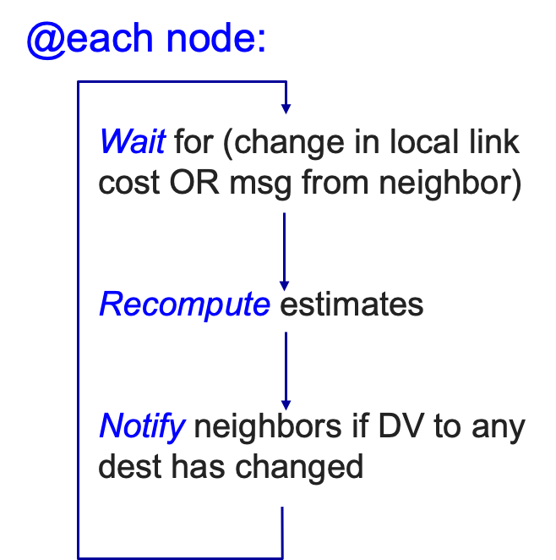
Q3 Distance-Vector Routing: Bellman-Ford
Bellman-Ford Equation
let d_{x}(y) := cost of least-cost path from x to y c(x, v) := cost to neighbor v
then d_{x}(y) = min_{v} {c(x, v) + d_{v}(y)} over all neighbors v of x

Slide 12
Q3 Distance-Vector Routing: Bellman-Ford
d_{x}(y) = min_{v} {c(x, v) + d_{v}(y)}

Slide 13
Q3 Distance-Vector Routing: Bellman-Ford
d_{x}(y) = min_{v} {c(x, v) + d_{v}(y)}

Slide 14
Q3 Distance-Vector Routing: Bellman-Ford
d_{x}(y) = min_{v} {c(x, v) + d_{v}(y)}

Slide 15
Thanks!

