Slide 1
Course and Teaching Evaluation (CTE) for Term 2, 2024-25
Notes for Students:
The CTE links were sent to your CUHK Link email accounts. Please check.
You will receive separate emails for teacher’s evaluation and TA’s evaluation.
Subject of the email is “Online CTE Questionnaire for [course code]: [course name] – [Teacher or TA name]”.
No login is required and all feedback is anonymous.
Course teacher will give you ~10-15 minutes to fill out the CTE questionnaires before the end of the class.
Submission deadline: By 23:59 tomorrow

Slide 2
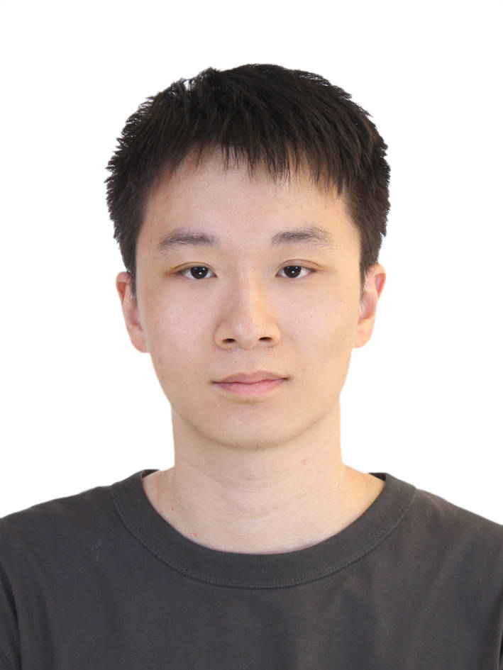
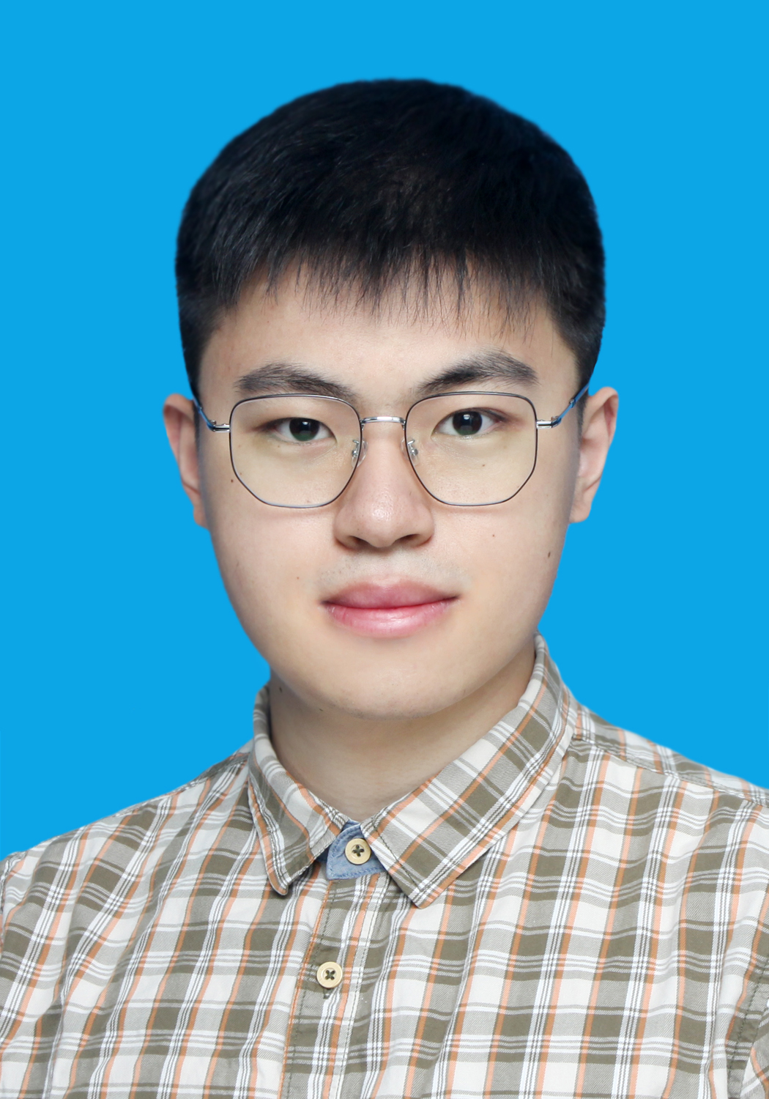
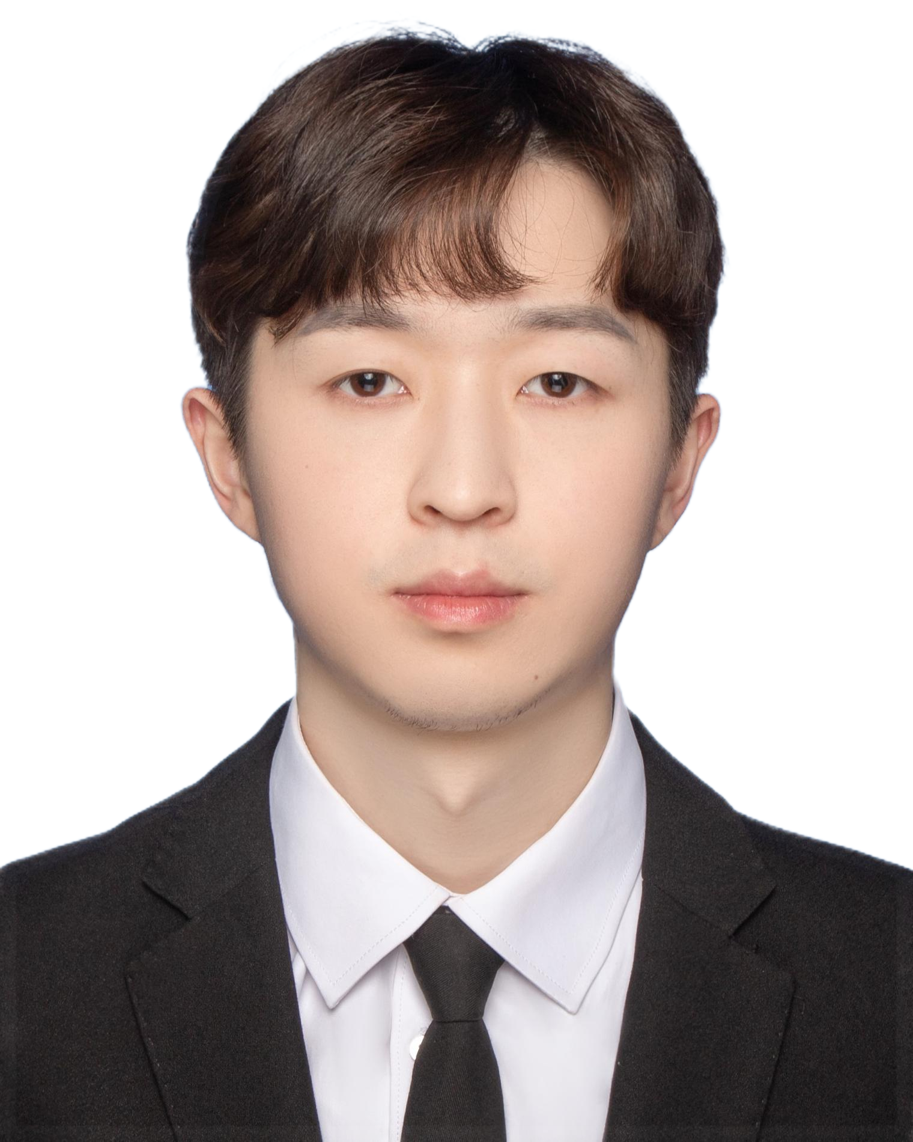
TA
Course Code: CSCI4430 Course Title: Data Communication and Computer Networks Teacher: Professor XU Hong
A. WU Shaofeng | B. YANG Yitao | C. FENG Yicheng

