Slide 1
ESTR4120 Computer Networks Lecture 1: Internet
Hong Xu

Slide 2
Logistics and expectations
Individual projects: 10% marks, replaces the tutorial quizzes
Choose your own topics
Final exam: 35%
My expectations: more in-class interactions, discussions/debates welcome
Contents: follow the 3-phase Internet evolution
Phase 1: Extensions on Internet basics
Phase 2: Video streaming, SDN, data center networking
Phase 3: AI networking, interconnect, scale-out/scale-up
Paper reading & critiques

Slide 3
Extension of Lecture 1

Slide 4
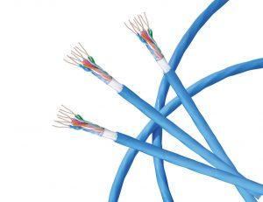
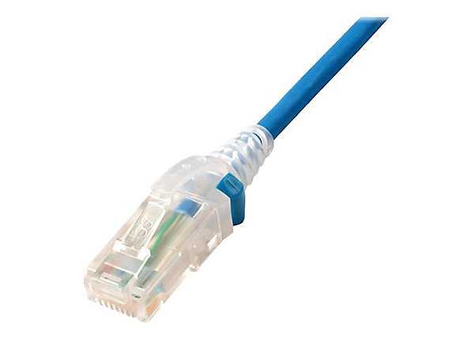
Links: physical media
bit: propagates between transmitter/receiver pairs
physical link: what lies between transmitter & receiver
guided media:
signals propagate in solid media: copper, fiber, coax
unguided media:
signals propagate freely, e.g., radio
Twisted pair (TP)
two insulated copper wires
Category 5: 100 Mbps, 1 Gbps Ethernet
Category 6: 10Gbps Ethernet

Slide 5
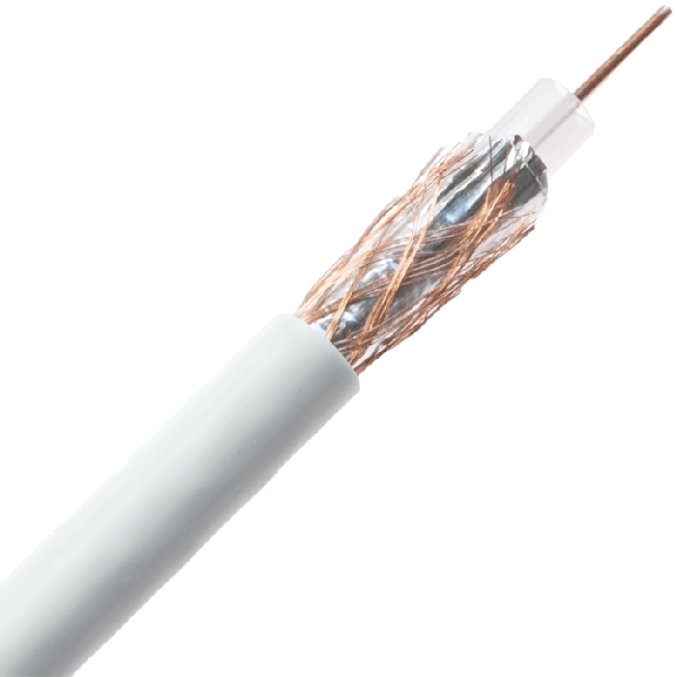
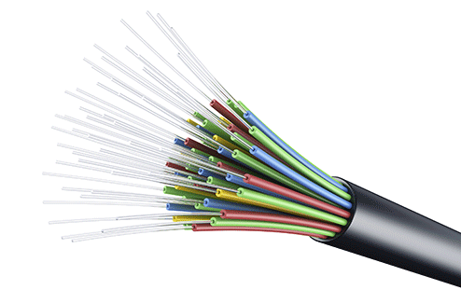
Links: physical media
Coaxial cable:
two concentric copper conductors
bidirectional
broadband:
multiple frequency channels on cable
100’s Mbps per channel
Fiber optic cable:
glass fiber carrying light pulses, each pulse a bit
high-speed operation:
high-speed point-to-point transmission (10’s-100’s Gbps)
low error rate:
repeaters spaced far apart
immune to electromagnetic noise

Slide 6
Links: physical media
Wireless radio
signal carried in various “bands” in electromagnetic spectrum
no physical “wire”
broadcast, “half-duplex” (sender to receiver)
propagation environment effects:
reflection
obstruction by objects
Interference/noise
Radio link types:
Wireless LAN (WiFi)
10-100’s Mbps; 10’s of meters
wide-area (e.g., 4G cellular)
10’s Mbps over ~10 Km
Bluetooth: cable replacement
short distances, limited rates
terrestrial microwave
point-to-point; 45 Mbps channels
satellite
up to 45 Mbps per channel
270 msec end-end delay

Slide 7

“Real” Internet delays and routes
what do “real” Internet delay & loss look like?
traceroute program: provides delay measurement from source to router along end-end Internet path towards destination. For all i:
sends three packets that will reach router i on path towards destination (with time-to-live field value of i)
router i will return packets to sender
sender measures time interval between transmission and reply
3 probes
3 probes
3 probes

Slide 8
Real Internet delays and routes
traceroute: gaia.cs.umass.edu to www.eurecom.fr
3 delay measurements from
gaia.cs.umass.edu to cs-gw.cs.umass.edu
1 cs-gw (128.119.240.254) 1 ms 1 ms 2 ms
2 border1-rt-fa5-1-0.gw.umass.edu (128.119.3.145) 1 ms 1 ms 2 ms
3 cht-vbns.gw.umass.edu (128.119.3.130) 6 ms 5 ms 5 ms
4 jn1-at1-0-0-19.wor.vbns.net (204.147.132.129) 16 ms 11 ms 13 ms
5 jn1-so7-0-0-0.wae.vbns.net (204.147.136.136) 21 ms 18 ms 18 ms
6 abilene-vbns.abilene.ucaid.edu (198.32.11.9) 22 ms 18 ms 22 ms
7 nycm-wash.abilene.ucaid.edu (198.32.8.46) 22 ms 22 ms 22 ms
8 62.40.103.253 (62.40.103.253) 104 ms 109 ms 106 ms
9 de2-1.de1.de.geant.net (62.40.96.129) 109 ms 102 ms 104 ms
10 de.fr1.fr.geant.net (62.40.96.50) 113 ms 121 ms 114 ms
11 renater-gw.fr1.fr.geant.net (62.40.103.54) 112 ms 114 ms 112 ms
12 nio-n2.cssi.renater.fr (193.51.206.13) 111 ms 114 ms 116 ms
13 nice.cssi.renater.fr (195.220.98.102) 123 ms 125 ms 124 ms
14 r3t2-nice.cssi.renater.fr (195.220.98.110) 126 ms 126 ms 124 ms
15 eurecom-valbonne.r3t2.ft.net (193.48.50.54) 135 ms 128 ms 133 ms
16 194.214.211.25 (194.214.211.25) 126 ms 128 ms 126 ms
17 * * *
18 * * *
19 fantasia.eurecom.fr (193.55.113.142) 132 ms 128 ms 136 ms
3 delay measurements
to border1-rt-fa5-1-0.gw.umass.edu
trans-oceanic link
looks like delays decrease! Why?
* means no response (probe lost, router not replying)
* Do some traceroutes from exotic countries at www.traceroute.org

Slide 9
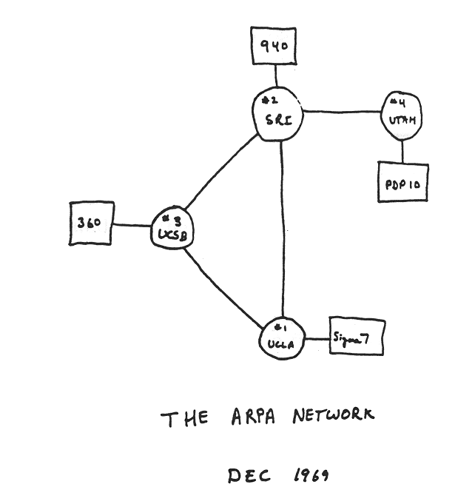
Internet history
1961-1972: Early packet-switching principles
1961: Kleinrock - queueing theory shows effectiveness of packet-switching
1964: Baran - packet-switching in military nets
1967: ARPAnet conceived by Advanced Research Projects Agency
1969: first ARPAnet node operational
1972:
ARPAnet public demo
NCP (Network Control Protocol) first host-host protocol
first e-mail program
ARPAnet has 15 nodes

Slide 10
Internet history
1972-1980: Internetworking, new and proprietary networks
1970: ALOHAnet satellite network in Hawaii
1974: Cerf and Kahn - architecture for interconnecting networks
1976: Ethernet at Xerox PARC
late70’s: proprietary architectures: DECnet, SNA, XNA
1979: ARPAnet has 200 nodes
Cerf and Kahn’s internetworking principles:
minimalism, autonomy - no internal changes required to interconnect networks
best-effort service model
stateless routing
decentralized control
define today’s Internet architecture

Slide 11
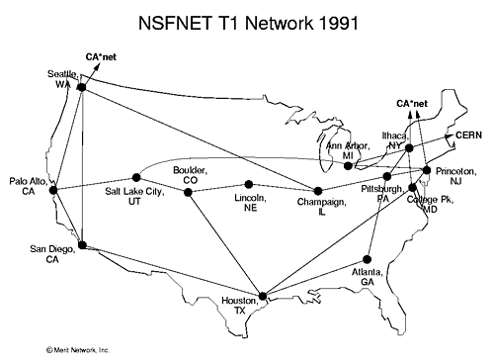
Internet history
1980-1990: new protocols, a proliferation of networks
1983: deployment of TCP/IP
1982: smtp e-mail protocol defined
1983: DNS defined for name-to-IP-address translation
1985: ftp protocol defined
1988: TCP congestion control
new national networks: CSnet, BITnet, NSFnet, Minitel
100,000 hosts connected to confederation of networks

Slide 12
Internet history
1990, 2000s: commercialization, the Web, new applications
early 1990s: ARPAnet decommissioned
1991: NSF lifts restrictions on commercial use of NSFnet (decommissioned, 1995)
early 1990s: Web
hypertext [Bush 1945, Nelson 1960’s]
HTML, HTTP: Berners-Lee
1994: Mosaic, later Netscape
late 1990s: commercialization of the Web
late 1990s – 2000s:
more killer apps: instant messaging, P2P file sharing
network security to forefront
est. 50 million host, 100 million+ users
backbone links running at Gbps

Slide 13
Internet history
2005-present: scale, SDN, mobility, cloud
Aggressive deployment of broadband home access (10-100’s Mbps)
2008: software-defined networking (SDN)
increasing ubiquity of high-speed wireless access: 4G/5G, WiFi
service providers (Google, Microsoft) create their own networks
bypass commercial Internet to connect “close” to end user, providing “instantaneous” access to social media, search, video content, …
enterprises run their services in “cloud” (e.g., Amazon Web Services, Microsoft Azure)
rise of smartphones: more mobile than fixed devices on Internet (2017)
~18B devices attached to Internet (2017)

Slide 14
Additional materials from IERG5090
Credit: Prof. Dahming Chiu and Prof. Wing Lau, IE, https://mobitec.ie.cuhk.edu.hk/ierg5090Spring2017/index.html

