Slide 1
CSCI 4430 - Fall 25
Tutorial 7
Credits to Computer Networking by Jim Kurose

Slide 2
GBN example with errors
Sender Window
Window size = 3 packets
Receiver Window
1
2
3
4
5
Timeout
Packet 4
6
Discard
Discard
4
5
6
Sender
Receiver
Time

Slide 3
SR example with errors
Sender Window
Window size = 3 packets
Receiver Window
{1}
1
{1, 2}
2
{1, 2, 3}
3
{2, 3, 4}
4
{3, 4, 5}
5
Timeout
Packet 4
{4, 5, 6}
6
Buffered
ACK=5
Buffered
{4, 5, 6}
4
ACK=6
{4, 5, 6}
ACK=4
{7, 8, 9}
7
Sender
Receiver

Slide 4
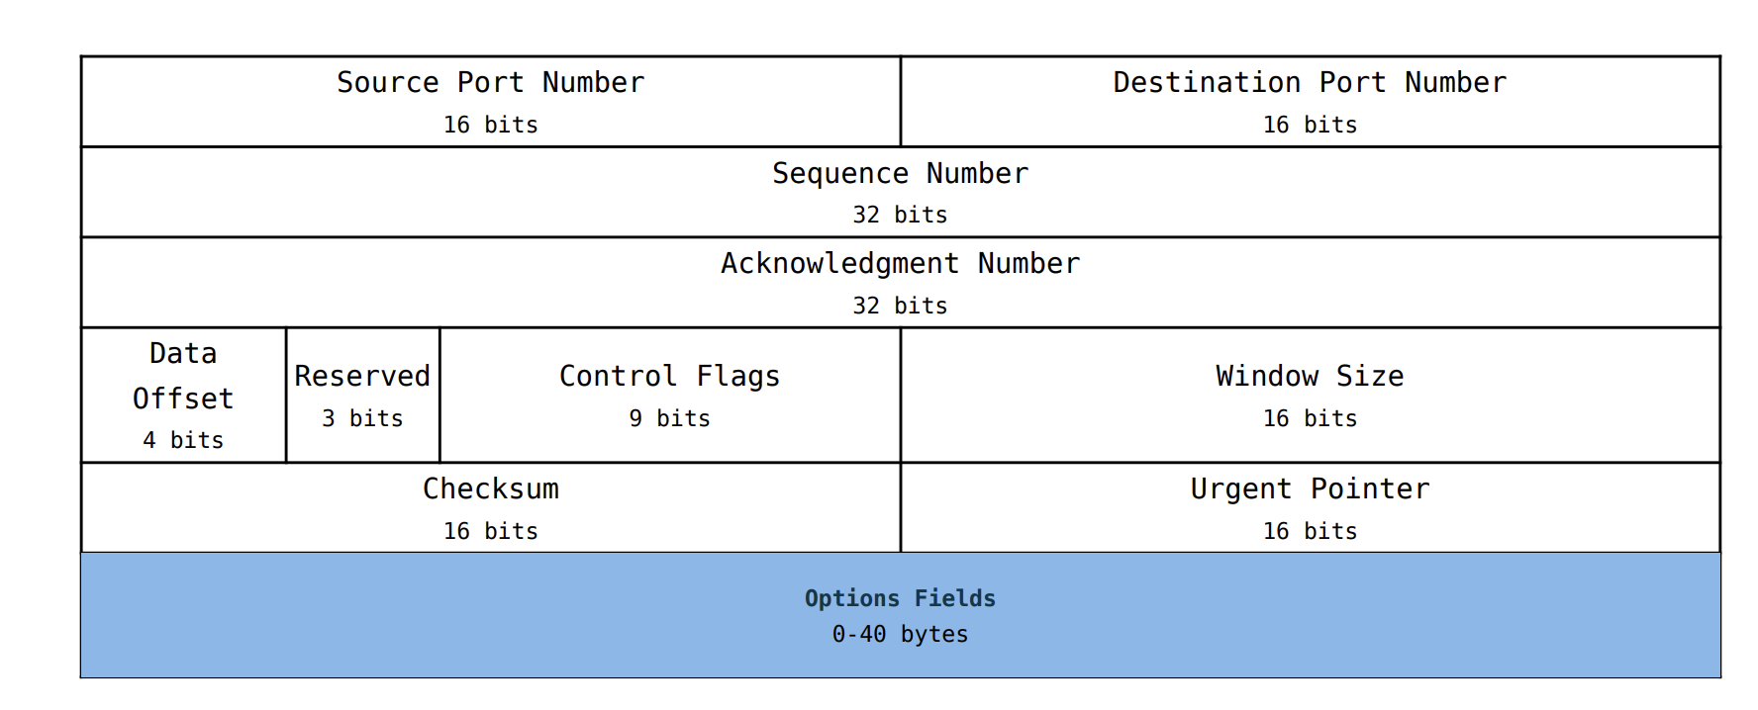
TCP: Overview
TCP is a transport layer protocol on top of IP
  It provides a reliable, ordered, and error-checked byte stream abstraction
TCP headers look like the following:

Slide 5
TCP: Overview
Reliable
  TCP attempts to resend lost packets; provides a “lossless” view to the application
Ordered
  TCP guarantees that the receiver application reads the data in the same order that it was sent
Error-checked
  TCP provides a checksum to detect errors in the received data
Byte stream
  TCP provides the view of a “stream of bytes” rather than discrete packets to the application

Slide 6
Q1 TCP File Transfer
Consider transferring an enormous file of L bytes from host A to host B.
What is the maximum value of L such that we don’t run out of TCP sequence numbers?
- Note:TCP sequence number is 4 bytes in the header
2^32 Bytes
Given L = 2^32 bytes, find how long it takes to transmit the file. Assume:
- MSS (max segment size) = 1460 Bytes
- MTU (max transmission unit) = 1500 Bytes
- 128 Mbps link from A to B
- Ignore flow and congestion control, assume A sends as fast as possible contiguously.
(2^32 / 1460 * 1500) / (128 *10^6 / 8) = 276 s
amount of data / bandwidth

Slide 7
Q2 TCP Segment Metadata
Host A (sender) and B (receiver) are communicating over a TCP connection. Assume the following events happen in order:
B has received the first 127 bytes of the flow from A, this consumes seq num 0-126
A then sends two segments, S1 (80 bytes of data), S2 (40 bytes of data)
S1 has sequence num 127, source port 30302, destination port 80
B sends ACK1 and ACK2 to A when it receives the first / second segment respectively
Assume S1 and S2 arrive in order
Q: For S2, what are the sequence num, source port and destination port?
Seq num: 207, Source port: 30302, Destination port: 80
Q: For ACK1, what are the ack num, source port and destination port?
Ack num: 207, Source port: 80, Destination port: 30302

Slide 8
Q3 TCP Segment CWND
Consider sending a large file over a lossless TCP connection Assume:
TCP uses AIMD for congestion control with slow start
ssthres = 16 MSS
Approximately constant RTT
CWND starts at 1 MSS
Q: How long does it take for CWND to increase from 1 MSS to 20 MSS?
CWND: 1 2 4 8 16 17 18 19 20; 8 RTT
Q: What is the average throughput (in terms of MSS and RTT) of the above
process?
(1+2+4+8+16+17+18+19) / 8 = 85 MSS / 8 RTT

Slide 9
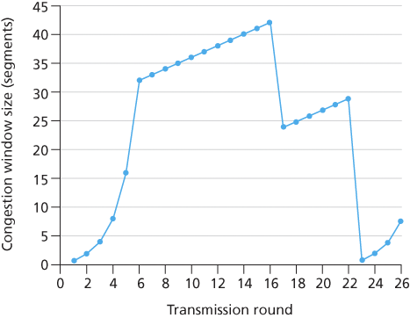
Q1 TCP Congestion Control
Assuming TCP Reno is the protocol experiencing the behavior shown above, answer the following questions. In all cases, you should provide a short discussion justifying your answer.
1. Identify the intervals of time when TCP slow start is operating.
2. Identify the intervals of time when TCP congestion avoidance is operating.
[1,6] and [23,26]
[6,16] and [17,22]

Slide 10
Q1 TCP Congestion Control
Assuming TCP Reno is the protocol experiencing the behavior shown above, answer the following questions. In all cases, you should provide a short discussion justifying your answer.
3. After the 16th transmission round, is segment loss detected by a triple duplicate ACK or by a timeout?
4. After the 22nd transmission round, is segment loss detected by a triple duplicate ACK or by a timeout?
Duplicate ACK
  Cut the ssthresh in half and set CWND to ssthresh + 2
Timeout
  Return to slow start

Slide 11
Q1 TCP Congestion Control
Assuming TCP Reno is the protocol experiencing the behavior shown above, answer the following questions. In all cases, you should provide a short discussion justifying your answer.
5. What is the initial value of ssthresh at the first transmission round?
6. What is the value of ssthresh at the 18th transmission round?
7. What is the value of ssthresh at the 24th transmission round?
5. 32
6. 21
7. 14

Slide 12
Thanks!

