Slide 1
ESTR4120 Computer Networks Lecture 3: Consistent hashing, Chord
Hong Xu

Slide 2
We can take caching to the Next Level
Web cache that is shared by many users
Idea: What if all users on CUHK Network (or close in location) can access amazon.com from some web cache located nearby?
The benefits: By aggregating the recent page requests of many users, these users will enjoy many more cache hits and consequently less latency.
The business plan for Akamai Technology in 1998 which is currently valuated at more than 10 billion.

Slide 3
Challenges
Remembering the recently accessed Web pages of a large number of users might take a lot of fast storage, with efficient retrieval.
Akamai’s plan was to do this in main memory.
Implementing a shared cache at a large scale requires spreading the cache over multiple machines
Suppose there are 100 machines and you are requesting amazon.com, which machine should you ask for it?

Slide 4
Some ideas
Poll all 100 servers for copy.
Infeasible at scale.
Our training so far: Use hash functions and for say amazon.com, let h(amazon.com) machine cache the page associated with amazon.com.
Easy to search!
What if you got 5 extra machines tomorrow? What if a server with #ID, crashed and it down.
It turns out this will be quite frequent at large scale.

Slide 5
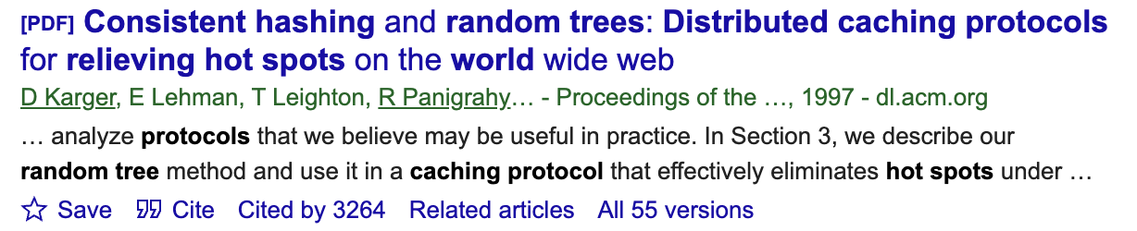
Reallocation?
h(x) = x mod 12
Addition or deletion of one machine changes it to x mod 13 or x mod 11. Shift everything to maintain consistency.
Infeasible when n is changing all the time.
Thoughts?
Solution: Consistent Hashing

Slide 6
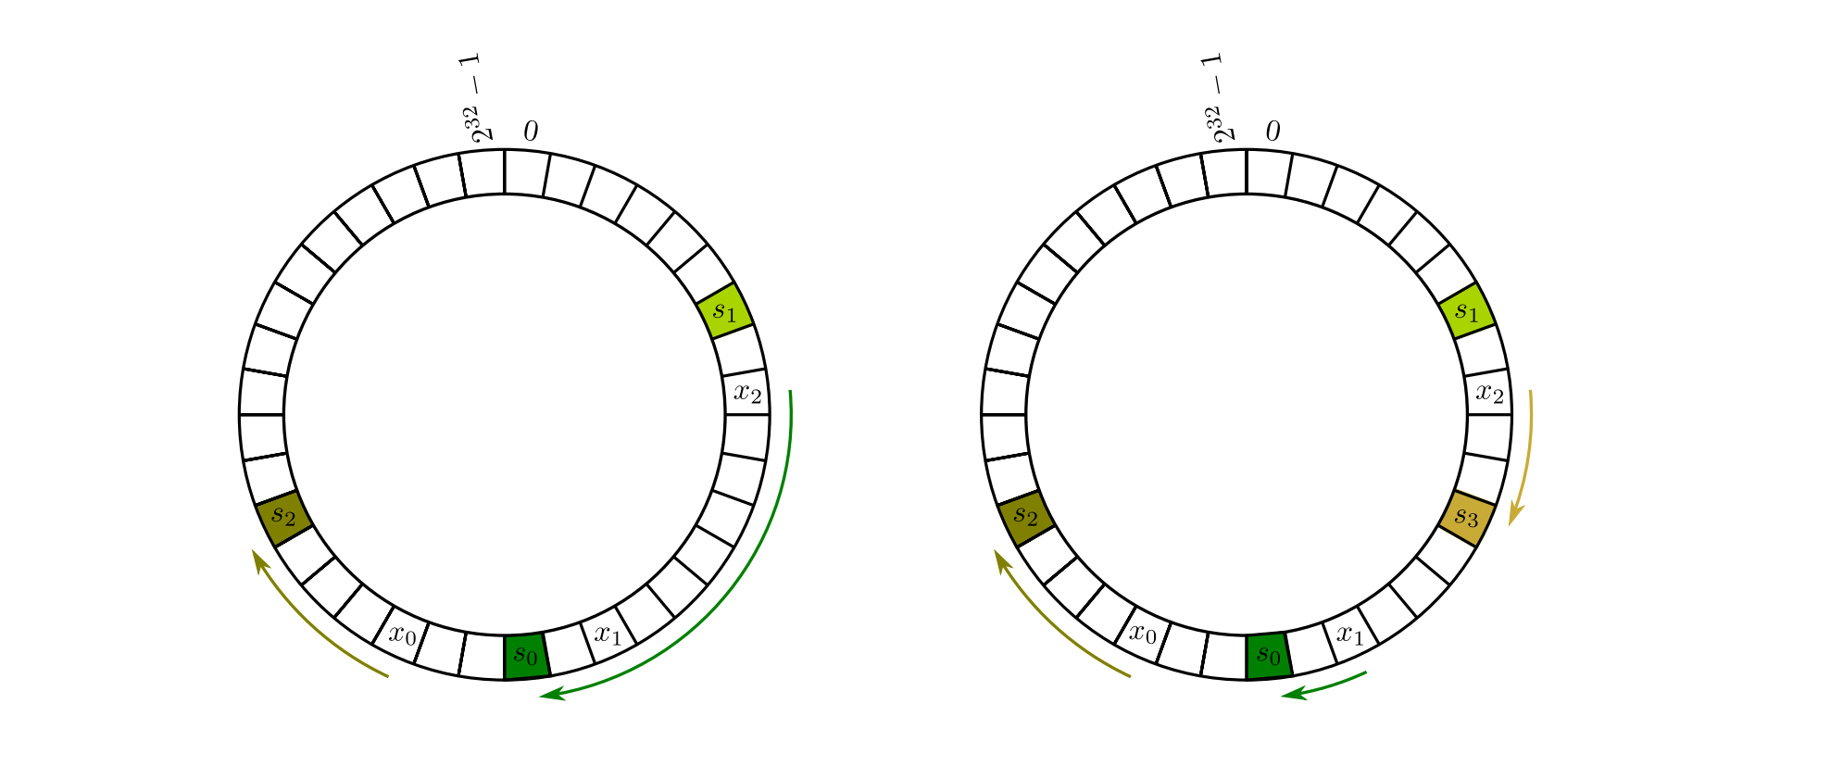

So what is consistent hashing?
Hash both machines and objects in the same range.
To assign object x, compute $h_{i}$(x) and then traverse right until you find the first machine’s hash $h_{m}(Y)$. Assign x to Y.

Slide 7
What happens when servers are added/deleted?
They all share the load.
We only have to move data from one of the servers instead of all with traditional hashing!

Slide 8
Consistent hashing: applications
Widely used in many applications: CDN, P2P
When scale is large, efficient lookup is a problem
Impractical to assume each node know about each other node in the system
Need an efficient “routing” protocol

