Slide 1
CSCI 4430 – Spring 25
Tutorial 13
Notes:
Hi everyone, welcome back! This is Tutorial 13 for CSCI 4430 — our Computer Networks course this Spring and this is the last tut in this term.
We’re getting closer to the end of the semester, and today’s session will focus on some key concepts at the data link and network layers. So let’s dive in and reinforce what you’ve been learning in lectures!

Slide 2
Grade Check
Please check your assignments and quizzes grades on Blackboard（except asg3）
Any problem like missing grades, please leave your message on Piazza.
Notes:
Before we get into the main content today, just a quick reminder to check your grades on Blackboard. You should be able to see your scores for all assignments and quizzes — except for assignment 3, which hasn’t been uploaded yet.
If you spot anything strange, like a missing grade or an error, don’t worry — just leave a message on Piazza and we’ll take care of it. Thanks for staying on top of things!"

Slide 3
Data Link Layer
Protocols
Ethernet (IEEE 802.3)
CSMA (Carrier-sense multiple access)/CD (Collision detection)
Recover after collision is detected
Wi-Fi (IEEE 802.11)
CSMA/CA (collision avoidance)
Designed to avoid collision
etc.
Device working in this layer use MAC address

Slide 4
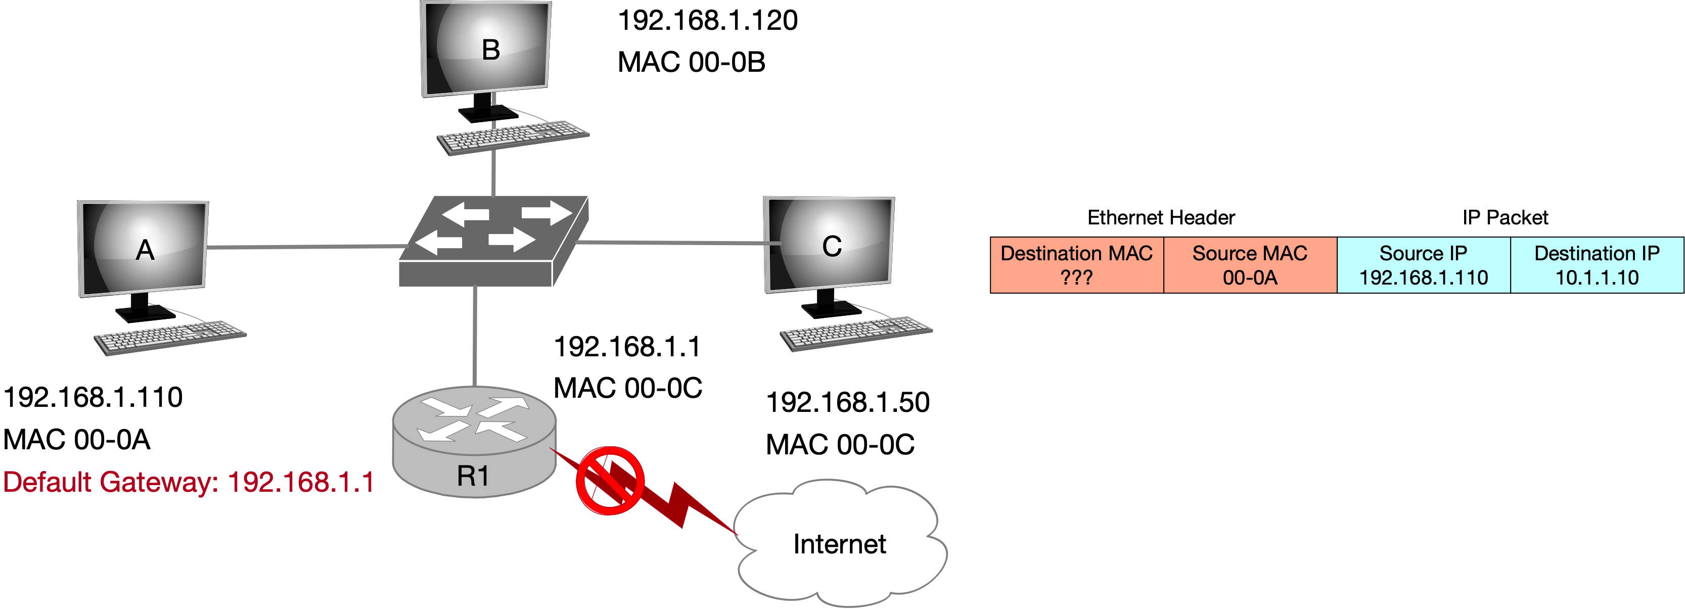
Address Resolution Protocol (ARP)
Used to find the MAC address of another device within subnet
ARP cache: A list from IPv4 address (32 bits) to MAC address (48 bits)
ARP broadcast address (when sending an ARP finding request): ff:ff:ff:ff:ff:ff

Slide 5
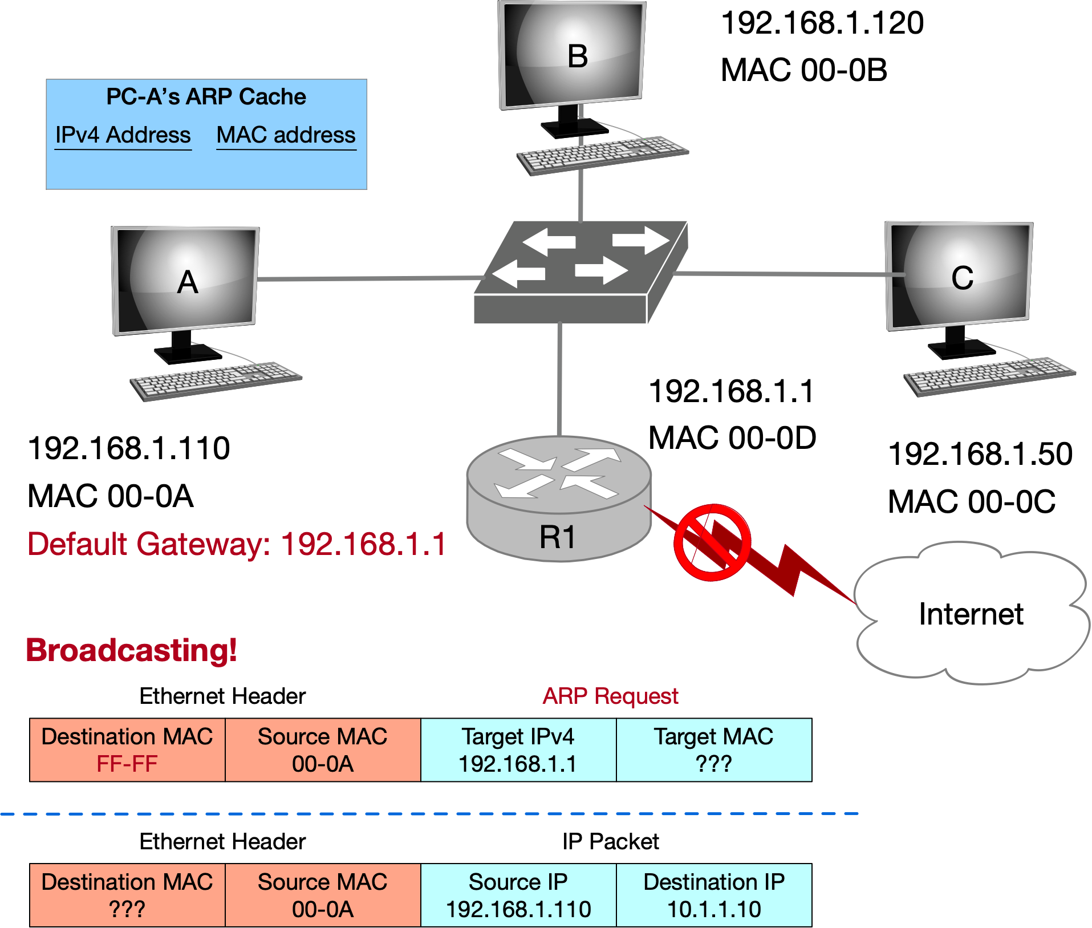
Address Resolution Protocol (ARP)

Slide 6
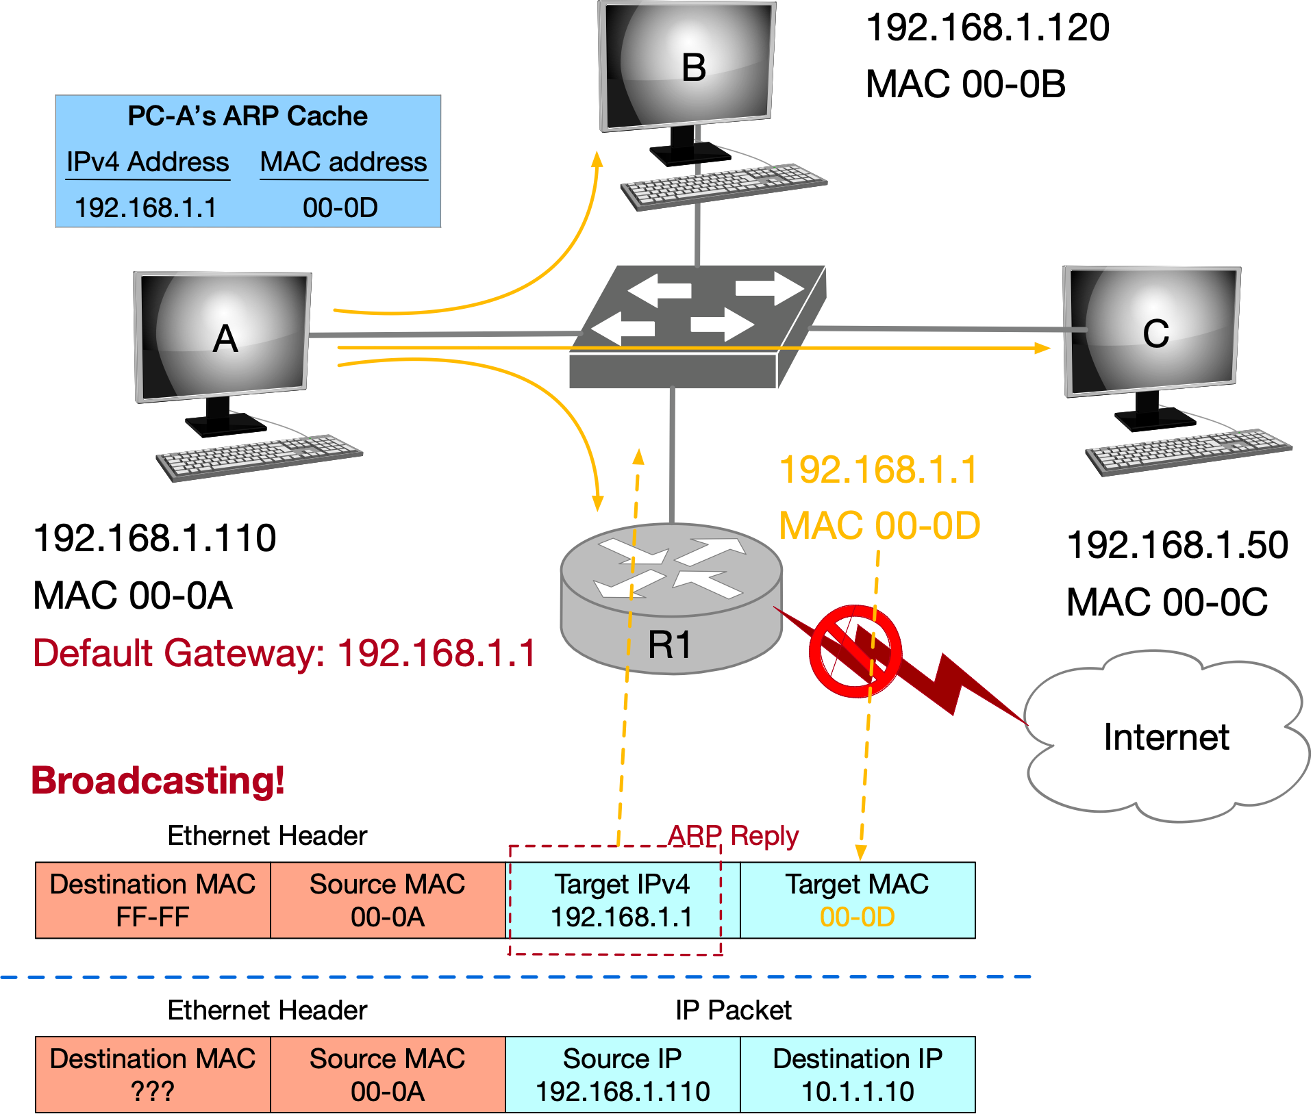
Address Resolution Protocol (ARP)

Slide 7
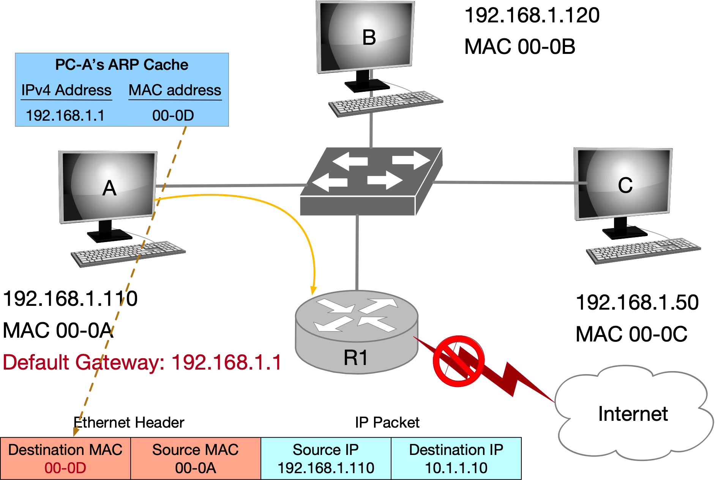
Address Resolution Protocol (ARP)

Slide 8
Spanning Tree Algorithm
Used to broadcast messages of switches in subnets and avoid loops
Aimed to construct a spanning tree of the topology
Messages (Y, d, X) (Each node)
From node X
Proposing Y as the root
Advertising distance d to Y
(Each node) Advertising Messages to its neighbors.
Switches elect the node with smallest identifier (MAC address) as root.
Each switch determines if a link is on its shortest path to the root; excludes it from the tree if not.
Breaking ties: choose the lowest switch ID.

Slide 9
Spanning Tree Algorithm
Algorithm Procedure
Initially, each switch proposes itself as the root
Switch X announces (X, 0, X) to its neighbors
Switches update their view of the root
Upon receiving (Y, d, Z) from Z, check Y’s id
If Y’s id < current root: set root = Y
Switches compute their distance from the root
Add 1 to the shortest distance received from a neighbor
If root or shortest distance to it changed, send neighbors updated message (Y, d+1, X)

Slide 10
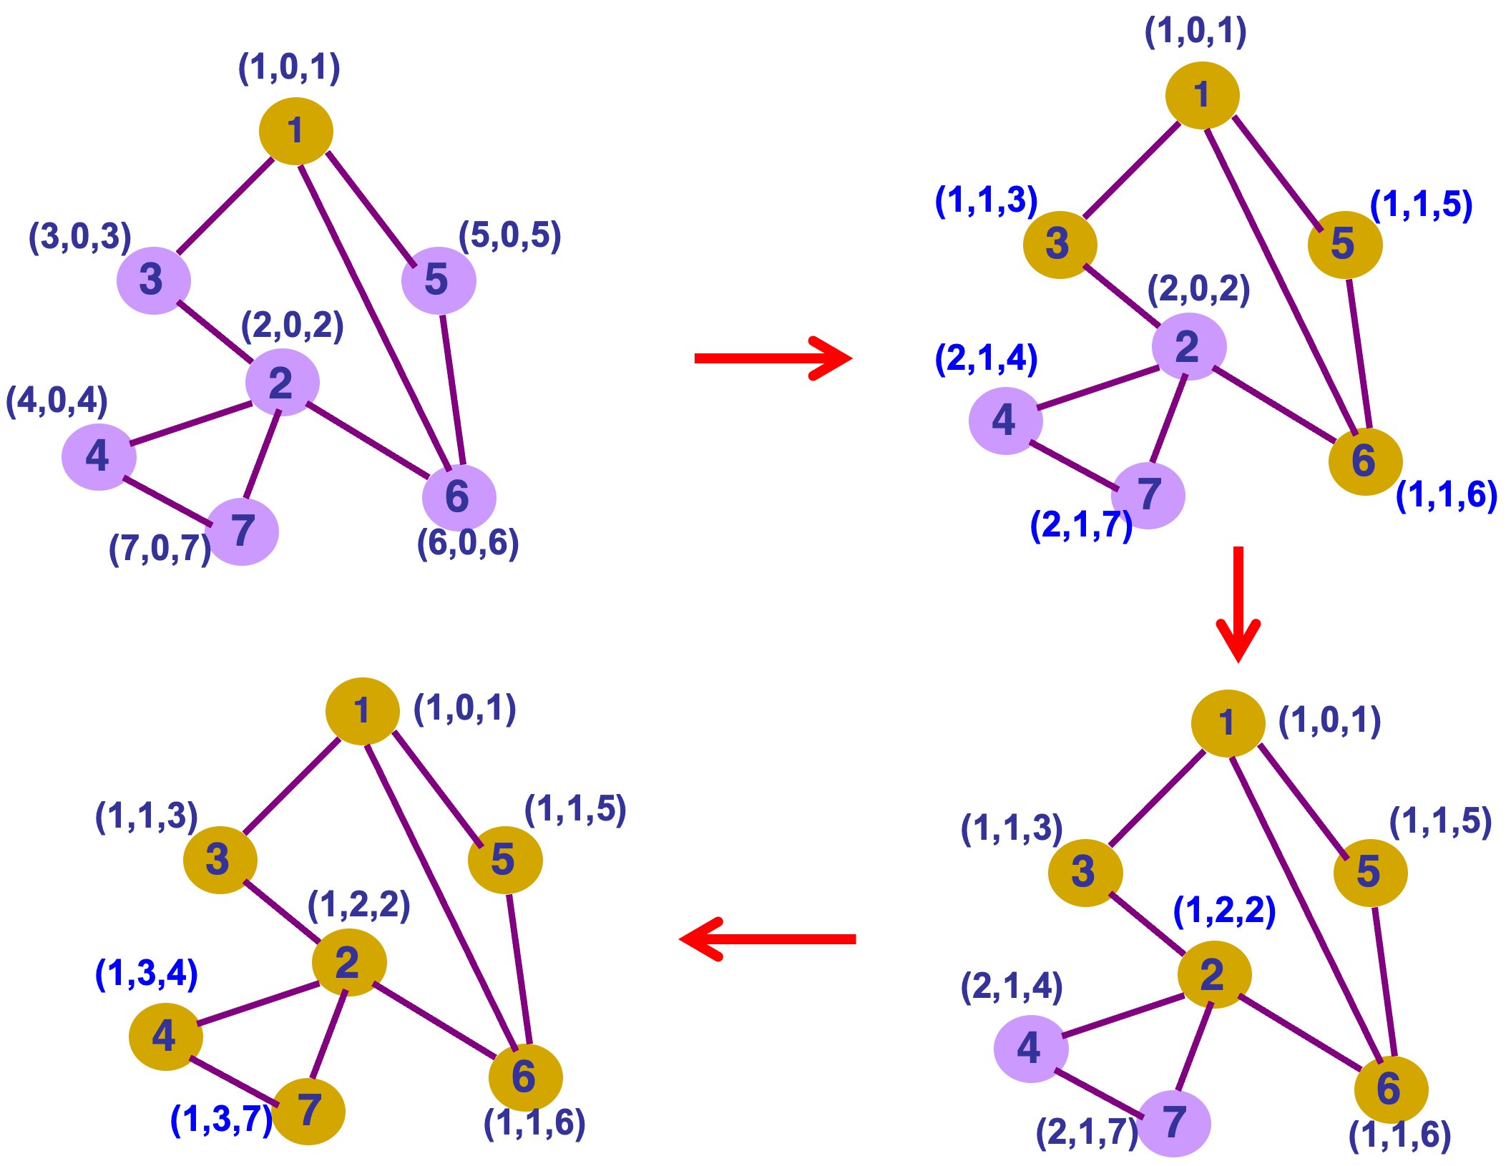
Initialize
1st step
2nd step
update
Switch root (compare id with neighbors)
distance = neighbor distance + 1
Switch root (compare id with neighbors)
distance = neighbor distance + 1
update
3rd step
4th step
update
Switch root (compare id with neighbors)
distance = neighbor distance + 1
Breaking ties: lowest neighbor ID
Breaking ties
Tree completed (coverage)

Slide 11
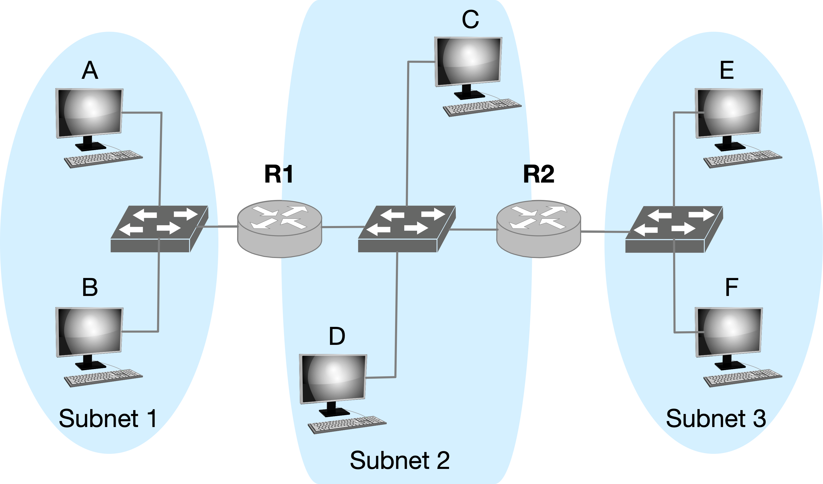
Q1 Forwarding
Consider sending an IP packet from Host E to Host F. Will Host E ask router R2 to forward the packet? Why?
No. Host E and Host F are on the same subnet and are connected via switch.

Slide 12
Q2 ARP
2-1. Consider E sending an IP packet to B. Assume E’s ARP cache is empty. Will E make an ARP request to find B’s MAC address?
No. Host B and Host E are on the different subnets.
2-2. Will E make an ARP request to? If yes, to whom?
R2 (its first-hop router).

Slide 13
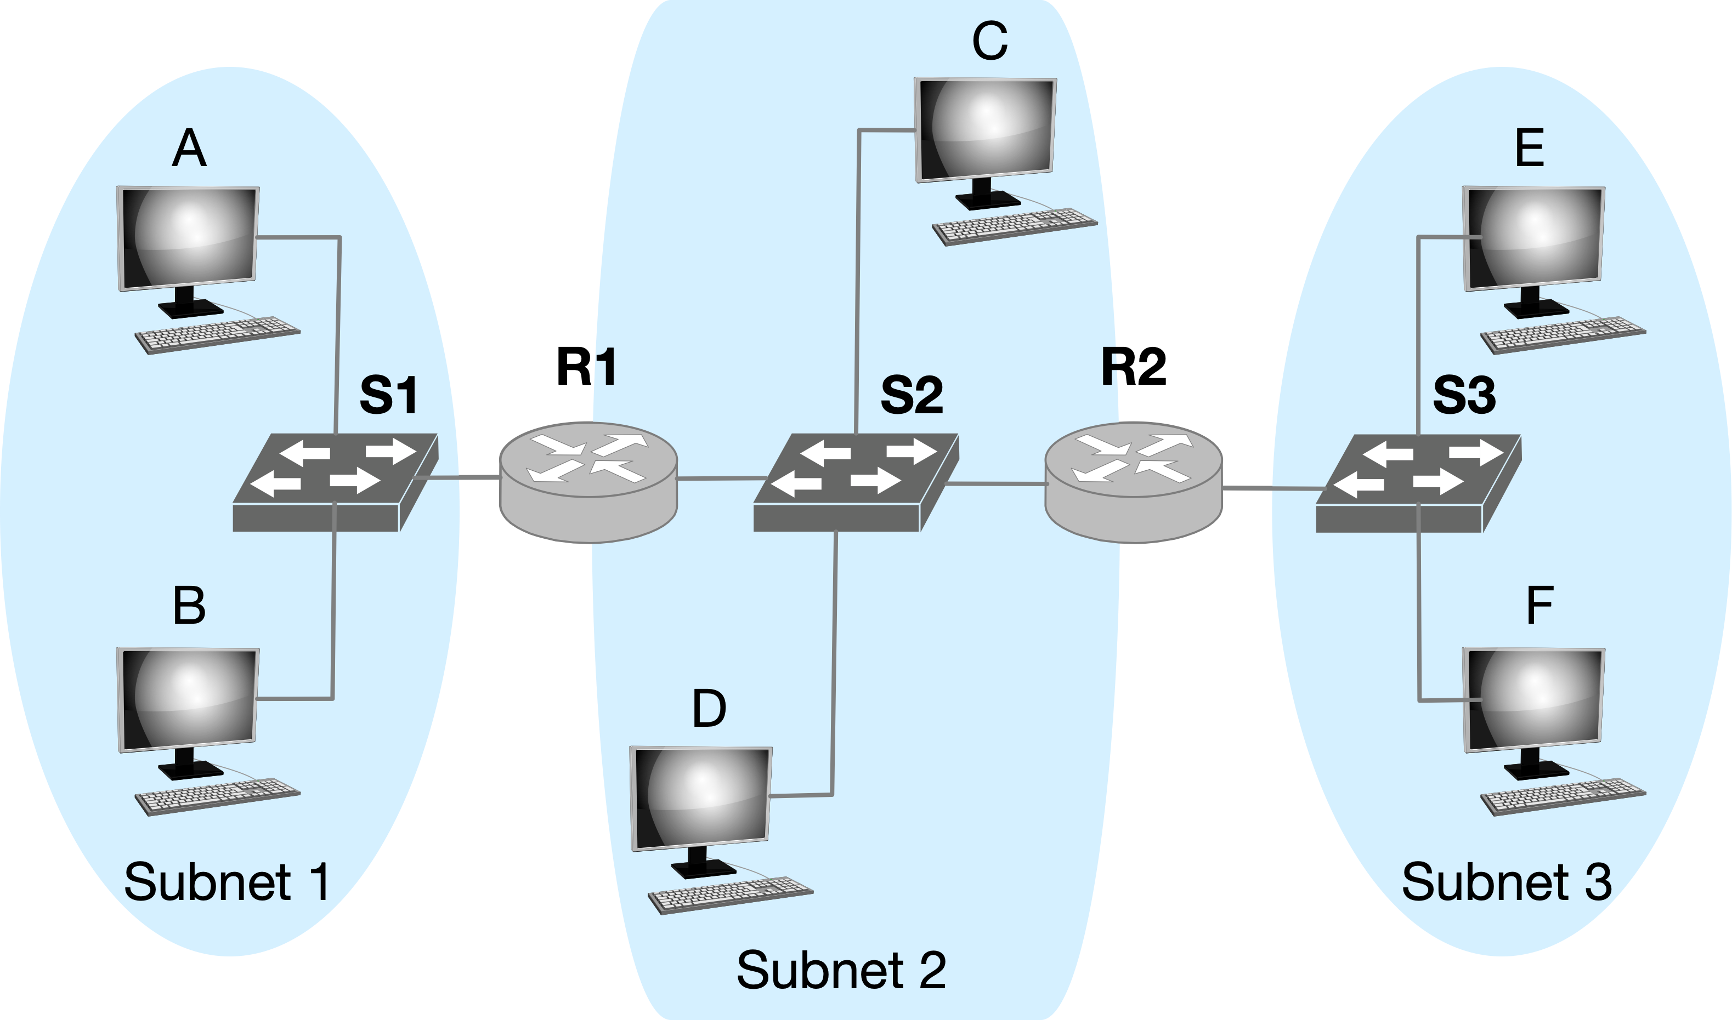
Q3 ARP and IP
Consider E sending an IP packet to B.
In the Ethernet frame of the IP packet from E to B is being delivered to router R1, what are the source and destination IP and MAC addresses?
srcIP: IP-E, dstIP: IP-B
srcMAC: MAC-R2, dstMAC: MAC-R1
Notes:
因为网络层负责端到端通信，源地址是发送者 E，目的地址是接收者 B，中间路由器只是转发者，不能篡改 IP 头部。MAC 地址是局域网（一个子网）内部使用的，只在每一跳（hop）中起作用。

Slide 14
Thanks!

