Slide 1
CSCI 4430 - FALL 25
Tutorial 1
Credits to Umich EECS 489 Discussion 1

Slide 2


Welcome to CSCI4430, Computer Networks!
Course page
Piazza

Slide 3
Outline
Introduction to ASG1.
Introduction to socket programming.

Slide 4
Assignment 1
Due: 11:59:59 p.m., Sun, Sep. 21st
Task:
Conduct measurements in Mininet (using standard tools)
Write your own iPerf (“iPerfer”)
Advice:
Get yourself familiar with the basic socket programming
START EARLY!

Slide 5
Assignment 1
iperf:
Purpose:
A network performance measurement tool to test bandwidth between two endpoints.
How It Works:
Operates in client-server mode.
The client generates traffic, and the server measures the received traffic.
Usage:
Server: iperf -s
Client: iperf -c <server_ip> -t <time>
Ping:
Purpose:
Measures latency (Round-Trip Time, RTT) between two endpoints.
Verifies connectivity and diagnoses network issues.
How It Works:
Sends ICMP echo requests and waits for replies.
Usage:
ping <destination_ip> -c <count> (e.g., 20 packets for consistent results).

Slide 6
Assignment 1
Mininet:
Purpose:
A network emulator for creating and testing virtual networks on a single machine.
How It Works:
Simulates hosts, switches, links, and controllers using a lightweight VM.
Usage:
Start Mininet: sudo mn
Create a topology: Use Python scripts or built-in commands (e.g., sudo python <file>.py).
Test connectivity: pingall
Launch terminals for hosts: xterm h1 h2
Workflow in Assignment:
Use Mininet to create and manage virtual network topologies.
Use ping & iPerf to measure RTT (latency) and network bandwidth.
Analyze network performance under different conditions (e.g., multiplexing, latency effects).
Write your own iPerf (“iPerfer”)

Slide 7

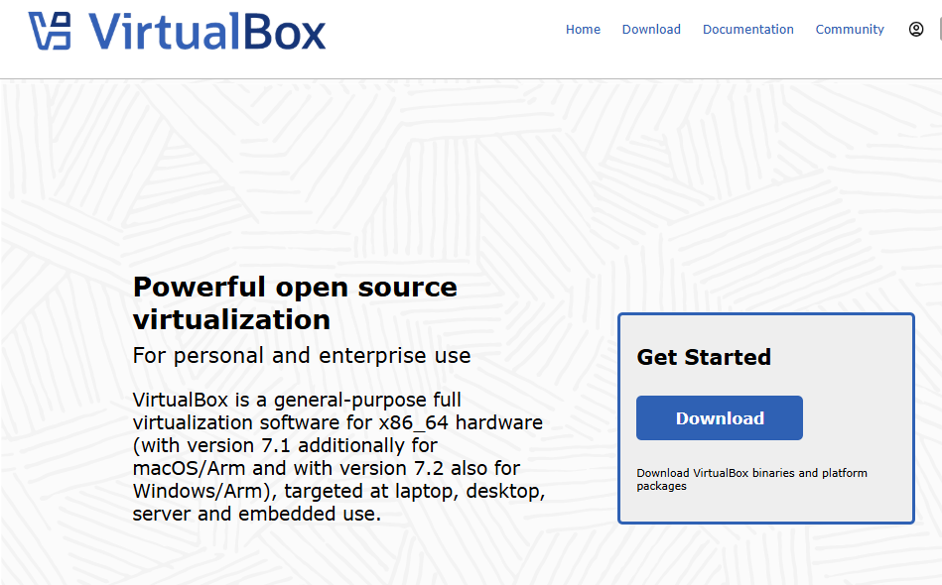
Assignment 1
Running Environment:
For Windows, Linux (amd64), and Intel-based macOS users: we provide a VirtualBox VM image (login password:csci4430) which includes running environment for ASG1.
For macOS (Apple Silicon) users: please follow the setup instructions in our GitHub repo.
All details: https://github.com/henryhxu/CSCI4430/tree/2025_fall/assignment/assignment-1

Slide 8
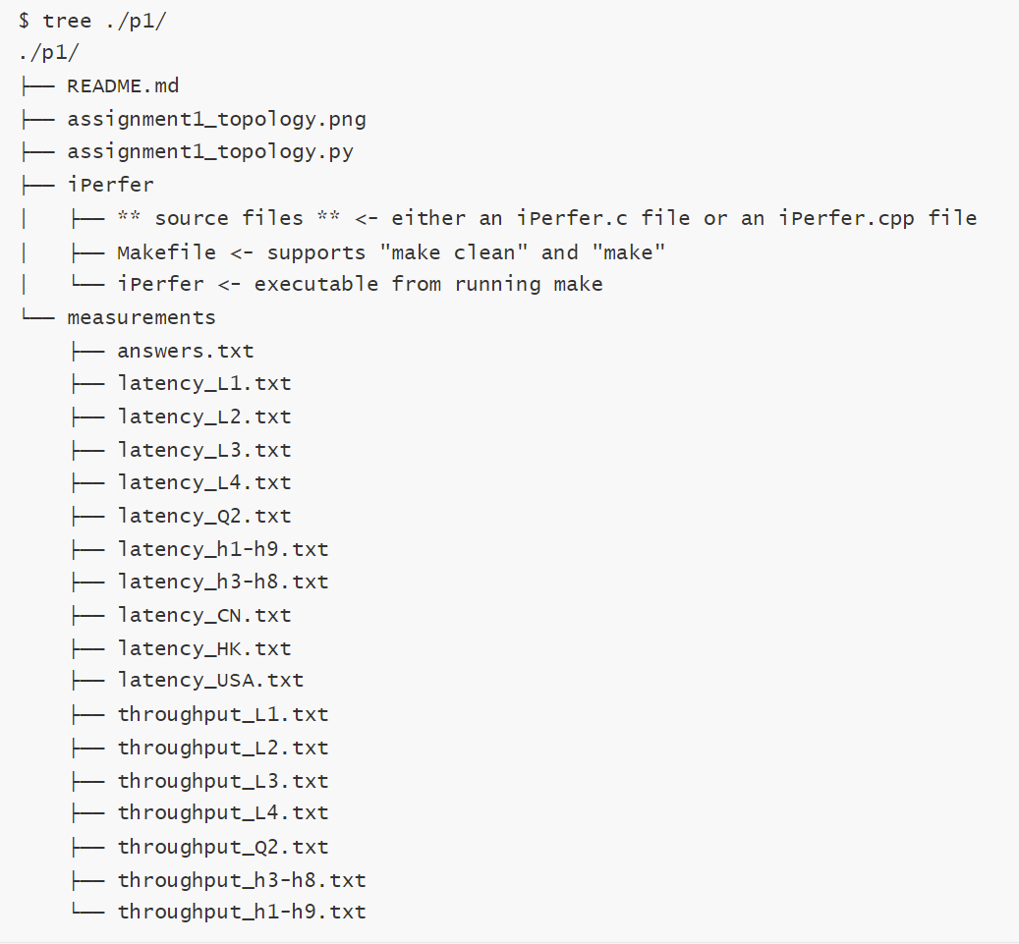
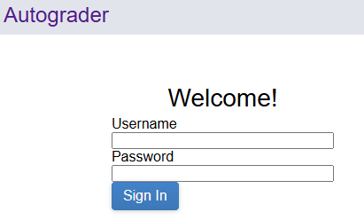
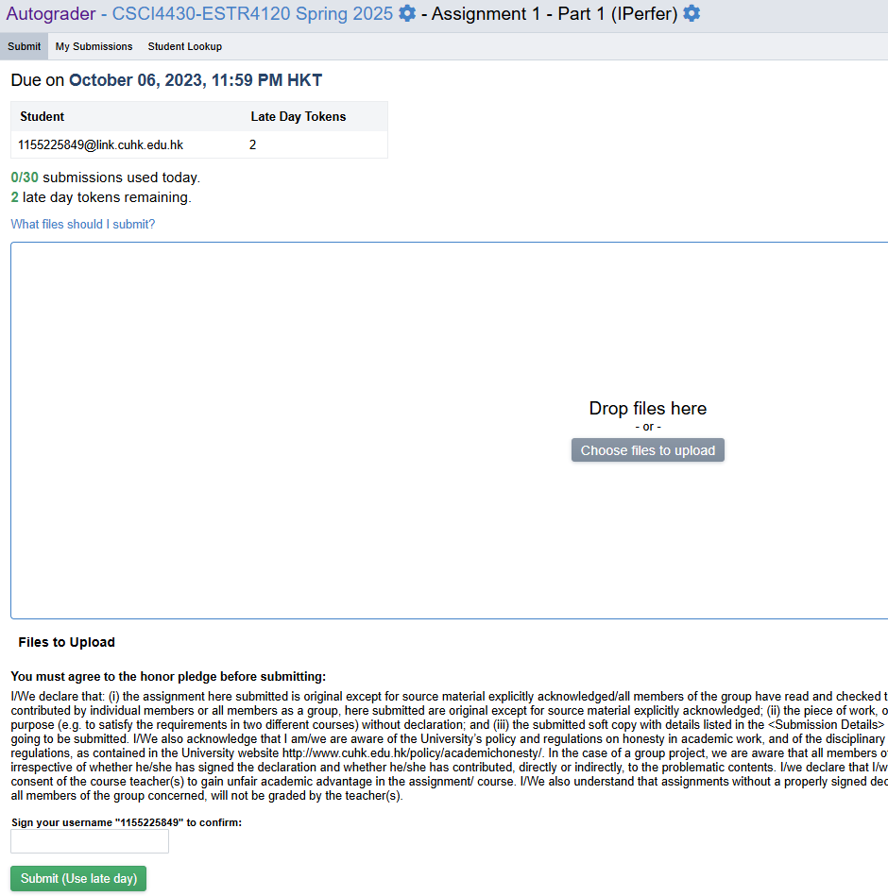

Assignment 1
Autograder:
Log in with your CUHK link email and password (will be sent by email after add/drop period) to URL under the connection of CSE VPN.
Example final structure of repository
Please find link for general use of the Autograder.

Slide 9
Socket Programming: Intro
What is a socket?
Communication endpoint at the end hosts[1].
Don’t mix network socket up with other “sockets”, i.e. CPU socket.
Why do we use a socket?
- It provides an application programming interface to exchange data between processes on the same or different machines.
[1] https://www.rfc-editor.org/rfc/rfc147

Slide 10
Socket Programming: Intro
L7
Application
Application
L7
socket
socket
L4
Transport
Transport
L4
L3
Network
Network
L3
Abstracted away
L2
Data link
Data link
L2
L1
Physical
Physical
L1

Slide 11
Socket Programming: TCP/UDP
Socket as the Programming Interface for TCP and UDP:
TCP and UDP are transport layer protocols responsible for data transmission over the network:
TCP (Transmission Control Protocol): Ensures reliable, connection-oriented data transfer.
UDP (User Datagram Protocol): Provides simple, fast, and connectionless data communication.
Sockets abstract the complexity of TCP and UDP, offering developers an easy way to use these protocols:
TCP/UDP functionality (e.g., packet segmentation, error checking) is handled internally by the socket.
Developers do not need to directly manage these protocol details.

Slide 12
Socket Programming: Complete Flow
Server
Client

Slide 13
Socket Programming: Client Side
read()
socket()
bind()
connect()
write()
Client flow chart
Step (1). socket()
- Create a socket.
read() – to receive data.
write() – to send data.
close() – to close the socket
Step (2). bind() [optional]
- Assign the socket a port number.
- Skip this step and will have a random port number assigned.
Important System calls
Client side | Server side
socket()
bind()* | bind()
connect() | listen() and accept()
Step (3). connect()
- Connect to the remote server.
- It is a blocking system call.
* means optional.

Slide 14
Socket Programming: Server Side
socket()
bind()
listen()
read()
Server flow chart
accept()
write()
Step (1) & Step(2) [ you know them now. ]
read() – to receive data.
write() – to send data.
close() – to close the socket
Step (3). listen()
- It sets the port to be listening to incoming connections, for TCP only.
Important System calls
Client side | Server side
socket()
bind()* | bind()
connect() | listen() and accept()
Step (4). accept()
- Accept incoming connections.
- A blocking system call.
* means optional.

Slide 15
Socket Programming: Complete Flow
Server
Client

Slide 16
Socket Programming: Complete Flow
Socket FD
socket()
bind()
listen()
Accept FD
Socket FD
Socket FD
connection #1
read() & write()
accept()
Socket FD
Accept FD
connection #n
read() & write()
Server flow chart
An interesting thing about accept() is the creation of a new file descriptor!
Application layer’s point of view.
Good! It provides each connection a new handler and we can distinguish every connection!
Transport layer’s point of view.
Well, for TCP, every FD points to a unique TCP control structure. It is a necessary for reliable data transfer!

Slide 17
Socket Programming: socket()
Create a socket
socket_fd = socket(AF_INET, SOCK_STREAM, IPPROTO_TCP);

Slide 18
Socket Programming-Server: bind()
Bind an address to a socket
struct sockaddr_in addr;
memset(&addr, 0, sizeof(addr));
addr.sin_family = AF_INET; % Address family
addr.sin_addr.s_addr = INADDR_ANY; % 0.0.0.0
addr.sin_port = htons(port); % Host to network long
bind(sockfd, (struct sockaddr *) &addr, sizeof(addr));

Slide 19
Socket Programming-Server: listen()
Listen for connections on a socket
listen(sockfd, 10);

Slide 20
Socket Programming-Client: connect()
Initiate a connection on a socket
struct hostent *server = gethostbyname(hostname);
struct sockaddr_in addr;
memset(&addr, 0, sizeof(addr));
addr.sin_family = AF_INET;
addr.sin_addr.s_addr = * (unsigned long *) server->h_addr_list[0];
addr.sin_port = htons(server_port);

Slide 21
Socket Programming-Server: accept()
Accept a connection on a socket
socklen_t addr_len = sizeof(addr);
int conn = accept(sockfd, (struct sockaddr *) &addr, &addr_len);

Slide 22
Socket Programming: send()
Send a message on a socket
send(sockfd, buffer, MSG_SIZE, MSG_NOSIGNAL);

Slide 23
Socket Programming: recv()
Receive a message on a socket
byte_recved = recv(conn, buffer, len, MSG_NOSIGNAL);

Slide 24
Socket Programming: A Demo
eecs482/bgreeves-socket-example: Sockets example from discussion
Linux or Mac OS.
A virtual machine is provided here. (The password is identical to the username.)
Tip: Manually set shared folder between your PC/laptop and VM: sudo mount - t vboxsf folder name in VirtualBox App setting folder name in VM

Slide 25
Socket Programming: Resources
Beej's Guide to Network Programming
eecs482/bgreeves-socket-example: Sockets example from discussion
man is always your good friend
man socket

Slide 26
Thanks!

