Slide 1
CSCI4430 Computer Networks
Lecture 4: Application Layer –
Caching and CDN, DNS
Hong Xu, Henry
CSE@CUHK, 2025
Material with thanks to Mosharaf Chowdhury, Aditya Akella, Sugih Jamin, Philip Levis, Sylvia Ratnasamy, Peter Steenkiste, and many other colleagues.

Slide 2
Agenda
Caching
CDN: Content Distribution Network
DNS: Domain Name System

Slide 3
Recap: Improving HTTP
Optimizing connections using three “P”s
  Persistent (latency)
  Parallel/concurrent (bandwidth and latency)
  Pipelined over the same connection (latency)
Caching
  Forward proxy: close to clients
  Reverse proxy: close to servers
Replication

Slide 4
Caching
Why does caching work?
  Exploits locality of reference
How well does caching work?
  Very well, up to a limit
  Large overlap in content
  But many unique requests –> long-tailed
    A universal story!
    Effectiveness grows logarithmically in size

Slide 5
Caching: How
Modifier to GET requests:
  If-modified-since – returns “not modified” if resource not modified since specified time
GET /somedir/page.html HTTP/1.1
Host: www.someschool.edu
User-agent: Mozilla/4.0
If-modified-since: Wed, 18 Jan 2017 10:25:50 GMT
(blank line)

Slide 6
Caching: How
Modifier to GET requests:
  If-modified-since – returns “not modified” if resource not modified since specified time
Client specifies “if-modified-since” time in request
Server compares this against “last modified” time of resource
Server returns “Not Modified” if resource has not changed
…. or a “OK” with the latest version otherwise

Slide 7
Caching: How
Modifier to GET requests:
  If-modified-since – returns “not modified” if resource not modified since specified time
Response header:
  Expires – how long it’s safe to cache the resource
  No-cache – ignore all caches; always get resource directly from server

Slide 8
Caching: Where?
Options
  Client (browser)
  Forward proxies
  Reverse proxies
  Content Distribution Network

Slide 9
Caching: Where?
Many clients request the same content
  E.g., cuhk; youtube videos; software updates
  Generate unnecessary server and network load
  Clients experience unnecessary latency
Server
Tier-1 ISP
ISP-1
ISP-2
Clients

Slide 10
Caching with Reverse Proxies
Cache documents close to server
  Decrease server load
  By content provider
Reverse proxies
Tier-1 ISP
ISP-1
ISP-2
Clients
10

Slide 11
Caching with Forward Proxies
Cache documents close to clients
  Reduce network traffic and decrease latency
  By ISPs or enterprises
Reverse proxies
Tier-1 ISP
Forward proxies
ISP-1
ISP-2
Clients
11

Slide 12
Replication
Replicate popular websites across many machines
  Spreads load across servers
  Places content closer to clients
  Helps when content isn’t cacheable

Slide 13
Content Distribution Networks (CDN)
Caching and replication as a service
Large-scale distributed storage infrastructure (usually) administered by one entity
  e.g., Akamai is in 135 countries and 1300+ networks
Combination of caching and replication
  Pull: Direct result of clients’requests (caching)
  Push: Expectation of high access rate (replication)
Notes:
Transcoding = change compression rate per user’s bandwidth

Slide 14
Cost-effective content delivery
General theme: multiple sites hosted on shared physical infrastructure
  Efficiency of statistical multiplexing
  Economies of scale (volume pricing, etc.)
  Amortization of human operator costs
Examples:
  CDNs
  Web hosting companies
  Cloud infrastructure

Slide 15
CDN example – Akamai
Akamai creates new domain names for each client
  e.g., a128.g.akamai.net for cnn.com
The client content provider modifies content so that embedded URLs reference new domains
  “Akamaize” content
  e.g., http://www.cnn.com/image-of-the-day.gif becomes http://a128.g.akamai.net/image-of-the-day.gif
Requests now sent to CDN’s infrastructure

Slide 16
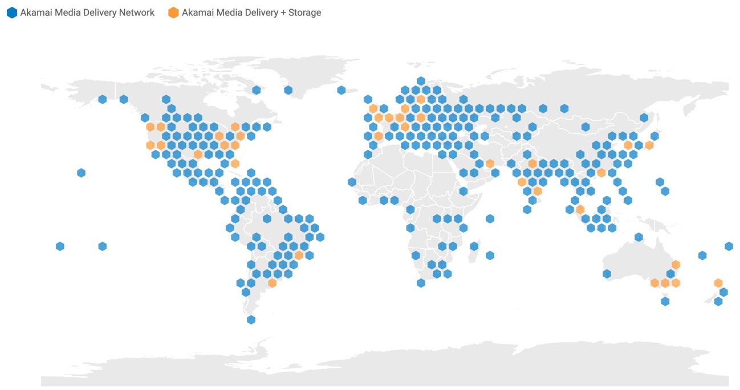
CDN example – Akamai
Retrieved on Sep 10, 2021 from https://www.akamai.com/visualizations/media-delivery-network-map

Slide 17
Why this replica, not others?
Balancing load across server replicas
Pairing clients with nearby servers to decrease latency and overall bandwidth usage

Slide 18
DNS: Domain name system

Slide 19
Internet names & addresses
Machine addresses: e.g., 141.212.113.143
  Router-usable labels for machines
  Conforms to network structure (the “where”)
Machine names: e.g., cse.cuhk.edu.hk
  Human-usable labels for machines
  Conforms to organizational structure (the “who”)
The Domain Name System (DNS) is how we map from one to the other
  A directory service

Slide 20
Why?
Convenience
  Easier to remember
Provides a level of indirection!
  Decoupled names from addresses
  Many uses beyond just naming a specific host

Slide 21
DNS: History
Initially all host-address mappings were in a hosts.txt file (in /etc/hosts):
  Maintained by the Stanford Research Institute (SRI)
  Changes were submitted by email and updates downloaded periodically from SRI
As the Internet grew SRI could not handle load
  Names were not unique anymore
  Hosts had inaccurate copies of hosts.txt

Slide 22
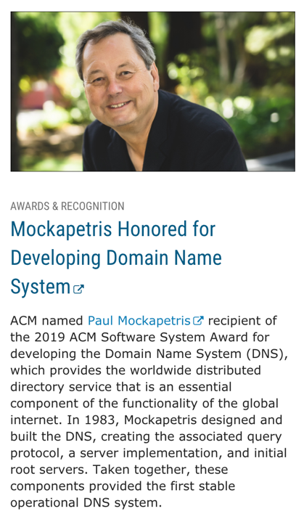
DNS: History
In 1983, the first stable operational DNS implementation included
  The associated query protocol;
  A server implementation; and
  Initial root servers.
Since inception, DNS scaled from 1000s of queries/day to 10s of billions queries/day

Slide 23
Goals
Uniqueness: no naming conflicts
Scalable
  Many names and frequent updates (secondary)
Distributed, autonomous administration
  Ability to update my own (machines’) names
  Don’t have to track everybody’s updates
Highly available
Lookups are fast
Perfect consistency is a non-goal

Slide 24
How?
Partition the namespace
Distribute administration of each partition
  Autonomy to update my own (machines’) names
  Don’t have to track everybody’s updates
Distribute name resolution for each partition
How should we partition things?

Slide 25
Key idea: Hierarchy
Three intertwined hierarchies
  Hierarchical namespace
    As opposed to original flat namespace
  Hierarchically administered
    As opposed to centralized
  (Distributed) hierarchy of servers
    As opposed to centralized storage

Slide 26
Hierarchical namespace
root
edu
com
gov
mil
org
net
cn
fr
…
“Top Level Domains” are at the top
Domains are subtrees
  e.g., .edu, umich.edu, eecs.umich.edu
Name is leaf-to-root path
  cse.eecs.umich.edu
Depth of tree is arbitrary (limit 128)
Name collisions trivially avoided
  Each domain is responsible
umich
berkeley
eecs
law
cse

Slide 27
Hierarchical administration
ICANN/IANA
root
edu
com
gov
mil
org
net
cn
fr
…
umich
berkeley
eecs
law
A zone corresponds to an administrative authority that is responsible for that portion of the hierarchy
  e.g., UMich controls names: *.umich.edu
  e.g., EECS controls names: *.eecs.umich.edu
cse
Notes:
ICANN: Internet Corporation for Assigned Names and Numbers
IANA: Internet Assigned Numbers Authority

Slide 28
Server hierarchy
Top of hierarchy: Root servers
  Location hardwired into other servers
Next Level: Top-level domain (TLD) servers
  .com, .edu, etc.
  Managed professionally
Bottom Level: Authoritative DNS servers
  Actually store the name-to-address mapping
  Maintained by the corresponding administrative authority

Slide 29
Server hierarchy
Each server stores a (small!) subset of the total DNS database
An authoritative DNS server stores “resource records” for all DNS names in the domain that it has authority for
Each server needs to know other servers responsible for other portions of the hierarchy
  Every server knows the root
  Root server knows about all top-level domains

Slide 30
DNS root
Located in Virginia, USA
How do we make the root scale?

Slide 31
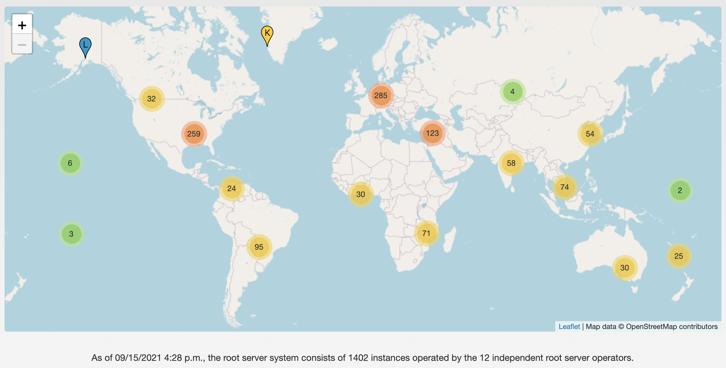
13 DNS root servers
https://root-servers.org/

Slide 32
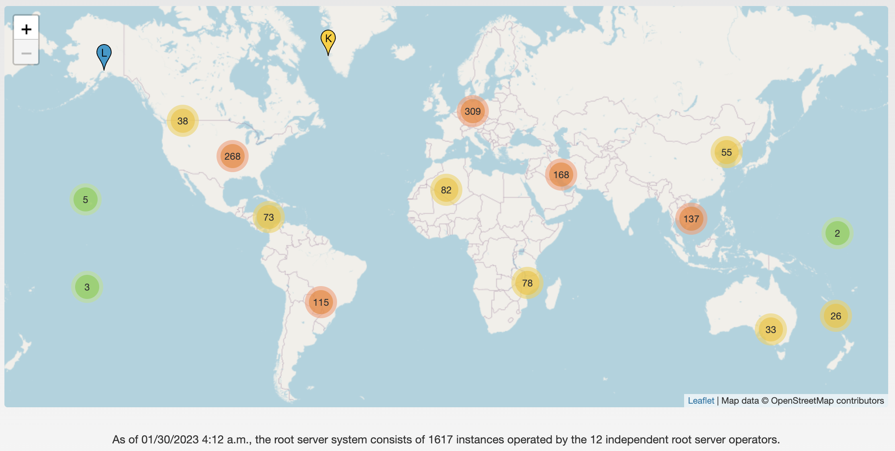
DNS root servers in 2023
https://root-servers.org/

Slide 33
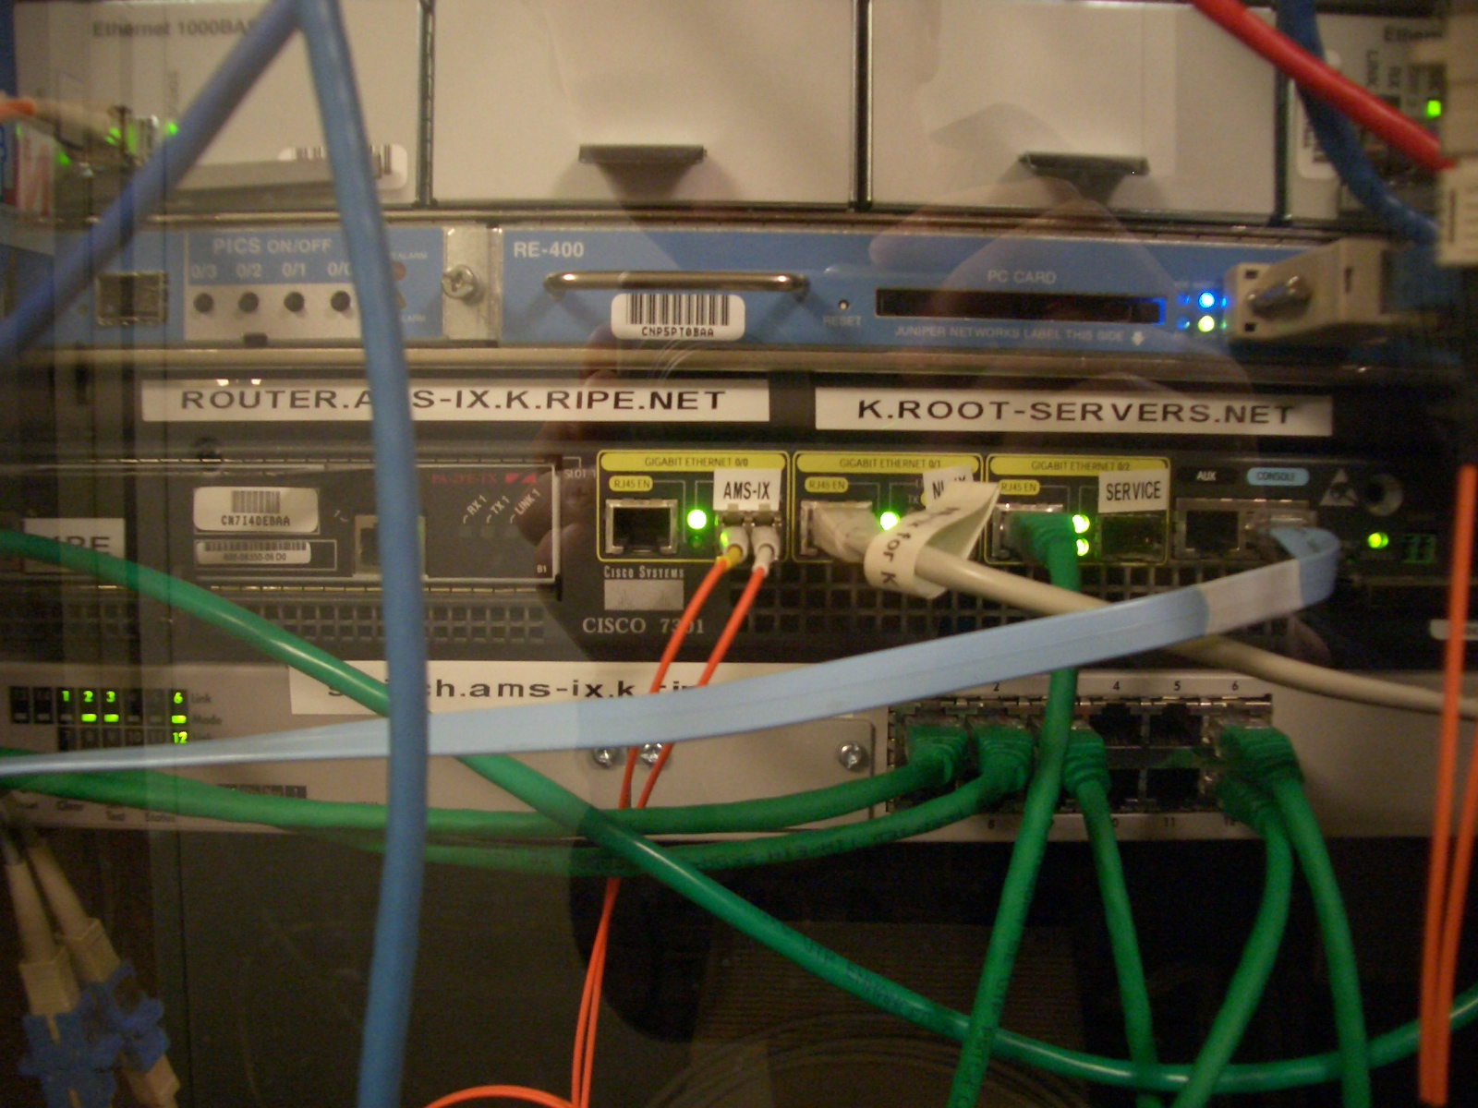
Root servers
https://www.iana.org/domains/root/servers
13 root servers, many instances for each
A Cisco 7301 router and a Juniper M7i, part of the K root-server instance at AMS-IX
Credit: https://commons.wikimedia.org/wiki/File:Ams-ix.k.root-servers.net.jpg

Slide 34
Start assignment 1 asap!

Slide 35
DNS records
DNS servers store resource records (RRs)
  RR is (name, value, type, TTL)
Type = A: (→ Address)
  name = hostname
  value = IP address
Type = NS: (→ Name Server)
  name = domain
  value = name of DNS server for domain

Slide 36
DNS records (cont’d)
Type = CNAME: (→ Canonical Name)
  name = alias name for some “canonical” (real) name
    e.g., cse.umich.edu is really cse.eecs.umich.edu
  value = canonical name
Type = MX: (→ Mail eXchanger)
  name = domain in email address
  value = name(s) of mail server(s)

Slide 37
Inserting Resource Records
Register foobar.com at registrar
  Provide registrar with names and IP addresses of your authoritative name server(s)
  Registrar inserts RR pairs into the .com TLD server:
    (foobar.com, dns1.foobar.com, NS)
    (dns1.foobar.com, 212.44.9.129, A)
Store resource records in your server dns1.foobar.com
  e.g., type A record for www.foobar.com
  e.g., type MX record for foobar.com

Slide 38
Using DNS (Client/App View)
Two components
  Local DNS servers
  Resolver software on hosts
Local DNS server (“default name server”)
  Clients configured with default server’s address OR learn it via a host configuration protocol (e.g., DHCP)
Client application
  Obtain DNS name (e.g., from URL)
  Do getnameinfo() to trigger DNS request to its local DNS server
Notes:
DHCP: Dynamic Host Configuration Protocol

Slide 39
dig
dig nyu.edu
; <<>> DiG 9.10.6 <<>> nyu.edu
;; global options: +cmd
;; Got answer:
;; ->>HEADER<<- opcode: QUERY, status: NOERROR, id: 47443
;; flags: qr rd ra; QUERY: 1, ANSWER: 1, AUTHORITY: 0, ADDITIONAL: 1
;; OPT PSEUDOSECTION:
; EDNS: version: 0, flags:; udp: 512
;; QUESTION SECTION:
;nyu.edu. IN A
;; ANSWER SECTION:
nyu.edu. 60 IN A 216.165.47.10
;; Query time: 39 msec
;; SERVER: 192.168.1.1#53(192.168.1.1)
;; WHEN: Fri Sep 10 08:21:43 EDT 2021
;; MSG SIZE rcvd: 52

Slide 40
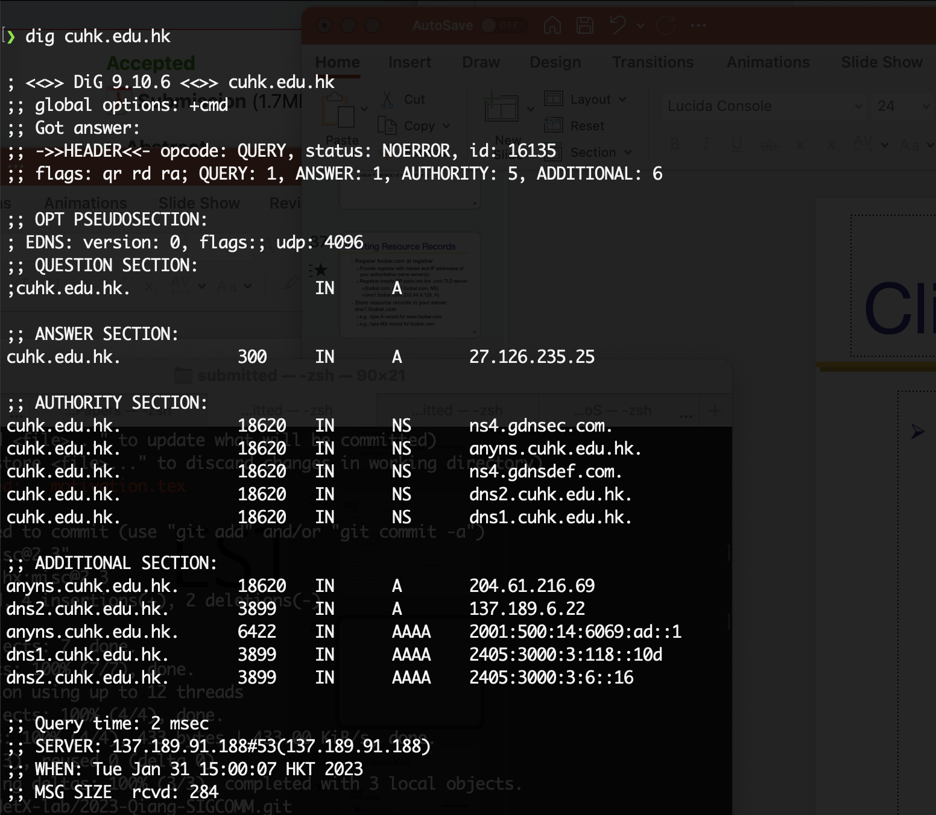
dig CUHK (2023)

Slide 41
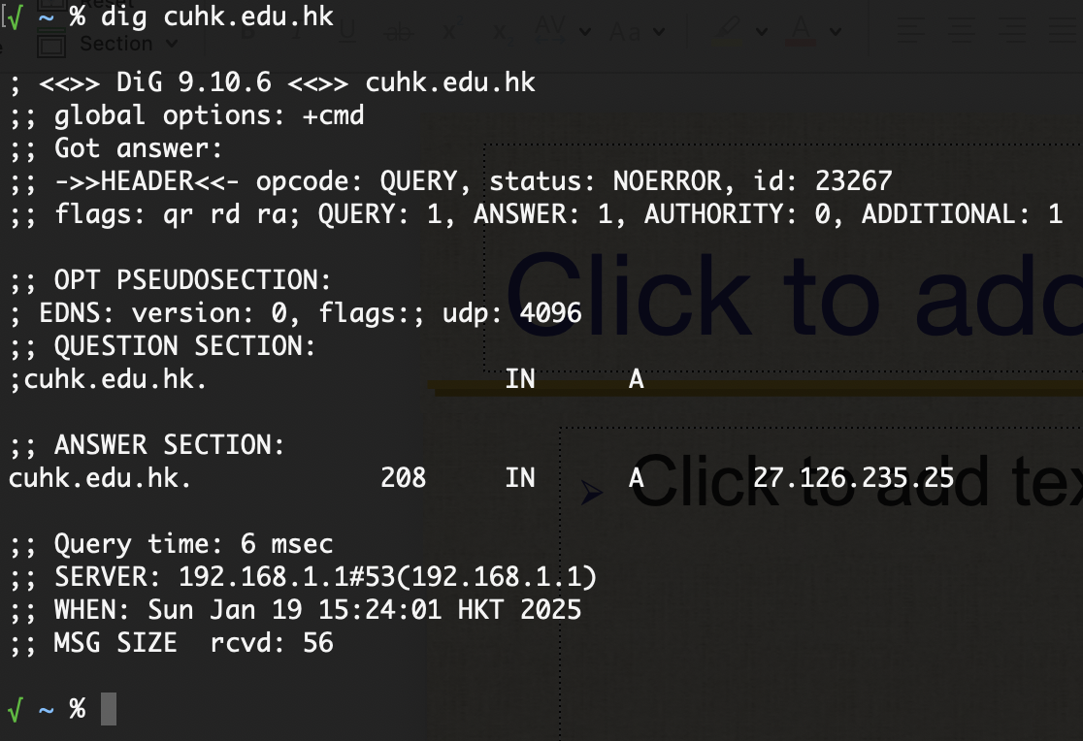
dig CUHK (2025)

Slide 42
Name resolution
root servers
local
DNS server
.edu servers
nyu.edu servers
DNS client
(me.cse.umich.edu)

Slide 43
Name resolution
root servers
local
DNS server
(mydns.umich.edu)
.edu servers
nyu.edu servers
www.nyu.edu?
DNS client
(me.cse.umich.edu)

Slide 44
Name resolution
root servers
local
DNS server
(mydns.umich.edu)
.edu servers
nyu.edu servers
www.nyu.edu?
DNS client
(me.cse.umich.edu)

Slide 45
Name resolution
root servers
local
DNS server
(mydns.umich.edu)
.edu servers
nyu.edu servers
www.nyu.edu?
DNS client
(me.cse.umich.edu)

Slide 46
Name resolution: Recursive
root servers
local
DNS server
(mydns.umich.edu)
.edu servers
nyu.edu servers
www.nyu.edu?
DNS client
(me.cse.umich.edu)

Slide 47
Name resolution: Iterative
root servers
local
DNS server
.edu servers
nyu.edu servers
www.nyu.edu?
DNS client
(me.cse.umich.edu)

Slide 48
Two ways to resolve a name
Recursive name resolution
  Ask server to do it for you
Iterative name resolution
  Ask server who to ask next
The iterative example we saw is a mix of both!

Slide 49
DNS protocol
Query and Reply messages; both with the same message format
  Header: identifier, flags, etc.
  Plus resource records
Client-server interaction on UDP Port 53
  Spec supports TCP too, but not always implemented

Slide 50
Goals: Are we there yet?
Uniqueness: No naming conflicts
Scalable
Distributed, autonomous administration
Highly available?

Slide 51
Reliability
Replicated DNS servers (primary/secondary)
  Name service available if at least one replica is up
  Queries can be load-balanced between replicas
Usually, UDP used for queries
  Reliability, if needed, must be implemented on UDP
Try alternate servers on timeout
  Exponential backoff when retrying same server
Same identifier for all queries
  Don’t care which server responds

Slide 52
Goals: Are we there yet?
Uniqueness: No naming conflicts
Scalable
Distributed, autonomous administration
Highly available
Fast lookups?

Slide 53
DNS caching
Performing all these queries takes time
  Up to 1-second latency before starting download
Caching can greatly reduce overhead
  The top-level servers very rarely change
  Popular sites (e.g., www.google.com) visited often
  Local DNS server often has the information cached
How DNS caching works
  DNS servers cache responses to queries
  Responses include a “time to live” (TTL) field
  Server deletes cached entry after TTL expires

Slide 54
TTL in dig output
dig nyu.edu
; <<>> DiG 9.10.6 <<>> nyu.edu
;; global options: +cmd
;; Got answer:
;; ->>HEADER<<- opcode: QUERY, status: NOERROR, id: 47443
;; flags: qr rd ra; QUERY: 1, ANSWER: 1, AUTHORITY: 0, ADDITIONAL: 1
;; OPT PSEUDOSECTION:
; EDNS: version: 0, flags:; udp: 512
;; QUESTION SECTION:
;nyu.edu. IN A
;; ANSWER SECTION:
nyu.edu. 60 IN A 216.165.47.10
;; Query time: 39 msec
;; SERVER: 192.168.1.1#53(192.168.1.1)
;; WHEN: Fri Sep 10 08:21:43 EDT 2021
;; MSG SIZE rcvd: 52
TTL
Notes:
60 Seconds

Slide 55
Negative caching
Remember things that do not work
  Misspellings like www.google.comm
  These can take a long time to fail the first time
  Good to remember that they do not work so the failure takes less time the next time around
Negative caching is optional
  Not widely implemented

Slide 56
Important properties of DNS
Administrative delegation and hierarchy enables:
  Easy unique naming
  Reasonable trust model
  Caching increases scalability and performance

Slide 57
DNS provides indirection
Addresses can change underneath
  Move www.cnn.com to 4.125.91.21
Name could map to multiple IP addresses
  Load-balancing (CDN)
  Reducing latency by picking nearby servers (CDN)
  Try out: dig google.com a few times
Multiple names for the same address
  E.g., many services (mail, www) on same machine
  E.g., aliases like www.cnn.com and cnn.com

Slide 58
Summary
CDNs improve web performance
  Via replication and caching
  Good server selection
DNS allows us to go to webpages without having to memorize IP addresses
  Allows a level of indirection that enables many functionalities including CDN server selection

