Slide 1
CSCI 4430 - Fall 23
Tutorial 10

Slide 2
Assignment 3
Due: Fri, 8th Dec, 11:59:59 p.m.
The deadline is close to the final exam time (11th Dec), so please arrange your time properly.

Slide 3
WTP: basis
 |  | WTP hdr | WTP data
 | UDP hdr | UDP data
IP hdr | IP data
Ethernet frame
Aim: a reliable transport protocol for file transfer
Packet types: START; END; DATA; ACK
Packet size
Ethernet frame upto 1500B
IP header 20B; UDP header 8B
WTP header 16B
type
seqNum
length
checksum
data
UDP header
IP header
4B
WTP header
WTP
4B
4B
4B
up to 1456B
1472B for the whole WTP with header and 1456B for WTP data only.

Slide 4
WTP: stages
Header format: <type, seqNum, length, checksum>
Initiate:
Sender: “I have something for you!” <START, R, 0, 0>
Receiver: “I am ready, please proceed.” <ACK, R, 0, 0>
Data transmission:
Sender: “Here is the i-th packet.” <DATA, i, LEN, SUM>
Receiver: “Got you, please send me the next packet (j-th packet).” <ACK, j, 0, 0>
Finish:
Sender: “That’s all there is for file R” <END, R, 0, 0>
Receiver: “I have saved it.” <ACK, R, 0, 0>
Special note:
initiate and finish stages use the same random seqNum R
unrelated to data packets
to mark the begin and end of the same file
seqNum in ACK packet is the next packet to be expected just like TCP (base part)
seqNum begin at 0 and increment by 1 for each packet in sender when transferring data
In compulsory part, receiver can just send one cumulative ACK after receiving all packets in a window rather than ACK for each packet

Slide 5
WTP: sliding window
Initially
Send a window of packets
When see a new ACK
Advance the window by how many pkt acked (could > 1: cumulative ack)
Send new packets covered by the window

Slide 6
WTP: sender
Special Cases Strategy
Packet Loss: retransmission timer
Reordered/delayed/duplicated ACK:
Ignore if the ACKed packet is not in the sliding window in the sender
Otherwise retransmit the desired packet
Implementation of retransmission timer
Use a timestamp to record packet sending time.
After sending, then wait for ACK receiving, check the time from timestamp to now.
If the time does not exceed timeout when receiving ACK, then:
Move sliding window and send new packet in window
Update timestamp when sending new data packet
If the time exceed timeout, then: re-transmit the un-ACKed data.

Slide 7
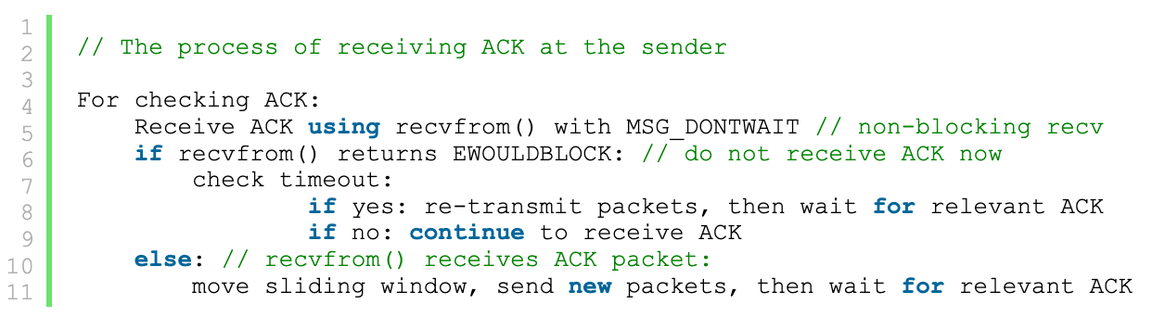
Hint: non-blocking recv in sender
recvfrom() is a blocking function
Consider a special situation: the ACK packet is lost, and sender cannot receive it anymore.
We cannot check timeout if the process is blocked at checking ACK!
We should use the loop of non-blocking recv while checking timeout.
non-bloacking recv: recvfrom with flag MSG_DONTWAIT
If the operation would block, recvfrom() returns EWOULDBLOCK.
Is possible that I miss some ACK packet?
No, if you did not receive anything in current loop, you will eventually get them in the next few loops.

Slide 8
WTP: receiver
Special Cases Strategy
Packet Corruption: drop and do not ACK the packet if calculated checksum is wrong.
Reordered/delayed/duplicated packets:
Maintain the sender’s sliding window range in receiver.
Ignore and do not ACK if the packet’s seqNum is not in the sliding window.
Only receive and send ACK for the packets with sequential seqNum.

Slide 9
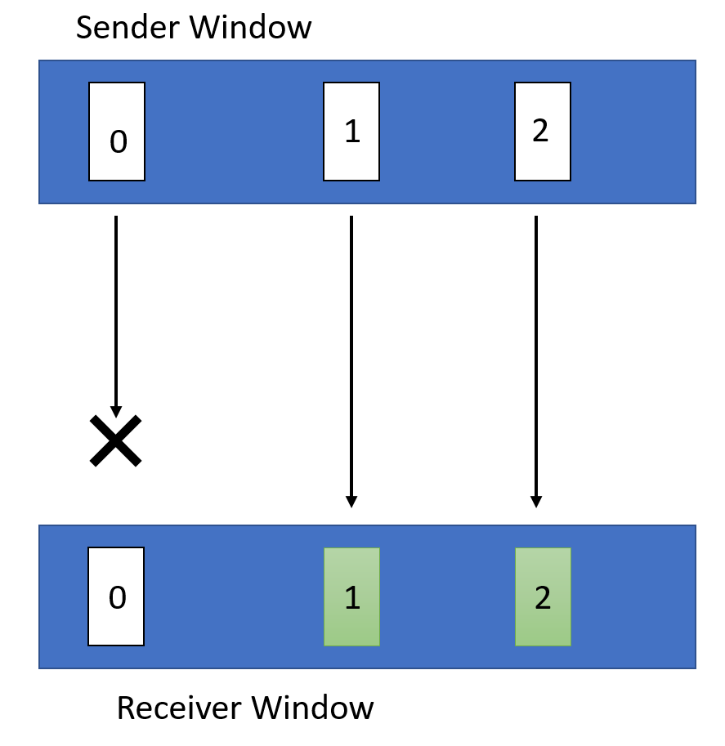
WTP: Optimization
Only re-transmit the un-received packets in sliding window.
Sender window and Receiver window are both 0~2 now.
Now there is a packet loss for packet 0.

Slide 10
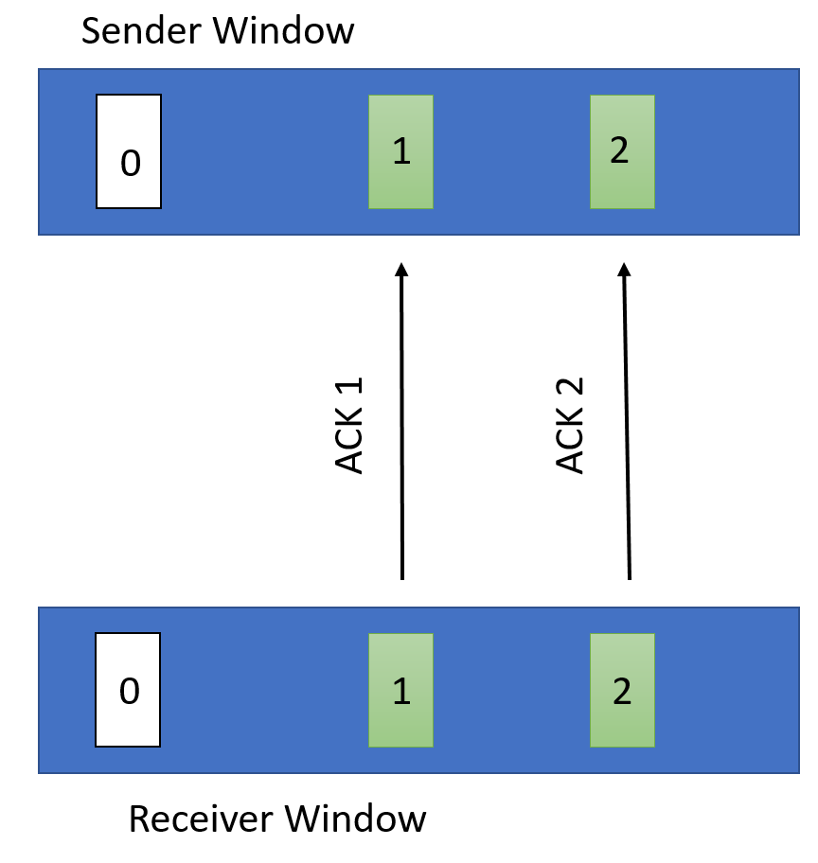
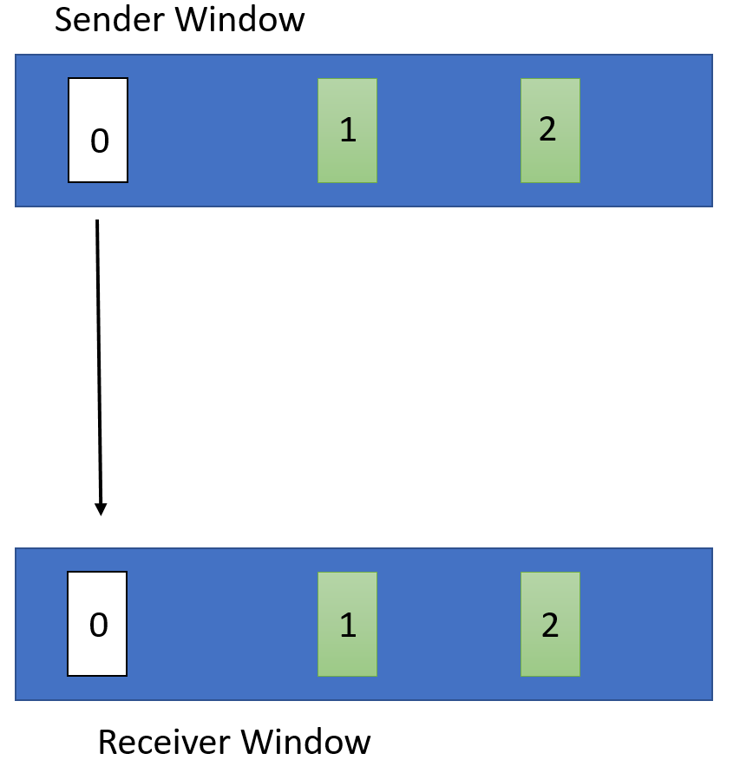
WTP: Optimization
Buffer packet 1 and 2 in the receiver window and send every corresponding ACK back so that we do not need to re-transmit the entire 1~2 as before.
The sender suffer timeout of packet 0, so it only retransmit packet 0.

Slide 11
WTP: Optimization - Receiver
Send ACK back for every packet immediately after buffered/received.
seqNum of ACK will be the same value as the received packet instead of the next expected packet.
Sliding window also move according to the sent sequential ACK.

Slide 12
WTP: Optimization - Sender
Track all Acks within its current window.
Resent un-ACKed packets in current window after timeout.
Sliding window also move according to the received sequential ACK.

Slide 13
Assignment 3 Q & A
Please refer to the Github Webpage for more detailed implementation hints.
Note: the base part of WTP is not the typical Go-Back-N method (we do not ACK for every received packet), please follow the information in Github Webpage and this tutorial strictly for implementation.
Quiz: Please Specify your SID and name in uReply.

Slide 14
Thanks!

