Slide 1
CSCI4430 Computer Networks Lecture 1: Intro and Overview
Hong Xu, Henry
CSE@CUHK, 2025
Material with thanks to Mosharaf Chowdhury, Aditya Akella, Sugih Jamin, Philip Levis, Sylvia Ratnasamy, Peter Steenkiste, Keith Winstein, and many others.

Slide 2
Agenda
Introduction
Class policies, logistics, and roadmap
Overview of the basics
How is the network shared?
How do we evaluate a network?

Slide 3
Course websites
Course materials:
https://github.com/henryhxu/CSCI4430
Discussions, Q&A, announcements:
https://piazza.com/cuhk.edu.hk/fall2025/csci4430estr4120
Marks:
https://blackboard.cuhk.edu.hk/ultra/courses/_221611_1/cl/outline

Slide 4
About me: Hong Xu, Henry
Ph.D. from Toronto
B.Eng. from IE@CUHK, 2003–2007, NA College
Research areas: Computer networks, ML systems
https://henryhxu.github.io/
Research opportunities available
Office hours: Mon 9–10am, Tue 1–2pm
By appointment (via Piazza private messages)

Slide 5



TA team
Yicheng (head TA), Yangtao, Shaofeng
Office hours: check course website
No office hours this week
Yicheng
Yangtao
Shaofeng

Slide 6
Prerequisites
CENG3150/CSCI3150, or equivalent OS courses
If you haven’t taken it or have failed it, you are advised NOT to take this course
Talk to me if you are not sure
Comfortable with C/C++ programming
Comfortable with Linux

Slide 7
What is this course about?
The question: How can computers communicate?
Well, slightly simpler than communication among people…
Two machines => link
Multiple machines => network
Multiple networks => Inter-network => Internet!
What it’s NOT about
How to design web pages
How to write web services
…

Slide 8
What is a network?
A system of “links” that interconnect “nodes” in order to move “information” across
We will focus primarily on the Internet

Slide 9
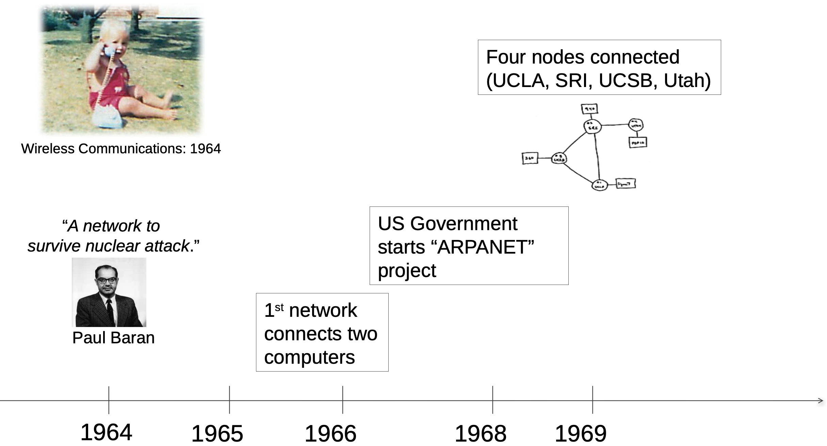

Slide 10
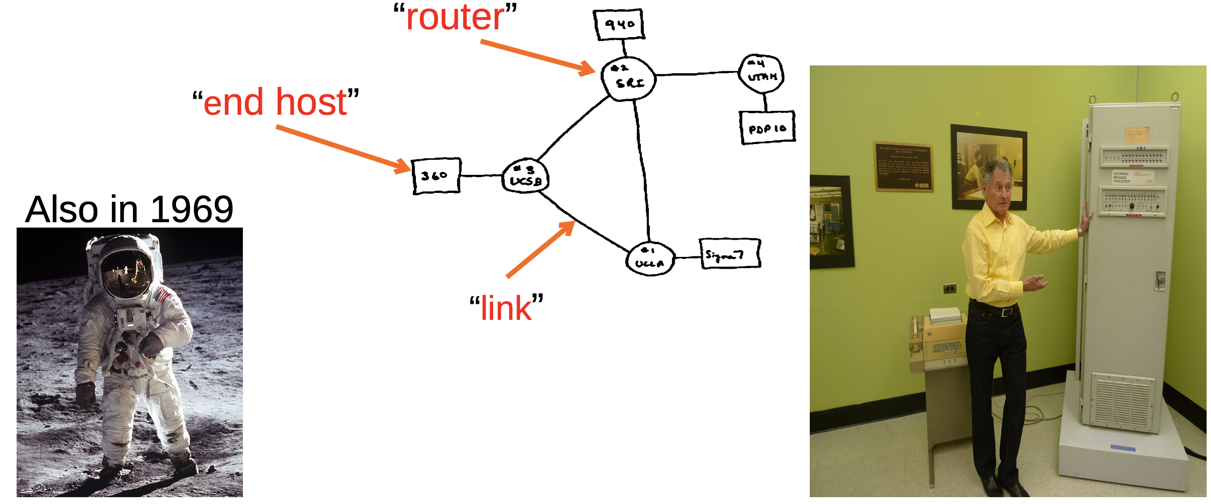
The Internet in 1969

Slide 11
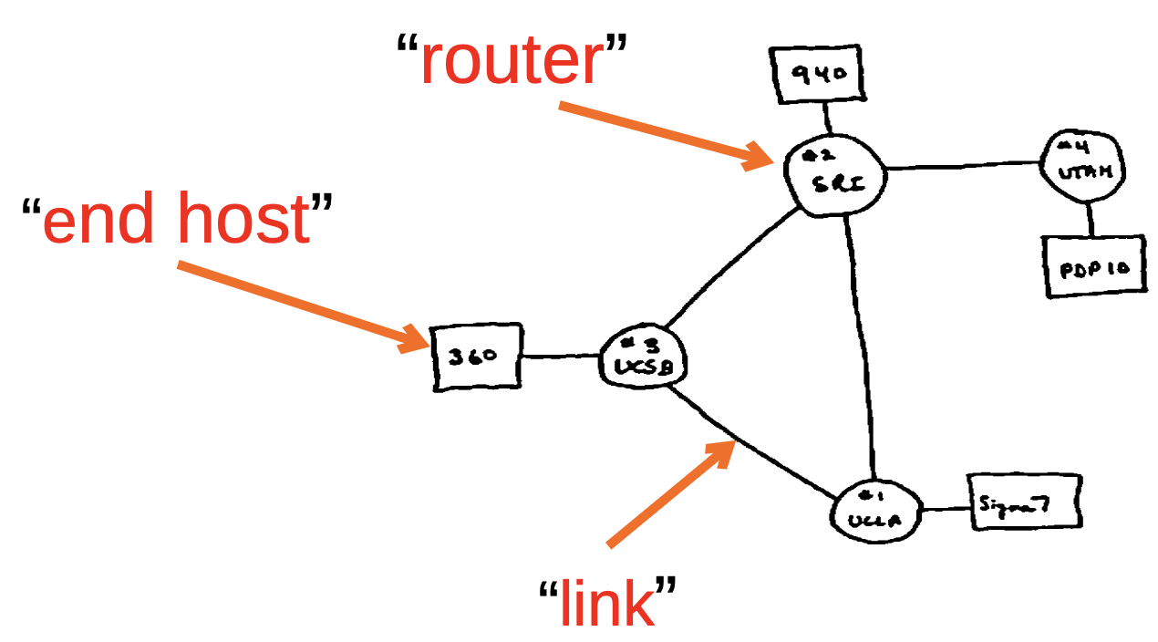
What did they use it for?
Sending files between scientists: “Here’s a big file of astronomy data!”
Email: “Where shall we have lunch today?”
Remote login to another computer

Slide 12
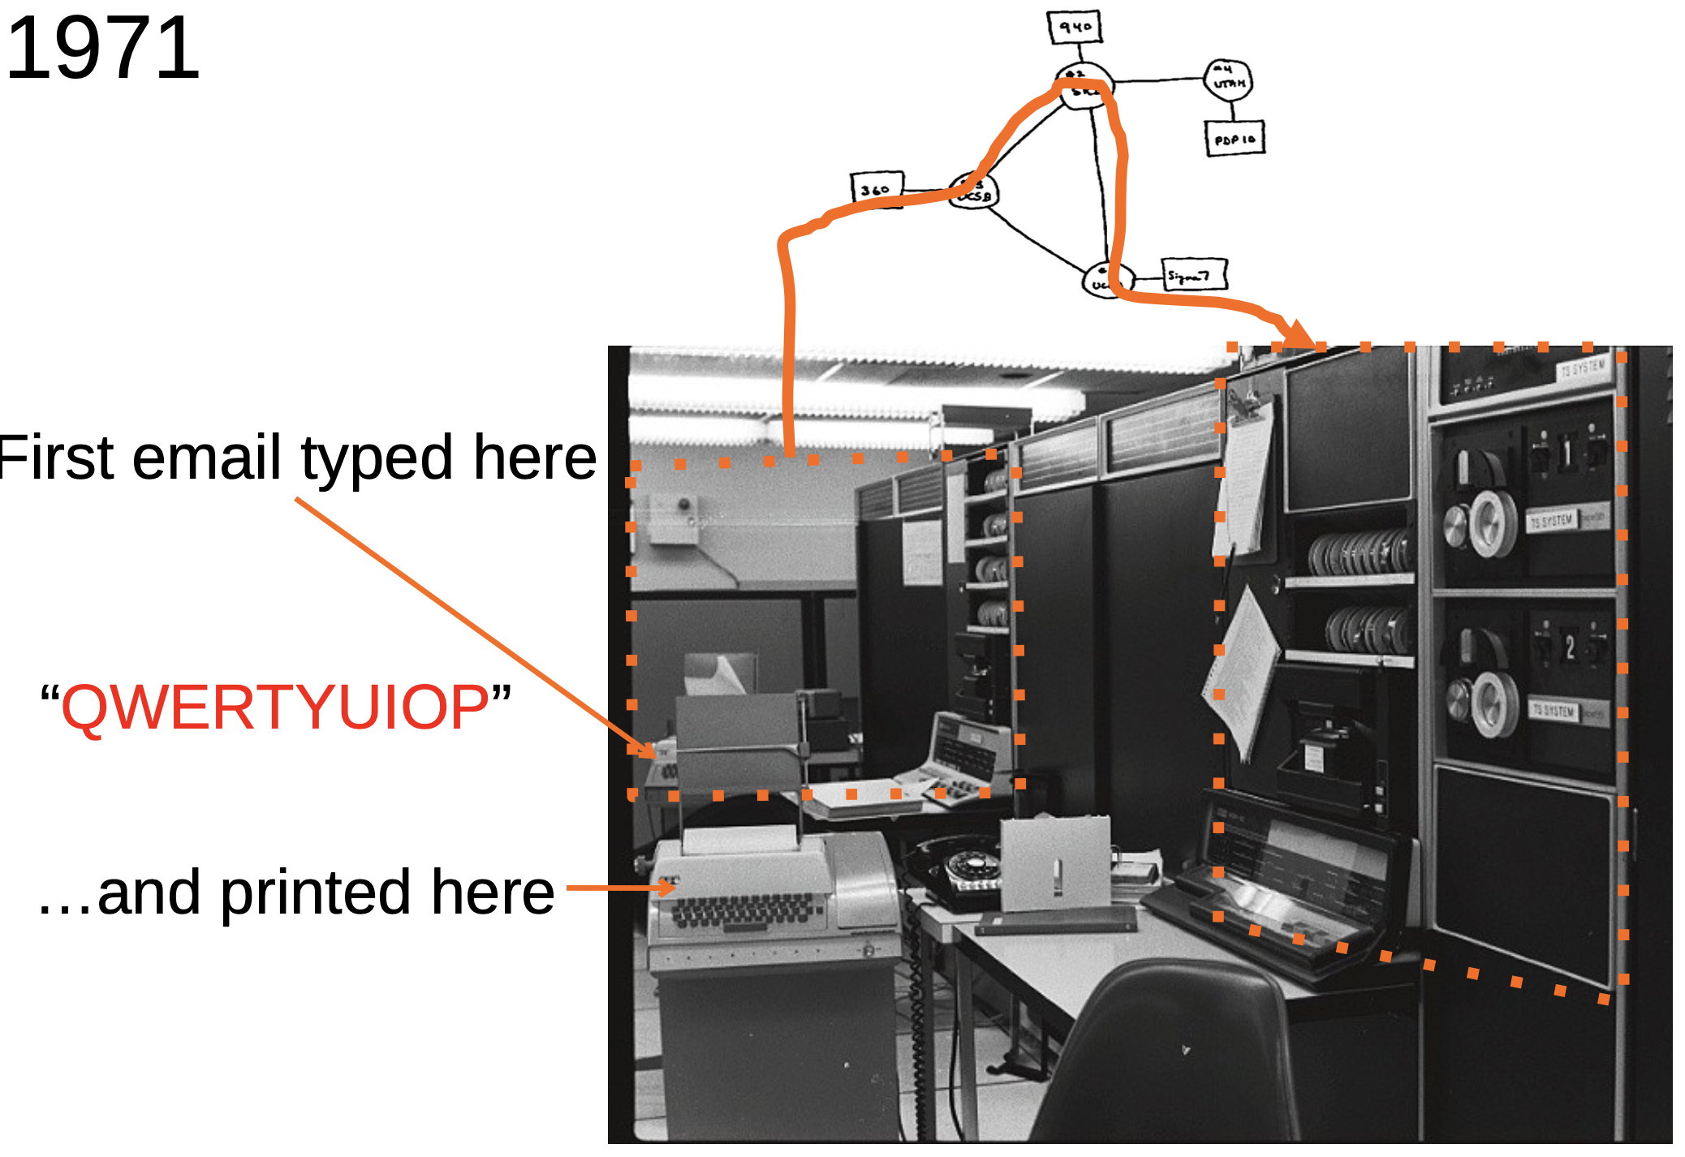
1971

Slide 13




TCP/IP, HTTP, Web browser
TCP, 1974, Vint Cerf & Robert Kahn
HTTP, 1989,
Tim Berners-Lee
Mosaic, 1993,
Marc Andreessen

Slide 14
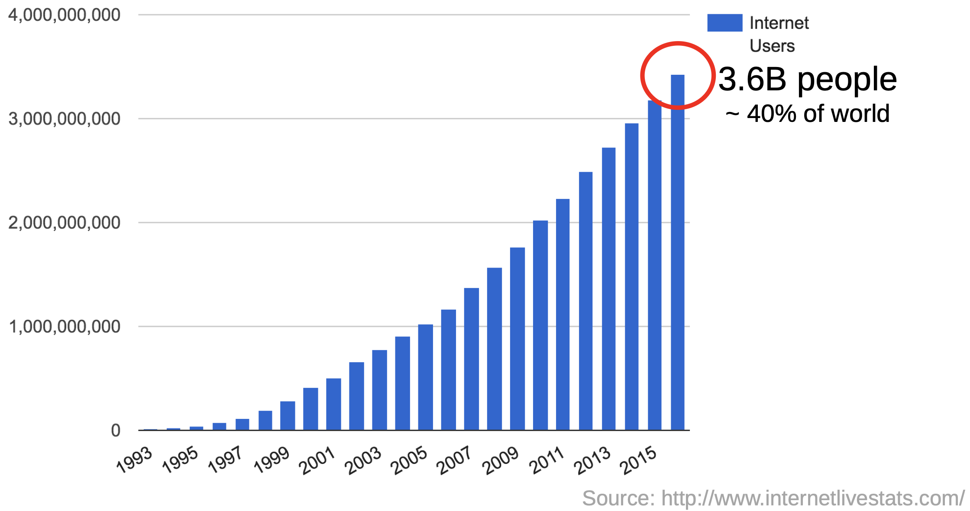
How does it evolve – Now

Slide 15
How does it all work?
Why was it designed this way?

Slide 16
Isn’t it really difficult…?
CSCI 4430

Slide 17
Our goals
To learn how the Internet works.
To learn why the Internet was designed this way.
To learn how to use the Internet.
To build some significant pieces of the Internet.
To learn the underlying principles and technologies of networking.

Slide 18
What you will learn
The whole stack of layers; details of each layer
Computer network (or the Internet) evolution follows a bottom-up pattern naturally
But you will learn it in a top-down manner
It’s important to keep this difference in mind; many confusions can be understood by remembering this discrepancy
Answer this question: what happens when you enter google.com in your browser

Slide 19
A little preview…
Quite different from other CS fields
No unifying framework or theory
“just a bag of protocols”
HTTP, IMAP, RTSP, DNS, TCP, UDP, IP, BGP, OSPF, ARP, DHCP, CSMA/CD, …
There is no right or wrong!
Learn the design philosophy and tradeoffs, more than anything else
There is good and bad design!

Slide 20


Design matters
Good design
Bad design

Slide 21
Internet evolution
Insights shared by Dahming Chiu through our emails
Three phases:
First ~20 years (till 1990s): need for a global infrastructure, with decentralized management, simple/robust but evolvable technology --> layered architecture, decentralized routing, simple congestion control, etc
Next ~20 years (till 2010s): different services: easy publishing/searching, social media, e-commerce, content distribution/streaming, management, expanding size --> HTTP, CDN/p2p, SDN, IPv6, etc

Slide 22
Internet evolution
Three phases:
Next ~20 years (till 2030s): Big data, centralization of services, AI etc -> IoT, cloud computing, AI fabrics, Interconnect, etc.
This courses focuses on the first phase
ESTR 4120 will cover more about the 2nd and 3rd phases

Slide 23
Class workload
Three programming assignments
First one is an individual assignment
The rest are in groups of 2
May have bonus parts
Quizzes
Randomly pick 5 tutorials to have quiz
MC or simple calculation, takes <3min
Midterm
Final exam

Slide 24
Assessment
 | Allocation
Assignment 1 | 10%
Assignment 2 | 15%
Assignment 3 | 20%
Quizzes | 5%
Midterm | 10%
Final Exam | 40%
Bonus in assignments | X%

Slide 25
Assignments (tentative)
Assignment 1: measure end-to-end throughput and delay of networks (i.e., simple speed test)
Assignment 2: video streaming from CDNs (i.e., simple Netflix)
Assignment 3: reliable transport (i.e., how to transfer data over an unreliable network)

Slide 26
Communication protocol
Piazza for all communication
Sign up code “4430_rocks!”
Do NOT email me or the TA! We may not respond
Use private messages for private matters
Only email us when you’re emailed to
Assignment submission via an autograder
Start forming groups
Details will be sent out soon

Slide 27
Other policies
Details on the course webpage
Don’t cheat
https://www.erg.cuhk.edu.hk/erg/AcademicHonesty
Consult this booklet from our faculty
https://www.erg.cuhk.edu.hk/erg/sites/default/files/Disciplinary_Booklet_2024-25%20(final).pdf

Slide 28
Let’s Talk Internet

Slide 29
The Internet consists of many end-systems
car navigator
sensor
smartphone
end-system
tablet
Linux server
MAC laptop
Windows PC

Slide 30
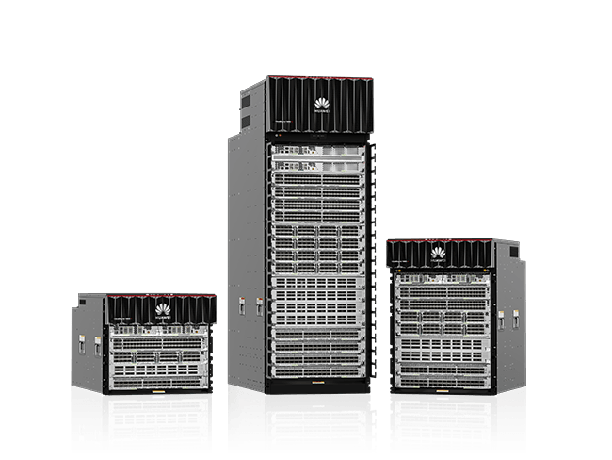
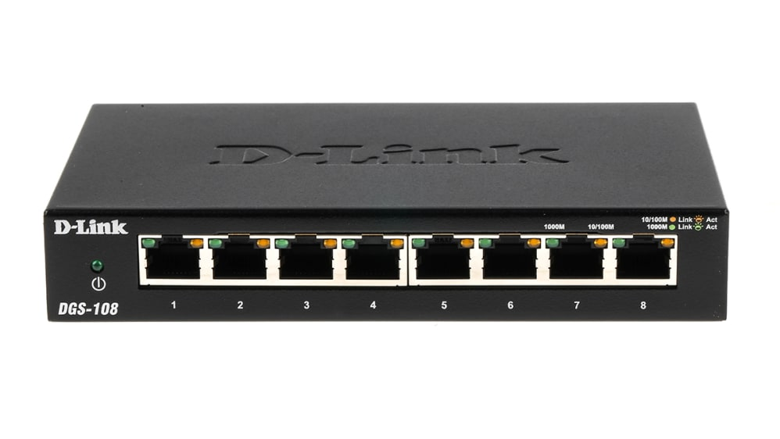
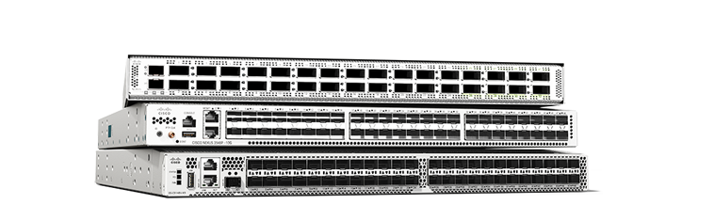
Connected by switches
end-system
switch

Slide 31
And links
link
phone lines
end-system
switch
fibers
wireless links
cable TV lines

Slide 32
Managed by many parties
link
phone company
end-system
switch
university net
cable company
Internet Service Provider

Slide 33

Transfers data
link
end-system
switch
path
data
Internet Service Provider

Slide 34
A federated system
The Internet ties together different networks by the IP protocol
A common interface binds them all together
HKBN
PCCW
China Mobile

Slide 35
Connecting everyone
Any two end-hosts (anywhere!) can talk to each other via the Internet
Q: how to connect millions of millions of nets?
…
access
net
access
net
…
access
net
access
net
access
net
access
net
access
net
…
…
access
net
access
net
access
net
access
net
access
net
…
access
net
access
net
access
net
access
net
…

Slide 36

Connecting everyone
…
…
access
net
access
net
access
net
access
net
access
net
access
net
access
net
connecting each network to each other directly doesn’t scale: O(N²) connections.
…
…
access
net
access
net
access
net
access
net
access
net
access
net
…
access
net
access
net
…
access
net

Slide 37
Solution: Switched networks
End-systems and networks connected by switches instead of directly connecting them
Why?
Allows us to scale!
…
access
net
access
net
…
access
net
access
net
access
net
access
net
access
net
…
…
access
net
access
net
access
net
access
net
access
net
…
access
net
access
net
access
net
access
net
…

Slide 38
When do we need to share the network?
Switch and link resources

Slide 39



Shared among many services
Xiaohongshu server
Netflix server
Zoom client
Zoom client
Firefox accessing instagram
Netflix client

Slide 40
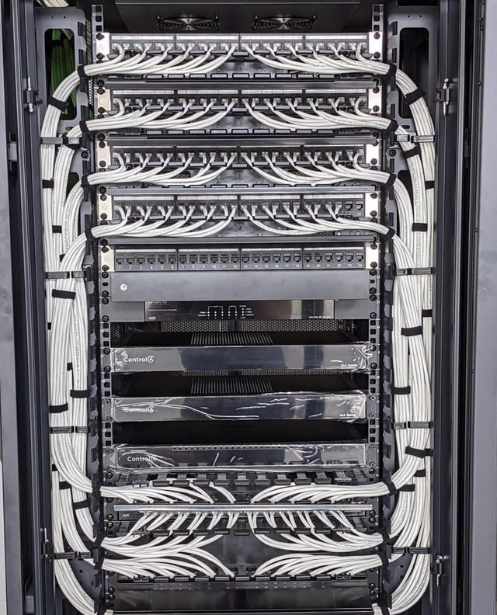
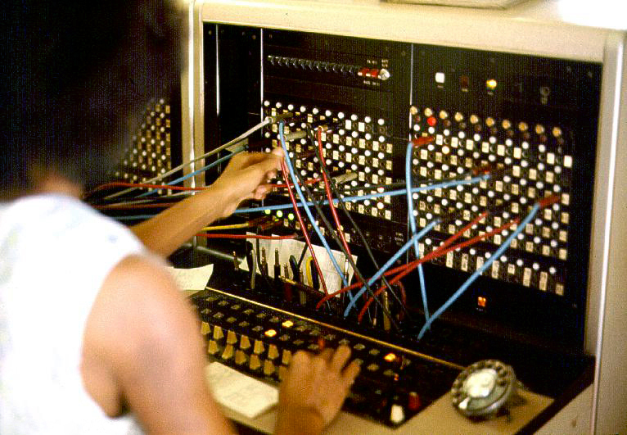
Two ways to share
Circuit switching
Resource reserved per connection
Packet switching via statistical multiplexing
Packets treated independently, on-demand

Slide 41
Circuit switching
src sends reservation request to dst
Switches create circuit after admission control
src sends data
src sends teardown request
More details in backup
dst
✔️
10 Mbps?
10 Mbps?
✔️
src

Slide 42
Circuit switching
Reservation establishes a “circuit” within a switch
switch
src
dst

Slide 43
Circuit switching
Pros
Predictable performance
Simple/fast switching (once circuit established)
Cons
Complexity of circuit setup/teardown
Circuit setup adds delay
Switch fails → its circuit(s) fails
Extremely inefficient when traffic is bursty!
Think: Are you always clicking?

Slide 44
Packet switching
Each packet contains destination (dst)
Each packet treated independently
switch
dst

Slide 45
Packet switching
Each packet contains destination (dst)
Each packet treated independently
With buffers to absolve transient overloads
switch
dst

Slide 46
Packet switching
Pros
Efficient use of network resources
Simpler to implement
Robust: can “route around trouble”
Cons
Unpredictable performance
Requires buffer management and congestion control

Slide 47
Statistical multiplexing
Allowing more demands than the network can handle
Hoping that not all demands are required at the same time
Results in unpredictability
Works well except for the extreme cases

Slide 48
MASSIVE Scale
4.6 Billion users
>1.8 Billion websites
>200 Billion emails sent per day
>2.5 Billion smartphones
>2.7 Billion Facebook users
>1 Billion hours of YouTube watched per day
Routers that switch 10 Terabits/second
Links that carry 400 Gigabits/second
Notes:
https://www.internetlivestats.com

Slide 49
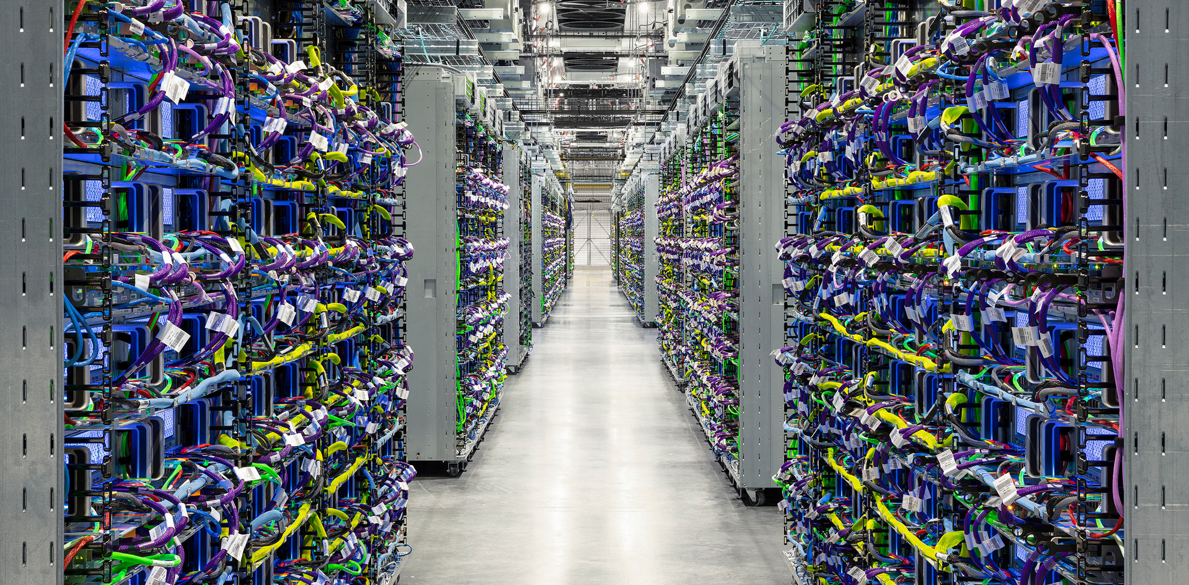
Google’s TPU cluster (pod)

Slide 50
Have we found the right solution?
We don’t really know…
What we do know
The early Internet pioneers came up with a solution that was successful beyond all imagining
Several enduring architectural principles and practices emerged from their work
Still, it is just one design with many questions

Slide 51
The Internet is a lesson
In how to reason through the design of a very complex system
What are our goals and constraints?
What’s the right prioritization of goals?
How do we decompose a problem?
Who does what? How?
What are the interfaces between components?
What are the tradeoffs between design options?

Slide 52
How do we evaluate a network?

Slide 53
Performance metrics
Delay
Loss
Throughput

Slide 54
Delay
How long does it take to send a packet from its source to destination?

Slide 55
Delay
Consists of four components
Transmission delay
Propagation delay
Queuing delay
Processing delay
due to link properties
due to traffic mix and
switch internals

Slide 56

A network link
Link bandwidth
Number of bits sent/received per unit time (bits/sec or bps)
Propagation delay
Time for one bit to move through the link (seconds)
BDP, bandwidth-delay product
bandwidth
delay x bandwidth
Propagation delay

Slide 57
1. Transmission delay
How long does it take to push all the bits of a packet into a link?
Packet size / Transmission rate of the link
E.g., 1000 bits / 100 Mbits per sec = 10⁻⁵ sec

Slide 58
2. Propagation delay
How long does it take to move one bit from one end of a link to the other?
Link length / Propagation speed of link
E.g., 30 kilometers / 3*10⁸ meters per sec = 10⁻⁴ sec

Slide 59

Packet delay Sending a 100-byte packet
A
B
1Mbps, 1ms
100Byte packet
time=0
Time to transmit one bit = 1/10⁶s
Time when that bit reaches B = 1/10⁶+1/10³s
Time to transmit 800 bits=800x1/10⁶s
The last bit reaches B at
(800x1/10⁶)+1/10³s
= 1.8ms
Time

Slide 60
Packet delay Sending a 100-byte packet
A
B
1Gbps, 1ms
100Byte packet
time=0
Time to transmit one bit = 1/10⁹s
Time when that bit reaches B = 1/10⁹+1/10³s
Time to transmit 800 bits=800x1/10⁹s
The last bit reaches B at
(800x1/10⁹)+1/10³s
= 1.0008ms
Time

Slide 61
Sending a large file using 100-byte packets
A
B
1Gbps, 1ms
100Byte packet
100Byte packet
100Byte packet

Slide 62
Pipe view of a link
Transmission delay decreases as bandwidth increases
transmission delay
bandwidth
time

Slide 63
3. Queuing delay
How long does a packet have to sit in a buffer before it is processed?

Slide 64

Queuing delay: “pipe” view

Slide 65
Queueing delay: “pipe” view
No overload!

Slide 66
Queueing delay: “pipe” view
Queue
Transient Overload
Not a rare event!

Slide 67
Queueing delay: “pipe” view
Queue
Transient Overload

Slide 68
Queueing delay: “pipe” view
Queue
Transient Overload

Slide 69
Queueing delay: “pipe” view
Queue
Transient Overload

Slide 70
Queueing delay: “pipe” view
Queue
Transient Overload

Slide 71
Persistent overload leads to packet drop/loss
Queue

Slide 72
Queueing delay
How long does a packet have to sit in a buffer before it is processed?
Depends on traffic pattern
Arrival rate at the queue
Nature of arriving traffic (bursty or not?)
Transmission rate of outgoing link

Slide 73
Queueing delay
How long does a packet have to sit in a buffer before it is processed?
Characterized with statistical measures
Average queuing delay
Variance of queuing delay
Probability delay exceeds a threshold value

Slide 74
Basic queueing theory terminology
Arrival process: how packets arrive
Average rate A
W: average time packets wait in the queue
W for “waiting time”
L: average number of packets waiting in the queue
L for “length of queue”

Slide 75

Little’s Law (1961)
L = A x W
Compute L: count packets in queue every second
Why do you care?
Easy to compute L, harder to compute W
Notes:
Row vs column

Slide 76
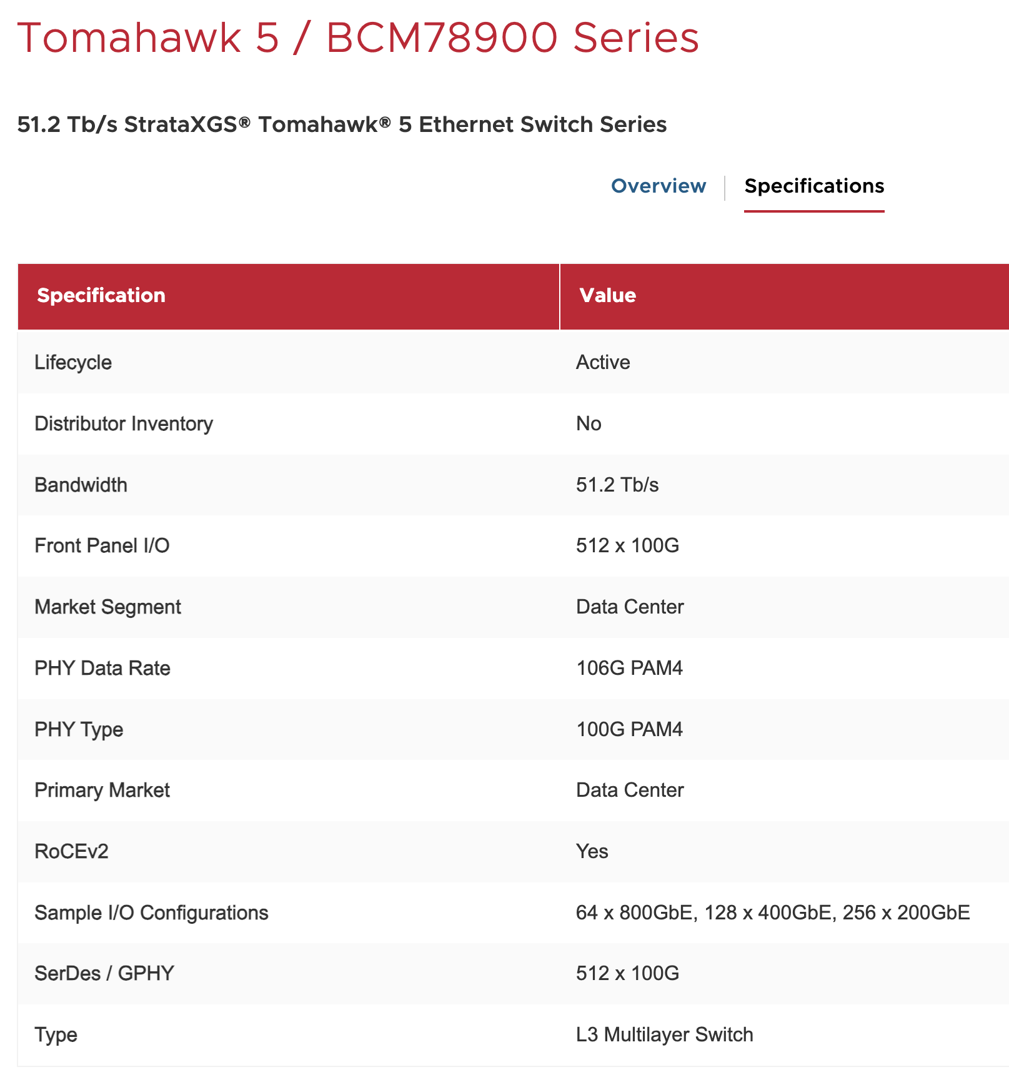
4. Processing Delay
How long does the switch take to process a packet?
Negligible

Slide 77
End-to-end delay
transmission
propagation
queueing
processing
transmission
propagation
queueing
processing
transmission
propagation

Slide 78
Round Trip Time (RTT)
Time for a packet to go from a source to a destination and to come back
Why do we care?
Measuring delay is hard from one end
RTT/2 equals average end-to-end delay
Why not exact?

Slide 79
Loss
What fraction of the packets sent to a destination are dropped?

Slide 80
Throughput
At what rate is the destination receiving data from the source

Slide 81
Throughput
Transmission rate R bits/sec
File of size F bits
Packets of size L bits
Transfer time (T) =
F/R + propagation delay
F/T ≈ R
Average throughput =

Slide 82
End-to-end throughput
Transmission rate R
Transmission rate R’ > R
File of size F bits
Packets of size L bits
bottleneck link
Average throughput =
min{R, R’} = R

Slide 83
Summary
How is the network shared?
On-demand or via reservation
How do we evaluate a network?
Bandwidth, delay, loss, …
BDP
See backup slides

Slide 85
A network link: BDP
Link bandwidth
Number of bits sent/received per unit time (bits/sec or bps)
Propagation delay
Time for one bit to move through the link (seconds)
Bandwidth-Delay Product (BDP)
Number of bits “in flight” at any time
BDP = bandwidth × propagation delay
bandwidth
delay x bandwidth
Propagation delay

Slide 86
BDP Examples
Same city over a slow link:
Bandwidth: ~100Mbps
Propagation delay: ~0.1msec
BDP: 10,000bits (1.25KBytes)
Cross-country over fast link:
Bandwidth: ~10Gbps
Propagation delay: ~10msec
BDP: 10⁸bits (12.5MBytes)

