Slide 1
CSCI4430 Computer Networks
Lecture 14: Network Layer –
Software-Defined Networking
Hong Xu, Henry
CSE@CUHK, 2025
Material with thanks to Patrick Lee, Mosharaf Chowdhury, Aditya Akella, Sugih Jamin, Philip Levis, Sylvia Ratnasamy, Peter Steenkiste, and many other colleagues.

Slide 2
Agenda
Software-defined networking
Programmable networks

Slide 3
The field of networking
Networking is largely the study of the Internet
  Maybe not today…
  Perhaps the only history class many will take in CS

Slide 4
Building an artifact, not a discipline
Other fields in “systems”: OS, DB, etc.
  Teach basic principles
  Are easily managed
  Continue to evolve
Networking:
  Teach a big bag of protocols
  Notoriously difficult to manage
  Evolves very slowly
Networks are much more primitive and less understood than other computer systems

Slide 5
A tale of two planes
Data plane: forwarding packets
  Based on local forwarding state
Control plane: computing that forwarding state
  Involves coordination with rest of system

Slide 6
Original goals for the control plane
Basic connectivity: route packets to destination
  Local state computed by routing protocols
  Globally distributed algorithms
Inter-domain policy: find policy-compliant paths
  Done by globally distributed BGP
What other goals are there in running a network?

Slide 7
Extended roles of the control plane
Performs various network management tasks
  For example,
    Where to route?
    How much to route?
    At what rate to route?
    Should we route at all?
    …

Slide 8
Bottom line
Many different control plane mechanisms
Each designed from scratch for their intended goal
Encompassing a wide variety of implementations
  Distributed, manual, centralized,…
None of them particularly well designed
Network control plane is a complicated mess!

Slide 9

“The Power of Abstraction”
“Modularity based on abstraction is the way things get done”
  Barbara Liskov, Turing Award (2008）
Abstractions ➔ Interfaces ➔ Modularity

Slide 10
Analogy: Mainframe to PC evolution
Vertical integration, closed
Open interfaces
Specialized application
Specialized operating system
Specialized hardware
Arbitrary applications
Commodity operating systems
Microprocessor
We want the same for networking!

Slide 11
Many control plane mechanisms
Variety of goals, no modularity
  Routing: distributed routing algorithms
  Isolation: ACLs, Firewalls,…
  Traffic engineering: adjusting weights,…
Control Plane: mechanism without abstraction
  Too many mechanisms, not enough functionality

Slide 12
Traditional fully decentralized control plane
Individual routing algorithm components in every router interact in the control plane
Control
Plane
Data
Plane
Dst | Next Hop
UMICH | 0
UCB | 0
MIT | 0
NYU | 0
111010010
MIT

Slide 13
Logically centralized control plane
A distinct (typically remote) controller interacts with local control agents (CAs)
Remote Control
Control
Plane
Data
Plane
Dst | Next Hop
UMICH | 0
UCB | 0
MIT | 0
NYU | 0
111010010
MIT

Slide 14
Logically centralized control plane
A distinct (typically remote) controller interacts with local control agents (CAs)
Each router contains a flow table
Each entry of the flow table defines a match-action rule
Entries of the flow table is computed and distributed by the (logically) centralized controller

Slide 15
Task: Compute forwarding state
Consistent with low-level hardware/software
  Which might depend on vendor
Based on entire network topology
  Because many control decisions depend on topology
For all routers/switches in network
  Every router/switch needs forwarding state

Slide 16
Separate concerns with abstractions
Be compatible with low-level hardware/software
  Forwarding abstraction
Make decisions based on entire network
  Network state abstraction
Compute configuration of each physical device
  Specification abstraction

Slide 17
#1: Forwarding abstraction
Express intent independent of implementation
  Don’t want to deal with proprietary HW and SW
Design details concern exact nature of:
  Header matching
  Allowed actions

Slide 18
#2: Network state abstraction
Abstraction: global network view
  Annotated network graph provided through an API
Creates a logically centralized view of the network (Network Operating System)
  Runs on replicated servers in network (“controllers”)
Information flows both ways
  Information from routers/switches to form “view”
  Configurations to routers/switches to control forwarding

Slide 19
#3: Specification abstraction
Control mechanism expresses desired behavior
  Whether it be isolation, access control, or QoS
It should not be responsible for implementing that behavior on physical network infrastructure
  Requires configuring the forwarding tables in each switch
Abstract view of network
  Models only enough detail to specify goals
  Will depend on task semantics

Slide 20
Each goal is an app via specification abstraction
What if an operator wants X?
What if a customer wants to do weighted traffic splitting?
…
There is an app for it!
  Write your own routing protocol, load balancing algorithm, access control policies

Slide 21
Reason about each app via network state abstraction
Now that the network is not distributed anymore and is a simple graph, we can verify the correctness of whatever we specified

Slide 22
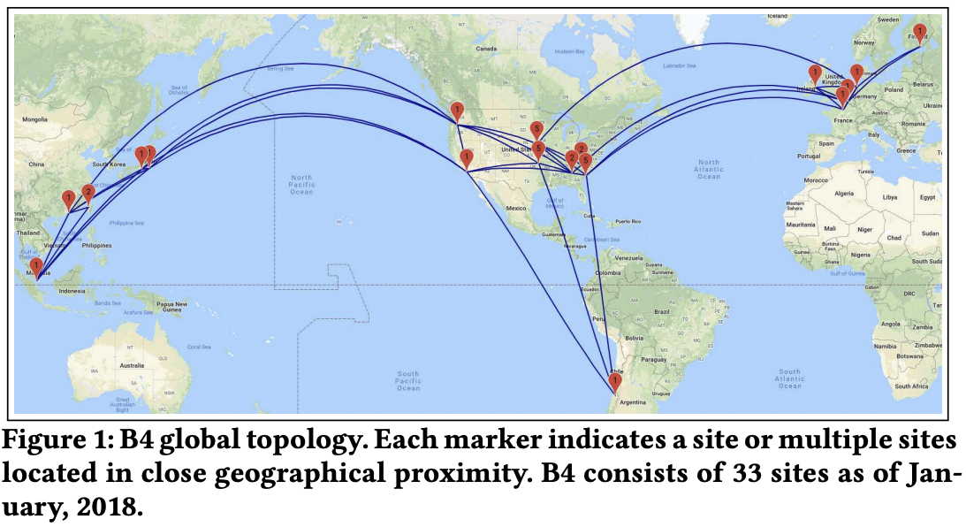
Progress in wide-area networks (WAN)
Google and Microsoft use SDN to manage traffic between datacenters
One centralized controller to rule the entire world (well, their world)

Slide 23
A tale of two planes
Data plane: forwarding packets
  Based on local forwarding state
Control plane: computing that forwarding state
  Involves coordination with rest of system

Slide 24
OpenFlow data plane abstraction
Flow is defined by header fields
Generalized forwarding: simple packet-handling rules
  Pattern: match values in packet header fields
  Actions: for matched packet: drop, forward, modify, matched packet or send matched packet to controller
  Priority: disambiguate overlapping patterns
  Counters: #bytes and #packets
src=1.2.*.*, dest=3.4.5.* → drop
src = *.*.*.*, dest=3.4.*.* → forward(2)
3. src=10.1.2.3, dest=*.*.*.* → send to controller

Slide 25
OpenFlow: Flow table entries
Rule
Action
Stats
Packet + byte counters
Forward packet to port(s)
Encapsulate and forward to controller
Drop packet
Send to normal processing pipeline
Modify Fields
Switch
Port
VLAN
ID
MAC
src
MAC
dst
Eth
type
IP
Src
IP
Dst
IP
Prot
TCP
sport
TCP
dport
Link layer
Network layer
Transport layer
Notes:
Now I’ll describe the API that tries to meet these goals.
25

Slide 26
Forwarding abstraction
Match + Action: unifies different kinds of devices
Router
  Match: longest destination IP prefix
  Action: forward out a link
Switch
  Match: destination MAC address
  Action: forward or flood
Firewall
  Match: IP addresses and TCP/UDP port numbers
  Action: permit or deny
NAT
  Match: IP address and port
  Action: rewrite address and port

Slide 27
OpenFlow protocol
Operates between controller, switch
TCP used to exchange messages
  Optional encryption
Three classes of OpenFlow messages:
  Controller-to-switch
  Asynchronous (switch to controller)
  Symmetric (misc.)
OpenFlow Controller

Slide 28
Fixed-function data plane
Traditional switches are fixed-function
  They can do whatever they can do at birth, but they cannot change!
  Bottom-up design
Even OpenFlow was designed to be a fixed protocol
  With a fixed table format
  Capable of doing limited things

Slide 29
Takes forever to get a feature
Feature
Software
Team
Feature
Network Owner
Network Equipment Vendor
Weeks
Feature
ASIC
Team
Years
Years

Slide 30
Programmable data plane
What if we could tell switches exactly what we want?
  What table to keep?
  What rules to use?
  What data to keep track of?
  …

Slide 31
Top-down approach
Precisely specify what you want to do and how you want a packet to be processed
table int_table {
reads {
ip.protocol
}
actions {
export_queue_latency
}
}
action export_queue_latency (sw_id) {
add_header(int_header);
modify_field(int_header.kind, TCP_OPTION_INT);
modify_field(int_header.len, TCP_OPTION_INT_LEN);
modify_field(int_header.sw_id, sw_id);
modify_field(int_header.q_latency,
intrinsic_metadata.deq_timedelta);
add_to_field(tcp.dataOffset, 2);
add_to_field(ipv4.totalLen, 8);
subtract_from_field(ingress_metadata.tcpLength, 12);
}

Slide 32
What’s left?
Compile it down to be something runnable on a programmable switch
  Similar to other high-level languages we use to run code on hardware like CPU, GPU, FPGA etc.
  P4 for programmable switches
But which switch?

Slide 33
PISA: Protocol Independent Switch Architecture
Programmer declares which
headers are recognized
Programmer declares what
tables are needed and how packets are processed
Match + Action
Memory
ALU
Programmable
Parser
All stages are identical – makes PISA a good “compiler target”

Slide 34
How’s programmability used today?
Remove features to reduce complexity
Add proprietary features
Silicon independence or avoid vendor lock-in
Telemetry and measurements

Slide 35
Example: In-band network telemetry (INT)
“Which path did my packet take?”
“Which rules did my packet follow?”
“How long did it queue at each switch?”
“Who did it share the queues with?”

Slide 36
Why now?
One of the earlier incarnation of programmable networks was in mid 90s
  Active networks
What’s changed after two+ decades?
  Hardware: We can now make programmable switches as fast as fixed ones
  Software: We have found a (so far) reasonable balance between programmability, performance, and security

Slide 37
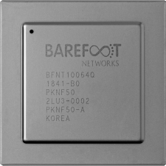
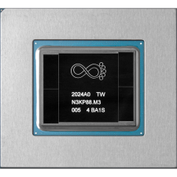
Why not now?...
Barefoot Networks was the company that designs programmable switching chips. Founded in 2013
Acquired by Intel at 2019
In Jan 2023, Intel announced it has halted production of the chips…

Slide 38
Summary
Abstractions beget modularity
  Modularity is (almost always) good
Programmability is powerful
  Finding the right balance is hard

Slide 39
Additional slides

Slide 40
Traffic engineering
Want to avoid persistent overloads on links
Choose routes to spread traffic load across links

Slide 41

Traffic engineering: Difficult
5
3
v
w
5
2
u
2
1
z
3
1
2
x
y
1
Q: What if network operator wants u-to-z traffic to flow along uvwz, x-to-z traffic to flow xwyz?
A: Need to define link weights so traffic routing algorithm computes routes accordingly (or need a new routing algorithm)!
Link weights are only control “knobs”
Notes:
Note: implicit assumption here: destination based forwarding

Slide 42
Traffic engineering: Difficult
5
3
v
w
5
2
u
2
1
z
3
1
2
x
y
1
Q: What if network operator wants to split u-to-z traffic along uvwz and uxyz (load balancing)?
A: Can’t do it (or need a new routing algorithm)
Notes:
Note: implicit assumption here: destination based forwarding

Slide 43
Traffic engineering: Difficult
5
3
v
w
5
2
u
2
1
z
3
1
2
x
y
1
Q: What if w wants to route the two flows differently?
A: Can’t do it (with LS or DV)
Notes:
Note: implicit assumption here: destination based forwarding

Slide 44
OpenFlow: Controller-to-switch messages
Key controller-to-switch messages
  Features: controller queries switch features, switch replies
  Configure: controller queries/sets switch configuration parameters
  Modify-state: add, delete, modify flow entries in the OpenFlow tables
  Packet-out: controller can send this packet out of specific switch port

Slide 45
OpenFlow: Switch-to-controller messages
Key switch-to-controller messages
  Packet-in: transfer packet (and its control) to controller. See packet-out message from controller
  Flow-removed: flow table entry deleted at switch
  Port status: inform controller of a change on a port
Network operators do not “program” switches by creating/sending OpenFlow messages directly.
  Instead, they use higher-level abstraction at controller

