Slide 1
CSCI 4430 - Spring 25
Tutorial 2
Credits to Umich EECS 489 Discussion 2

Slide 2
Outline
Socket Programming Revisiting
Performance Metrics - Delay
Performance Metrics - Throughput
Exercise 1
Exercise 2

Slide 3
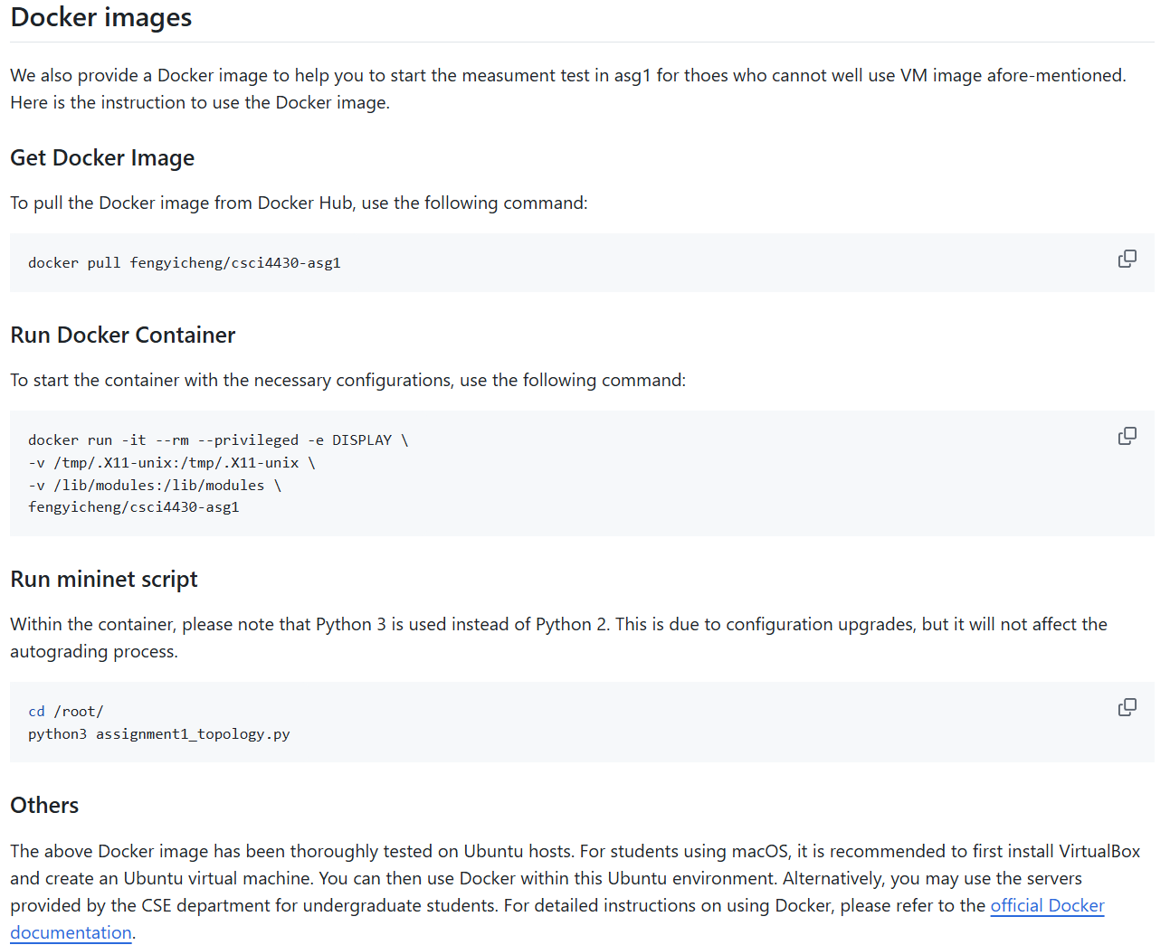
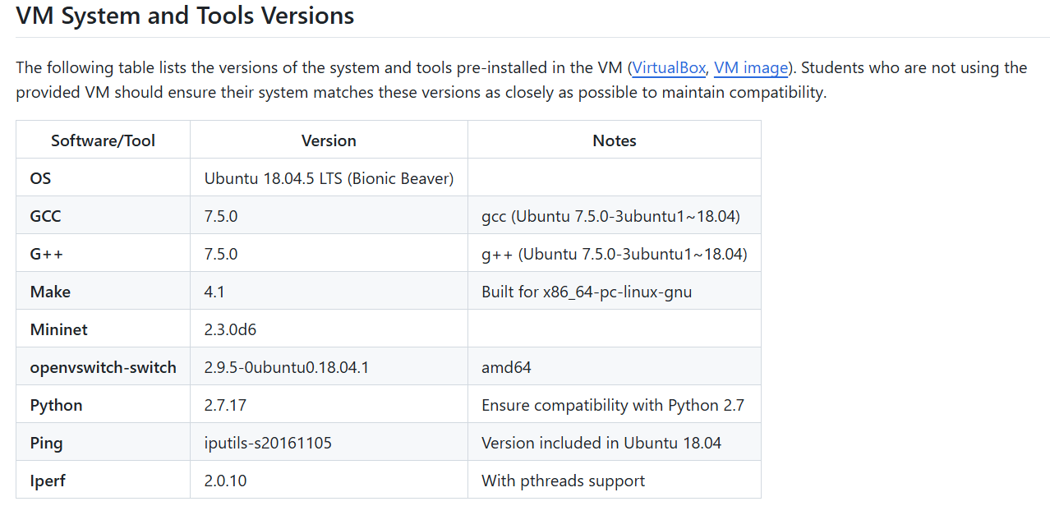
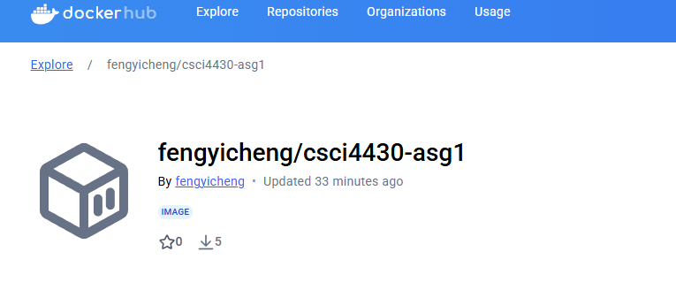

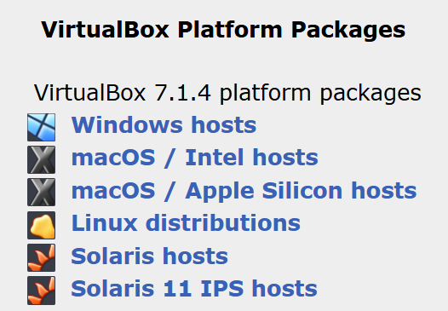
Assignment 1
Due: 11:59:59 p.m., Sat, Jan. 25th

Slide 4
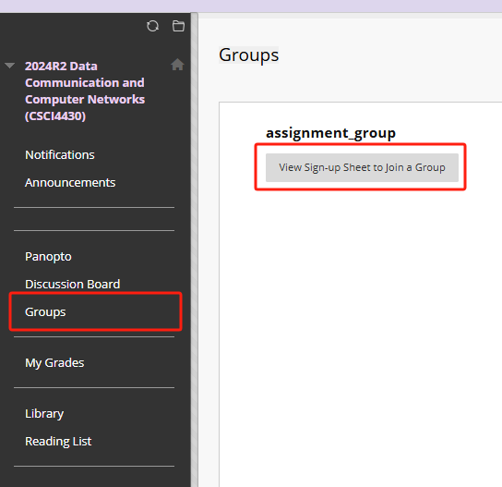
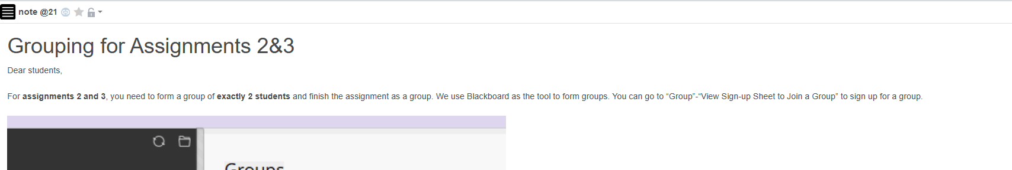
Assignment 2&3 Group
The deadline for grouping is 23:59:59, Jan. 24th 2025, the next Friday.
For assignments 2 and 3, you need to form a group of exactly 2 students and finish the assignment as a group. We use Blackboard as the tool to form groups.
More information, plz check Piazza announcement: https://piazza.com/class/m5g5xzrpiad38y/post/21

Slide 5
Socket Programming: Complete Flow
Server
Client

Slide 6
Socket Programming: Client Side
read()
socket()
bind()
connect()
write()
Client flow chart
Step (1). socket()
- Create a socket.
read() – to receive data.
write() – to send data.
close() – to close the socket
Step (2). bind() [optional]
- Assign the socket a port number.
- Skip this step and will have a random port number assigned.
Important System calls
Client side | Server side
socket()
bind()* | bind()
connect() | listen() and accept()
Step (3). connect()
- Connect to the remote server.
- It is a blocking system call.
* means optional.

Slide 7
Socket Programming: Server Side
socket()
bind()
listen()
read()
Server flow chart
accept()
write()
Step (1) & Step(2) [ you know them now. ]
read() – to receive data.
write() – to send data.
close() – to close the socket
Step (3). listen()
- It sets the port to be listening to incoming connections, for TCP only.
Important System calls
Client side | Server side
socket()
bind()* | bind()
connect() | listen() and accept()
Step (4). accept()
- Accept incoming connections.
- A blocking system call.
* means optional.

Slide 8
Socket Programming: Complete Flow
Socket FD
socket()
bind()
listen()
Accept FD
Socket FD
Socket FD
connection #1
read() & write()
accept()
Socket FD
Accept FD
connection #n
read() & write()
Server flow chart
An interesting thing about accept() is the creation of a new file descriptor!
Application layer’s point of view.
Good! It provides each connection a new handler and we can distinguish every connection!
Transport layer’s point of view.
Well, for TCP, every FD points to a unique TCP control structure. It is a necessary for reliable data transfer!

Slide 9
Socket Programming: Complete Flow
socket()
bind()
listen()
accept()
New connection arrives
connection is closed.
Server flow chart
Application-layer code
Limitation:
Only supports a single client!
read()
&
write()
Application-layer code
DONE!
socket()
bind()
connect()
close()
exit()
Client flow chart
9

Slide 10
Socket Programming: Server Parallelization
socket()
bind()
listen()
accept()
New connection arrives
parent
Server main
flow chart
fork() or pthread_create()
child
Server client-handler flow chart
exit() or
pthread_exit()
Application-layer code
connection is closed.
Notes:
The flow starts similarly: the server creates a socket with socket(), binds it to an address with bind(), and begins listening for connections with listen().
When a client connects, the accept() call returns a new file descriptor. But instead of processing the client request directly, the server creates a child process or thread to handle the connection. This can be done using fork() for creating processes or pthread_create() for threads.
The parent process remains in the listening loop, ready to handle additional client connections.
This approach enables the server to handle multiple clients concurrently, without one client blocking others. It is widely used in real-world servers, and understanding its principles will help you build more scalable applications.

Slide 11
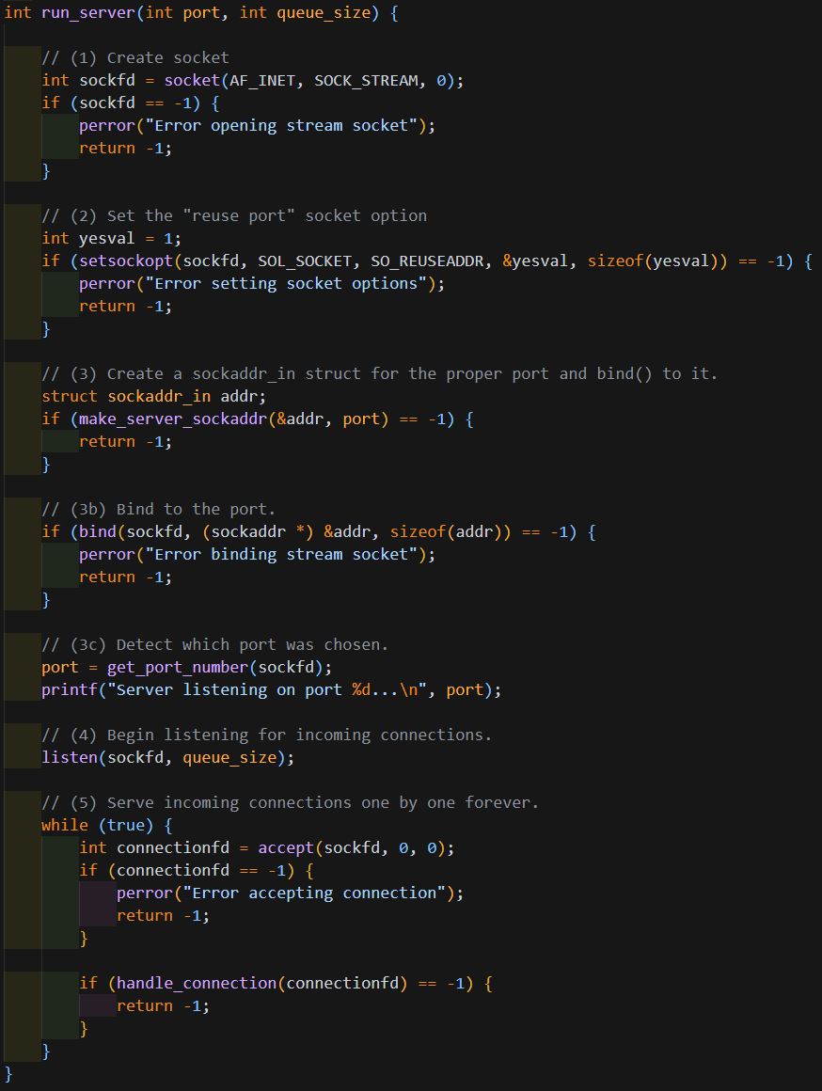
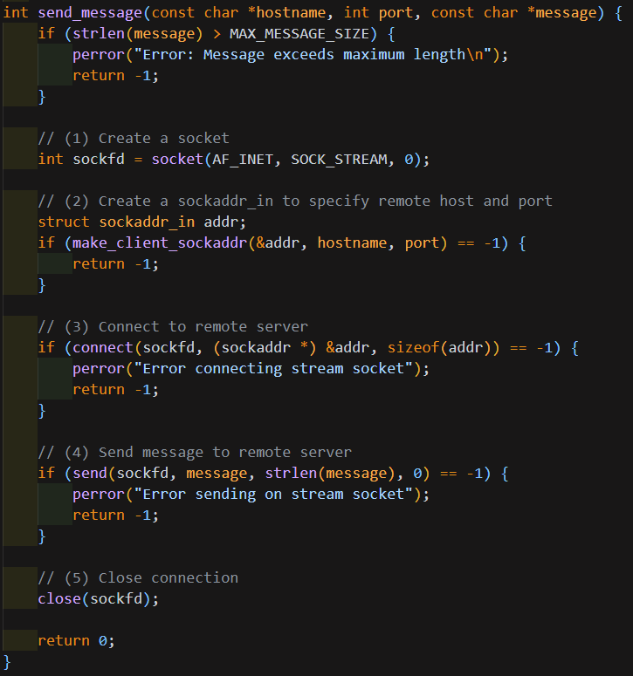
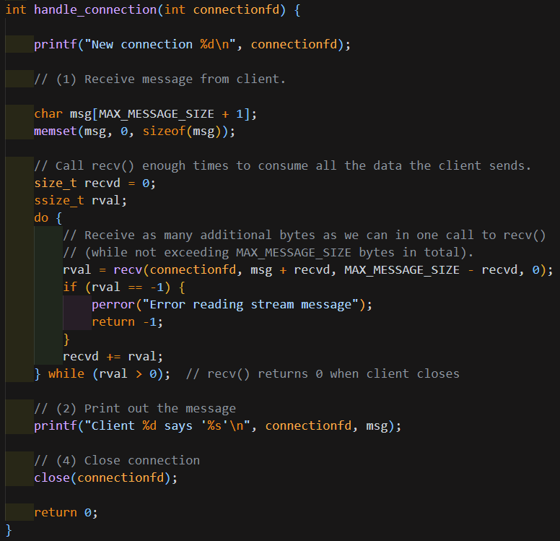
Socket Programming: C++ Demo
Server-side
Server-side
Client-side
https://github.com/henryhxu/CSCI4430/tree/2025_spring/tutorial/T01/bgreeves-socket-example

Slide 12
Performance Metrics - Delay
Link properties
Transmission delay
Propagation delay
Sender
Receiver
Propagation delay
Transmission delay

Slide 13
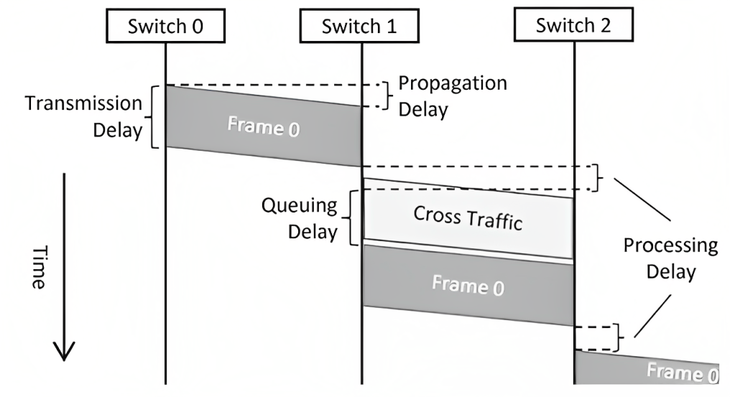
Performance Metrics - Delay
Traffic mix and switch internals
Queuing delay
Processing delay (negligible?)
[1] Graphical_Description_of_Network_Delay.png (428×233) (wikimedia.org)

Slide 14
Performance Metrics - Throughput
Throughput = Data transferred / Transfer time
Transfer time = transmission delay + propagation delay

Slide 15
Exercise - Q1
Suppose a 100-Mbps point-to-point link is being set up between Earth and a new lunar colony.
The distance from the moon to Earth is approximately 385,000 km, and data travels over the link at the speed of light = 3∗10^8 m/s.
(a) Calculate the minimum RTT(round-trip time) for the link.
propagation delay = 385000 km / (3 * 10^5 km/s) = 1.28333s
RTT = 2 * propagation delay = 2 * 1.28333 = 2.56666s

Slide 16
Exercise - Q1
Suppose a 100-Mbps point-to-point link is being set up between Earth and a new lunar colony.
The distance from the moon to Earth is approximately 385,000 km, and data travels over the link at the speed of light = 3∗10^8 m/s.
(b) Suppose Mission Control on Earth wishes to download a 25MB (1MB = 10^6B) image from a camera on the lunar base. What is the minimum amount of time that will elapse between when the request for the data goes out and the transfer is finished? Throughput?
transmission delay = 25MB / 100Mbps = 25 * 8 / 100 = 2s
Transfer time = RTT (propagation delay) + transmission delay = 2.5666 + 2 = 4.5666s
Throughput = 25MB * 8 / (2s + 1.28333s) = 60.9 Mbps

Slide 17
Exercise - Q1
Suppose a 100-Mbps point-to-point link is being set up between Earth and a new lunar colony.
The distance from the moon to Earth is approximately 385,000 km, and data travels over the link at the speed of light = 3∗10^8 m/s.
(c) The maximum number of flying bits on the link?
# bits = propagation delay * bandwidth
= 1.28333s * 100Mbps = 1.28333 * 10^8

Slide 18
Exercise - Q2
Calculate the latency (from first bit sent to last bit received) for the following:
(a) A 10-Mbps link with a single store-and-forward switch in the path, and a packet size of 5,000 bits. Assume that each section of the link introduces a propagation delay of 10 microseconds, and that the switch begins retransmitting immediately after it has finished receiving the packet.
(5000 b / 10Mbps + 10us) * 2 = 1.02ms
sender
switch
receiver

Slide 19
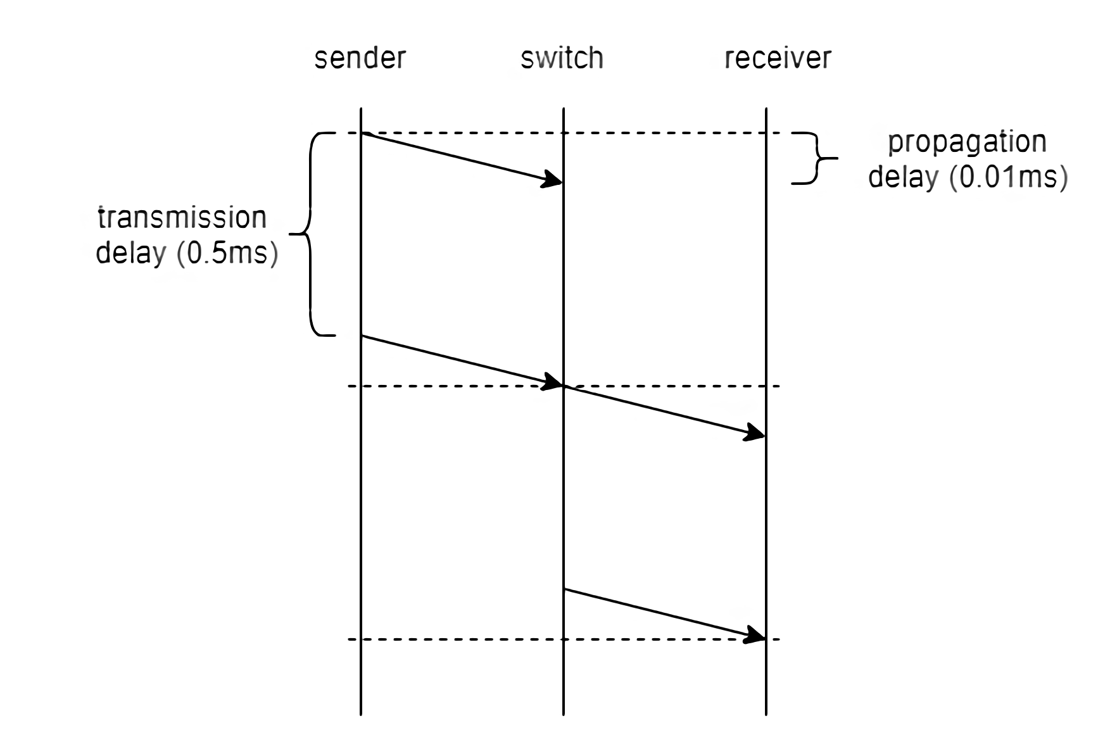
Exercise - Q2
(5000 b / 10Mbps + 10us) * 2 = 1.02ms

Slide 20
Exercise - Q2
Calculate the latency (from first bit sent to last bit received) for the following:
(b) A 10-Mbps link with a single cut-off switch in the path, and a packet size of 5,000 bits. Assume that each section of the link introduces a propagation delay of 10 microseconds, and that the switch begins retransmitting immediately after the first 200 bits have been received.
0.51ms + 200b / 10Mbps + 10us = 0.54ms

Slide 21
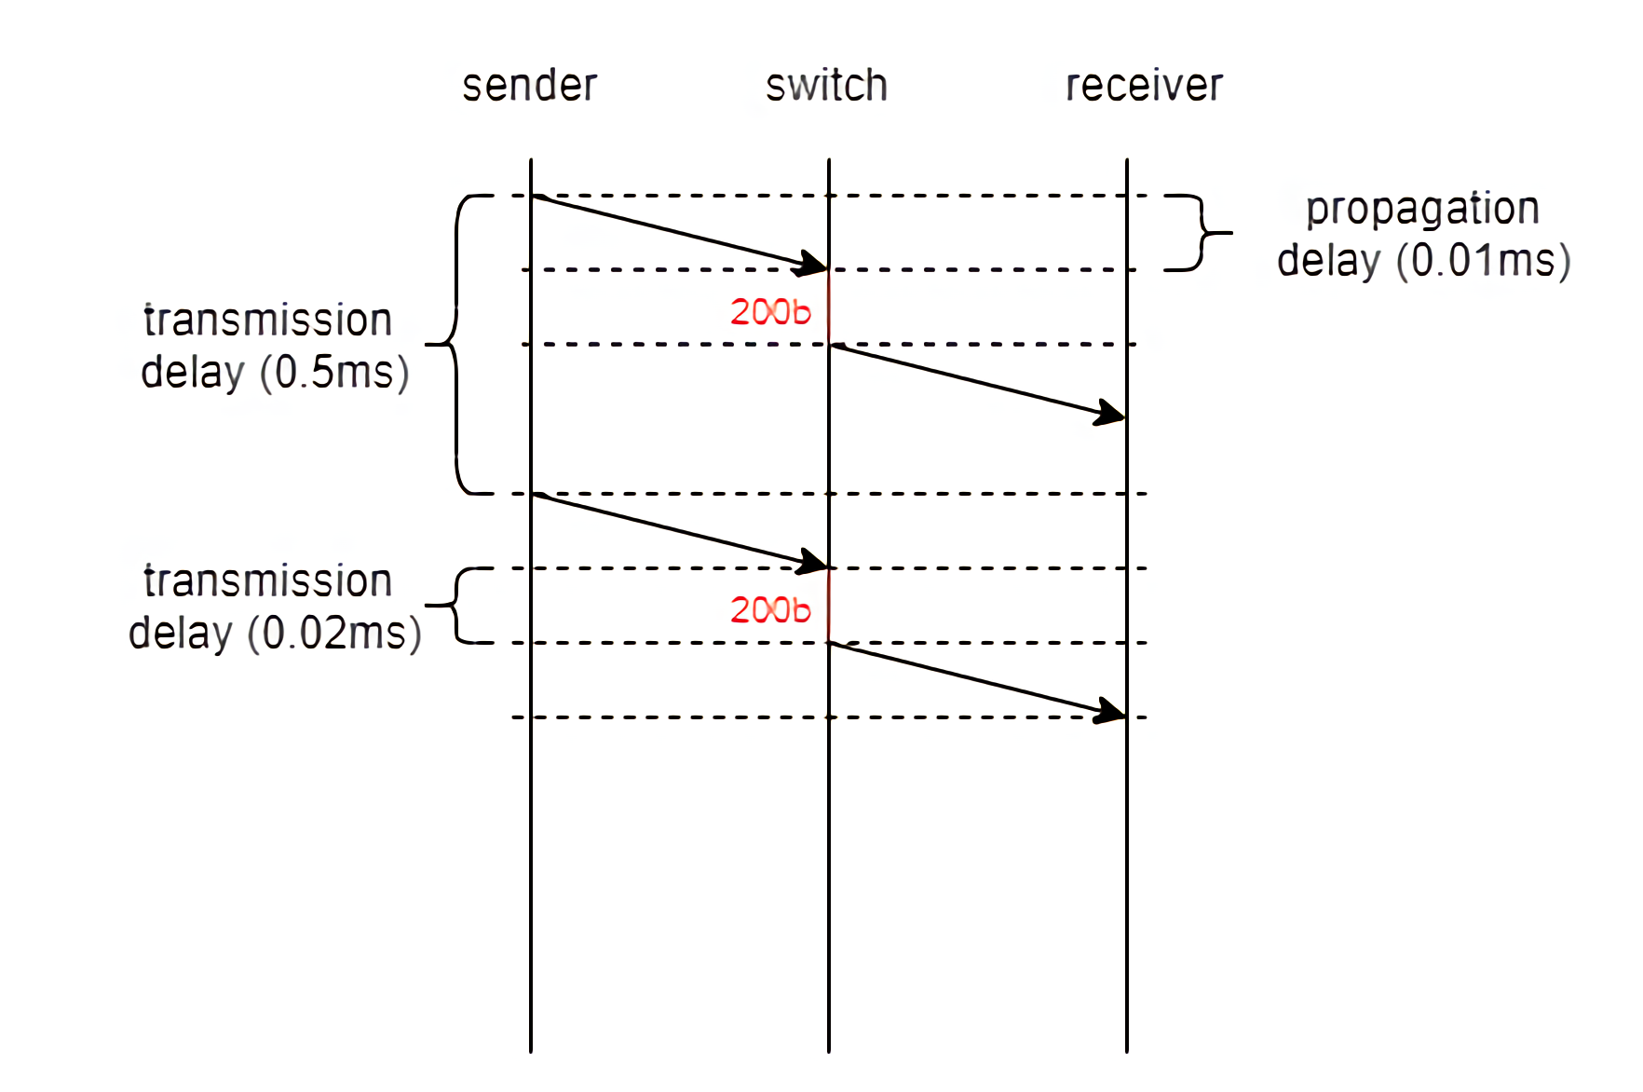
Exercise - Q2
0.51ms + 200b / 10Mbps + 10us = 0.54ms

Slide 22
THANKS!

