Slide 1
CSCI 4430 - Fall 25
Tutorial 6
Credits to Umich EECS 489 Discussion 6

Slide 2
Assignment 2
Due: Oct 26th, 2025 @ 11:59 PM
Form a group of exactly 2 students
Assignment 2 is a significantly harder project than Assignment 1
Autograder has been released on the website
Start early!

Slide 3
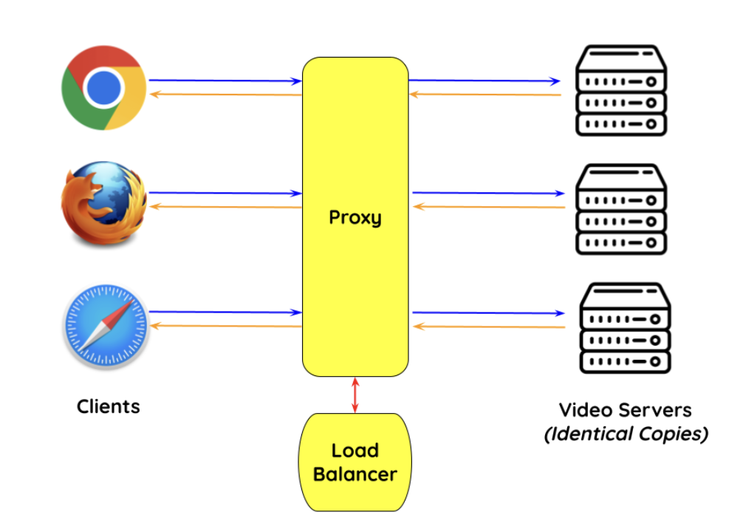
Assignment 2 Overview
Part1: miProxy
The proxy only forwards messages between the browser and the web server
Doesn’t care what are forwarded
Don’t make any assumption on what are forwarded
Part2: Load balancer (DNS server)
Assign appropriate server to the clients
Balance the load of each server

Slide 4
Assignment 2 Overview
Tasks for the miProxy:
Run as a server on a specified port
Accept connections from clients, including multiple clients simultaneously
Connect to a video server
Forward HTTP requests from clients to the appropriate video server
Forward HTTP responses from the video server to the appropriate client
Measure the throughput of each video segment to each client
A POST request to /on-fragment-received with information about a segment that the client has finished receiving.
Capture video manifest file HTTP requests (mpd), returning the no-list manifest file to clients while reqeuesting the regular manifest file for itself
A GET request for a video manifest (.mpd) file.
Capture video segment HTTP requests (m4s) and modify the request to have the appropriate bitrate
A GET request for a video segment (.m4s) file

Slide 5
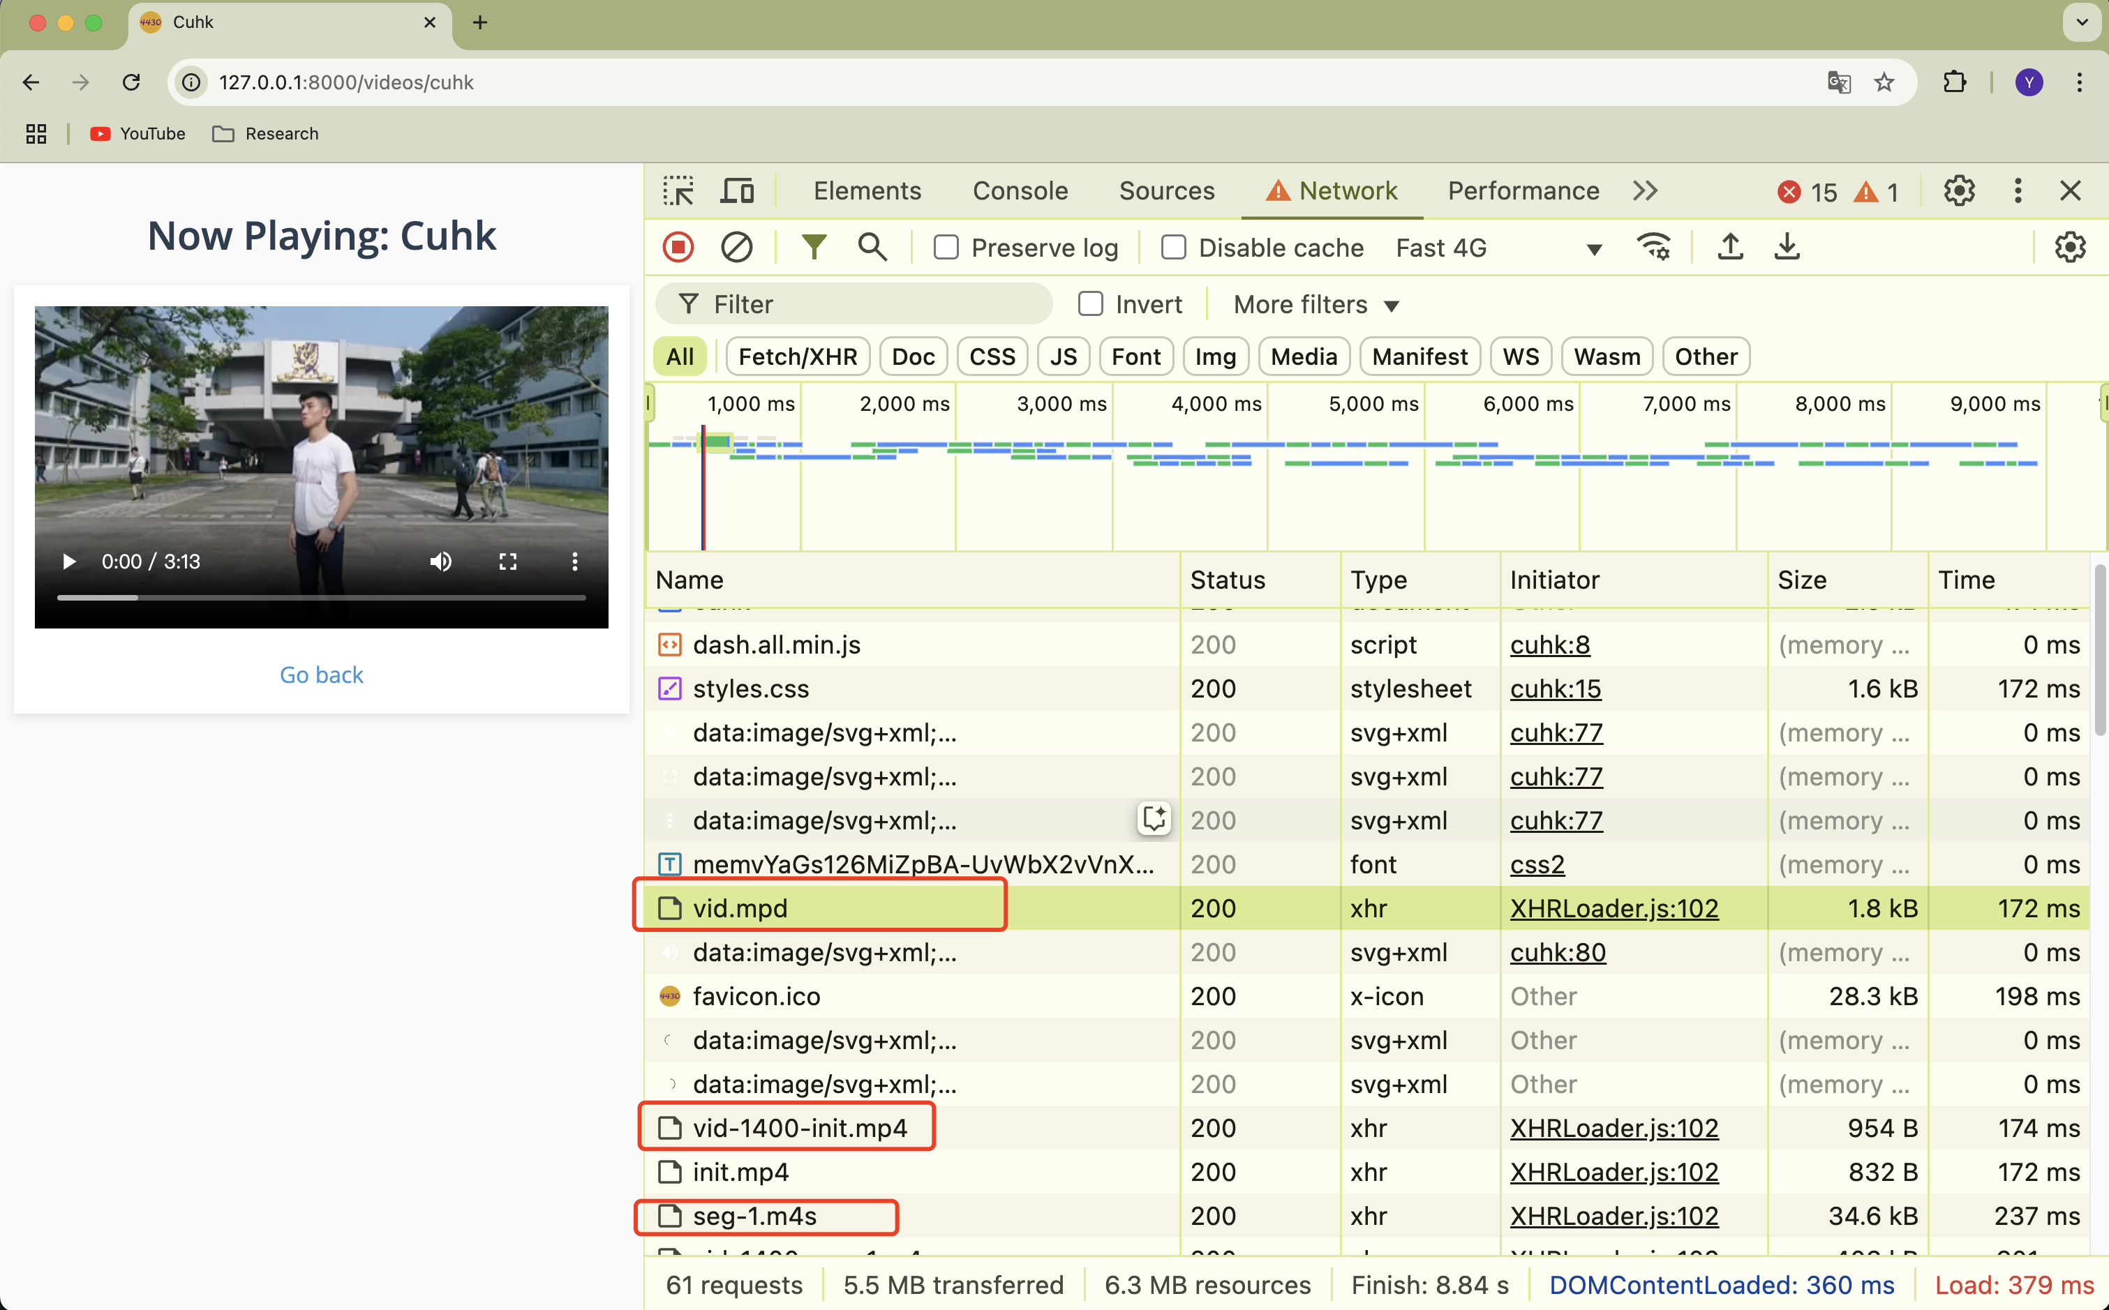
Assignment 2 Overview
Pay close attention to these files:
vid.mpd: manifest file
proxy should request the original vid.mpd manifest file for itself
Then request vid-no-list.mpd file to forward back to the browser
Init.mp4: video init file
Once the client parses the manifest file, it begins requesting video segment files.
vid-[BITRATE]-seg-[NUMBER].m4s
Video segment files begins here.
You may see requests for audio files (also ending with .m4s) and an init.mp4 file. These should not be treated as video segment requests.
Throughput Calculation (see next slide)
Other requests:
Forward to server and client with no changes

Slide 6
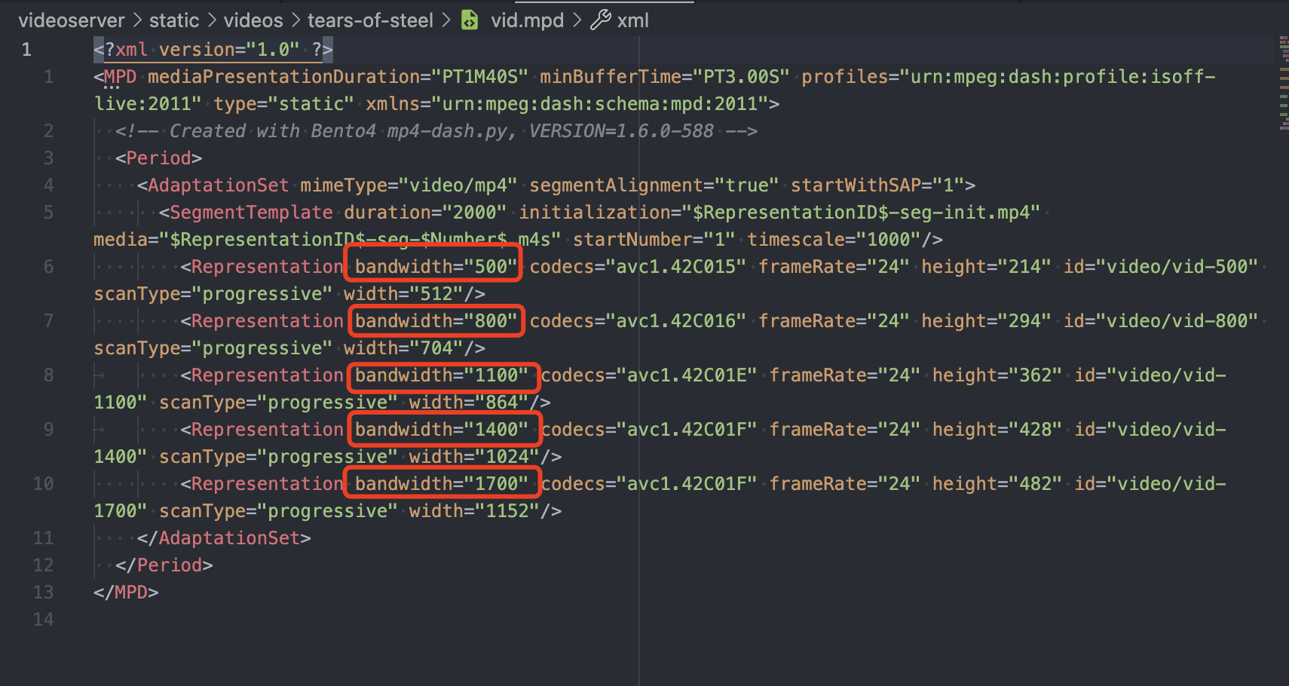
Assignment 2: vid.mpd

Slide 7
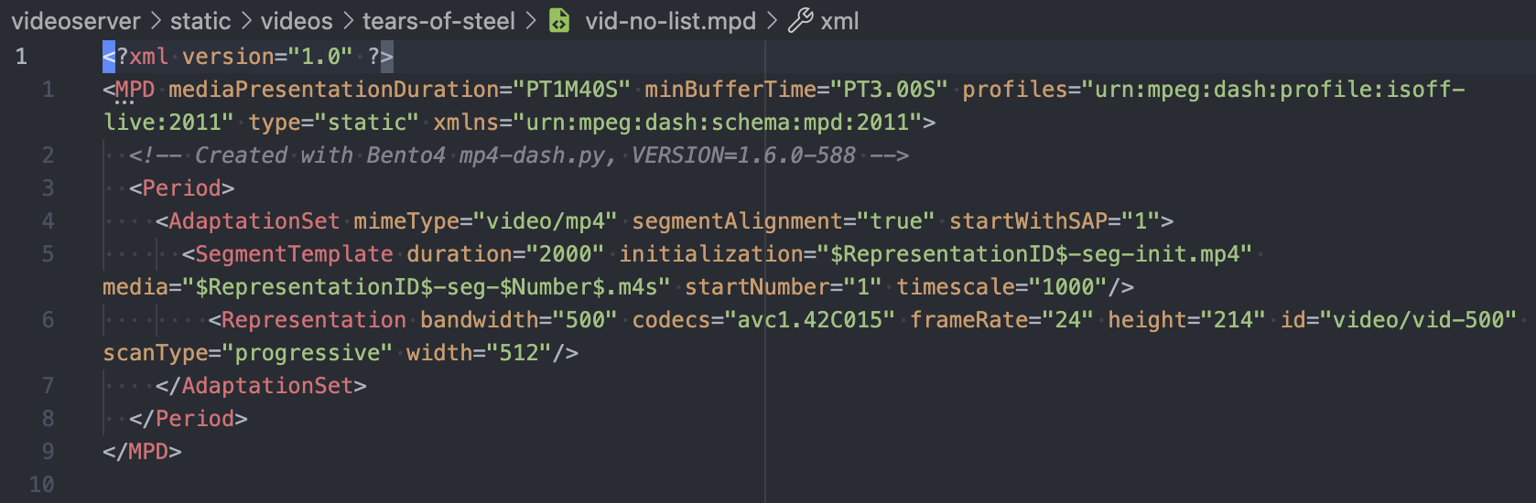
Assignment 2: vid-no-list.mpd

Slide 8
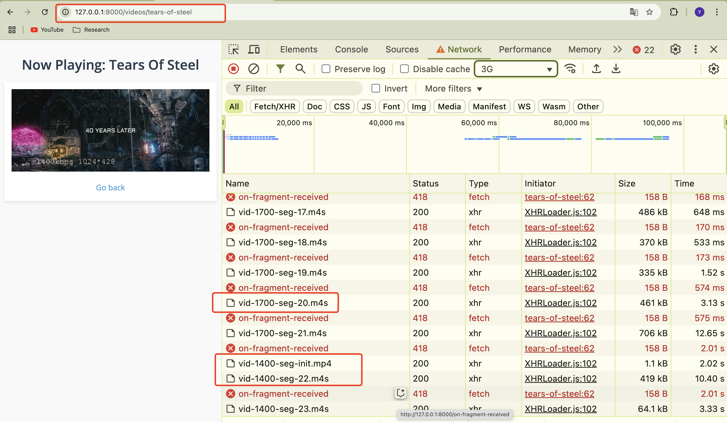
Assignment 2: visit videoserver
Client can adjust the bitrate, changing from 1700 to 1400 bitrate request
(have original vid.mpd)

Slide 9
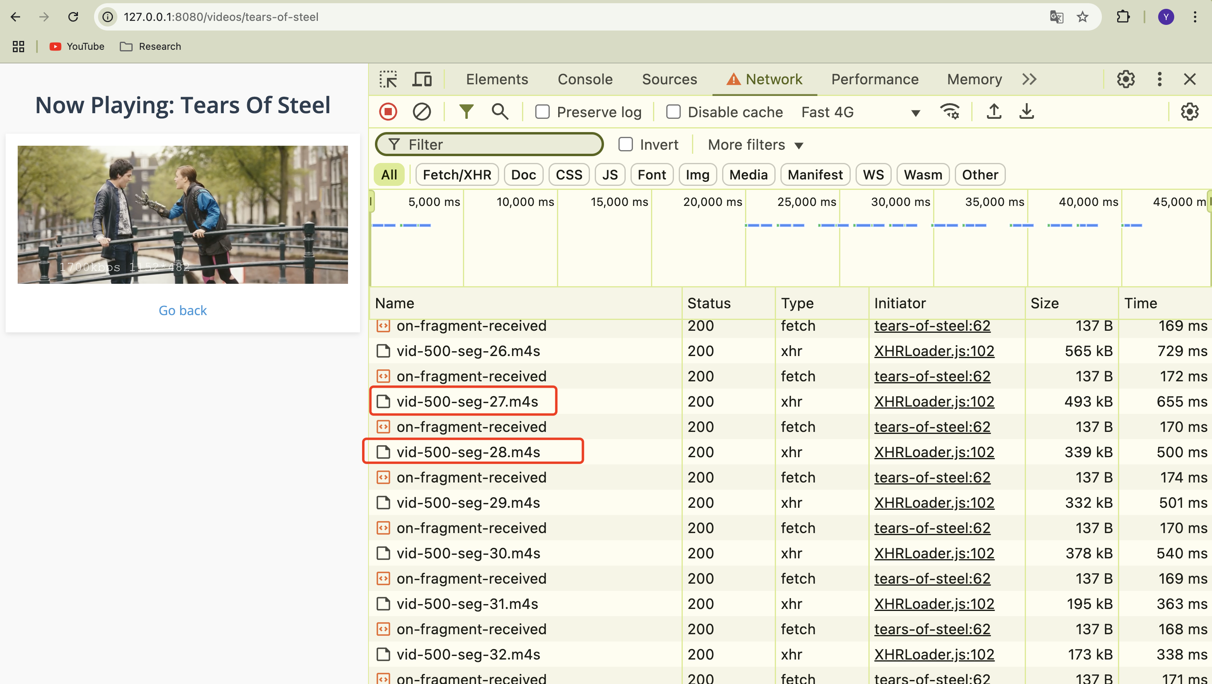
Assignment 2: visit miProxy
Client can not adjust the bitrate, just sending 500 bitrate request (just have vid-no-list.mpd)

Slide 10
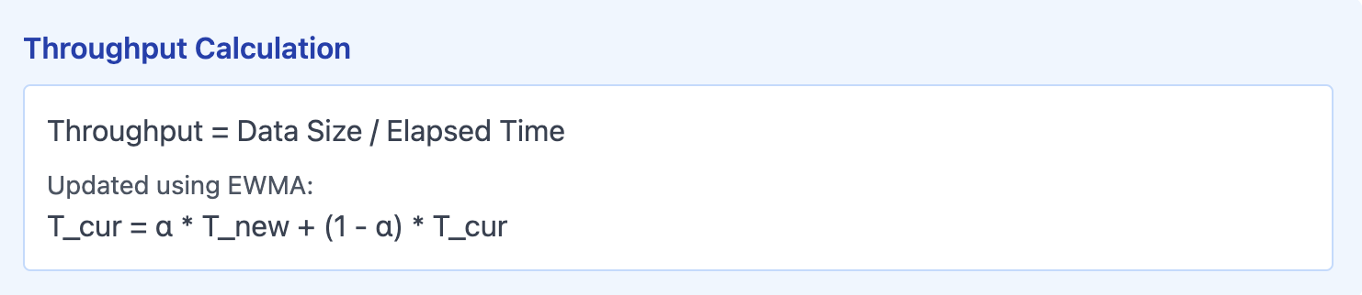
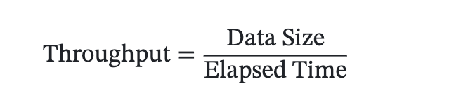
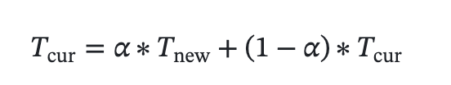
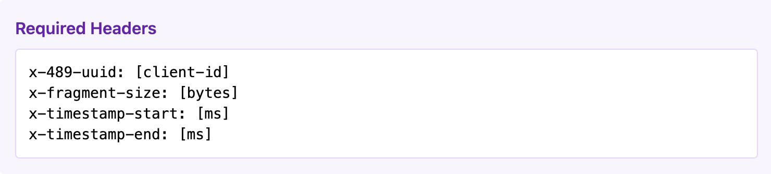
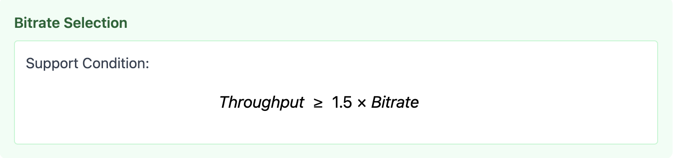
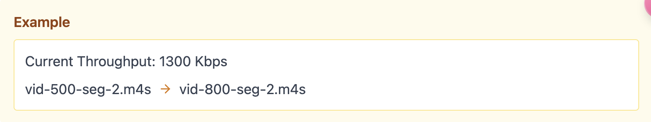
Assignment 2: Throughput Calculation

Slide 11
Assignment 2:Workflow Summary
The proxy receives a request for a video segment from a client.
Using the currently calculated throughput for that client, the proxy modifies the request to request the segment at the appropriate bitrate.
The proxy forwards the request to the video server.
The video server sends the segment back to the proxy.
The proxy forwards the segment to the client.
Once the client fully receives the segment, it sends a POST request to /on-fragment-received with some throughput-related information.
The proxy uses this information to update the measured throughput of that client.
Web
Server
miProxy
Browser
Request
Request
Response
Response

Slide 12
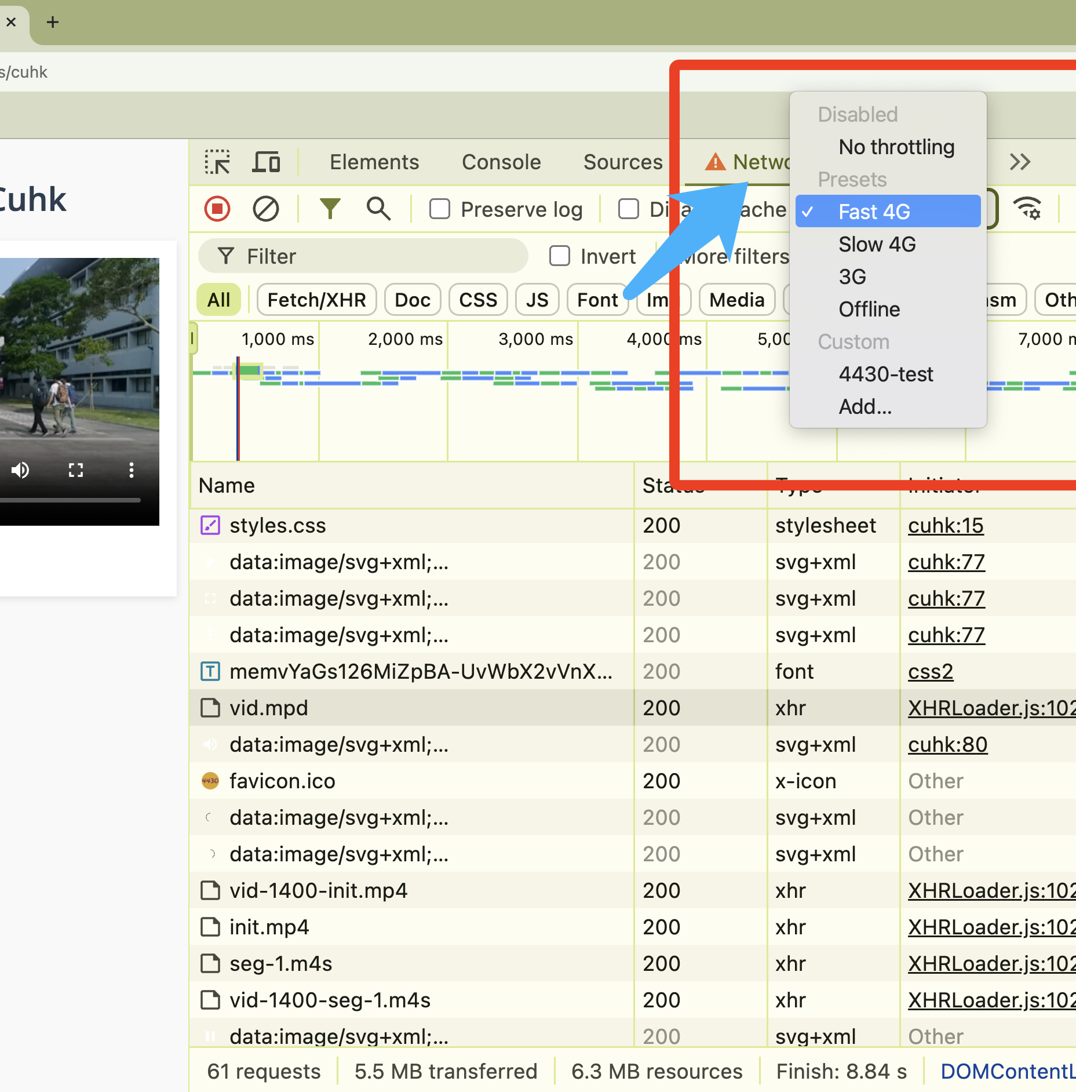
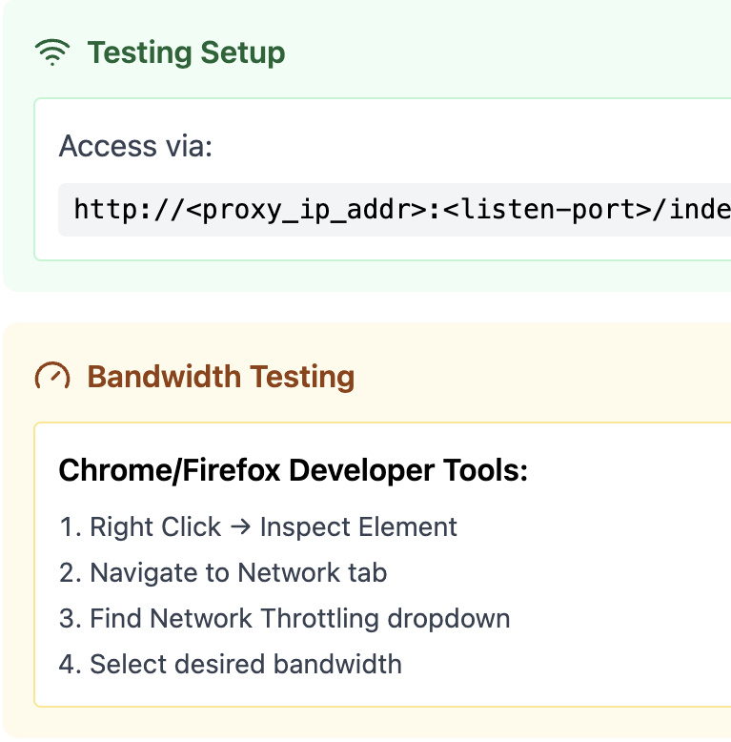
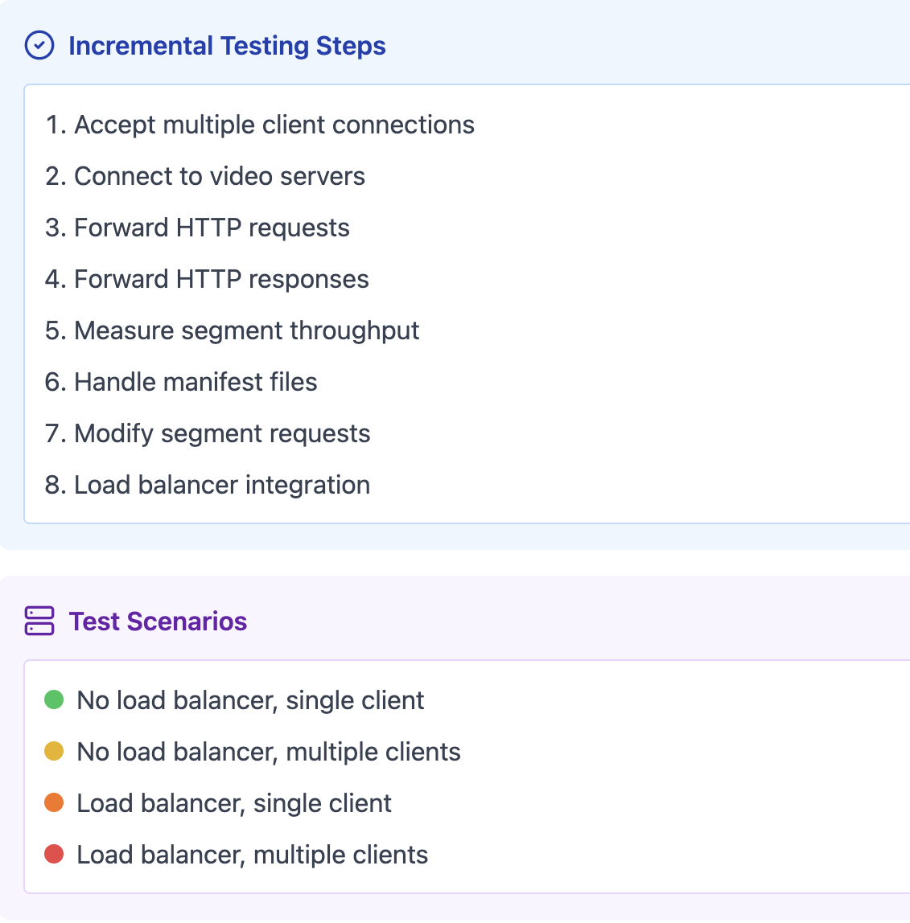
Assignment 2:
Testing Guideline

Slide 13
Assignment 2: Load Balancer
Tasks for the LoadBalancer:
Implement a load balancer for video CDN servers
Support two load balancing strategies:
Round-Robin
Geographic Distance
Handle communication between miProxy and video servers
Key Components:
Load Balancer Protocol (defined in loadBalancerProtocol.h)
Server configuration files
Network topology information

Slide 14
Assignment 2: Load Balancer - Testing
Test with provided sample configuration files
Verify correct server selection in both modes
Test edge cases: - Empty server list - Invalid configurations - Network disconnections

Slide 15
Assignment 2: Submission Instructions
For instance, if your current working directory is the base of the repo, you could run bash util/submit.sh .
This will create a file called submit.tar.gz containing the contents of your cpp/ folder.
You can submit your submit.tar.gz to our autograder system.
Please do not use autograder as debugging tools.
You only have 5 times to submit each day.

Slide 16
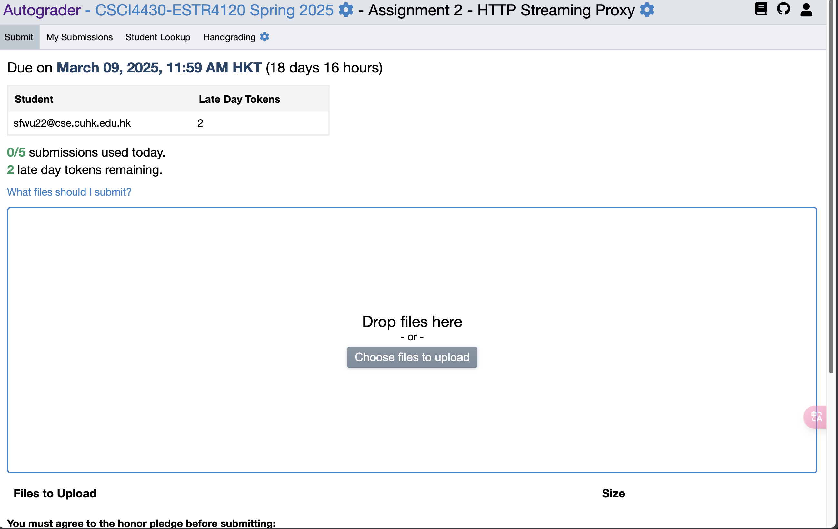
Assignment 2: Autograder

Slide 17
Assignment 2: Bonus Part
Current Limitation
Blocking connection attempts in select() loop cause delays and potential failures
Key Improvements
Non-blocking Sockets
Async Server Connections
Resource Optimization
Results
Higher number of simultaneous connections
Reduced connection delays
Improved overall proxy performance

Slide 18
Thanks!

