Slide 1
CSCI 4430 – Fall 25
DENG Yangtao
Tutorial 5
Credits to Umich EECS 489 Discussion 5

Slide 2
Assignment 2
Due: 11:59:59 p.m., Sun, Oct. 26th.
Asg2 and Asg3 are both group projects.

Slide 3
Video Streaming

Slide 4
Exercise - Q1 HTTP Streaming
Consider a simple HTTP streaming model.
𝑄 is the number of bits that must be buffered before the client application begins playout.
𝑟 is the video consumption rate.
𝑥 is the bits sending rate whenever the client buffer is not full.
Also assume that 𝑥 < 𝑟.
Describe the behavior of the video output?

Slide 5
Exercise - Q1 HTTP Streaming
Consider a simple HTTP streaming model.
𝑄 is the number of bits that must be buffered before the client application begins playout.
𝑟 is the video consumption rate.
𝑥 is the bits sending rate whenever the client buffer is not full.
Also assume that 𝑥 < 𝑟.
Describe the behavior of the video output?
Alternate between playout and freeze.

Slide 6
Exercise - Q1 HTTP Streaming
Consider a simple HTTP streaming model.
𝑄 is the number of bits that must be buffered before the client application begins playout.
𝑟 is the video consumption rate.
𝑥 is the bits sending rate whenever the client buffer is not full.
Also assume that 𝑥 < 𝑟.
Suppose the buffer starts out empty. How long will it be before the video can begin playout?

Slide 7
Exercise - Q1 HTTP Streaming
Consider a simple HTTP streaming model.
𝑄 is the number of bits that must be buffered before the client application begins playout.
𝑟 is the video consumption rate.
𝑥 is the bits sending rate whenever the client buffer is not full.
Also assume that 𝑥 < 𝑟.
Suppose the buffer starts out empty. How long will it be before the video can begin playout?
Q / x

Slide 8
Exercise - Q1 HTTP Streaming
Consider a simple HTTP streaming model.
𝑄 is the number of bits that must be buffered before the client application begins playout.
𝑟 is the video consumption rate.
𝑥 is the bits sending rate whenever the client buffer is not full.
Also assume that 𝑥 < 𝑟.
Assume the number of bits in buffer currently is Z (> 𝑄).
How long will the playout last?

Slide 9
Exercise - Q1 HTTP Streaming
Consider a simple HTTP streaming model.
𝑄 is the number of bits that must be buffered before the client application begins playout.
𝑟 is the video consumption rate.
𝑥 is the bits sending rate whenever the client buffer is not full.
Also assume that 𝑥 < 𝑟.
Assume the number of bits in buffer currently is Z (> 𝑄).
How long will the playout last?
Z / (r - x)

Slide 10
Reliable Transport

Slide 11
Review: Reliable Transport
Motivation:
IP provides a best-effort packet delivery service – this means that packets sometimes get corrupted or dropped!
We need some way to build reliable transport on top of an unreliable network.
Key Question:
How does sender figure out what to send / resend?

Slide 12
Review: Reliable Transport
Common Techniques:
Checksums
Sequence numbers
Acknowledgements upon receiving packet
Sender-side timers to trigger resending packets

Slide 13
Review: Sliding Window
A window is a set of adjacent sequence numbers. If the window size is n and the window starts at sequence number s, it will consist of packets
s, s + 1, s + 2, …, s + n - 1.
A larger window enables more throughput, as more packets can be in-flight at once.
A window that is too large leads to the sender/receiver having to buffer and keep track of too many packets, which can create slowness.

Slide 14
Review: Sliding Window
To confirm that a packet has been received, the receiver sends an ACK (acknowledgement) back to the sender for every packet it receives.
Cumulative ACKs: The receiver sends an ACK containing the sequence number of the next packet it expects.
Selective ACKs: The receiver just sends back the sequence number of the packet it just received.
Selective ACKs convey more information, but the sender and receiver have to keep track of a lot more state. Why?

Slide 15
Go-Back-N vs. Selective Repeat
Go-Back-N | Selective Repeat
Used with sliding window | Used with sliding window
Receiver only accepts packets in-order, and discards out-of-order packets (i.e. does not ACK nor buffer). | Receiver accepts any packet that is in its window, possibly buffering until it can recreate them in-order
Cumulative ACKs | Selective ACKs.
Sender maintains one timer (for first outstanding ACK) and resends n packets if the timer expires. | Sender maintains one timer per packet, resending just that packet if ACK is not received in time.

Slide 16
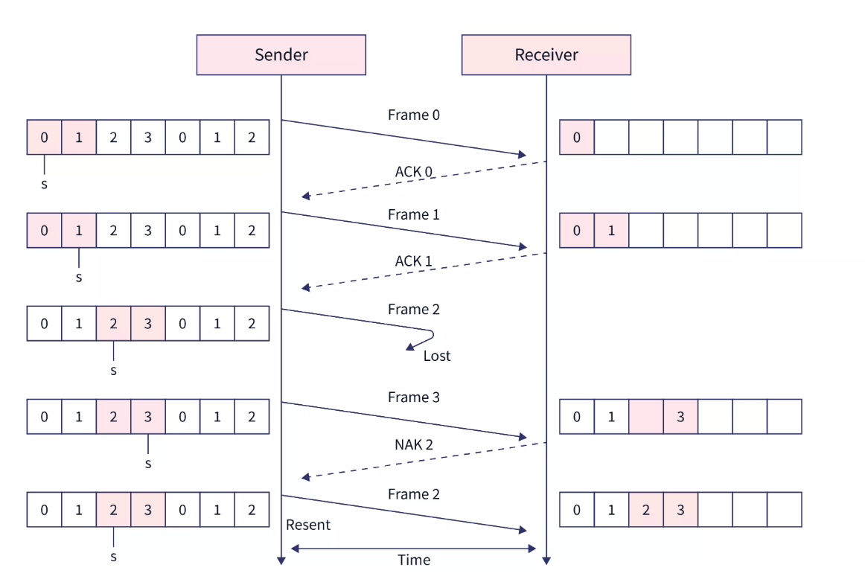
Exercise – Q2 Selective Repeat
With the Selective Repeat (SR) protocol, Is it possible for the sender to receive an ACK for a packet that falls outside of its current window? Why?
Selective Repeat Protocol Explanation
Selective Repeat ARQ Protocol | Scaler Topics

Slide 17
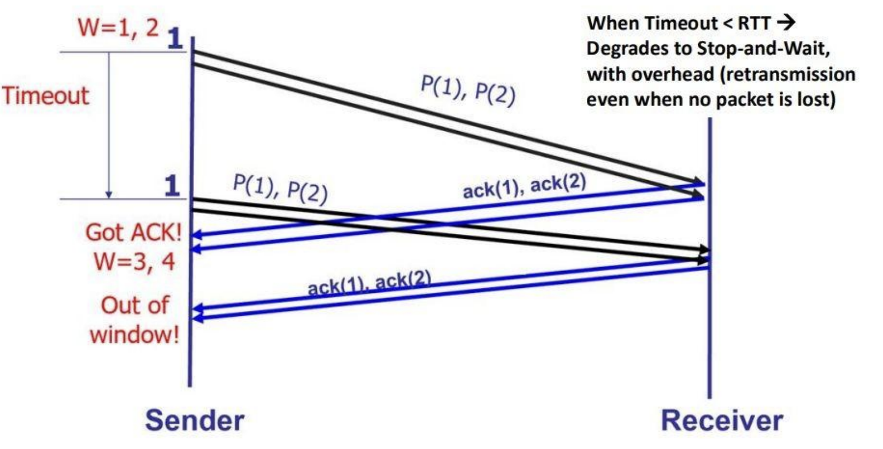
Exercise – Q2 Selective Repeat
With the Selective Repeat (SR) protocol, Is it possible for the sender to receive an ACK for a packet that falls outside of its current window? Why?
True
Selective Repeat ARQ Protocol | Scaler Topics

Slide 18
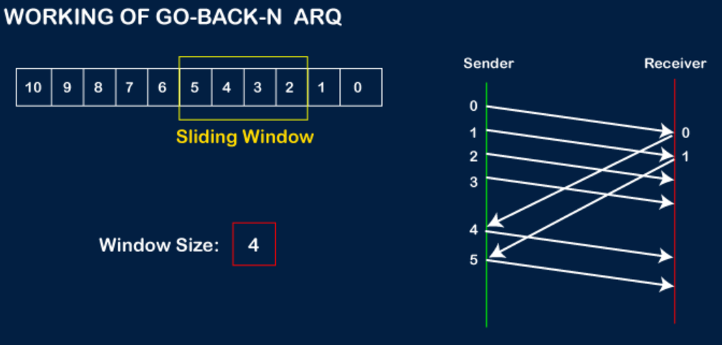
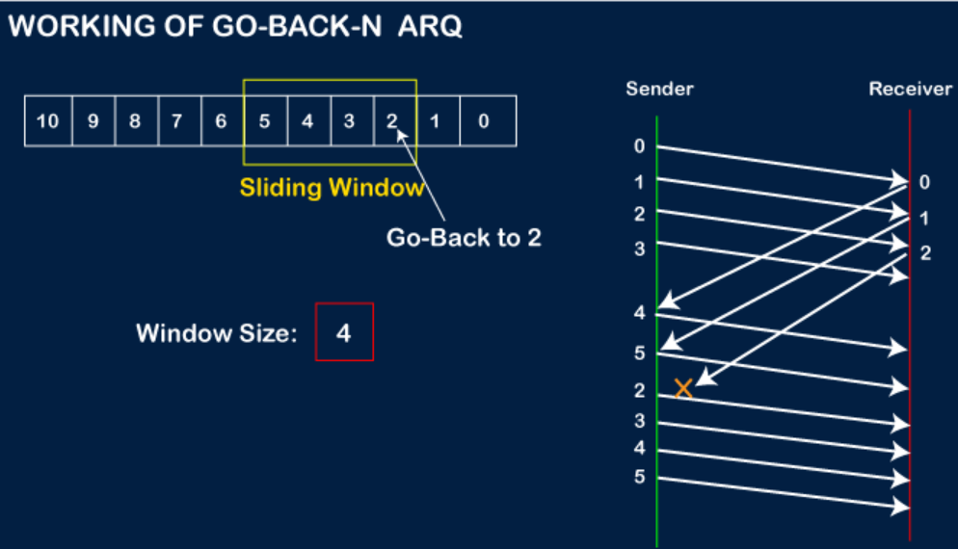
Exercise – Q3 Go-Back-N
With the Go-Back-N (GBN) protocol, Is it possible for the sender to receive an ACK for a packet that falls outside of its current window? Why?
Go-Back-N Explanation
Go-Back-N ARQ - javatpoint

Slide 19
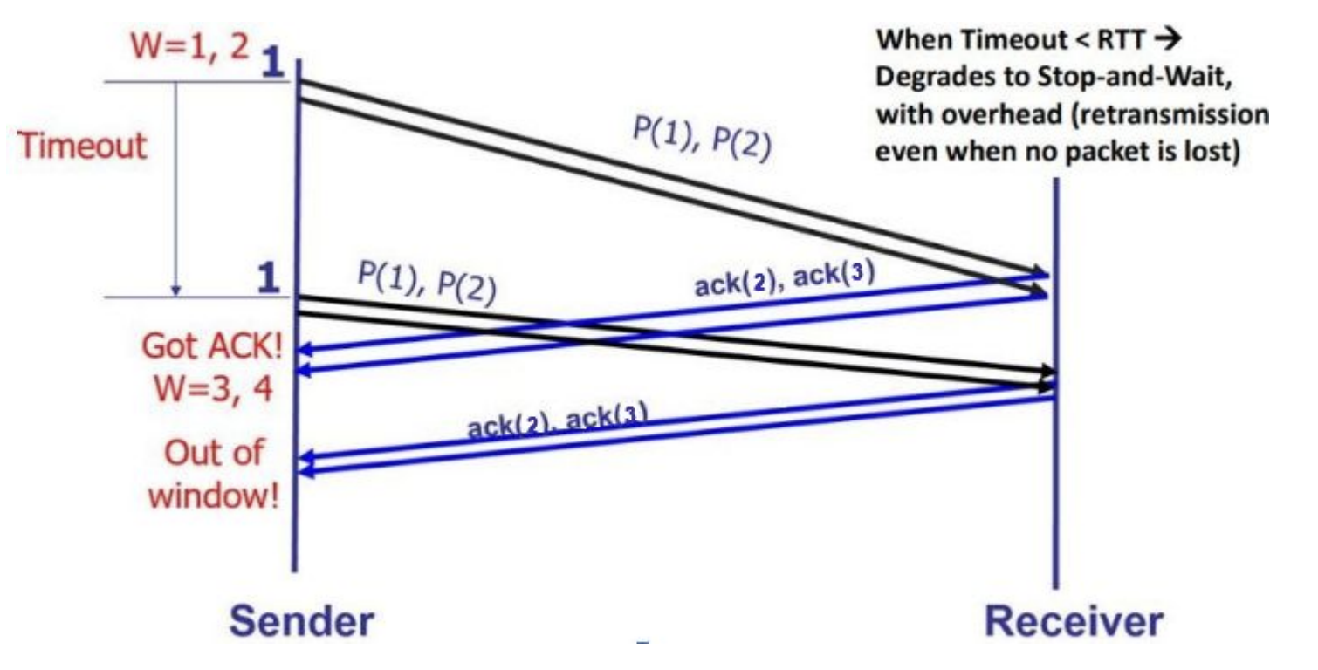
Exercise – Q3 Go-Back-N
With the Go-Back-N (GBN) protocol, Is it possible for the sender to receive an ACK for a packet that falls outside of its current window? Why?
True (for the same reason)
Go-Back-N ARQ - javatpoint

Slide 20
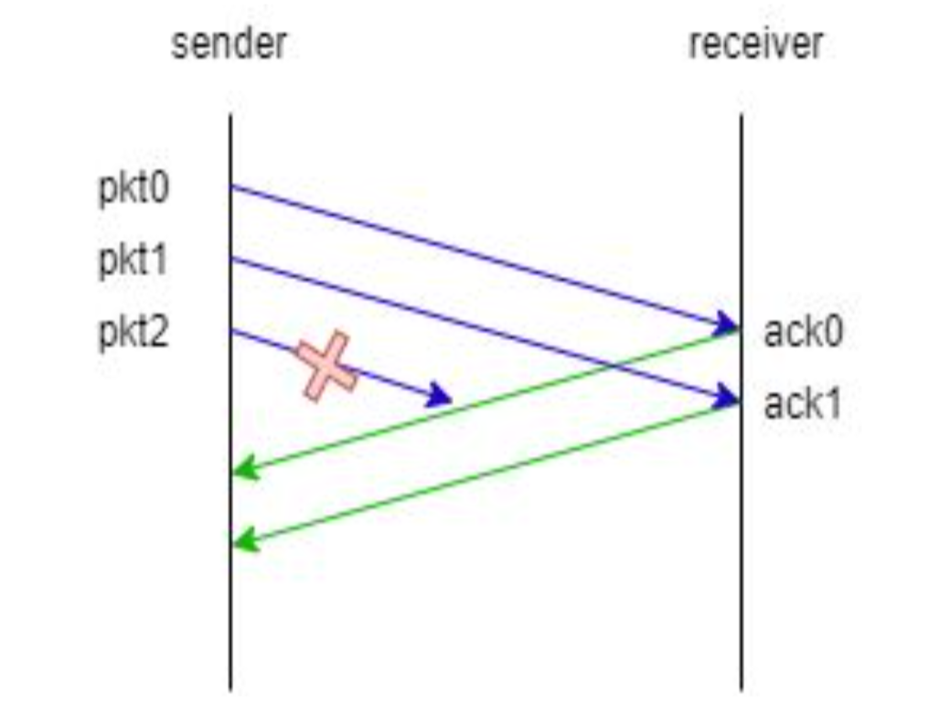
Exercise – Q4 Sliding Window Protocols (1)
Consider the sliding window protocol in the following figure. Does this figure indicate that GBN is being used, SR is being used, or there is not enough information to tell?
There is not enough information to tell, since both GBN and SR will individually ACK each of the first two messages as they are received correctly.

Slide 21
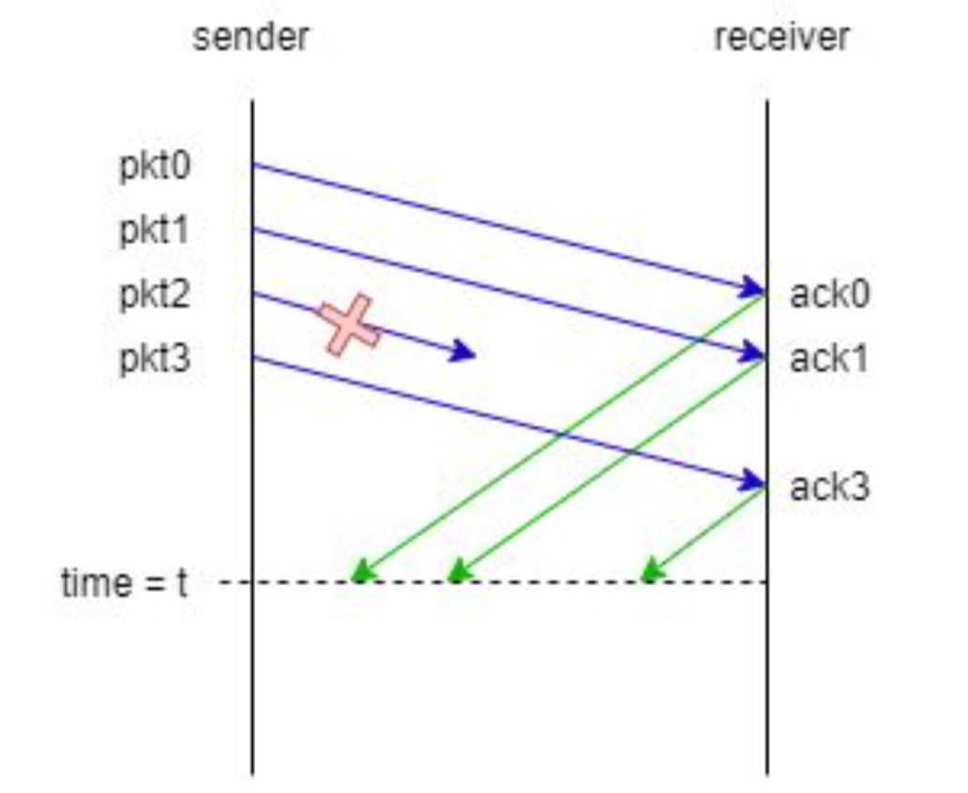
Exercise – Q4 Sliding Window Protocols (2)
Consider the sliding window protocol in the following figure. Does this figure indicate that GBN is being used, SR is being used, or there is not enough information to tell?

Slide 22
Exercise – Q4 Sliding Window Protocols (2)
Consider the sliding window protocol in the following figure. Does this figure indicate that GBN is being used, SR is being used, or there is not enough information to tell?
This must be the SR protocol since pkt3 is acked even though pkt2 was lost.
GBN will discard pkt3 if pkt2 was dropped.

Slide 23
Exercise – Q4 (N)ACK
Consider a reliable data transfer protocol that uses only negative acknowledgments (NACK). Suppose the sender sends data only infrequently. Would a NACK-only protocol be preferable to a protocol that uses ACKs? Why?
ACK: send ACK upon packet arrival
NACK: send NACK upon packet loss
No. In a NAK only protocol, the loss of packet x is only detected by the receiver when packet x+1 is received. If there is a long delay between the transmission of x and the transmission of x+1, then it will be a long time until x can be recovered, under a NAK only protocol

Slide 24
Exercise – Q5 (N)ACK
Now suppose the sender has a lot of data to send and the end-to-end connection experiences few losses. In this second case, would a NACK-only protocol be preferable to a protocol that uses ACKs? Why? (Assuming ACK/NACK is never lost)
ACK: send ACK upon packet arrival
NACK: send NACK upon packet loss
Yes. If data is being sent often, then recovery under a NAK-only scheme could happen quickly. Moreover, if errors are infrequent, then NAKs are only occasionally sent (when needed).

Slide 25
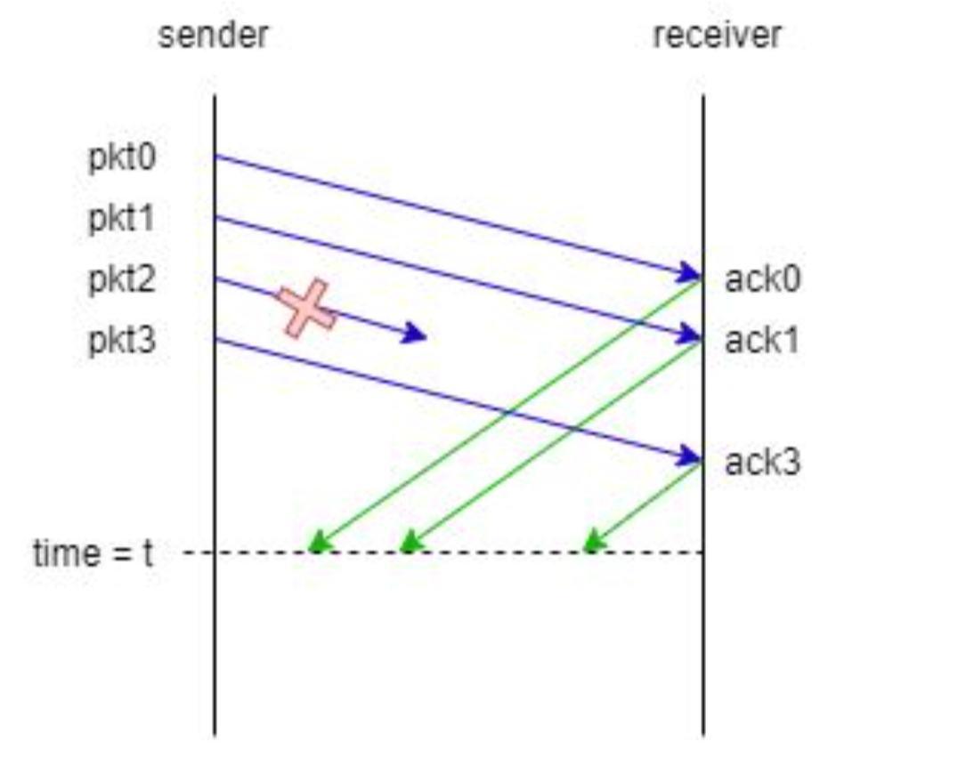
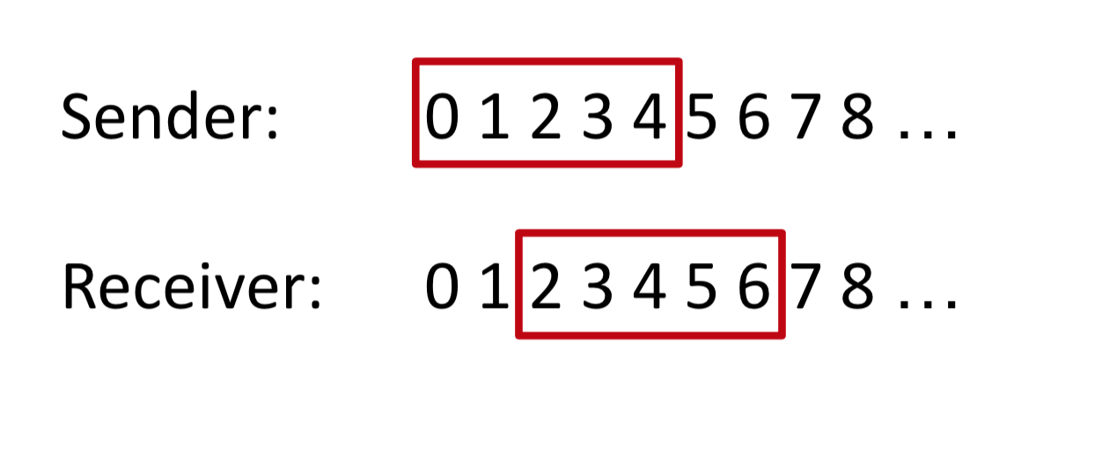
Exercise – Q8 Sliding Window Protocols (3)
Consider the sliding window protocol in the following figure. Suppose the window size = 5 for both sides. Show the positions of windows for the sender and receiver at time = t (no ack has been received).

Slide 26
Thanks!

