Slide 1

CSCI 5540: Machine Learning Systems
Hong Xu

Slide 2
Today’s Agenda
Administrivia
Topics
Projects
https://github.com/henryhxu/CSCI5540
Credit: Prof. Mosharaf Chowdhury’s CSE 585, Fall 2026

Slide 3





About Me
Performance and Efficiency
Associate Professor of CSE
https://henryhxu.github.io
Research areas
AI infra and systems
Networking
Office hours:
Appointment-only
Reliability, Usability, and Beyond

Slide 4
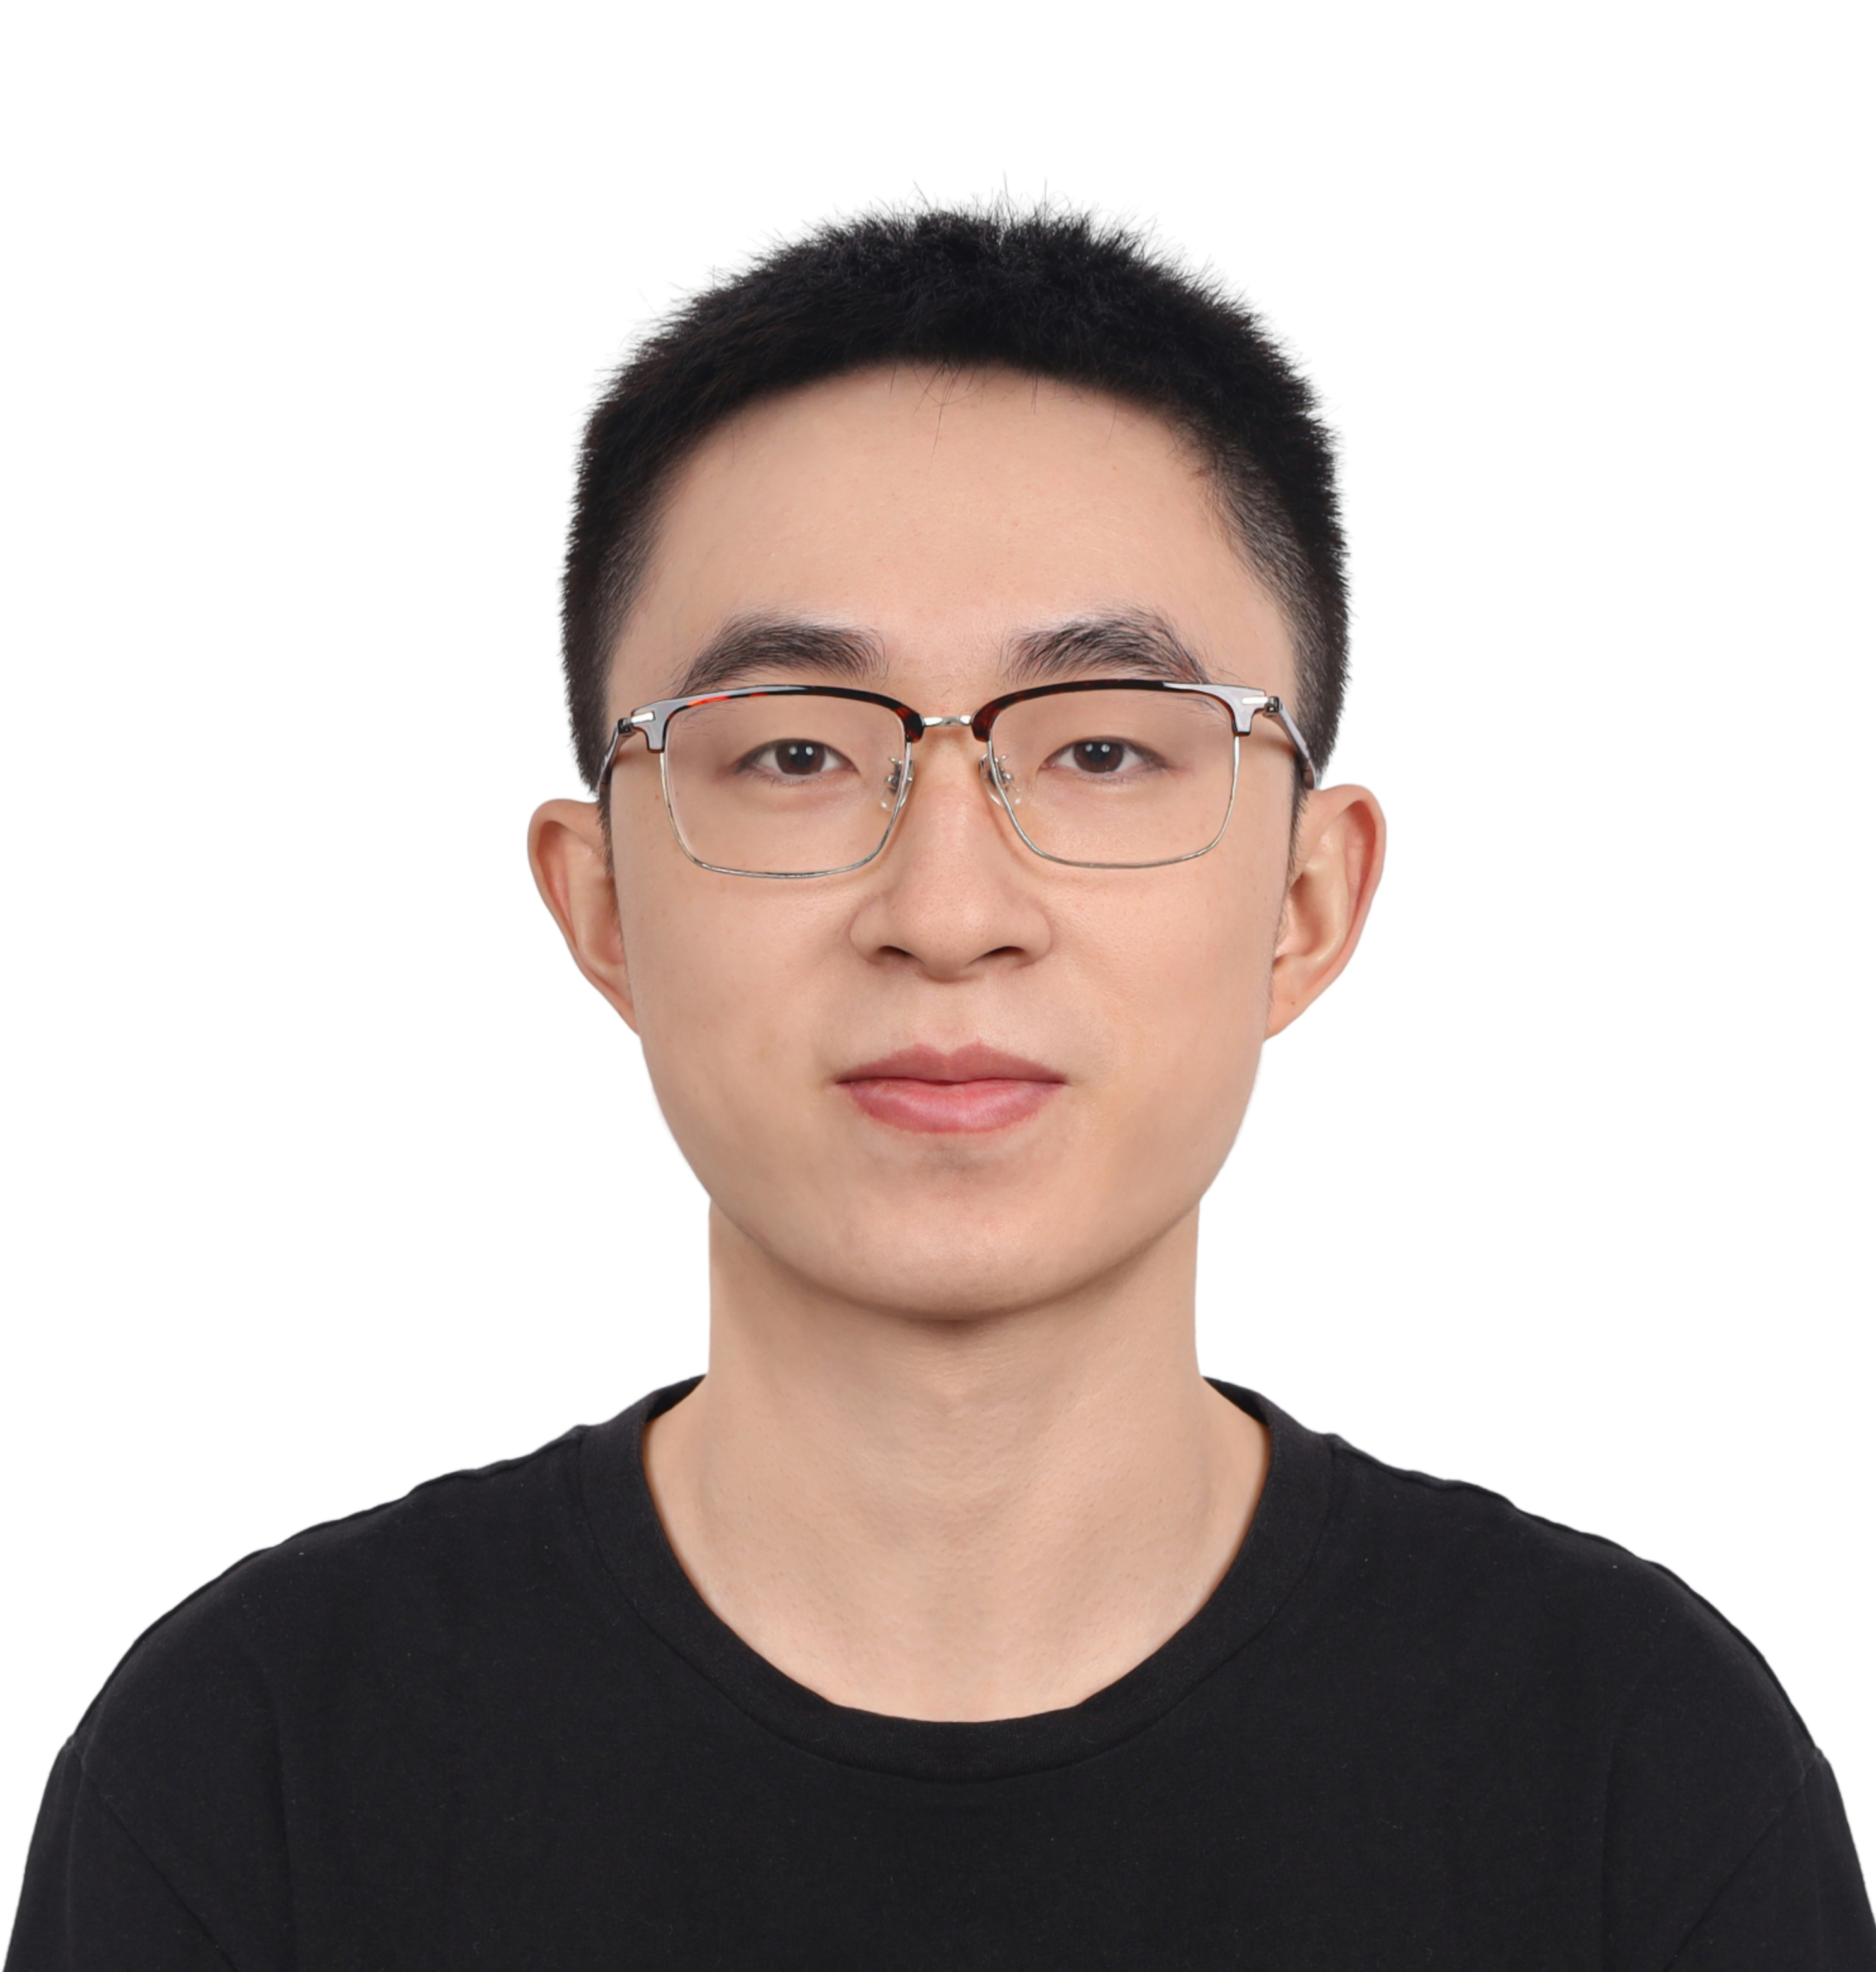

TAs
2nd-year PhD students in my lab
AI infra veterans: Both have been working with frontier labs and have shipped production systems
DENG Yangtao
Head TA
JIA Chaobo

Slide 5
Course Schedule
Webpage: https://github.com/henryhxu/CSCI5540
Discussion on Ed: Check course website for self sign-up
All announcements also on Ed
Pay attention to the online announcements and schedule
Check back often!

Slide 6
Course Requirements
Paper Presentation | 20%
Paper Summary | 10%
Participation | 10%
Project Report | 40%
Project Presentations | 20%

Slide 7
Policies
Adverse weather (read the website): Switch to Zoom at the original time by default
Use of AI: Approach 3 – Use of AI tools is allowed with explicit acknowledgement and proper citation
You should use AI as much as possible (spend the money) to reduce the time on laborious chores, so you can focus on the creative and strategic things
Efficiency booster, definitely not the ultimate way out
AI can help you learn, but cannot learn for you (there’s no such thing)

Slide 8
What is good use of AI
Ask your favorite coding agent to reproduce a paper’s core design and the experiments (verify!!!)
You focus on the problems encountered by AI during the process, the discrepancies of the results, etc. -> Possible new problems to work on may emerge
You may have a new idea, ask AI to implement it on top of the paper’s design, evaluate the difference

Slide 9
Topics (#Lectures)
Basics
What’s above us, what’s below us (attention; bare-metal) (1)
Systems for LLMs
Pre-training (2)
Inference (2)
Systems for Agents
Post-training / RL (2)
Sandbox (1)
Agentic applications in vertical domains (1)
Infra
Kernels; CCL (1)
Reliability; simulation (1)
Guest lecture (1)

Slide 10
Group-Based Work
ALL activities will be done in groups except for participation
Paper presentation
Paper summary
Research projects

Slide 11
Form Groups ASAP
Submit to the Google form (on course website)
By September 14 the latest, but right now is better
Can use Ed to find group members
With the current class size, group size should be 5

Slide 12
Readings
~40 papers/articles across
Primarily from systems venues like SOSP, OSDI, NSDI, SIGCOMM, ASPLOS, ATC, EuroSys, MLSys, etc.
A couple from traditional AI/ML venues but still with systems-y flavor

Slide 13
Paper Presentation
This is a seminar-style course
Each group must present at least one lecture (required papers and the rest)
Paper presentation account for 20% of the total grade
The entire class will be dedicated to the assigned paper(s)
Aim for 40-minute presentation per paper without interruption
But there will be intermittent discussions
Lead the discussion
Go through the paper in details, along with its strengths and weaknesses
Include companion papers and other related papers

Slide 14
Paper Presentation
Share your slides to us 24 hours before the class
Use Google Slides so we can provide in-place comments/feedback
Prepare early
Practice, practice, practice
Do NOT read the scripts!
Marks are deducted when you do this
Also, read
How to Give a Bad Talk, by David A. Patterson

Slide 15
Paper Summaries
This is a paper-reading course
Paper summaries account for 10% of the total grade
Roughly 1-2 summary per-group (assigned)
Each summary must follow the template and address the following
What is the problem and why is it important?
What is the hypothesis of the work?
What is the proposed solution, and what key insight guides their solution?
What is one (or more) drawback or limitation of the proposal, and how will you improve it?
Summary must include the gist of class discussion

Slide 16
Paper Summaries
Summaries must be shared to us within 24 hours after class presentation
Use Google docs so we can provide in-place comments/feedback
Delayed submission will receive NO marks
There will be NO extensions

Slide 17
Panel Discussion
The Authors
Groups that present and write summary
The Reviewers
Each group will be assigned to at least one of these slots
Will have their own questions to ask to the authors
Will receive questions raised by the class (described below) from the GSI before the lecture
Rest of the Class
Submit one insightful question for each presented papers by 5PM the day before
Ask questions directly too

Slide 18
In general,
Late submissions receive 0 marks
No extensions
Everyone must come to class after reading the required papers of the day

Slide 19
Projects

Slide 20
Research-Oriented Course!
The project accounts for 60% of total grades
What can and cannot be a project?
Just surveys are not allowed
Measurements of new environments or of existing solutions on new environments are acceptable
Reproducing results from existing solutions is also acceptable
An ideal project should answer the questions you asked during paper reviews and points you cared about for presentations

Slide 21
How to Approach it?
Find a problem and motivate why this is worth solving
Quickly survey background and related work
Might require you to go back to the first step
Form/update your hypothesis
Test your hypothesis
Go back to 3 until you are happy
Present your findings on poster and in writing
Discuss known limitations

Slide 22
Milestones (subject to change)
Date | Milestone | Details
09/14/26 | Form Group | Find like-minded students
09/30/26 | Submit Proposal | Send your proposal by email to receive feedback either via email or in-person or both
Late Oct, Early Nov | Mid-Semester Presentations | Define and motivate a problem, overview related work, and form initial hypothesis and idea
End of term | Poster Presentation | Present your findings
12/15/26 | Research paper | Submit a report like the papers you read

Slide 23
Draft Proposal (Sep 30)
Two pages including references that must include
What is the problem?
Why is it important to solve?
Any initial thoughts on what you want to do?
How would you evaluate your solution?
Include team members
Meaning, form a group ASAP
Approved by the instructor and agreed upon by you
Forms the basis of expectation

Slide 24
Mid-Semester Checkpoint
In-tutorial short presentation (subject to change)
This is to make sure you are making progress
Must include
What is the problem?
Why is it important?
What are the most related work?
What’s your hypothesis so far?
How are/will you evaluate it?

Slide 25
Presentation & Paper
Research paper
The key part
Should be written like the papers you’ve read
As if you’d submit it to a workshop with ~2-3 more months of work or to a conference after ~6 more months of work
How to Write a Great Research Paper by Simon Peyton Jones
Extended from the mid-semester checkpoint

Slide 26
Basics of the Bare-Metal

Slide 27

What’s in a (Simplified) Server?
Interconnected compute and storage resources
Different bandwidth and latency constraints
Simplified diagram
Doesn’t include faster networks such as RDMA, CXL, dedicated GPU interconnects such as NVlink, etc…
(64 GB/s)
DDR5
(8 GB/s)*
PCIe v6
(25 GB/s)
SATA 3
(600 MB/s)
Ethernet
NVMe
(7.5 GB/s)
* Per channel

Slide 28
Typical Memory/Storage Hierarchy
Fundamental Goals of (SW/HW) System Design
Minimize time to access data
Maximize compute utilization
Balanced System
Register
0.2ns
Main Memory
NVM
Network Attached Memory
SSD
HDD
CXL-Memory
L1/L2/L3 Cache
1-40ns
Higher Bandwidth/
Lower Latency
80-140ns
170-280ns
300-400ns
2-4μs
10-40μs
3-10ms
Maruf et al, SIGMETRICS 2023

Slide 29
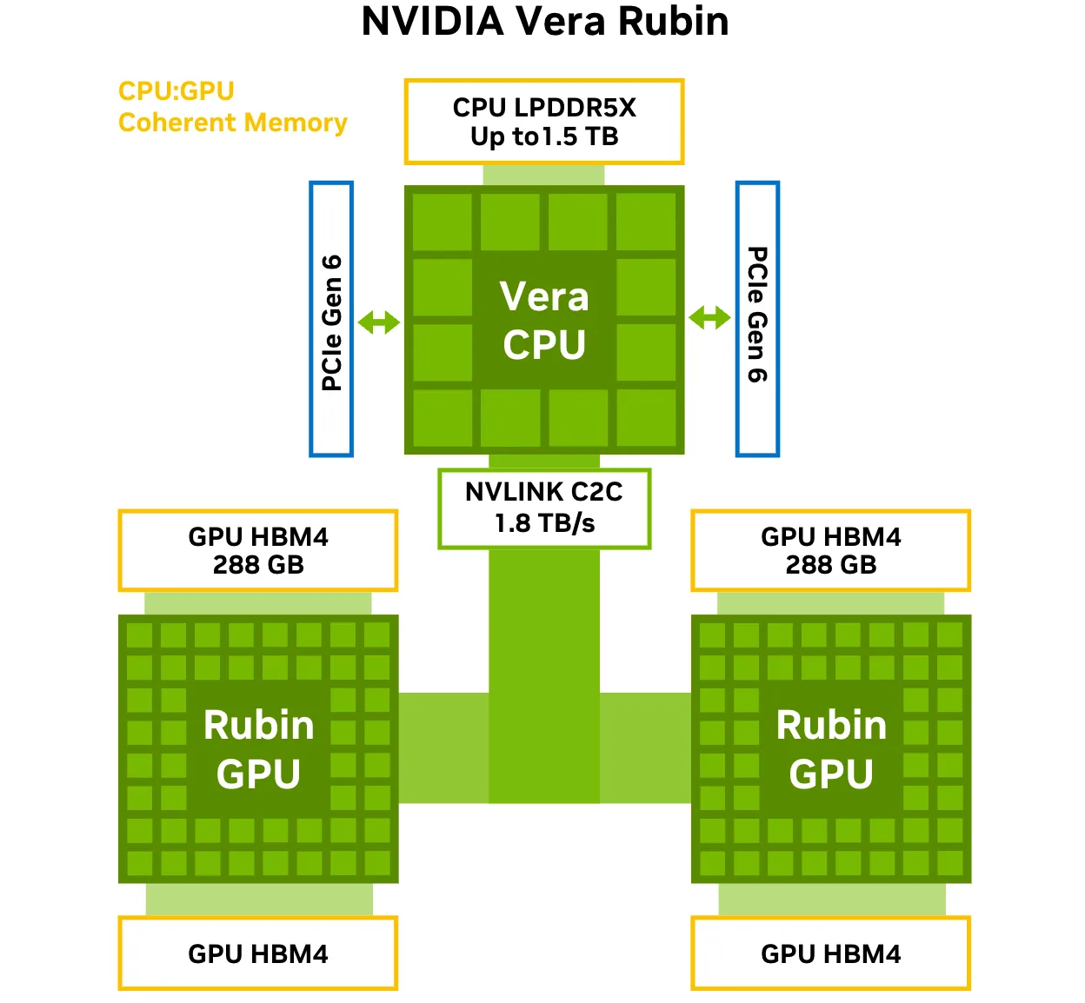
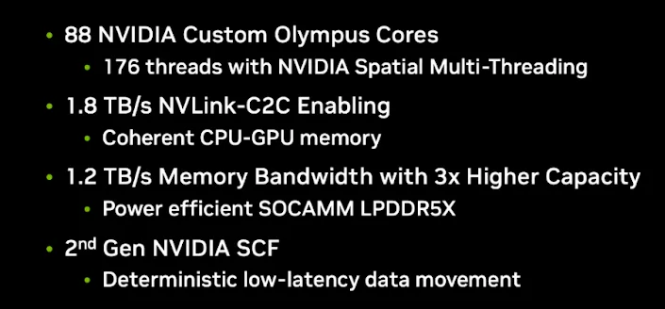
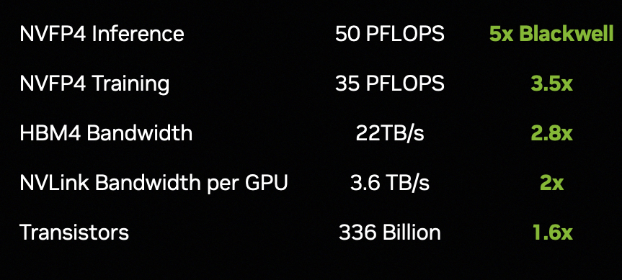
What’s in a Modern AI Server?
https://developer.nvidia.com/blog/inside-the-nvidia-rubin-platform-six-new-chips-one-ai-supercomputer/

Slide 30
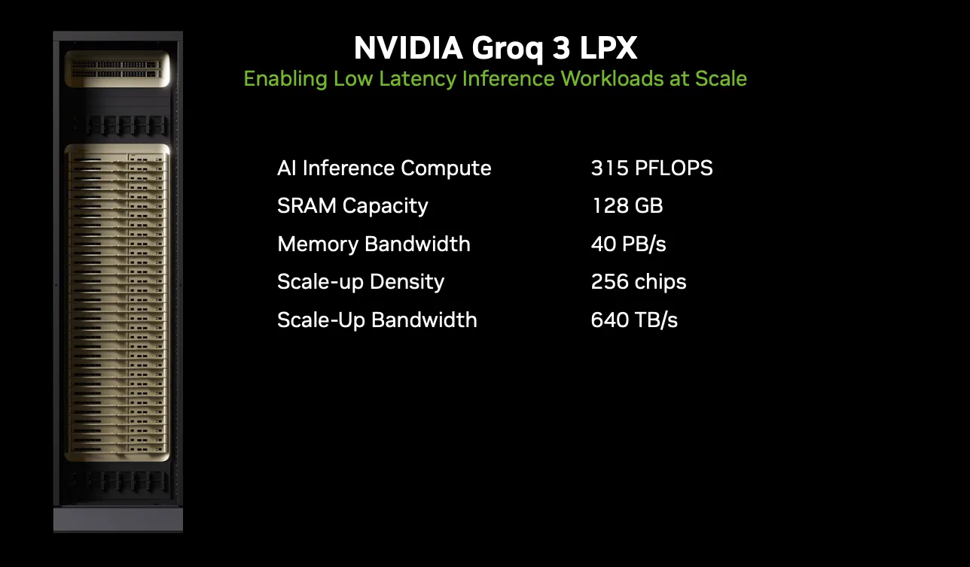
One Step Further…
https://developer.nvidia.com/blog/inside-nvidia-groq-3-lpx-the-low-latency-inference-accelerator-for-the-nvidia-vera-rubin-platform

Slide 31
Scale Out: Warehouse-Scale Computer (WSC)
Single organization
Homogeneity (to some extent)
Cost efficiency at scale
Multiplexing across applications and services
Rent it out!
Many concerns
Infrastructure
Networking
Storage
Software
Power/Energy
Failure/Recovery
…

Slide 32
WSC/Datacenter Architecture
DDR5
PCIe v6
SATA 3
Ethernet
NVMe
Server
Server

Slide 33
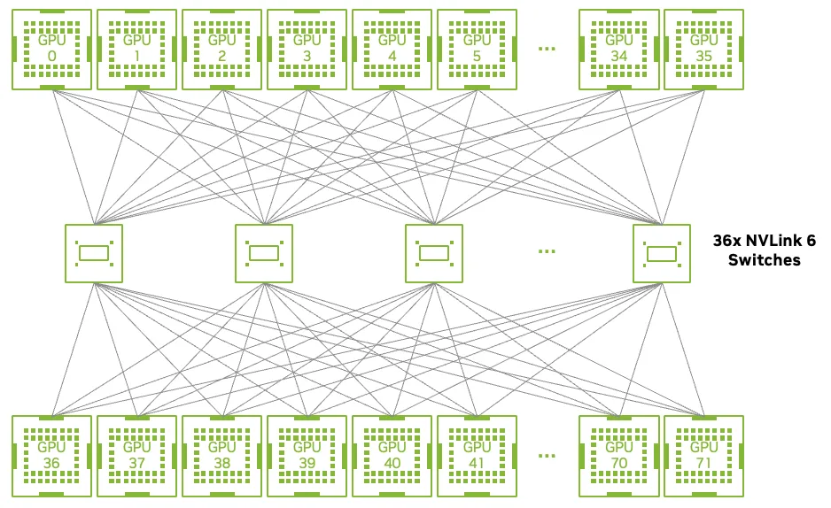
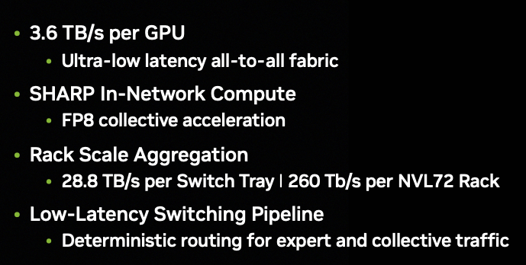
Vera Rubin NVL72 NVLink All-to-All Topology
https://developer.nvidia.com/blog/inside-the-nvidia-rubin-platform-six-new-chips-one-ai-supercomputer/

Slide 34
Datacenter Needs an Operating System
Datacenter is a collection of
Compute
Memory
All connected by an interconnect
Not unlike a computer
Some differences
VERY high level of parallelism
VERY large scale
Diversity of workloads
Resource heterogeneity
Failure is the norm

Slide 35
Three Categories of Software
Platform-level
Software firmware that are present in every machine
Cluster-level
Distributed systems to enable everything
Application-level
User-facing applications built on top

Slide 36
Common “Systems” Techniques
Technique | Performance/Efficiency | Availability/Resilience
Replication & Erasure coding | X | X
Sharding/partitioning | X | X
Scheduling & Load balancing | X
Health & Integrity checks |  | X
Compression & Quantization | X
Centralized controller | X
Canaries |  | X
Speculation & Redundant execution | X

Slide 37
Transformer and attention
https://docs.google.com/presentation/d/1rzFn13uV9SD7PIIDT1j8qh9UHhFCrIBlvvIfoDDgbEw/edit?usp=sharing

