Slide 1
Tutorial 2
Detail Guide for CSS
CSCI 4140: Open-Source Software Project Development Spring 2021
WANG, Chuanwen
21 Jan 2021
Notes:
Thanks to the contribution of Mingxue Zhang, who was the TA of this course last year.

Slide 2
Outlines
Background
Basic Usage
Import CSS.
How to select elements to be stylized?
How to stylized them?
Other issues.
Reference

Slide 3
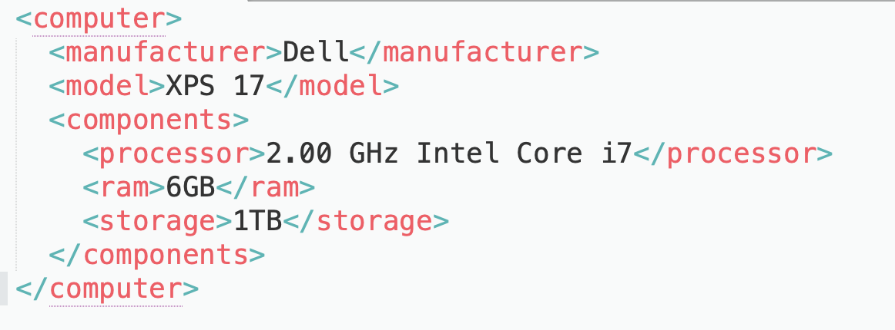
Background
What is CSS - Cascading Style Sheets
style sheet language used for describing the style of a document written in a markup language
Where do we use it?
Markup languages
HTML, XML
Why do we need it?
Enable the separation of presentation and content
Notes:
Markup : uses tags to define elements within a document
Other Mark-up languages
SVG stands for Scalable Vector Graphics, SVG is used to define vector-based graphics for the Web, SVG defines the graphics in XML format
XUL (XML User Interface Language) is Mozilla’s XML-based language for building user interfaces of applications like Firefox
Efficiency and Reusabiity.

Slide 4
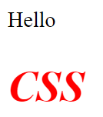
Basic Usage: internal CSS
A simple example: internal CSS
Code
View
<html>
<head>
<style type="text/css">
h1{color:red; font-style:italic;}
</style>
</head>
<body>
Hello <h1>CSS</h1>
</body>
</html>

Slide 5
Basic Usage: internal CSS
Basic elements
Selector and one or more declarations
Declaration = property + style attribute value
<html>
<head>
<style type="text/css">
h1{color:red; font-style:italic;}
</style>
</head>
<body>
Hello <h1>CSS</h1>
</body>
</html>
selector
separator
h1{color:red; font-style:italic;}
property
value
Attention: CSS is case insensitive, except for the names of class and ID when working with HTML

Slide 6
Basic Usage
How to include CSS?
Inline CSS
Internal/embedded CSS
External CSS
So, which one is preferred?
Inline CSS
External CSS
<p style=“color:red; font-style:italic;”>Hello CSS</p>
<head>
<link href="http://www.example.com/my.css"
rel="stylesheet" type="text/css“ />
</head>
Internal CSS
<head>
<style type="text/css">
#s1{color:red; font-style:italic;} </style>
</head>

Slide 7
Basic Usage: selector
Selector
It points to the HTML elements which need to be stylized
How to specify the elements?
Tag name,
ID
Class
Attribute
…

Slide 8
How do we select elements?

Slide 9
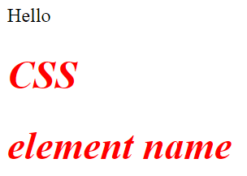
Basic Usage: selector by tag name
Summon selector by its tag name
Code
View
<html>
<head>
<style type="text/css">
h1{color:red; font-style:italic;}
</style>
</head>
<body>
Hello <h1>CSS</h1>
<h1>element name</h1>
</body>
</html>

Slide 10
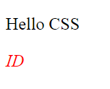
Basic Usage: selector by ID
Summon selector by its ID
Code
View
<html>
<head>
<style type="text/css">
#s1{color:red; font-style:italic;}
</style>
</head>
<body>
<p>Hello CSS</p>
<p id="s1">ID</p>
</body>
</html>
Attention: an ID cannot start with a number!

Slide 11
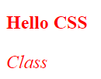
Basic Usage: selector by class name
Summon selector by class
Code
View
<html>
<head>
<style type="text/css">
.it {
font-style:italic;
color: red;}
.bold {
font-weight:bold;
color: red;}
</style>
</head>
<body>
<p class=‘bold’>Hello CSS</p>
<p class=‘it’>ID</p>
</body>
</html>

Slide 12
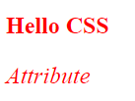
Basic Usage: selector by attribute
Summon selector by attribute
Code
View
<html>
<head>
<style type="text/css">
[title=it] {
font-style:italic;
color: red;}
[name=bold] {
font-weight:bold;
color: red;}
</style>
</head>
<body>
<p name="bold">Hello CSS</p>
<p title="it">Attribute</p>
</body>
</html>

Slide 13
Basic Usage: selector by attribute
More usages about attribute name in the selector
Selector
Example
Example description
[attribute] | [target] | Selects all elements with a target attribute
[attribute=value] | [target=_blank] | Selects all elements with target="_blank"
[attribute~=value] | [title~=flower] | Selects all elements with a title attribute containing the word "flower"
[attribute|=value] | [lang|=en] | Selects all elements with a lang attribute value starting with "en"

Slide 14
Basic Usage: selector by attribute
More usages about attribute name in the selector
Selector
Example
Example description
[attribute^=value] | a[href^="https"] | Selects every <a> element whose href attribute value begins with "https"
[attribute$=value] | a[href$=".pdf"] | Selects every <a> element whose href attribute value ends with ".pdf"
[attribute*=value] | a[href*="w3schools"] | Selects every <a> element whose href attribute value contains the substring "w3schools"

Slide 15
Basic Usage: combinator
Combinators
It explains the relationship between selectors.
Four types
Descendant selector (space)
Child selector (>)
Adjacent sibling selector (+)
General sibling selector (~)

Slide 16
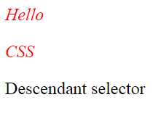
Basic Usage: combinator
Combinator: Descendant selector (space)
Code
View
<html>
<head>
<style>
div p {
font-style:italic;
color: red;}
</style>
</head>
<body>
<div>
<p>Hello</p>
<span><p>CSS</p></span>
</div>
<p>Descendant selector</p>
</body>
</html>

Slide 17
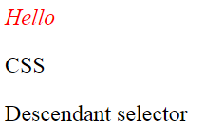
Basic Usage: combinator
Combinator: Child selector (>)
Code
View
<html>
<head>
<style>
div > p {
font-style:italic;
color: red;}
</style>
</head>
<body>
<div>
<p>Hello</p>
<span><p>CSS</p></span>
</div>
<p>Descendant selector</p>
</body>
</html>

Slide 18
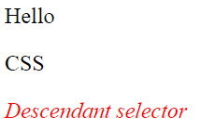
Basic Usage: combinator
Combinator: Adjacent sibling selector (+)
Code
View
<html>
<head>
<style>
div + p {
font-style:italic;
color: red;}
</style>
</head>
<body>
<div>
<p>Hello</p>
<span><p>CSS</p></span>
</div>
<p>Descendant selector</p>
</body>
</html>

Slide 19
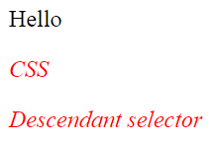
Basic Usage: combinator
Combinator: General sibling selector (~)
Code
View
<html>
<head>
<style>
div ~ p {
font-style:italic;
color: red;}
</style>
</head>
<body>
<div>
<p>Hello</p>
</div>
<p>CSS</p>
<p>Descendant selector</p>
</body>
</html>

Slide 20
How do we stylize selected elements?

Slide 21
Basic Usage: declarations
Properties for Declarations:
Background
Borders
Margins
Box Model
Display
Position
Overflow
Align
...
layout

Slide 22
Basic Usage: background property
Background
It is used to define the background effects for elements.
CSS background properties:
background-color
background-image
background-repeat
background-attachment
background-position
Examples
color
image / repeat / attachment / position

Slide 23
Basic Usage: border property
Border
It allows you to specify the style, width, and color of an element's border.
The border-style properties:
dotted - Defines a dotted border
dashed - Defines a dashed border
solid - Defines a solid border
double - Defines a double border
…
Examples
Different border-styles

Slide 24
Basic Usage: margins property
Margins
It is used to create space around elements, outside of any defined borders.
Its properties:
margin-top, margin-right, margin-bottom and margin-left
Possible values for these properties
auto - the browser calculates the margin
length - specifies a margin in px, pt, cm, etc.
% - specifies a margin in % of the width of the containing element
inherit - specifies that the margin should be inherited from the parent element
Example
Notes:
The properties for specifying the margin for each side of an element

Slide 25
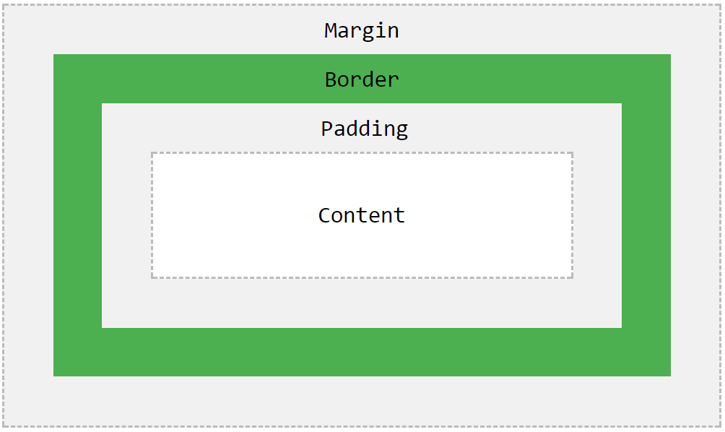
Basic Usage: box model property
Box Model
It is is essentially a box that wraps around every HTML element.
It consists of
Margins
Borders
Padding
Content
Example

Slide 26
Basic Usage: display property
Display
It specifies if/how an element is displayed.
value: inline / block / none
Example

Slide 27
Basic Usage: position property
Position
It specifies the type of positioning method used for an element.
The position properties
static
relative
fixed
absolute
sticky
Overlapping issues
z-index
Example

Slide 28
Basic Usage: overflow property
Overflow
It controls what happens to content that is too big to fit into an area.
Clip
Add scrollbars
Its properties
visible - Default. The overflow is not clipped. It renders outside the element's box
hidden - The overflow is clipped, and the rest of the content will be invisible
scroll - The overflow is clipped, but a scrollbar is added to see the rest of the content
auto - If overflow is clipped, a scrollbar should be added to see the rest of the contentOverlapping issues
overflow-x / overflow-y
Example

Slide 29
Basic Usage: float & clear
Float
It specifies how an element should float.
Its properties
left - The element floats to the left of its container
right- The element floats to the right of its container
none - The element does not float (will be displayed just where it occurs in the text)
inherit - The element inherits the float value of its parent
Example
Clear
it specifies what elements can float beside the cleared element and on which side.
Its properties
…
both - No floating elements allowed on either the left or the right side
Example

Slide 30
Basic Usage: inline-block property
Inline-block
It can create a grid of boxes that fills the browser width and wraps nicely (when the browser is resized) easily
Example

Slide 31
Basic Usage: align property
Align
It specifies how to align an element
Methods
Center Align Elements
Center Align Text
Center an Image
Left and Right Align (position / float)
Center Vertically (padding / line-height / position & transform)

Slide 32
Other Issues.

Slide 33
Basic Usage: pseudo-class
Pseudo-classes
Can we dynamically stylish the presentation with user-interaction?
A pseudo-class is used to define a special state of an element.
Syntax
Examples
Style an element when a user mouses over it
Simple Tooltip Hover
selector:pseudo-class { property:value; }

Slide 34
Basic Usage: pseudo-elements
Pseudo-elements
Can we partially stylish the presentation of the content?
A pseudo-element is used to style specified parts of an element.
Examples
::first-line / ::first-letter
::before
::after
::selection

Slide 35
Resolution dependent layouts
How to display web contents for devices in different size in a proper way?
Define CSS rules when dealing with different resolution devices
Define rules outside the CSS file
Example 1
<link href="my1.css" rel="stylesheet" type="text/css" media="screen and (min-device-width: 700px)"/>
Example 2
<link href="my2.css" rel="stylesheet" type="text/css" media="screen and (min-width: 700px) and (max-width: 900px)"/>

Slide 36
Resolution dependent layouts
How to display web contents for devices in different size in a proper way?
Define CSS rules when dealing with different resolution devices
Define rules inside the CSS file
Example 3
@media only screen and (max-device-width: 480px){
h1{color:red; font-style:italic;}
}
@media only screen and (min-device-width: 481px){
h1{color:blue; font-weight:bold;}
}

Slide 37
Reference
https://www.w3schools.com/css/default.asp
https://en.wikipedia.org/wiki/Cascading_Style_Sheets
https://www.htmlgoodies.com/beyond/css/targeting-specific-devices-in-your-style-sheets.html
https://css-tricks.com/resolution-specific-stylesheets/

Slide 38
Thanks for listening！
Q & A

