Slide 1
Basic Git Tutorial
Yang YU
Parts of the material are credit to Ding Qian &Wang Yue

Slide 2
Version Control System
Better control of your source code with Git
Clear picture of your development
Never worried about writing wrong code
Easier coordination with others
http://git-scm.com/

Slide 3
Installation
Linux (Ubuntu)
sudo apt-get install git
Mac
Install homebrew first from http://brew.sh
brew install git
Windows
Install Cygwin first, then you have a UNIX shell
Install git for windows (http://gitforwindows.org/)
Your own way…

Slide 4
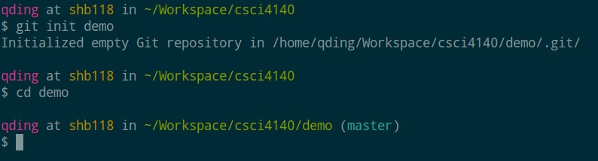
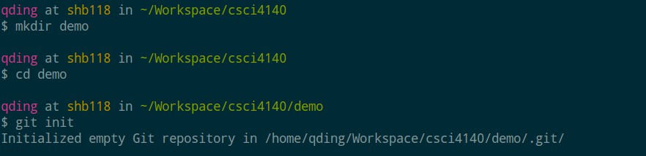
Initialization
Create a local git repository : git init
same as

Slide 5
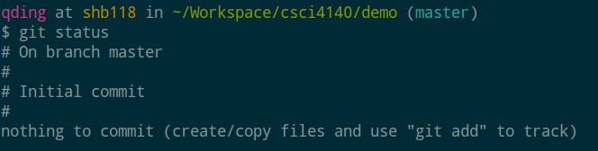
Working with Git
git status
Check the status of your git repository
Use this command before critical changes like commit or push!!!

Slide 6
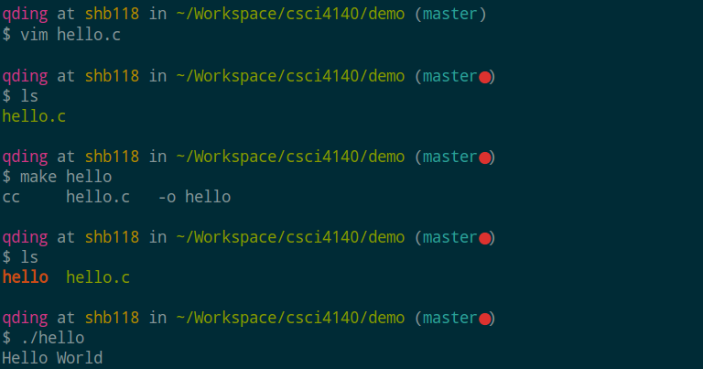
Working with Git
// hello.c
#include <stdlib.h> #include <stdio.h>
int main()
{
printf ("Hello World\n"); return 0;
}

Slide 7
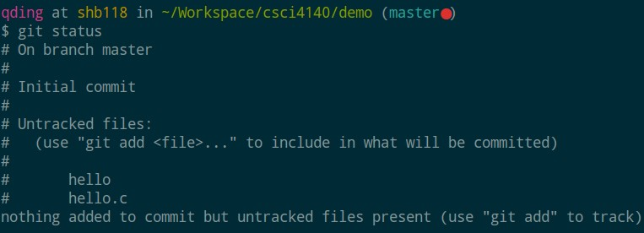
Working with Git
The status of each file
unstaged/untracked: file change not tracked by git
tracked/staged: file change tracked by git

Slide 8
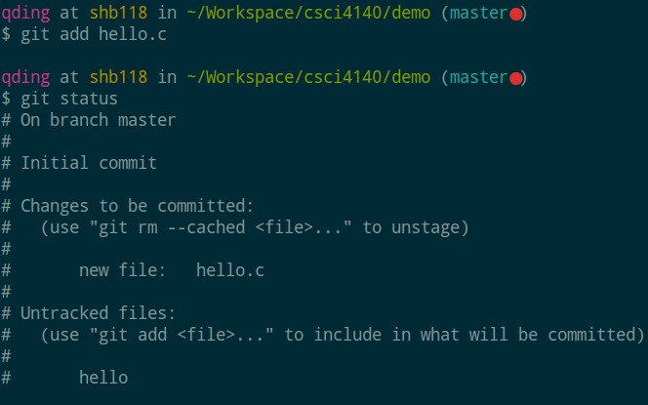
Working with Git
git add <file_path>
To add unstaged/untracked file to git repository
hello.c become tracked/staged now

Slide 9
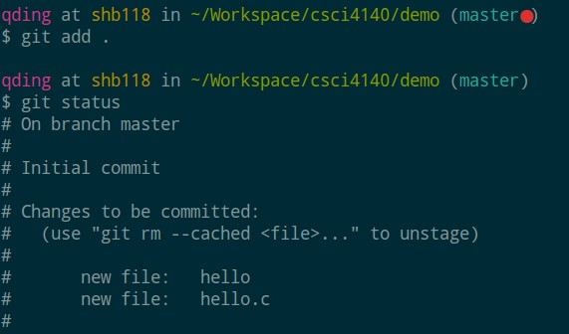
Working with Git
git add <dir_path>
Add all file (recursively) in the directory to git repository
hello.c and hello become tracked/staged now

Slide 10
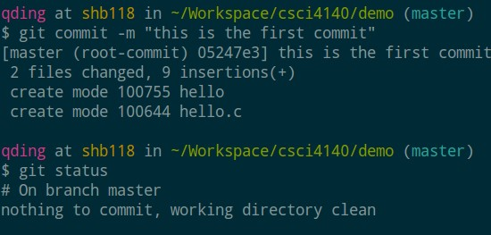
Working with Git
git commit –m “commit message”
– Make the changes persistent as a commit

Slide 11
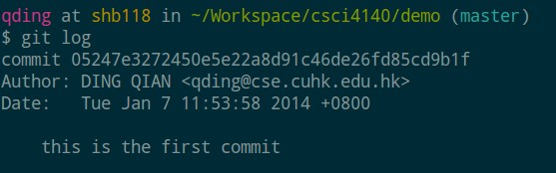
Working with Git
git log
– Check your commit history
commit hash key
author and date info
commit message

Slide 12
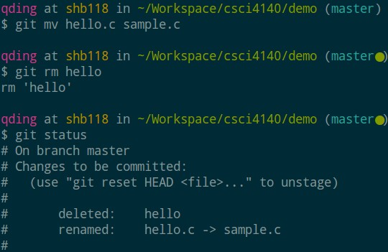
Working with Git
git mv <old_file> <new_file>
Rename tracked file or move to another directory
git rm <file_path>
Delete tracked file
Similar to git add, the changes made by git mv/rm is staged by default, you can commit them directly

Slide 13
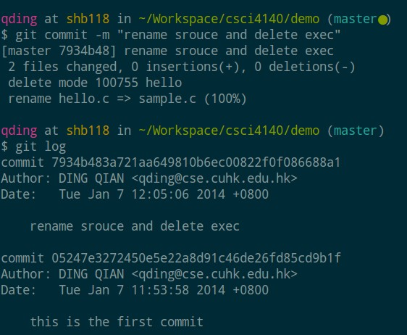
Working with Git
Commit again, now we have two commits

Slide 14
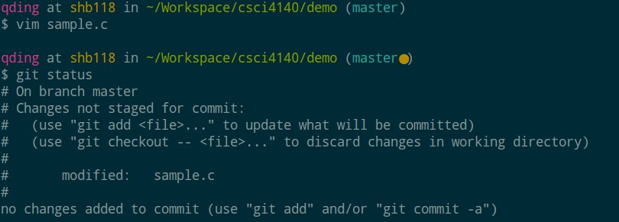
Working with Git
// hello.c #include <stdlib.h> #include <stdio.h>
Let’s modify sample.c
int main()
{
printf ("Hello World\n"); printf ("Hello CUHK\n"); return 0;
}
Similar to create a new file, after modifying a existing file in the repository, the change is unstaged by default, you need to use git add again to let git know you want to stage the change.

Slide 15
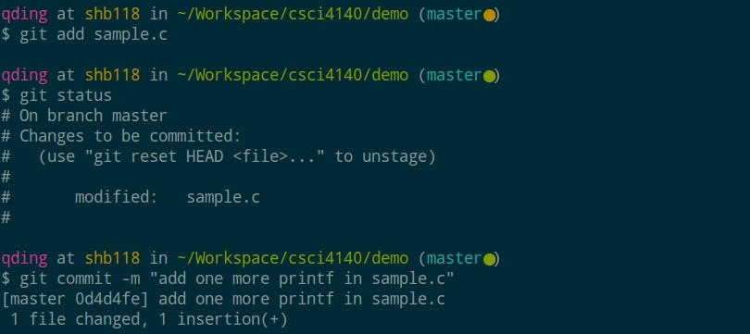
Working with Git
Let’s commit the modified sample.c

Slide 16
Working with Git
Sometimes, you made some changes to your code, but you regretted. So how to rollback?
– Case 1: the changed is unstaged

Slide 17
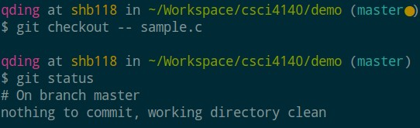
Working with Git
Sometimes, you made some changes to your code, but you regretted. So how to rollback?
Case 1: the changed is unstaged
git checkout -- <file_path>
This let you rollback to the latest commit

Slide 18
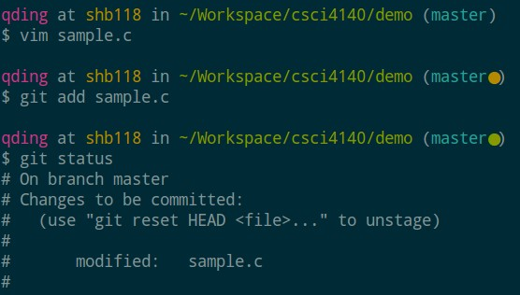
Working with Git
Sometimes, you made some changes to your code, but you regretted. So how to rollback?
– Case 2: the changed is staged

Slide 19
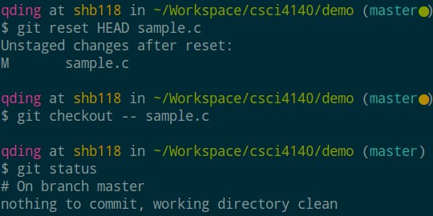
Working with Git
Sometimes, you made some changes to your code, but you regretted. So how to rollback?
Case 2: the changed is staged
git reset HEAD <file_path>
git checkout -- <file_path>
– You need one additional step to unstage first
What if I don’t
unstage??? Try it yourself.

Slide 20
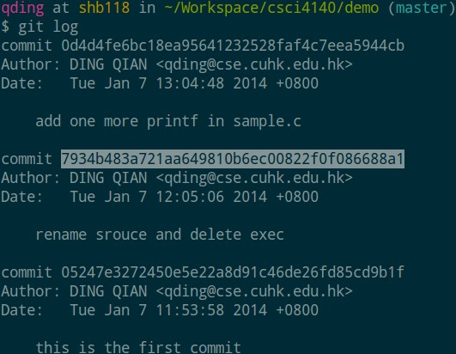
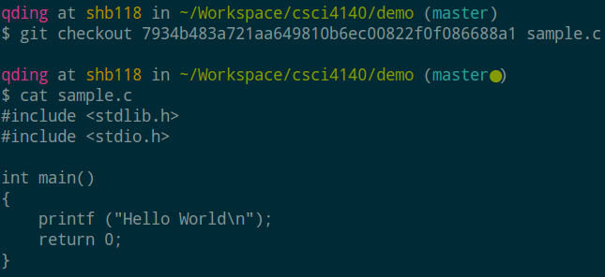
Working with Git
Sometimes, you made some changes to your code, but you regretted. So how to rollback?
Case 3: You want to rollback to previous commit, not the latest one
git checkout <commit_hash> <file_path>

Slide 21
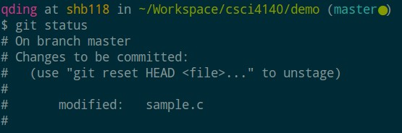
Working with Git
Sometimes, you made some changes to your code, but you regretted. So how to rollback?
Case 3: You want to rollback to previous commit, not the latest one
By checkout, the changes are staged already

Slide 22
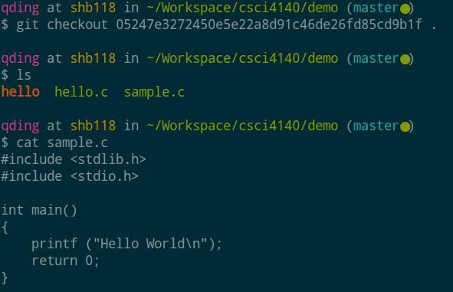
Working with Git
Sometimes, you want to rollback your entire directory to a previous commit
– git checkout <commit_hash> <dir>
Don’t forget this dot, it specifies the directory you want to rollback

Slide 23
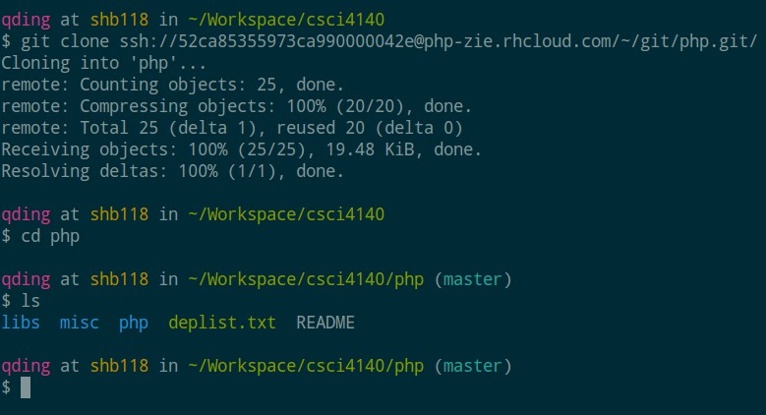
Synchronize with remote server
Clone a remote git repository tracking central server: git clone <url>

Slide 24
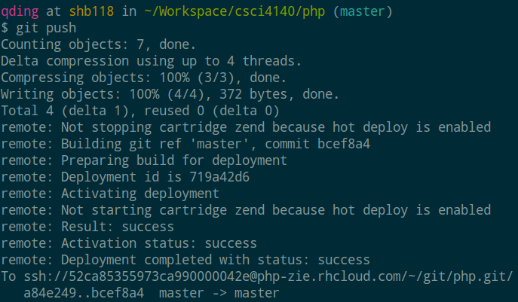
Synchronize with remote server
Once you commit your changes, you can push your local commits to the remote server by
– git push

Slide 25
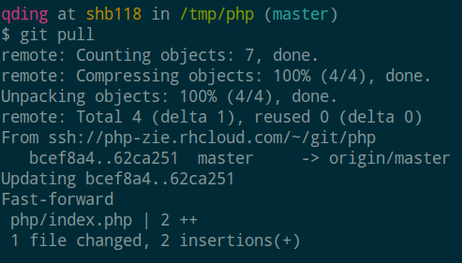
Synchronize with remote server
If another developer also tracking this repo, he can get your update via
– git pull

Slide 26
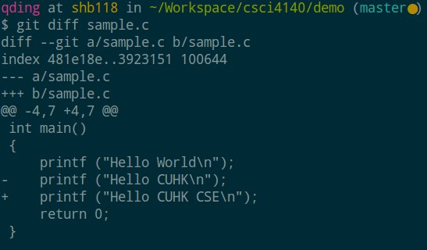
Advanced Techniques
git diff <file_path>
Get the difference between your working copy (unstaged) and the staged copy
You can try git add <file_path> and then git diff
<file_path> to see what will happen

Slide 27
Advanced Techniques
.gitignore file
Let git ignores and never tracks particular file types or files
Create a hidden file named “.gitignore” under your repository
Each line in the .gitignore file named a type or a file that will be ignored

Slide 28
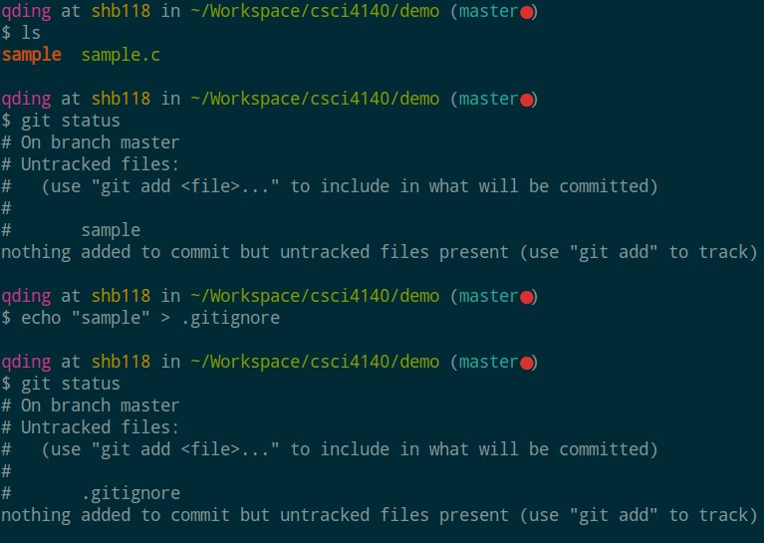
Advanced Techniques
.gitignore file

Slide 29
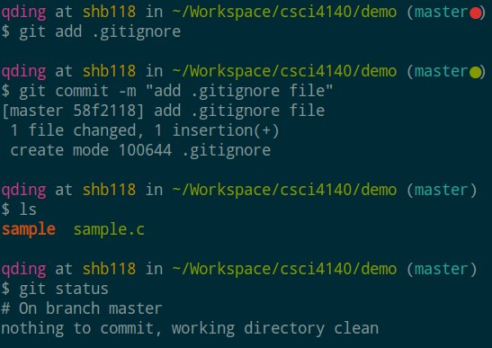
Advanced Techniques
.gitignore file
//.gitignore file
*.o img/ sample
*.c

Slide 30
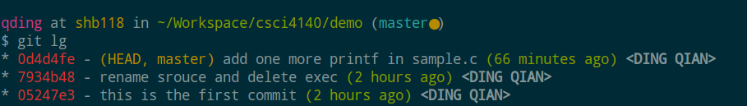
Advanced Techniques
Config your git with your username, email, customized log style
git config --global user.name "John"
git config --global user.email "abc@example.com"
git config --global alias.lg "log --color --graph -- pretty=format:'%Cred%h%Creset -%C(yellow)%d%Creset
%s %Cgreen(%cr) %C(bold blue)<%an>%Creset' --abbrev-
commit --"
These short hash values can also be used with git checkout

Slide 31
Basic Branching and Merging
Let’s go through a simple example of branching and merging with a workflow that you might use in the real world. You’ll follow these steps:
Do some work on a website.
Create a branch for a new story you’re working on.
Do some work in that branch.
At this stage, you’ll receive a call that another issue is critical and you
need a hotfix. You’ll do the following:
Switch to your production branch.
Create a branch to add the hotfix.
After it’s tested, merge the hotfix branch, and push to production.
Switch back to your original story and continue working.
https://git-scm.com/book/en/v2/Git-Branching-Basic-Branching-and-Merging

Slide 32

Basic Branching and Merging
If you want to create a new branch and switch to it at the same time
git checkout –b [branch name]
git branch [branch name], git checkout [branch name]

Slide 33
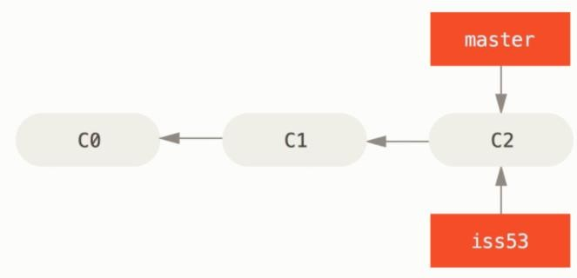
Basic Branching and Merging
Assume the current commit flow is as following:
https://git-scm.com/book/en/v2/Git-Branching-Basic-Branching-and-Merging

Slide 34
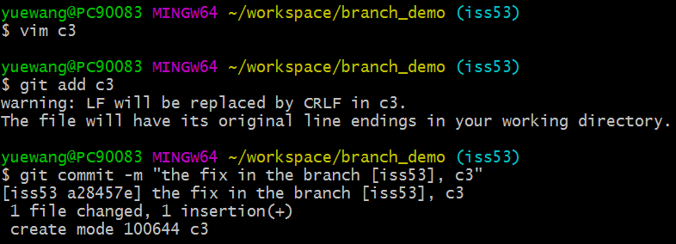
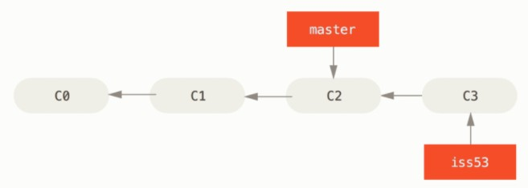
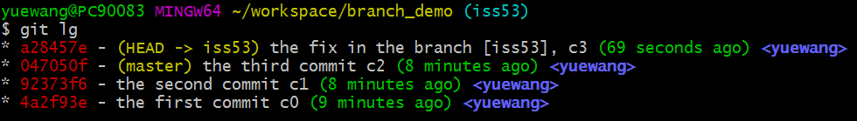
Basic Branching and Merging

Slide 35
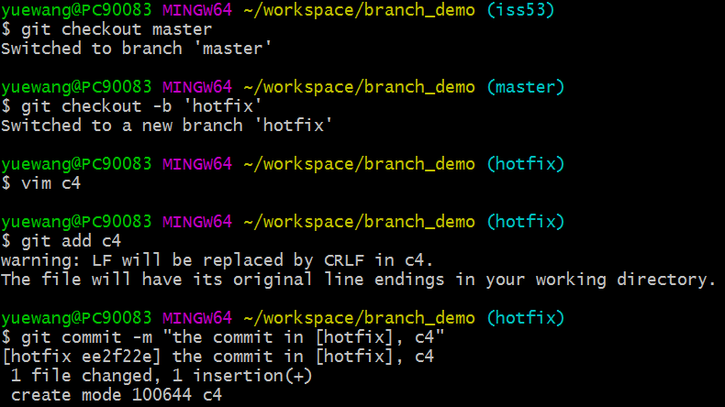
Basic Branching and Merging
Return back to the master branch and create a new branch hotfix and work on it

Slide 36
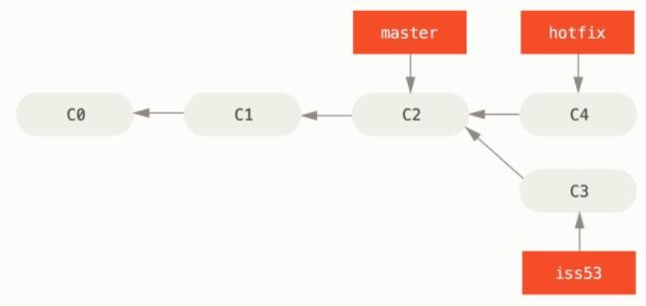
Basic Branching and Merging
Now the snapshot of the commit is like:

Slide 37
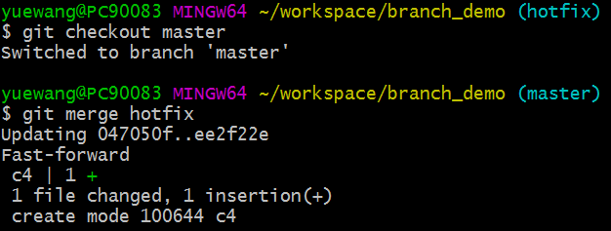
Basic Branching and Merging
We want to merge the branch hotfix into the master branch
– git merge [branch name]
No conflict!
Merge successfully

Slide 38
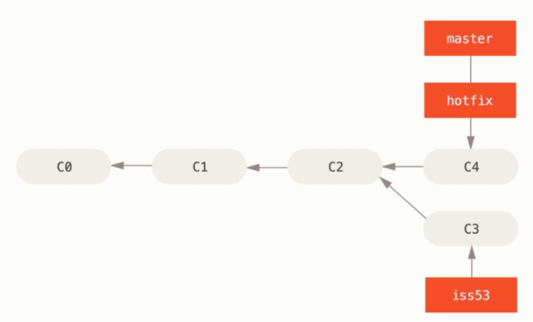
Basic Branching and Merging
Now the snapshot of the commit is like:

Slide 39

Basic Branching and Merging
We can delete the useless branch hotfix now
– git branch –d [branch name]

Slide 40
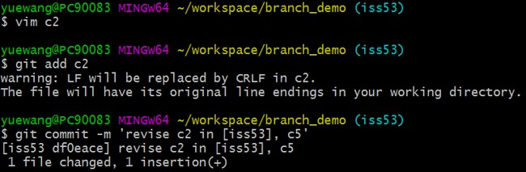
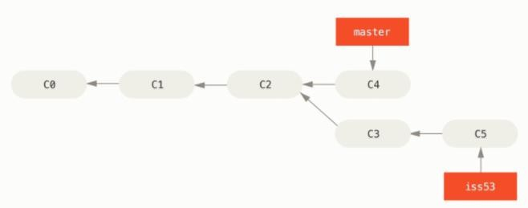
Basic Branching and Merging
Switch to iss53 and work on it
Now the snapshot of the commit is like:

Slide 41
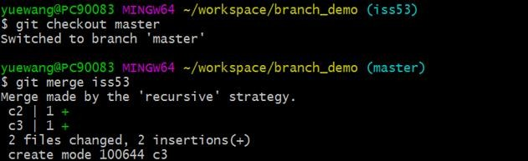
Basic Branching and Merging
Merge iss53 into the master branch

Slide 42
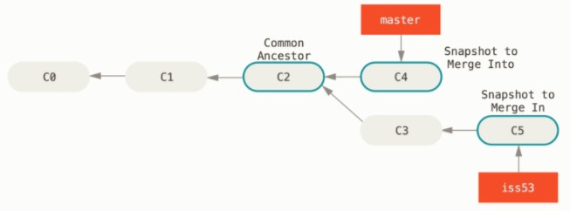
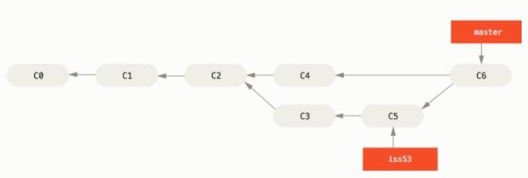
Basic Branching and Merging
The snapshot will be changed in the way as:

Slide 43
Basic Branching and Merging
Conflicts may happen when merge
Assume the first commit in the master is to create a readme file as “a”
The second commit: create a branch[op1] to revise the readme as “b”
The third commit: return to master and revise the readme as “c”
Finally merge [op1] into master
What will happen?

Slide 44
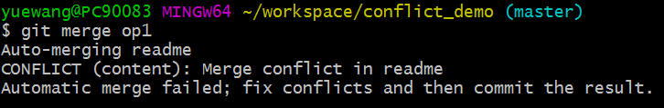
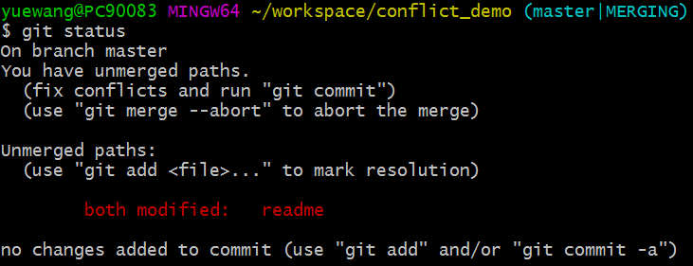
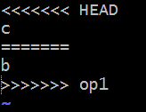
Basic Branching and Merging
You need to resolve the conflict in person

Slide 45
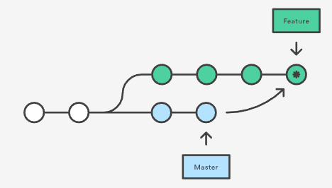
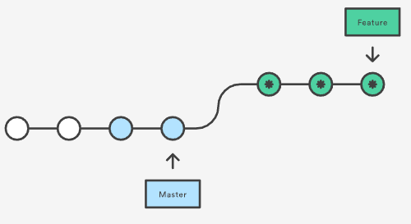
Merging vs. Rebasing
Tradeoff between safe and clean
merge
rebase
https://www.atlassian.com/git/tutorials/merging-vs-rebasing

Slide 46
Advanced Techniques
A successful Git branching model
http://nvie.com/posts/a-successful-git-branching- model/
Basic branch and merge operation
http://git-scm.com/book/en/Git-Branching-Basic- Branching-and-Merging
Git tutorial reference
http://www.cs.columbia.edu/~sedwards/classes/2 013/4840/git-tutorial.pdf

Slide 47
What is github?
www.github.com
Largest web-based git repository hosting service
hosts ‘remote repositories’
Allows for code collaboration with anyone online
Adds extra functionality on top of git
UI, documentation, bug tracking, feature requests, pull requests, and more!
Free public repository for everyone and free private repository for students

Slide 48
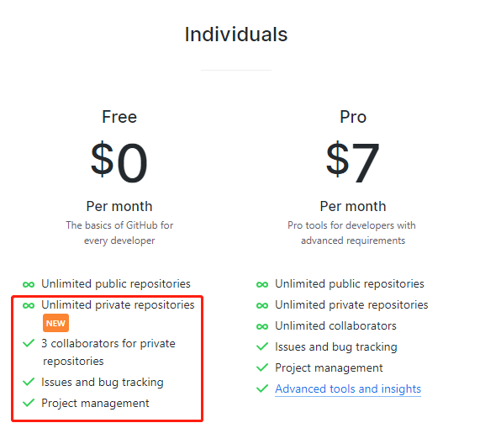
Free public/private repositories ! ☺

