Slide 1
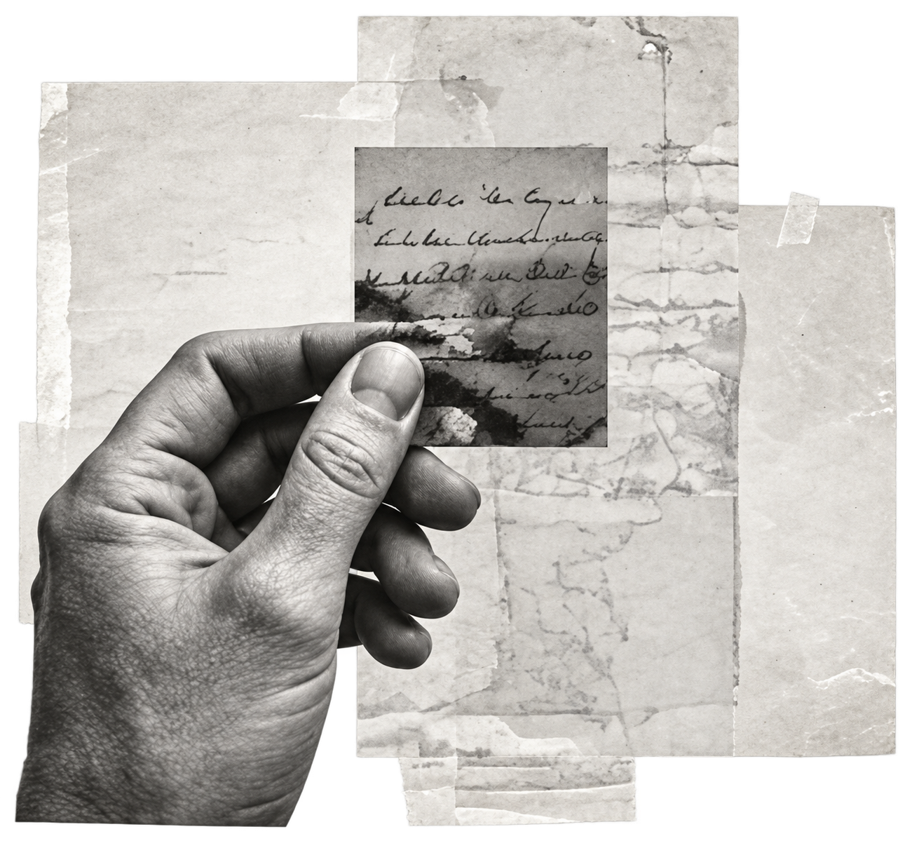
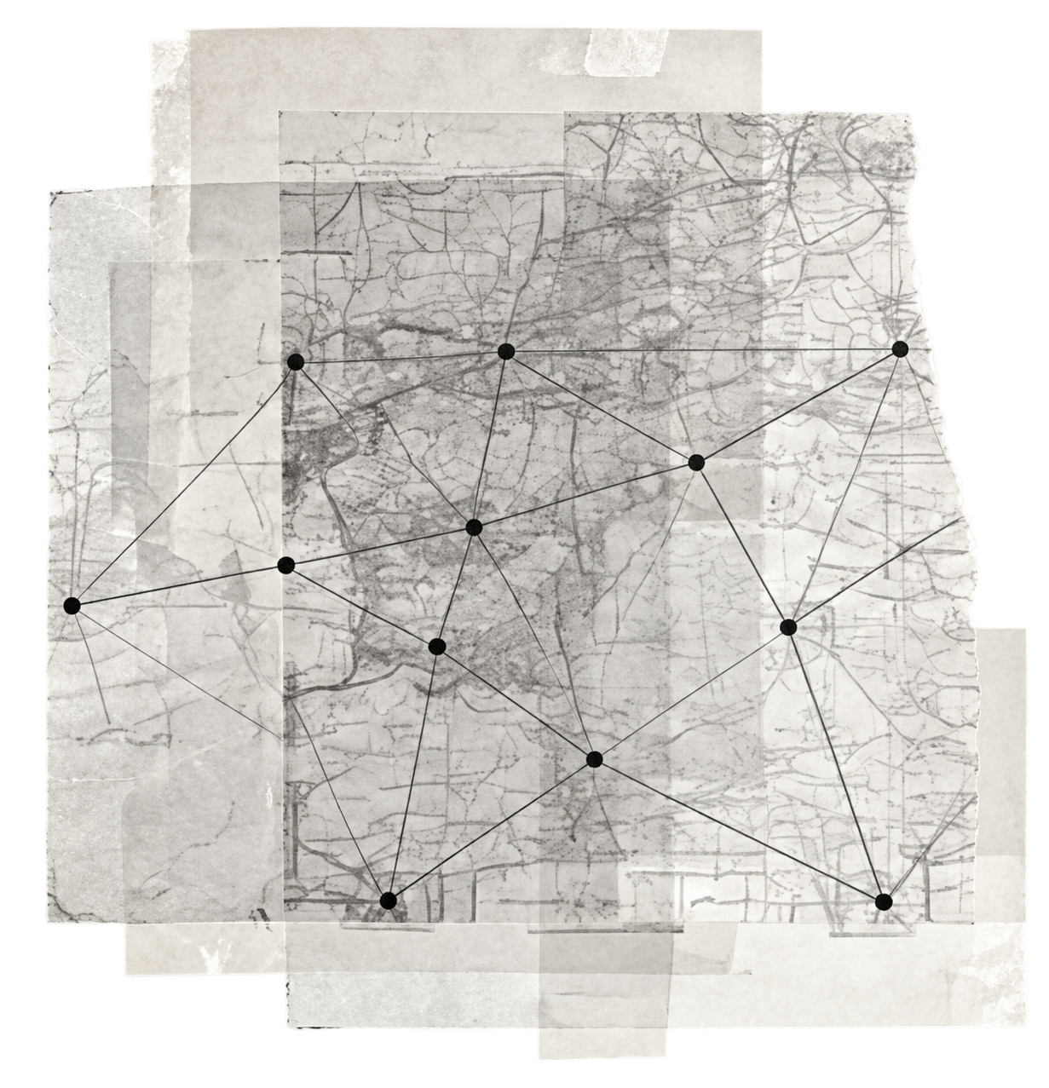
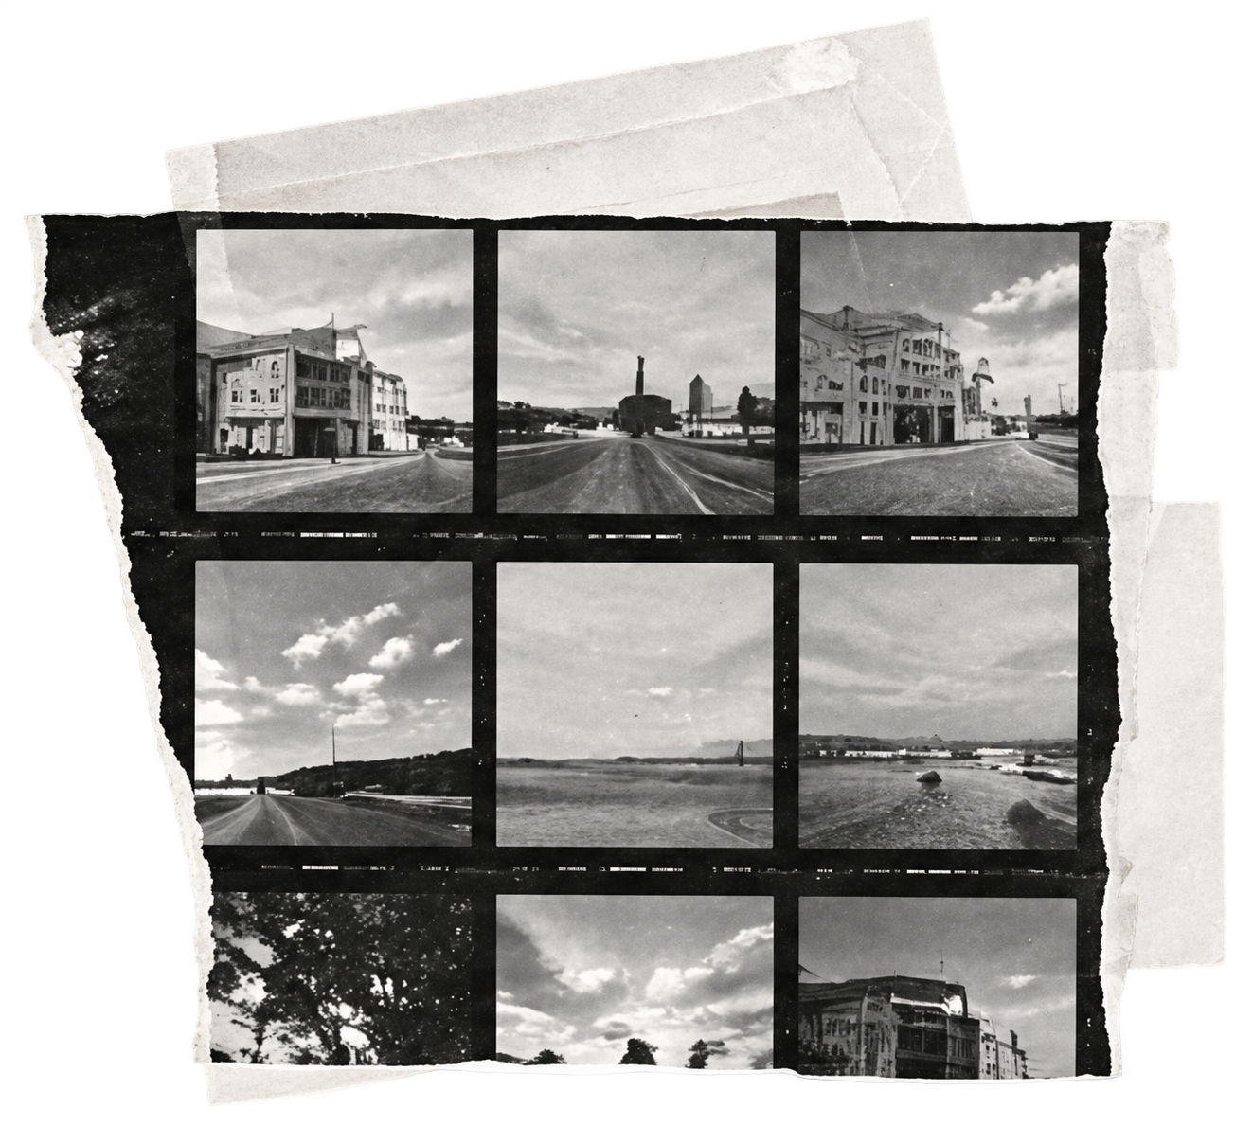
Collect. Connect. Challenge.
Three moves for a thought worth keeping.
Collect
Connect
Challenge
Keep the source close.
Put distant ideas in contact.
Ask what the pattern leaves out.
FIELD NOTES / 03
Notes:
[SlidePoise sources] Generated target visual: /Users/henry/Codes/AI_slide_drafting/examples/personal-thinking-system/run/slides/s03-practice/work/accepted-slide.png

