Slide 1
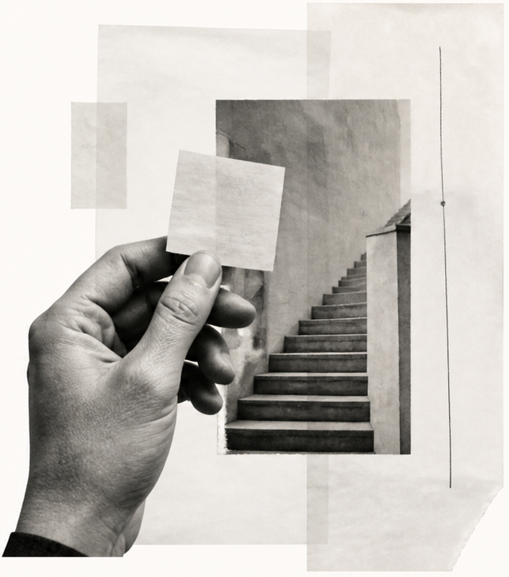
A second
thinking
system
Working with AI without outsourcing a point of view.
FIELD NOTES / 01
An essay in five parts
Notes:
[SlidePoise sources] Generated target visual: /Users/henry/Codes/AI_slide_drafting/examples/personal-thinking-system/run/slides/s01-opening/work/accepted-slide.png

