Slide 1
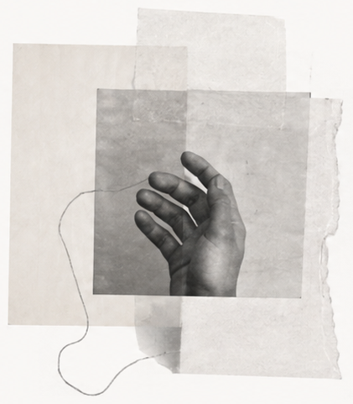
The point of
view is still
yours.
Let the system widen the field.
Choose what deserves to remain.
A second thinking system. A first-person responsibility.
FIELD NOTES / 05
Notes:
[SlidePoise sources] Generated target visual: /Users/henry/Codes/AI_slide_drafting/examples/personal-thinking-system/run/slides/s05-close/work/accepted-slide.png

