Slide 1
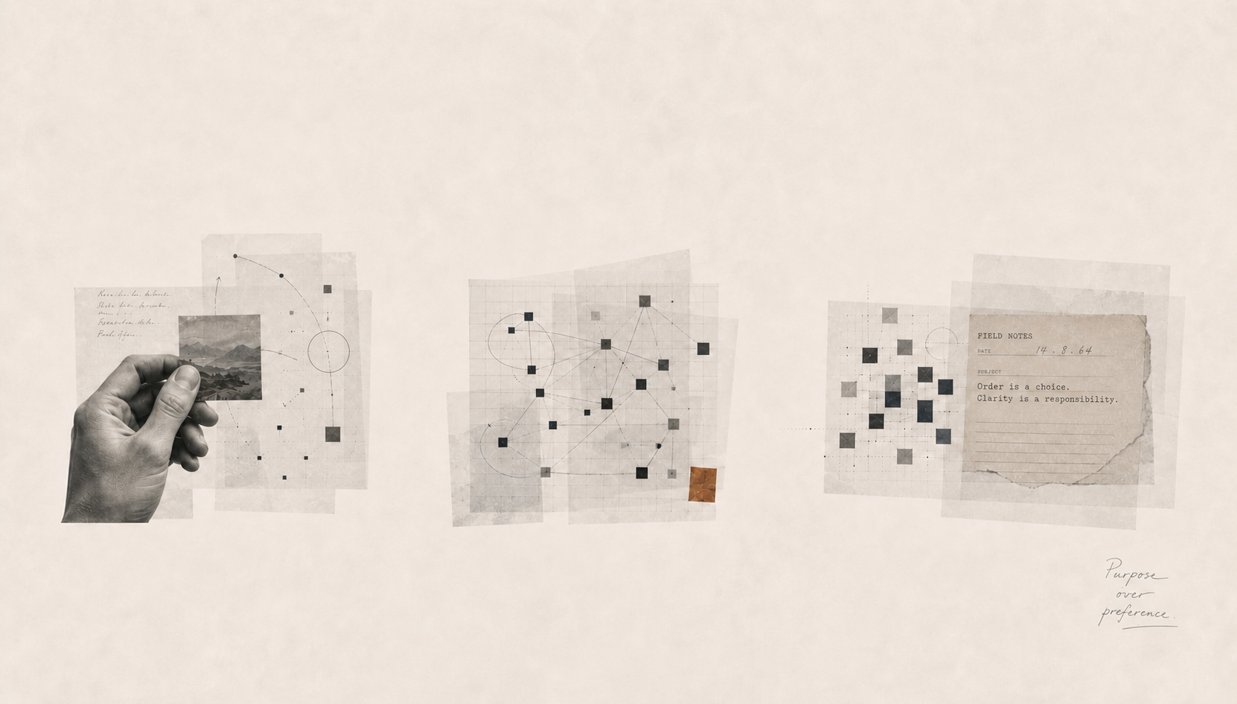

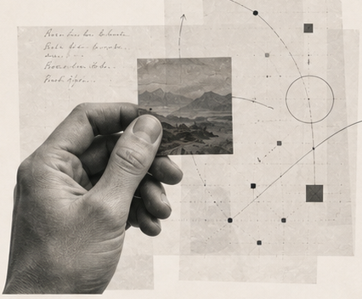
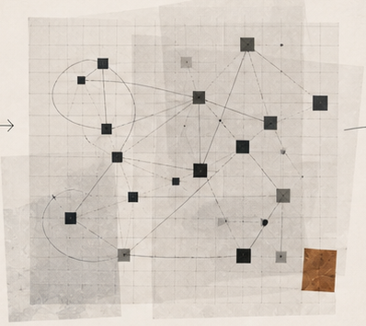
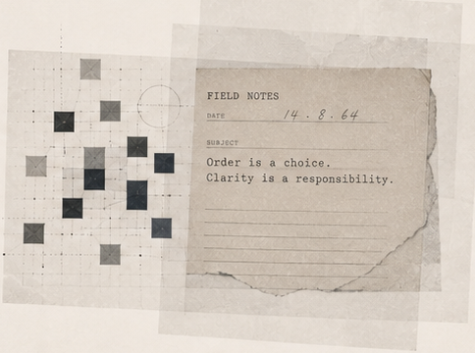

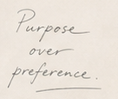
FRAGMENTS
PORTFOLIO PROFILE
No. 27-P
BECOME A POINT OF VIEW
Designer & Strategist
Obsessive about clarity.
Driven by meaning.
Studio Archive
Personal Work
2024
01
02
03
COLLECT
ORGANIZE
ARTICULATE
Observations
Themes
Point of view
Not everything is noise.
I notice. I collect.
Patterns emerge.
I connect. I distill.
A point of view is not given.
It’s built.
OBSERVE
ORGANIZE
ARTICULATE
Notes:
[Slidecraft sources] Generated target visual: /Users/henry/Codes/AI_slide_drafting/output/fragments-reconstruction/work/accepted-slide.png

