Slide 1
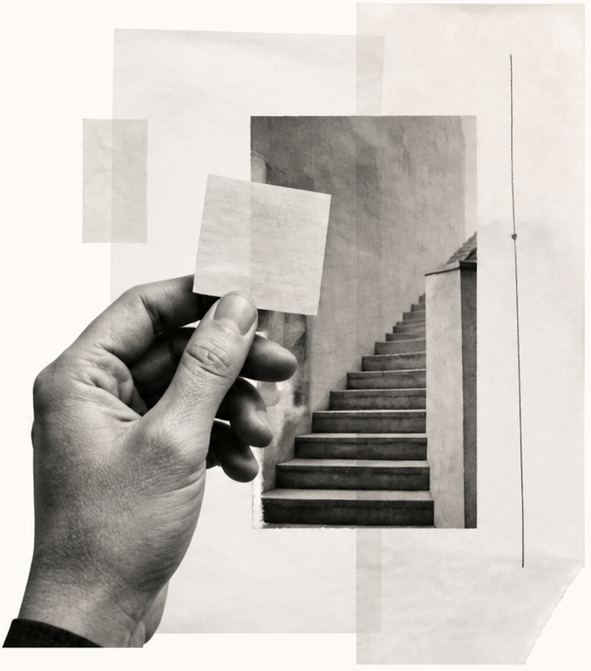
A second
thinking
system
Working with AI without outsourcing a point of view.
FIELD NOTES / 01
An essay in five parts
Notes:
[SlidePoise sources]
Generated target visual: /Users/henry/Codes/AI_slide_drafting/output/showcase-revisions/personal-v2-authoring/slides/s01-opening/work/accepted-slide.png

Slide 2
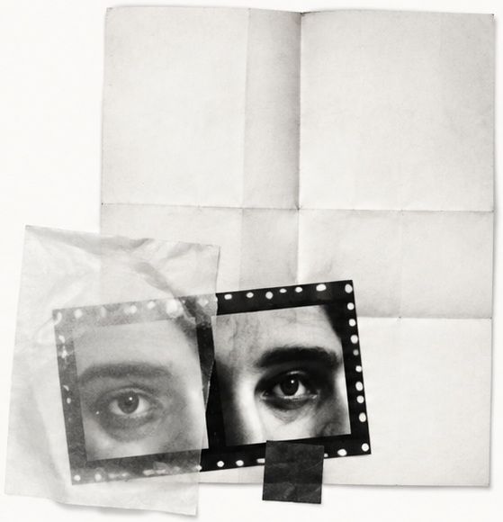
Keep the
question open.
A fast answer can close a thought too early.
What am I assuming?
What would change my mind?
The useful conversation begins with a better question.
FIELD NOTES / 02
Notes:
[SlidePoise sources]
Generated target visual: /Users/henry/Codes/AI_slide_drafting/output/showcase-revisions/personal-v2-authoring/slides/s02-question/work/accepted-slide.png

Slide 3
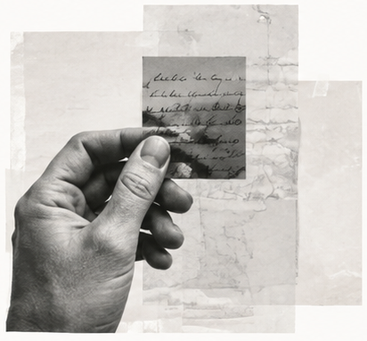
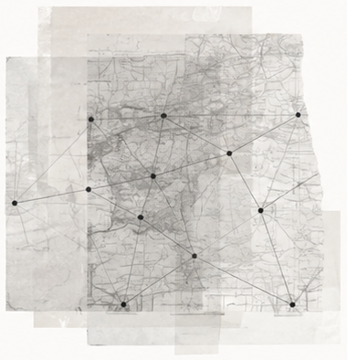
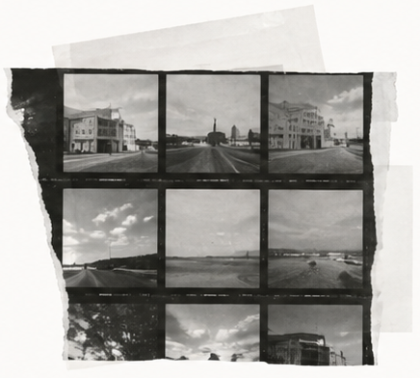
Collect. Connect. Challenge.
Three moves for a thought worth keeping.
Collect
Connect
Challenge
Keep the source close.
Put distant ideas in contact.
Ask what the pattern leaves out.
FIELD NOTES / 03
Notes:
[SlidePoise sources]
Generated target visual: /Users/henry/Codes/AI_slide_drafting/output/showcase-revisions/personal-v2-authoring/slides/s03-practice/work/accepted-slide.png

Slide 4
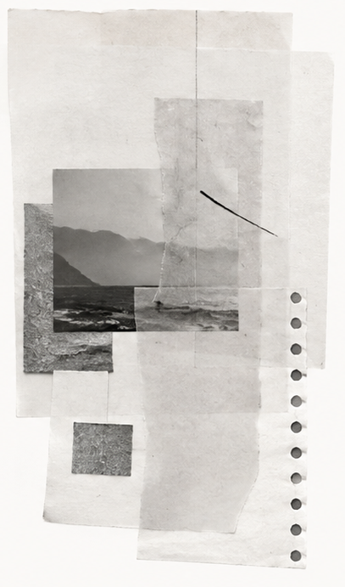
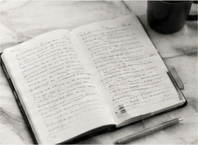
Leave
a trace of
01
Source
What did I encounter?
the thinking.
02
Question
What does it unsettle?
03
Counterargument
What is the strongest objection?
04
Decision
A small record makes
a conversation reusable.
What will I carry forward?
FIELD NOTES / 04
Notes:
[SlidePoise sources]
Generated target visual: /Users/henry/Codes/AI_slide_drafting/output/showcase-revisions/personal-v2-authoring/slides/s04-trace/work/accepted-slide.png

Slide 5
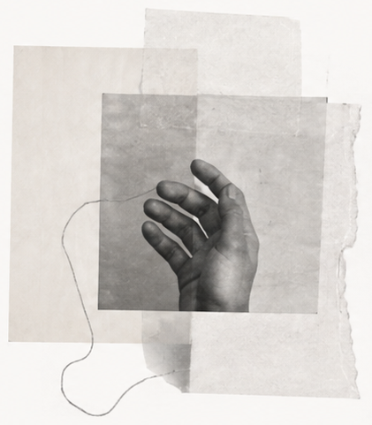
The point of
view is still
yours.
Let the system widen the field.
Choose what deserves to remain.
A second thinking system. A first-person responsibility.
FIELD NOTES / 05
Notes:
[SlidePoise sources]
Generated target visual: /Users/henry/Codes/AI_slide_drafting/output/showcase-revisions/personal-v2-authoring/slides/s05-close/work/accepted-slide.png

