Slide 1
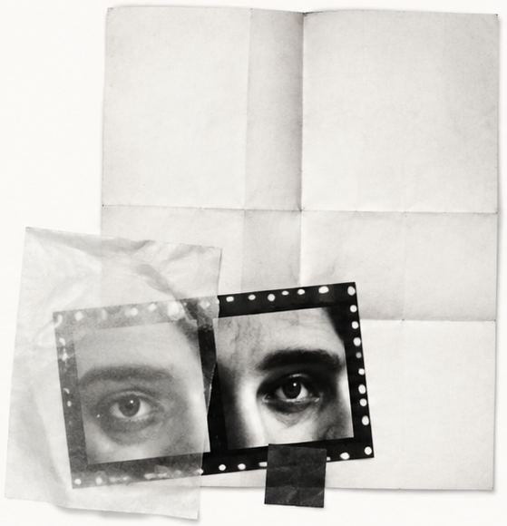
Keep the
question open.
A fast answer can close a thought too early.
What am I assuming?
What would change my mind?
The useful conversation begins with a better question.
FIELD NOTES / 02
Notes:
[SlidePoise sources] Generated target visual: /Users/henry/Codes/AI_slide_drafting/examples/personal-thinking-system/run/slides/s02-question/work/accepted-slide.png

