Slide 1

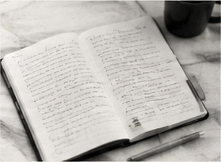
Leave
a trace of
01
Source
What did I encounter?
the thinking.
02
Question
What does it unsettle?
03
Counterargument
What is the strongest objection?
04
Decision
A small record makes
a conversation reusable.
What will I carry forward?
FIELD NOTES / 04
Notes:
[SlidePoise sources] Generated target visual: /Users/henry/Codes/AI_slide_drafting/examples/personal-thinking-system/run/slides/s04-trace/work/accepted-slide.png

