Slide 1
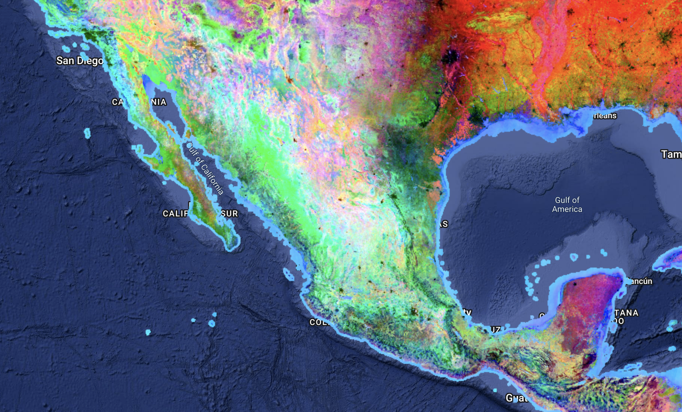
Predicting Population Density from Satellite Imagery: Evidence from Mexico
Henry Chen
advised by Luke Sanford
Paskus Mellon Forum
Jonathan Edwards College
March 31, 2026

Slide 2
Agenda
Motivation
Intervention
Methodology
Results

Slide 3


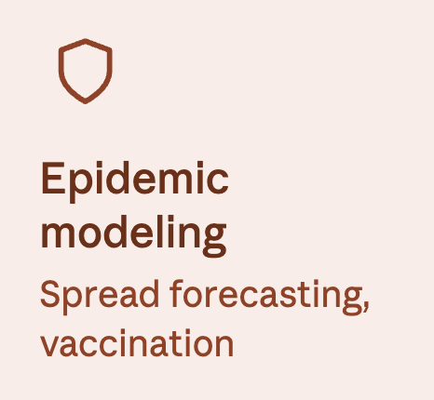

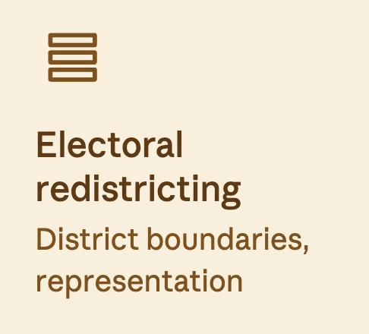
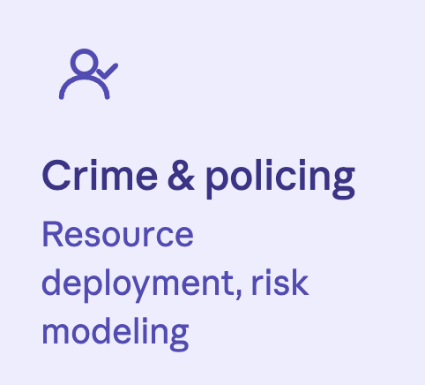
Population data underlies many critical decisions in public life…
More questions abt how it applies to policy making?
Example of world cup in Mexico was good
More concrete examples of how it can be used and the larger socioeconomic implications of those applications
$2.8T+
in federal spending allocated annually using census-derived formulas¹
1. US Census Bureau press release CB23-102, June 14, 2023.
Notes:
Population data is foundational to a wide range of social science research — from estimating the effects of crime on neighborhood outcomes to understanding how infrastructure investment shapes development.

Slide 4

… yet population data is often not frequently collected or updated.
More questions abt how it applies to policy making?
Example of world cup in Mexico was good
More concrete examples of how it can be used and the larger socioeconomic implications of those applications
Latency problem: Robust census data only collected every 10 years
Granularity problem: Between censuses, there is often no high-frequency full count at the neighborhood/block levels
This means researchers often rely on incomplete data up to a decade old
Notes:
Population data is foundational to a wide range of social science research — from estimating the effects of crime on neighborhood outcomes to understanding how infrastructure investment shapes development. In most countries, including the United States and Mexico, comprehensive population counts are conducted only once a decade. Although annual estimates and survey-based measures exist, they rely on modeling and sampling rather than full enumeration and can carry substantial uncertainty, particularly for small geographic areas. At the sub-municipal level — neighborhoods, blocks, or census tracts — high-frequency, fully enumerated population data is rarely available.

Slide 5
Motivating question: How can we address temporal sparsity and spatial granularity to make population data more accurate/usable?

Slide 6
Agenda
Motivation
Intervention
Methodology
Results

Slide 7
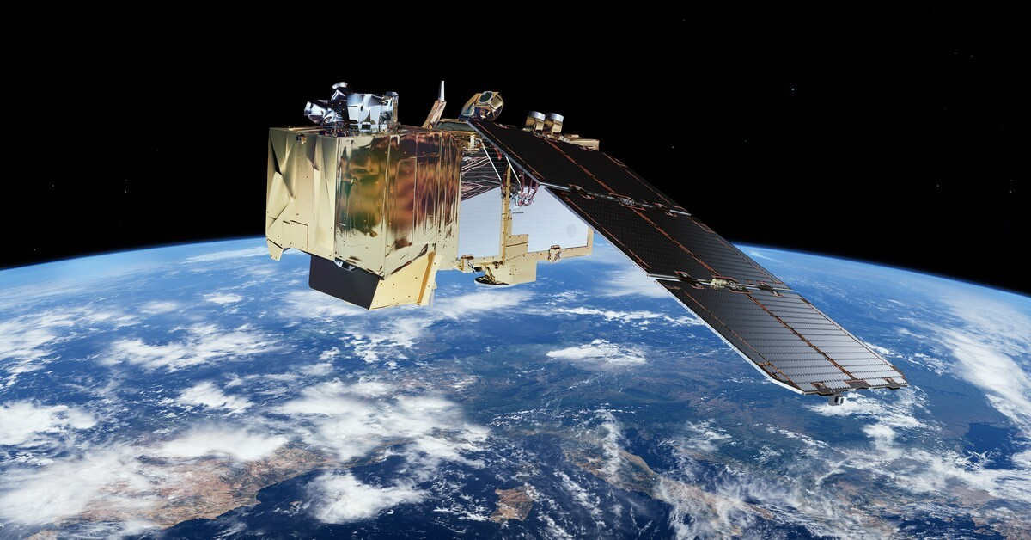
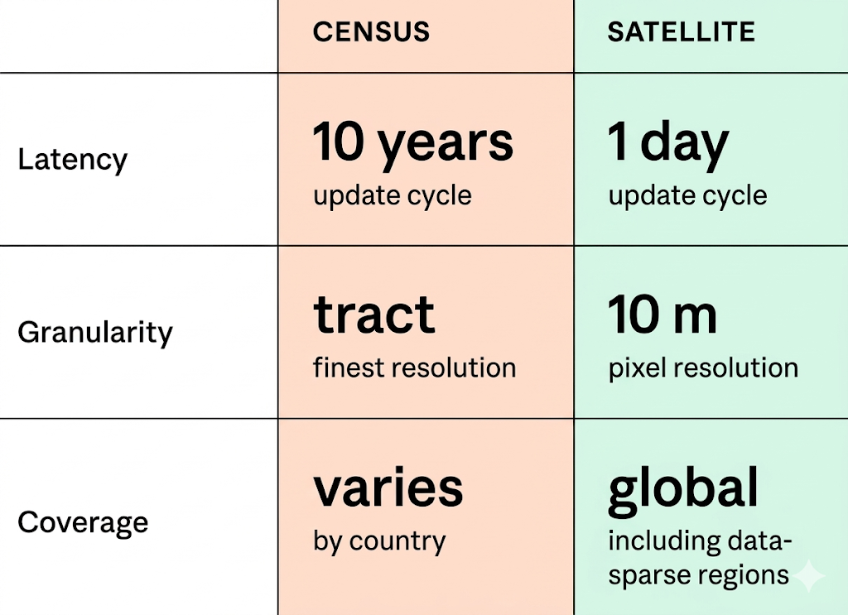
Satellite imagery can solve both problems
It’s global, continuously updated, and available at fine resolutions
Sentinel-2 satellite (launched in 2015)
Census survey data vs. satellite imagery
camera + sensors capture high resolution photos and infrared, radar, thermal, multispectral signals of Earth
Notes:
One promising alternative data source is satellite imagery. Unlike census data, satellite imagery is collected continuously — in some cases updated every few days — and it covers the entire surface of the earth at resolutions fine enough to distinguish individual buildings. Crucially, it is available at the sub-municipal level, which means it can in principle fill exactly the geographic and temporal gaps that census data leaves open. The question is whether it contains enough signal about human settlement patterns to support accurate population estimates.

Slide 8
Research question: Does satellite imagery contain enough signal about human settlement patterns to support accurate population estimates?

Slide 9
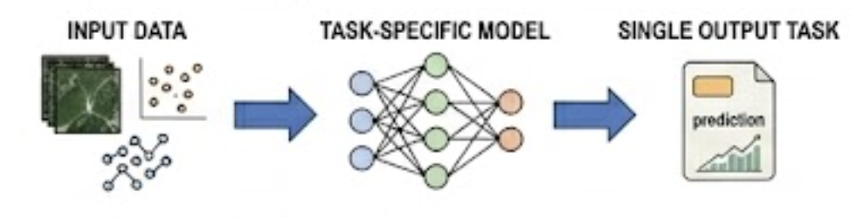
Previous studies of this question predict population density using task-specific trained models
How does a task-specific trained model work?
Limitations
Doesn’t scale to new regions / doesn’t generalize
Requires expensive re-training of model for each new task / geography
Results in the literature
Using geospatial data, traditional task-specific models capture 60–75% of the variation in population density in the real world.¹
Limited by the data it was trained on
1. Stevens et al. (2015), WorldPop project, various studies on deep learning (CNN) approaches to the geospatial problems

Slide 10
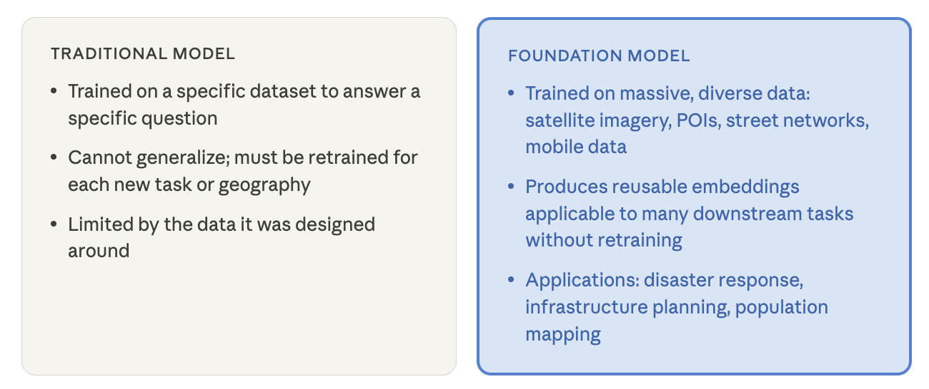
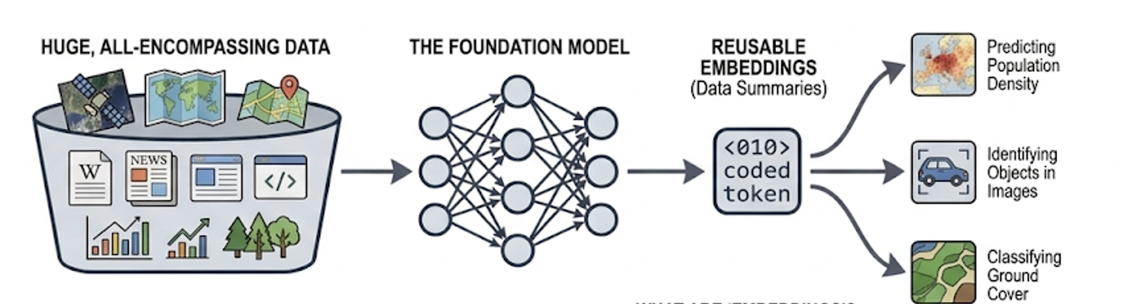
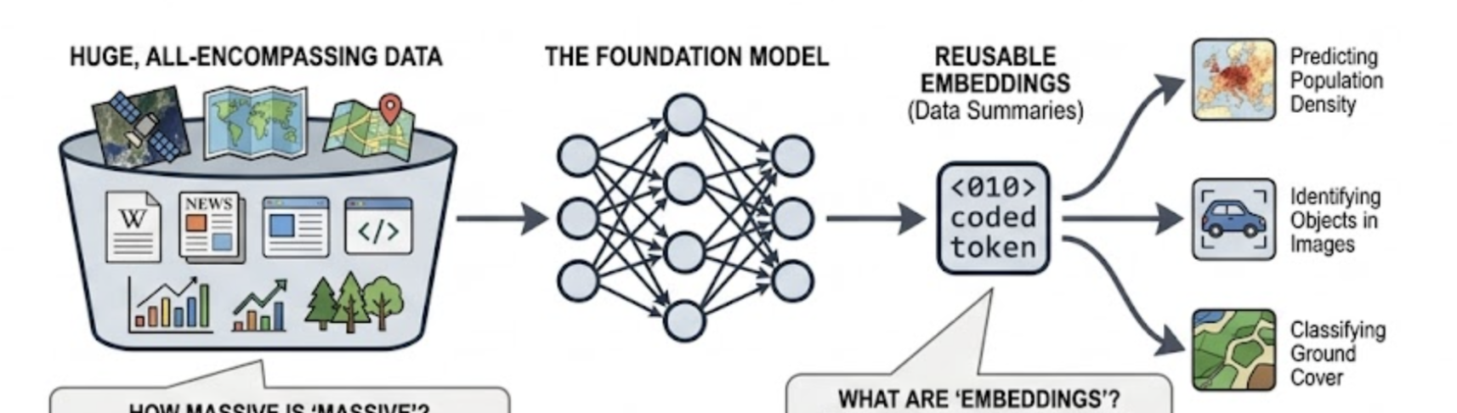
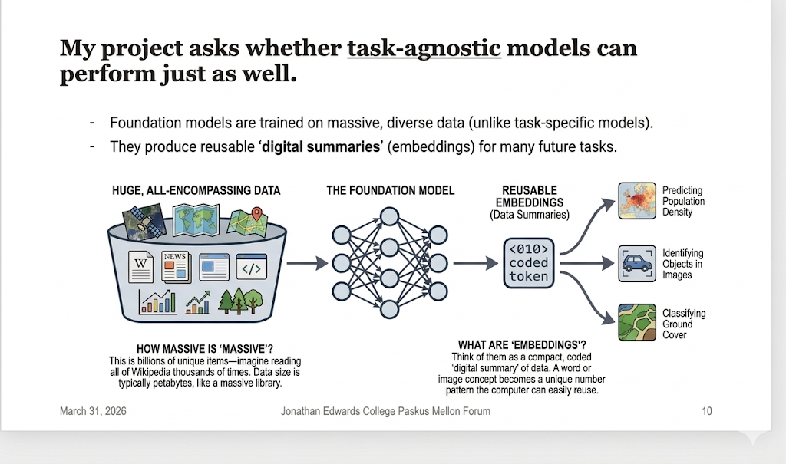
My project asks whether task-agnostic models can perform just as well.
Rather than trained for the specific task of population density prediction, task-agnostic “foundation” models are trained on massive, diverse data
They produce reusable embeddings applicable to many downstream tasks without retraining
on the order of petabytes (1000 terabytes)

Slide 11
Agenda
Motivation
Intervention
Methodology
Results

Slide 12
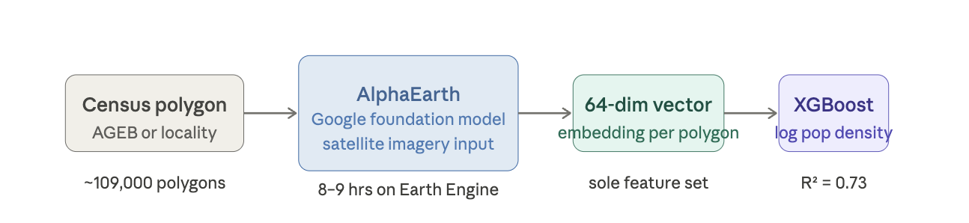
My approach has four key stages:
High-level project approach
General, task-agnostic model
Downstream prediction model
Custom dataset
109,000 x 64 data points

Slide 13
Step 1: constructing census polygon
High-level project approach

Slide 14

I chose to study Mexico because it has great data availability and documentation.
Data is available for censuses ranging from 1895–2020
Population data reported at locality and AGEB levels
Locality represent human settlement. It’s any place inhabited with one or more dwellings that is known by a specific name (given by law or custom).
AGEBs are the fundamental geographic unit used for statistical data collection (similar to a Census Tract in the US).
Notes:
another unit of analysis.

Slide 15
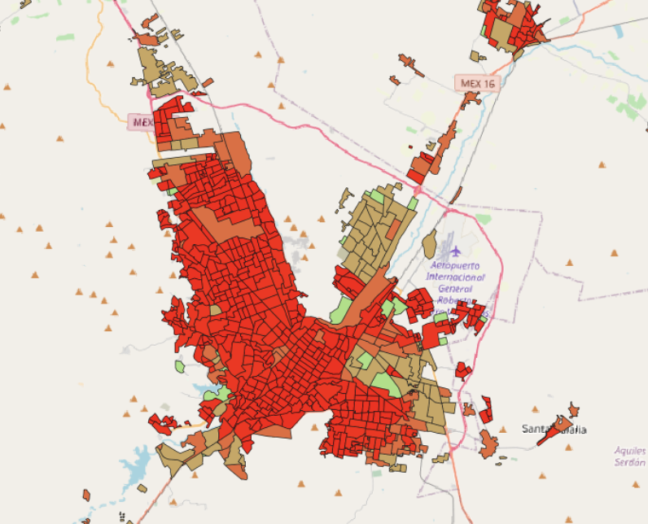
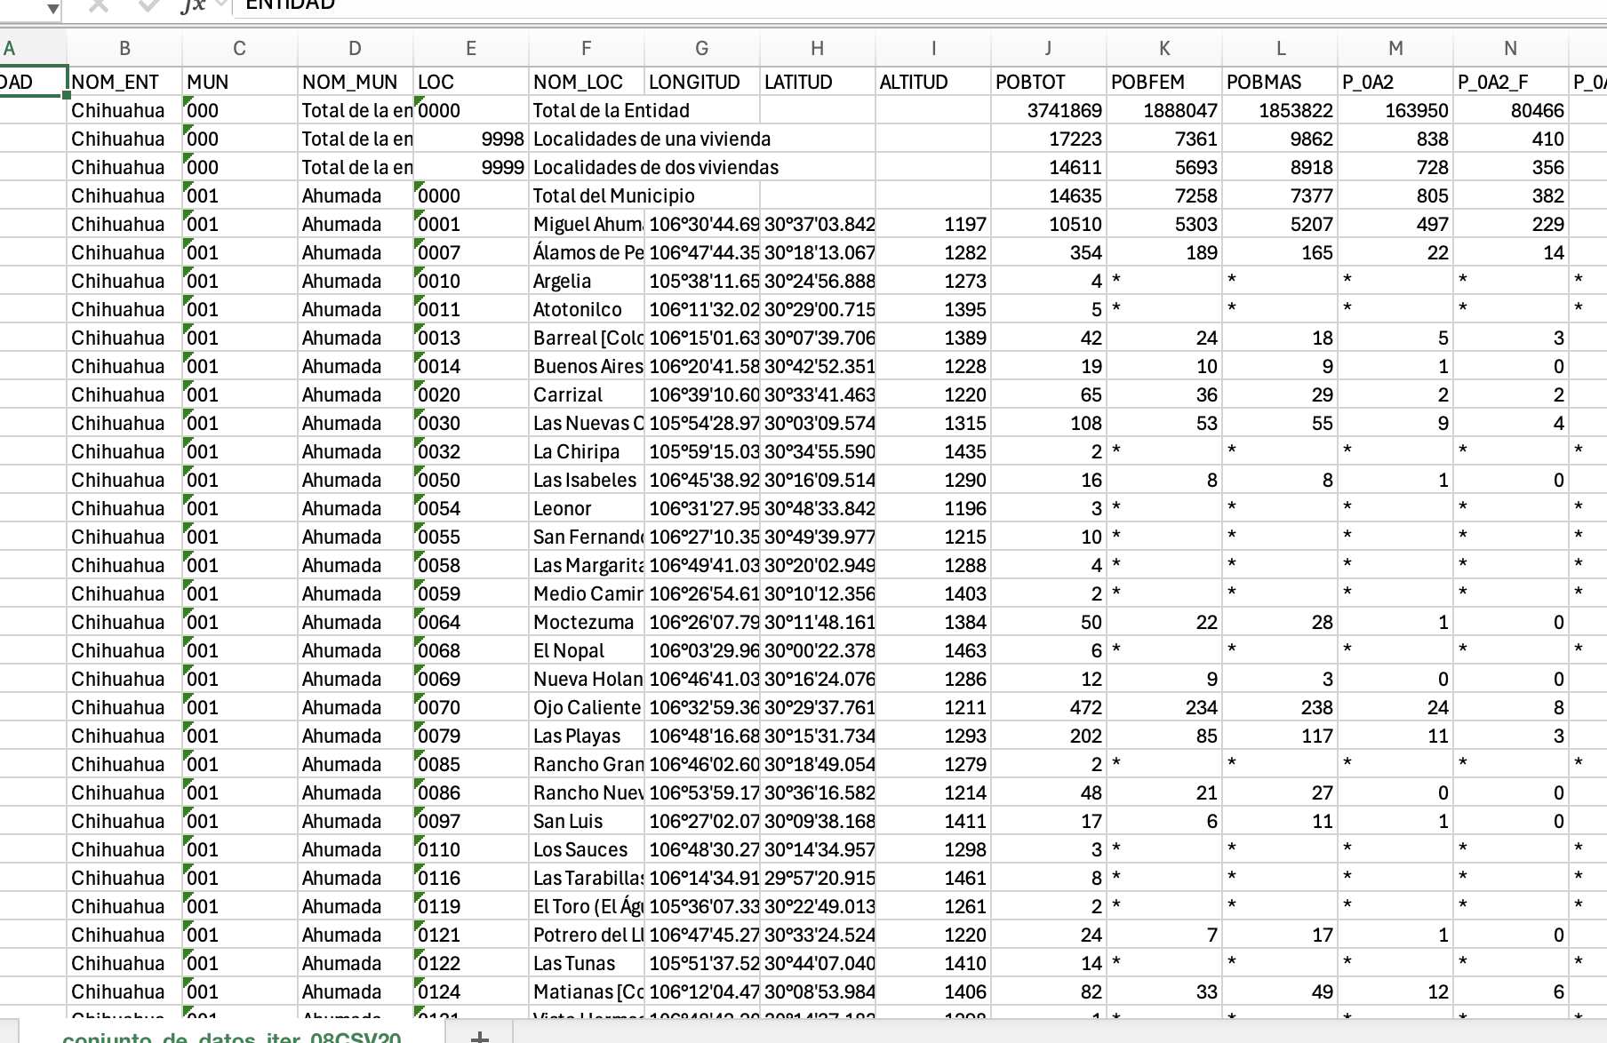
Creating the census polygons required merging data across different data types and sources (1/2)
Shapefiles for the locality and AGEB distinctions in Mexico
Population data from census at AGEB and locality levels

Slide 16
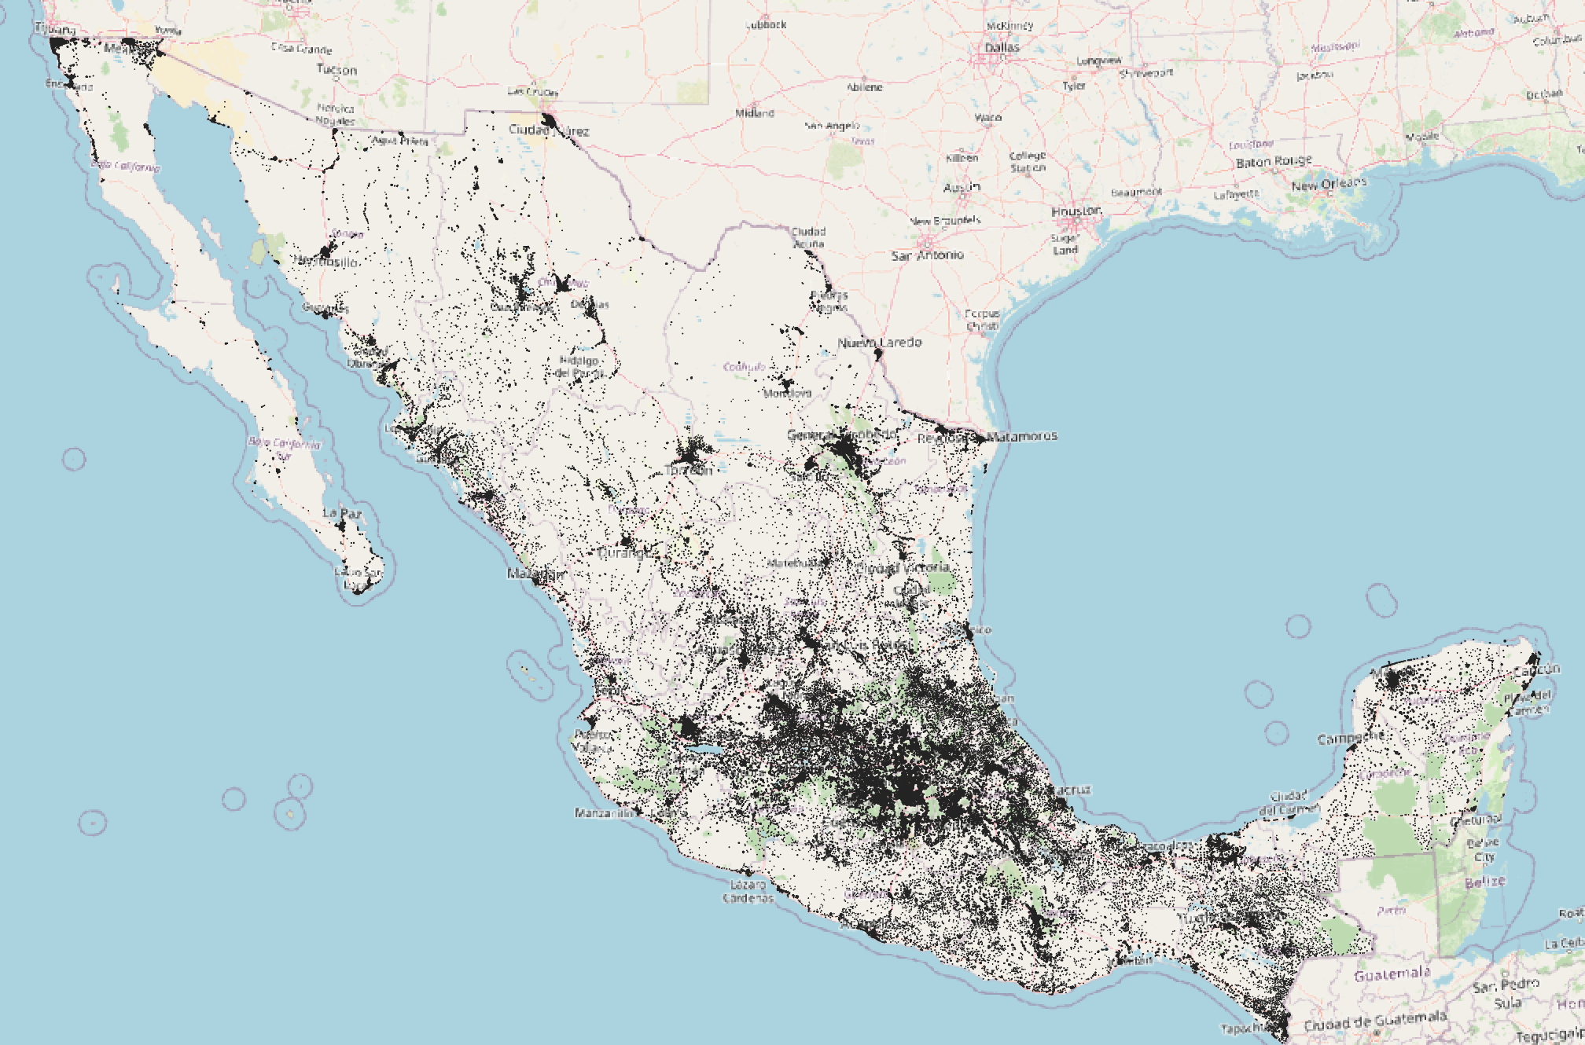
Creating the census polygons required merging data across different data types and sources (2/2)
109,000 polygons!
Black areas indicate polygons or areas where I have data on population
Empty areas indicate areas with no recorded population
This is the input for next step (AlphaEarth model)

Slide 17
Step 2: the Google AlphaEarth Foundation Model
High-level project approach

Slide 18
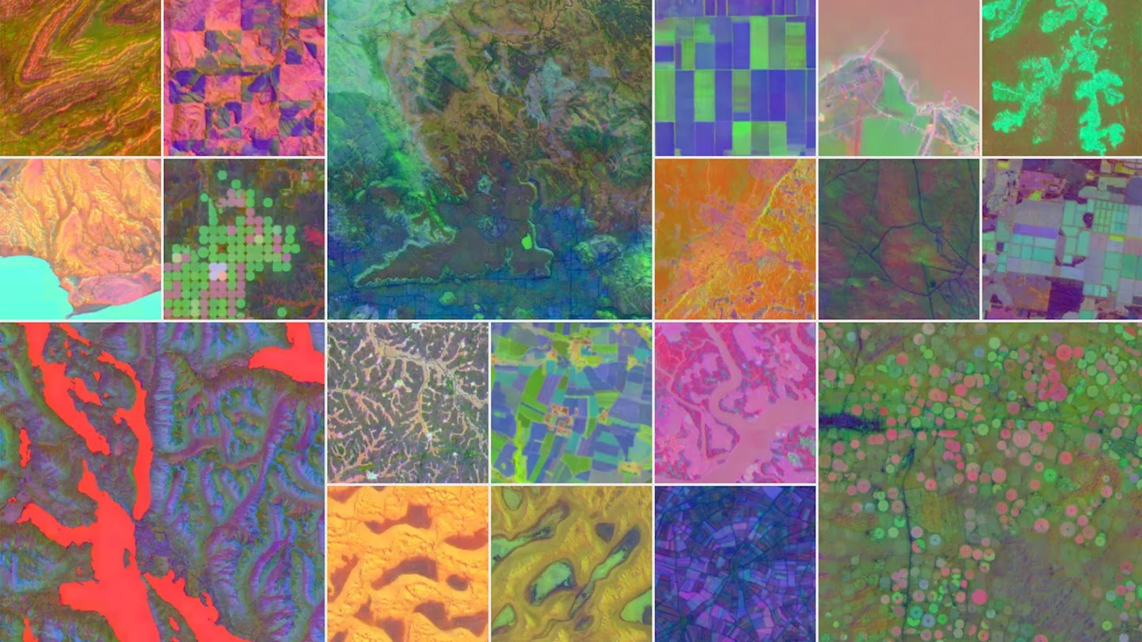
Google’s AlphaEarth foundation model is a recently released state-of-the-art geospatial foundation model
Released in 2025
Has data from 2017– present day
10m by 10m resolution. For each 10m x 10m patch of earth’s surface, it generates 64 number “embedding” that describes that area.
Total: 96 trillion points of data.
Earth’s surface area = 150 million sqkm = 150 trillion sqm.
With 10m x 10m resolution, AlphaEarth distills Earth’s surface area into 1.5 trillion patches of land.
For each patch, it assigns 64 numbers describing it
Notes:
It captures information about land cover + built environment (e.g., building density, road networks, vegetation, land use)

Slide 19
Step 3: Prediction
High-level project approach

Slide 20
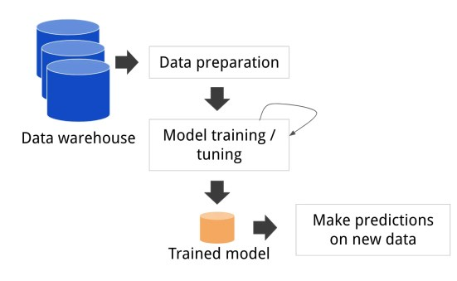
Model specifics
Label the dataset with the “true” population density (population in polygon / area of polygon) for each polygon from the Mexican census
Feed these this dataset into a machine learning model that learns patterns/trends between these 64 numbers and true population count
From AlphaEarth, we get 64 numbers describing each of the 109k polygons
Test it on an out of sample data and evaluate how well it performs

Slide 21
Agenda
Motivation
Intervention
Methodology
Results

Slide 22
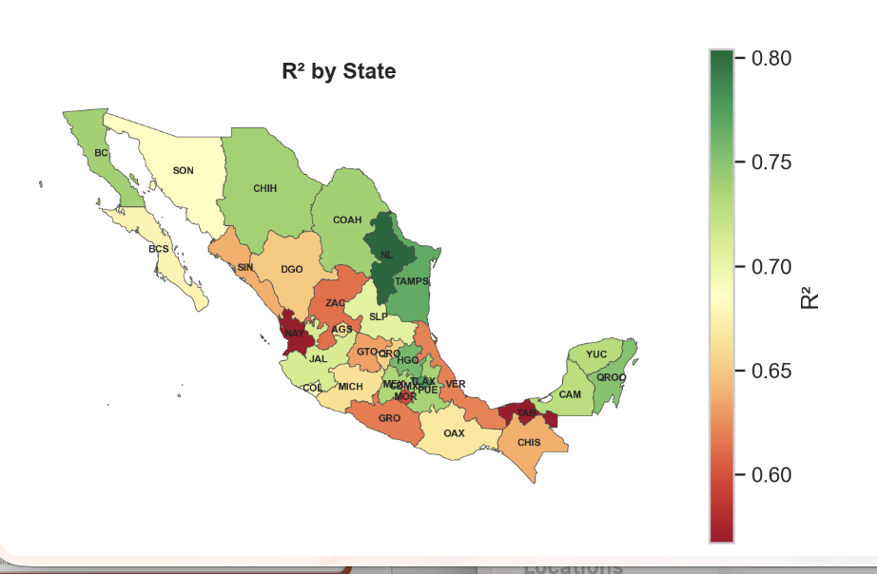
Key Results
Performance on par with existing task-specific models: 73% of the variability in population density can be explained by the AlphaEarth embeddings
Spatial differences in performance: Northern states tend to perform better than southern, more tropical states (?)

Slide 23
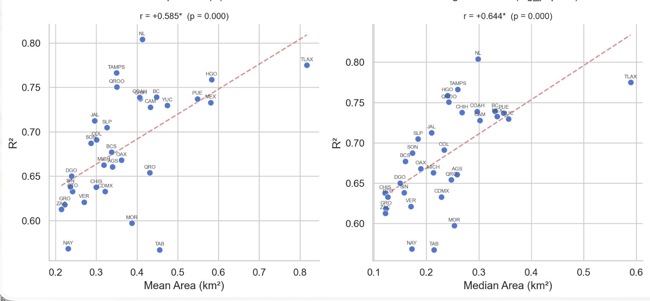
Variations in state-by-state performance are driven by average size of polygon in the state
A larger polygon area correlates strongly with better R² model performance
Larger polygons average over more satellite pixels, which can produce stabler, less noisy embeddings

Slide 24
Next steps include expanding to other models and predicting pop. change over time.
TODAY
2020 census using AlphaEarth model
Next step #1
2020 census using CLAY model
Next step #2
2010 using CLAY model. Compare with 2020 predictions to see how well model predicts change over time
Next step #3
Apply embeddings to exciting applications – world cup??

Slide 25
Thank you! Questions?
Notes:
Make it more accessible for broad audience
Has all elements needed for presentation
Motivations, lit review, findings, next steps
Have agenda slide at beginning / signposting
Did good job translating technical terms into layman explanations
Second slide: subtitles for top and bottom
Clear up structure + rehearse
Data ownership questions? Policy?
Add a slide (?)
Spoke a little fast (!)
Takeaway: how it connects to real life (!)

