Slide 1
BigMart Item Sales Prediction Analysis
Wenhan Ji
Worcester Polytechnic Institute Data Science Master

Slide 2
01
Problem
content
02
Data Exploration
03
Feature Engineering
04
Model training and Validation

Slide 3
Problem
/01

Slide 4
BigMart Sales Problem
The data scientists at BigMart have collected 2013 sales data for 1559 products across 10 stores in different cities.
Data:
Train Set: 8523 rows
Test Set: 5681 rows
Aim:
Build a predictive model and find out the sales of each product at a particular store. Using this model, BigMart will try to understand the properties of products and stores which play a key role in increasing sales.

Slide 5
Data Exploration
/02

Slide 6
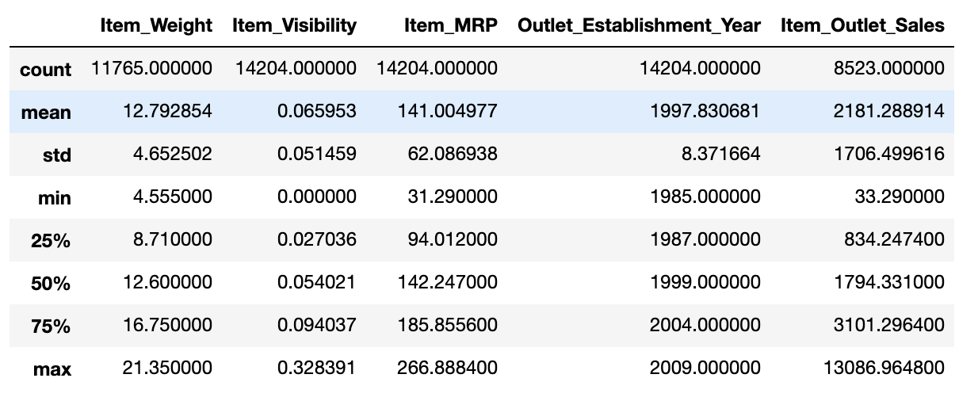
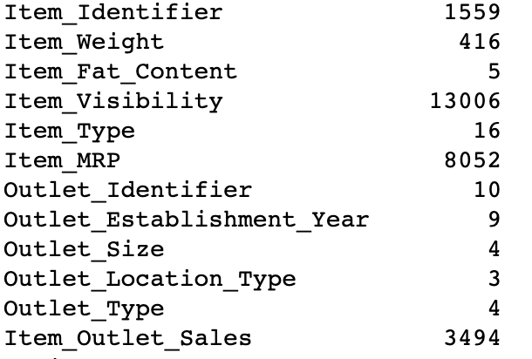
2.1 Statistical Computation
Description of Numeric Features
Feature Unique Value Count

Slide 7
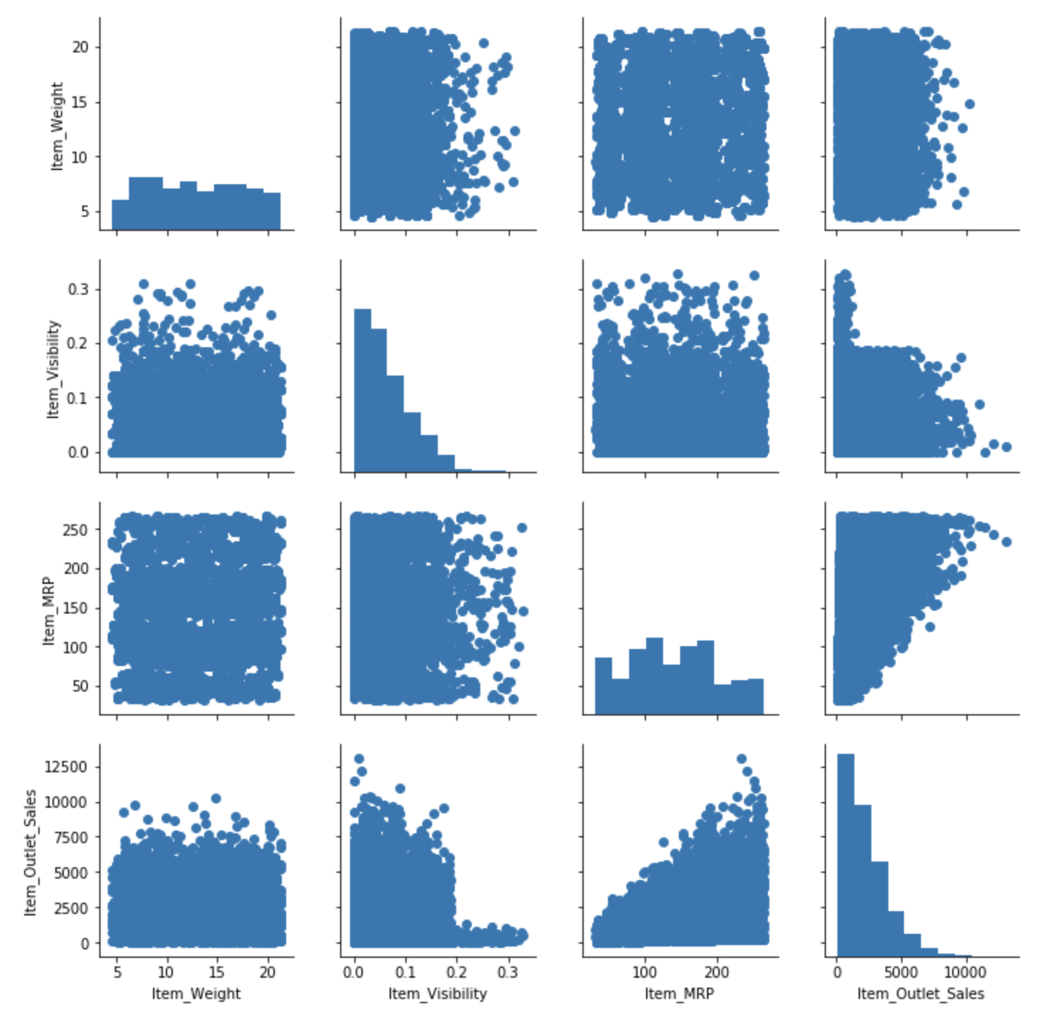
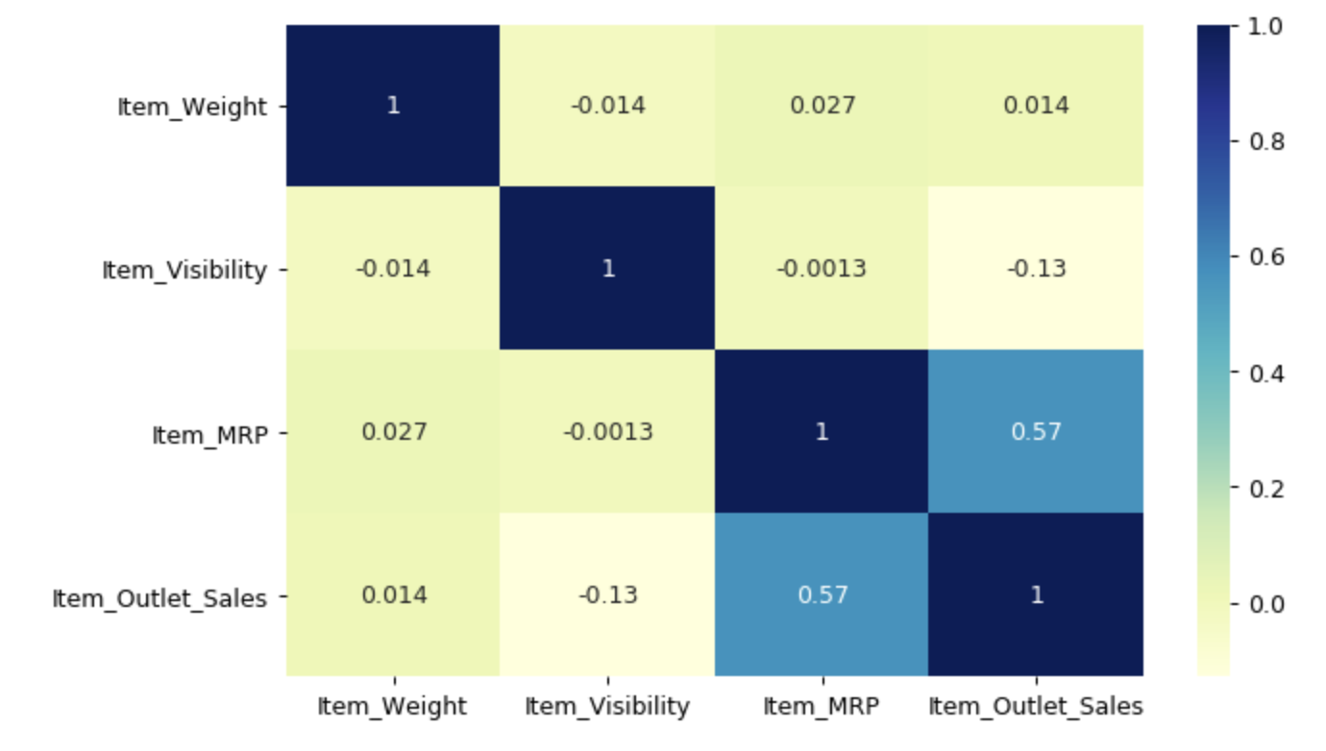
2.2 Numeric Features
Item_Outlet_Sales and Item_Visibility are skewed.
Item_MRP has some correlation with Item_Outlet_Sales .
Some outliers may exist.

Slide 8
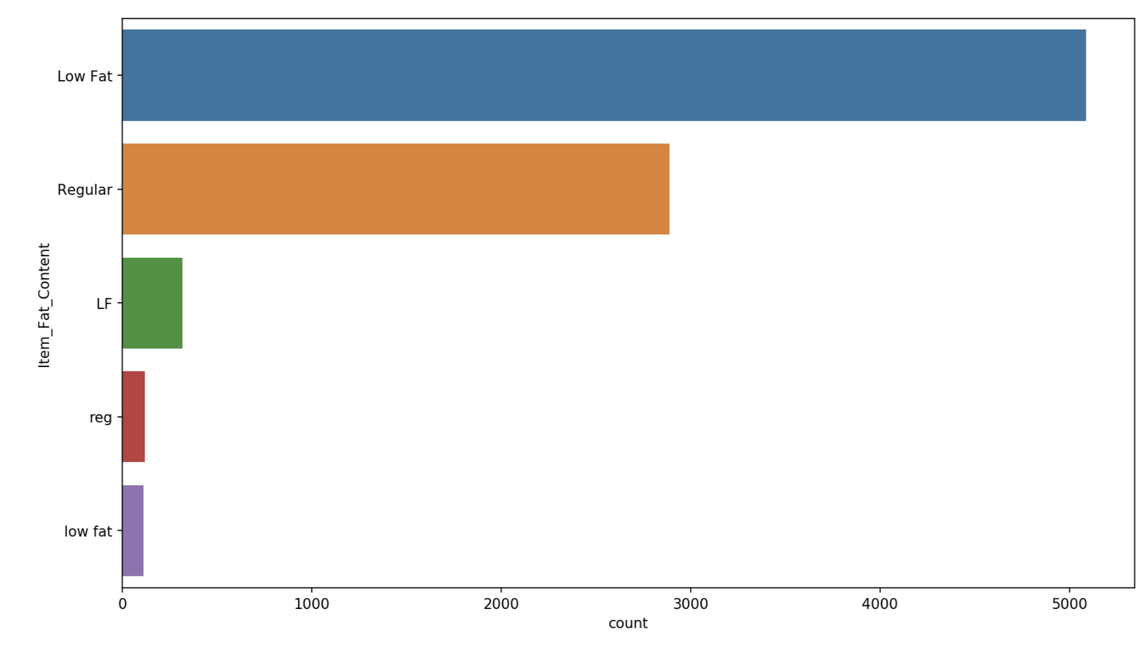
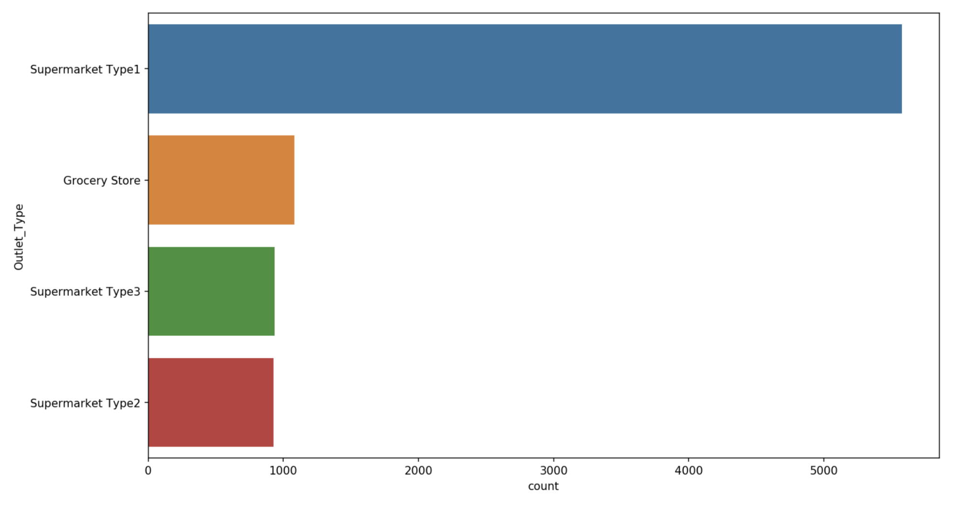
2.3 Categorical Features
Countplot of Item_Fat_Content Feature.
Item_Fat_Content needs to be cleaned.
‘LF’, ‘Low Fat’ and ‘low fat’ are the same thing.
‘Regular’ and ‘reg’ are the same thing.
Countplot of Outlet_Type Feature.
Size of Type1 Supermarket is very large.

Slide 9
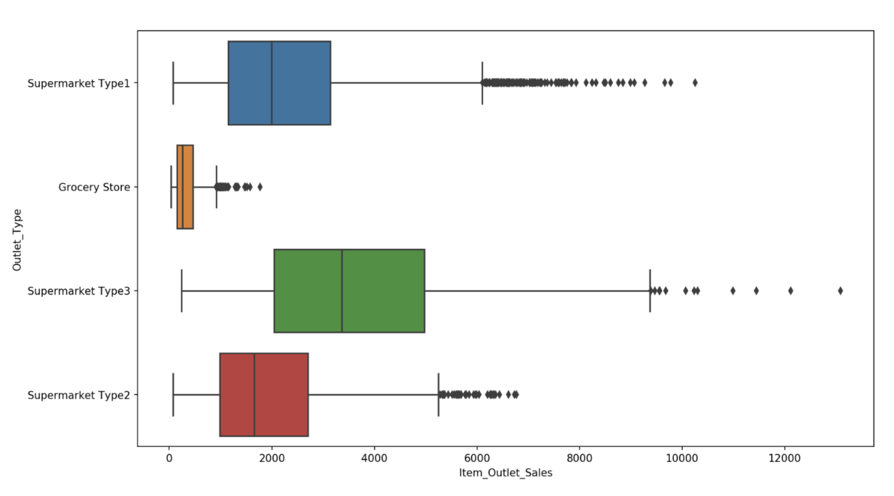
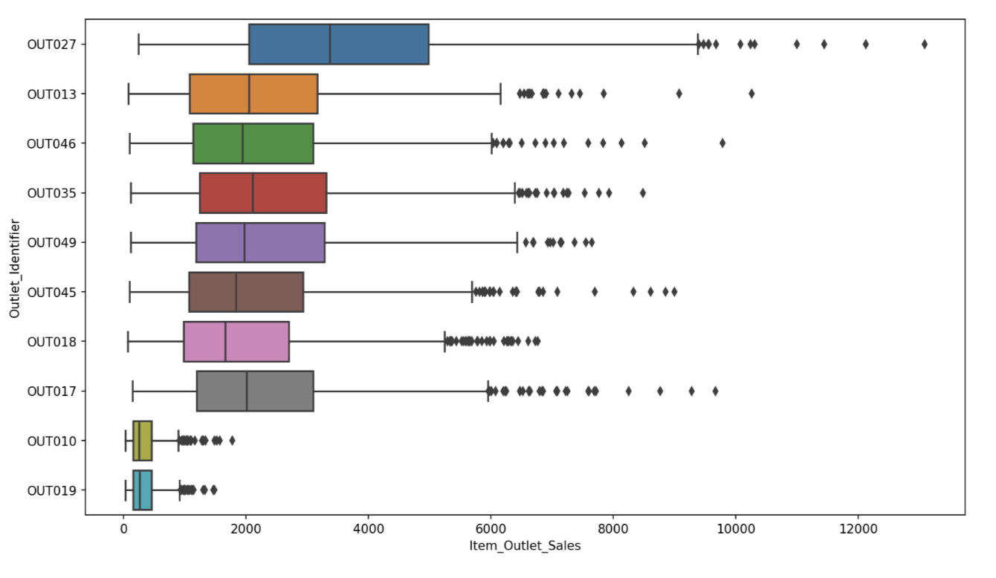
2.3 Categorical Features
Boxplot of Item_Outlet_Sales by Outlet_Type.
The items with sales over 10000 might be outliers.
Different type of mart has different item sales distribution.
Boxplot of Item_Outlet_Sales by Outlet_Identifier.
Outlet 010 and 019 have obviously fewer average sales than other outlets.

Slide 10
Feature Engineering
/03

Slide 11
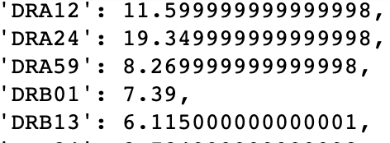
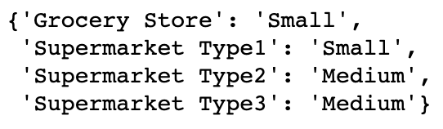
3.1 Data Cleaning
Item_Weight missing values
Outlet_Size missing values
Outlet 027 and 019 didn’t provide item weight information.
Fill NA with average weight for each item.
Fill NA with mode of outlet size for corresponding outlet type.

Slide 12
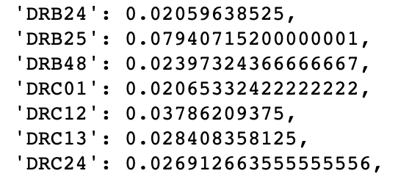
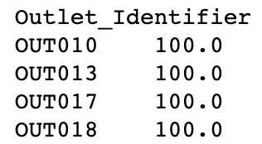
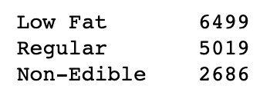
3.1 Data Cleaning
Item_Fat_Content
Item_Visibility outliers
Turn ‘low fat’ and ‘LF’ to ‘Low Fat’.
Turn ‘reg’ to ‘Regular’.
Set Non-Consumable item’s fat content to ‘Non-Edible’
Some Item_Visibility is 0, which makes no sense.
Turn 0 to average visibility for each item.
Make sure sum of item_visibility for each outlet is 100 using softmax.

Slide 13
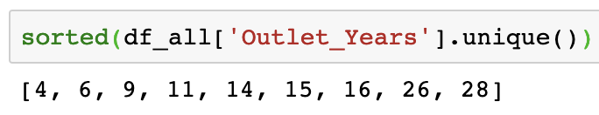
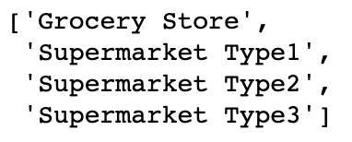
3.2 Feature Calculation
Outlet Operation Year
Parse Item Identifier
Outlet Type Combine
Outlet Operation year =
2013 – Outlet_Establishment_Year
The oldest outlet has operated for 28 years.
Save first two char
FDA15 - FD
3 distinct types
Save first three char
FDA15 – FDA
71 distinct types
Combine 3 supermarket type to 1 class.
‘isSupermarket’ feature indicates whether the outlet is supermarket or grocery.

Slide 14
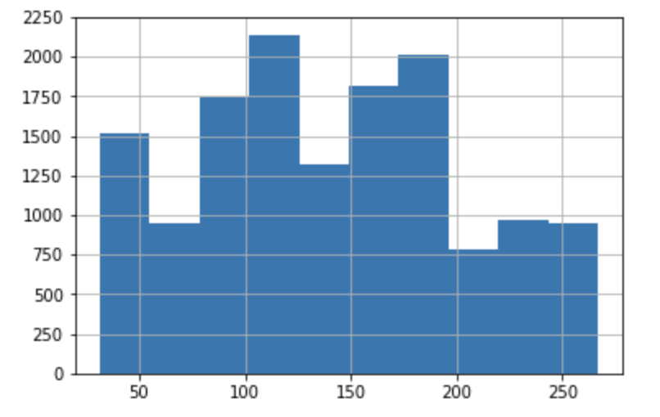
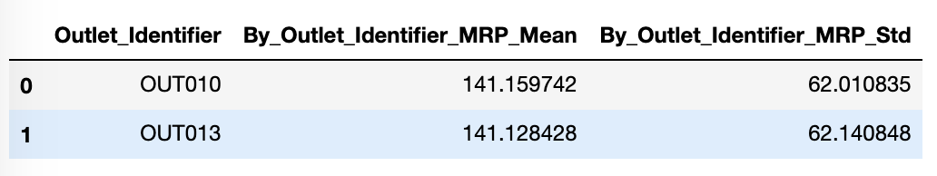
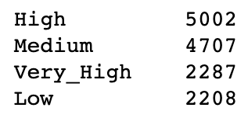
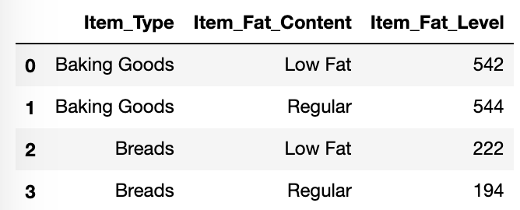
3.2 Feature Calculation
Item_MRP Level
Aggregation Features
Cut numeric features to factor.
Item_MRP has a relatively strong correlation with target.
Using groupby and aggregation function.
Mean, standard deviation of Item_MRP for each outlet.
Item counts for item’s different fat level.

Slide 15
3.3 Feature Encoding
Ordered and 2 Class Factor
Encoded Categorical Factor
Map ‘High’ to 3, ‘Medium’ to 2, ‘Low’ to 1.
Map class1 to 1, class2 to 2.
One Hot Encoding.

Slide 16

3.4 Final Features
125

Slide 17
Model Training and Validation
/04

Slide 18
4.1 Benchmark Model Training
Linear Regression
Elastic Net
Decision Tree
Random Forest
GBDT
Train RMSE: 1120
Test RMSE: 1144
Train RMSE: 1126
Test RMSE: 1138
Train RMSE: 1068
Test RMSE: 1102
Train RMSE: 1077
Test RMSE: 1097
Train RMSE: 1050
Test RMSE: 1096

Slide 19
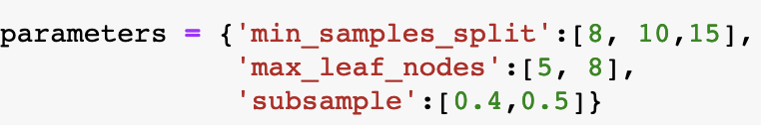
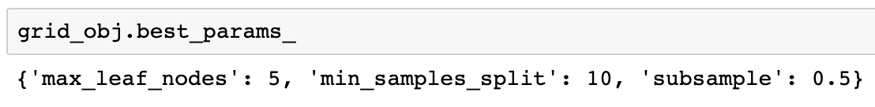
4.2 Fine Tune GBDT Hyper Parameters
Use Sklearn GridSearchCV to try all hyperparameter combinations for given parameter grid.
Perform 3-fold cross validation to train GBDT for each parameter combination.
Return parameter with lowest validation set average error.
Train GBDT with best parameters and all training data. Predict on test data.

Slide 20
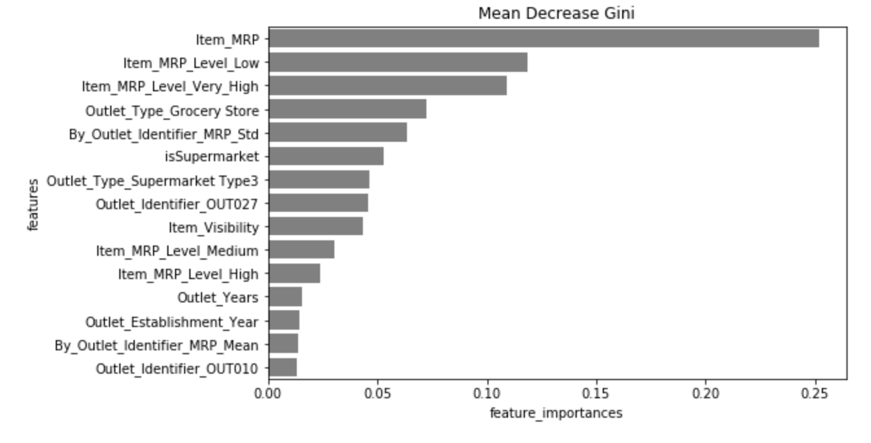
4.3 Top 15 Important Features
In this feature importance bar plot, it’s clear to see which feature plays a key role in increasing sales.
The most important top 3 and the sixth features are all related to Item Max Retail Price. It makes sense as it has most strong relation with target in correlation matrix.
The forth, sixth and seventh are all related with outlet types. Whether it’s a big supermarket or small grocery makes influence on the item sales.
The ninth most important feature is Item Visibility. If mart put the item more visible to customers, this item’s sales should be higher.

Slide 21
THANKS
Wenhan Ji
Worcester Polytechnic Institute

