Slide 1
Forest Cover Type Prediction in the Roosevelt National Forest
Group 7
Yu Ruan, Wenhan Ji, Yixin Zhang, Sam Longenbach, Luke Buquicchio

Slide 2
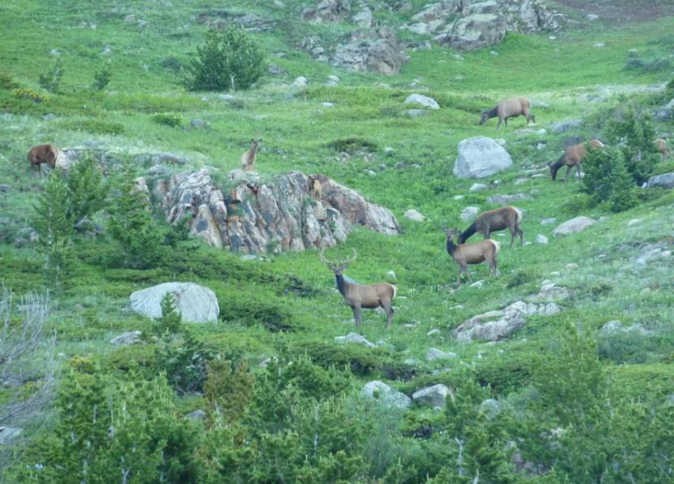
The Problem
Roosevelt National Forest is a beautiful National Forest located in north Colorado. The Natural resource managers there are responsible for developing ecosystem management strategies require basic descriptive information.
Our goal is using the predictive models to predict the forest cover types in the the Roosevelt National Forest.

Slide 3

Data Collection
01
Dataset
02
Dataset
UCI machine learning Repository
The dataset has 12 measures
54 columns of data
(10 quantitative variables
4 binary wilderness areas
40 binary soil type variables)
03
Tree Types:
04
Attributes information
Spruce Fir
Lodgepole Pine
Ponderosa Pine
Cottonwood/Willow
Aspen Tree
Douglas Fir
Krummholz
Elevation; Aspect; Slope
Horizontal_Distance_To_Hydrology;
Vertical_Distance_To_Hydrology;
Hillshade_9am; Noon; 3pm;
Horizontal_Distance_To_Fire_Points
Wilderness_Area (4 binary columns)
Soil_Type; Cover_Type

Slide 4

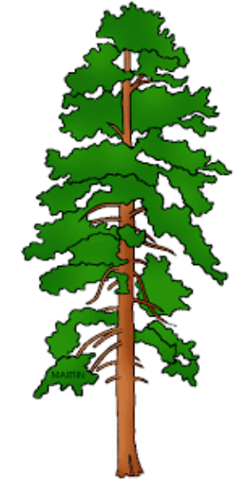
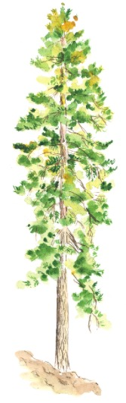
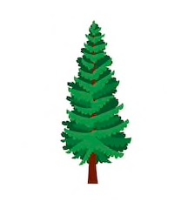


Data Collection
Spruce-Fir
Lodgepole Pine
01
02
Douglas-Fir
Krummholz
Ponderosa Pine
06
07
03
Aspen
Cottonwood/Willow
05
04
7 Tree Types
40 Soil Types

Slide 5
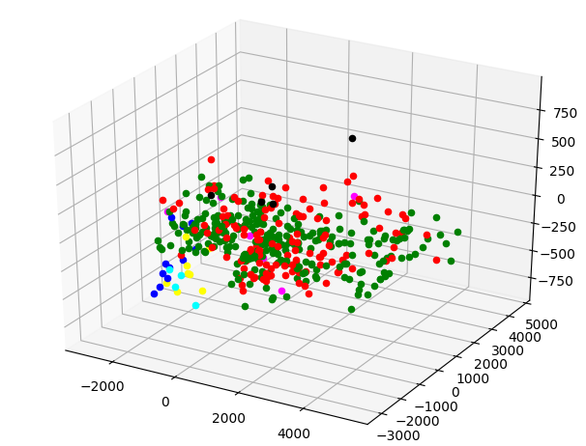
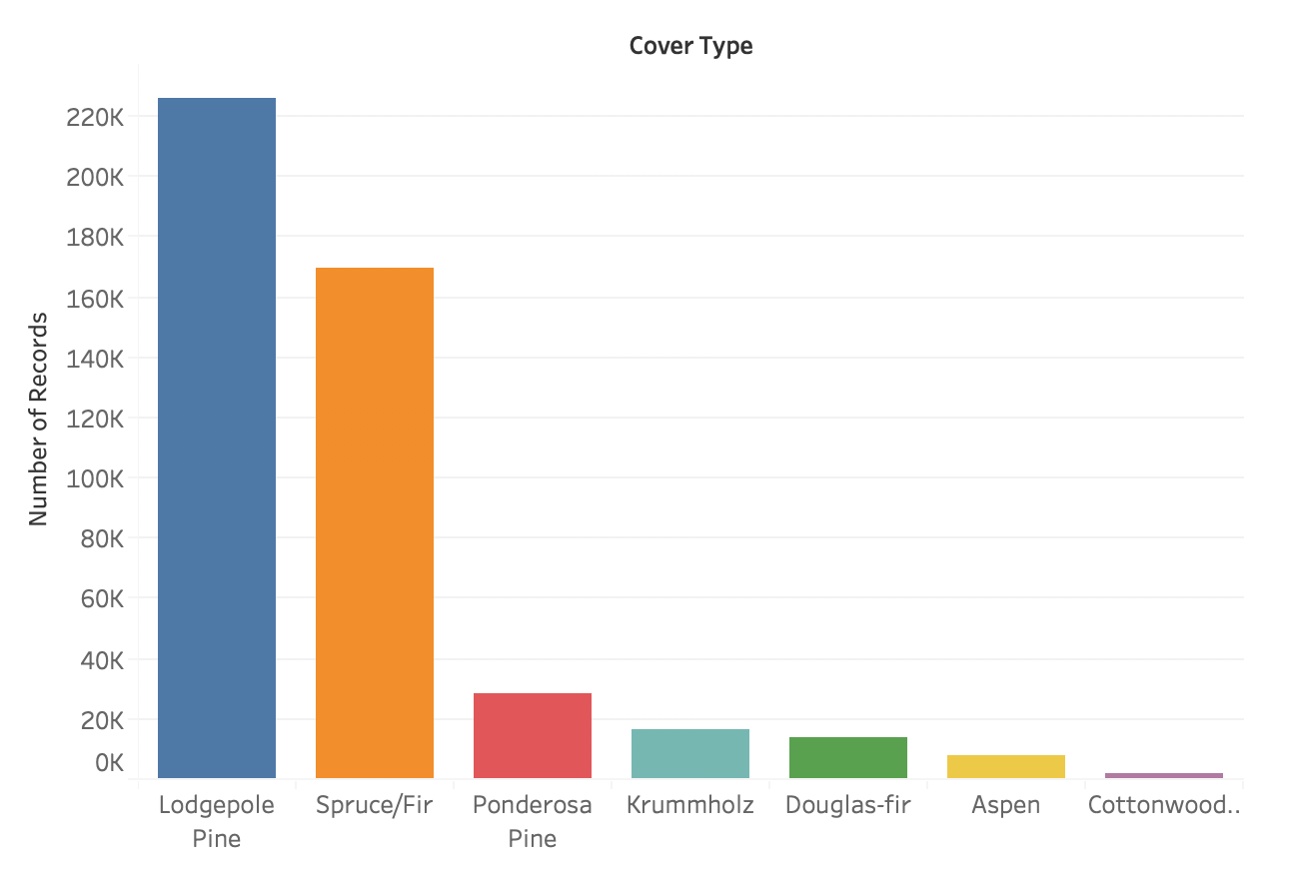
Data Exploration
Using PCA in 3 dimensions

Slide 6
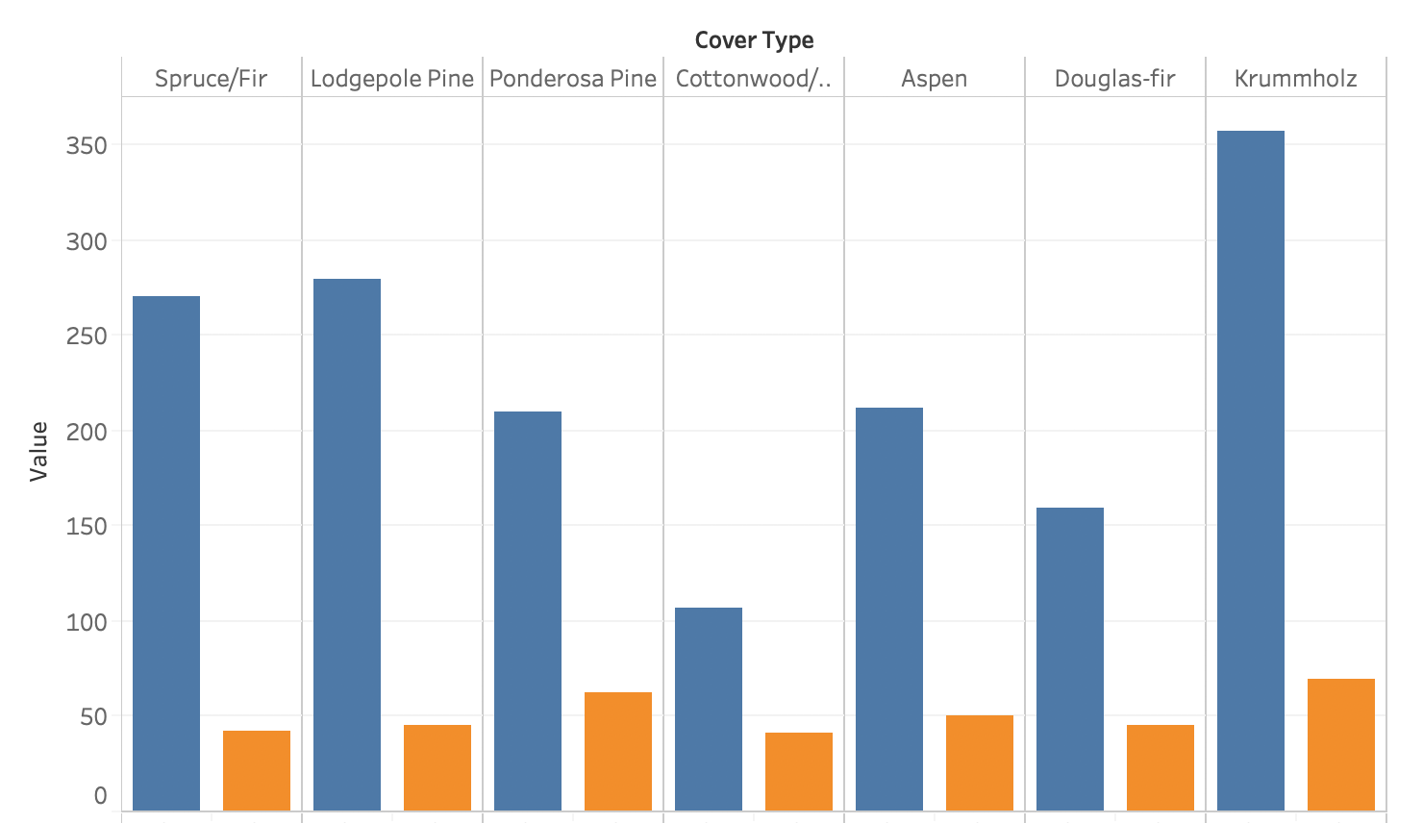

Data Exploration

Slide 7
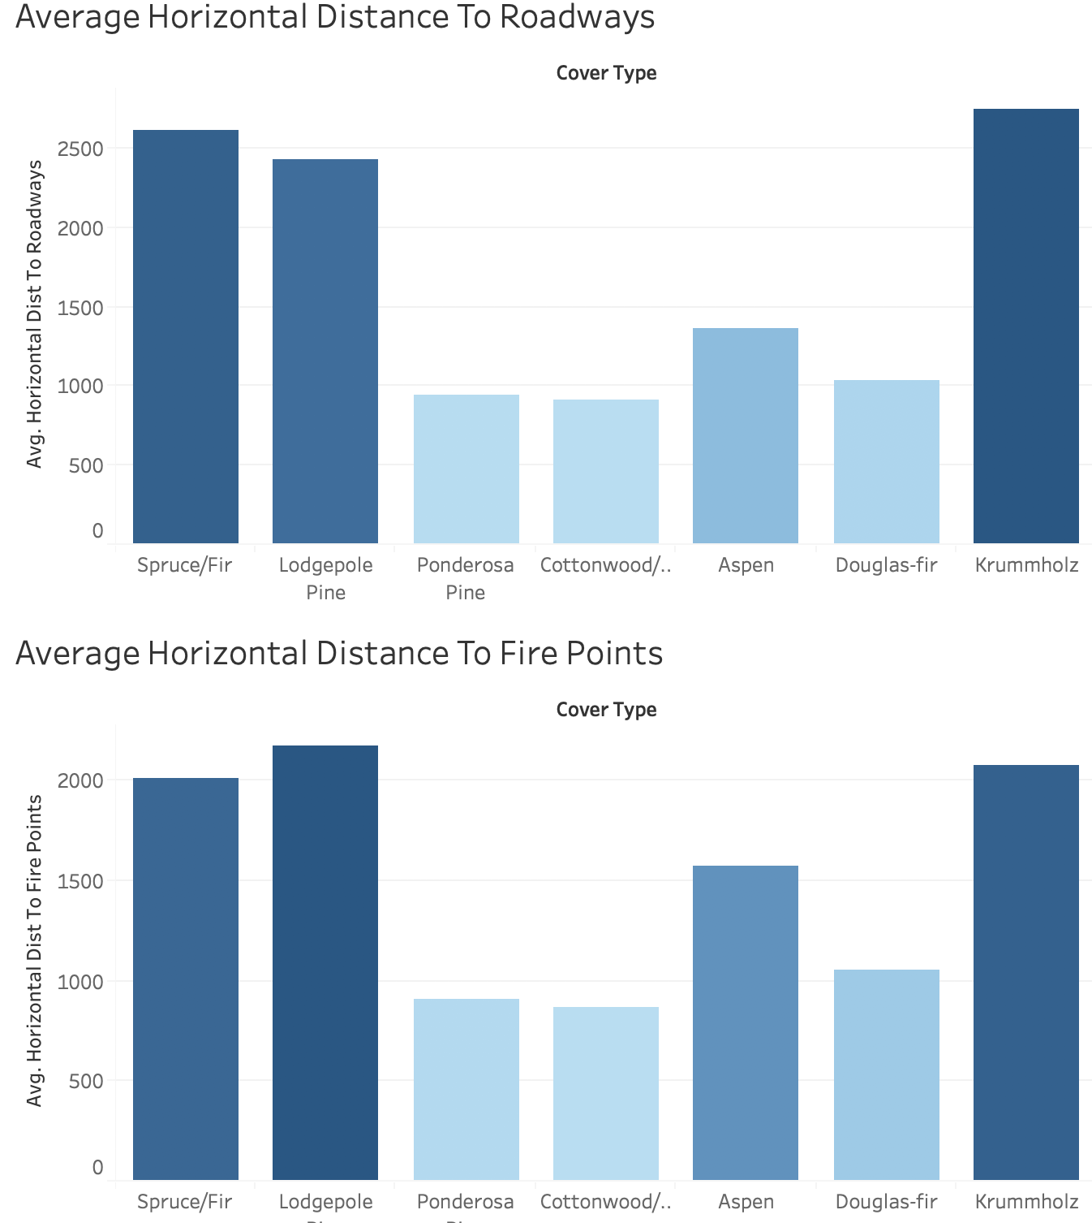
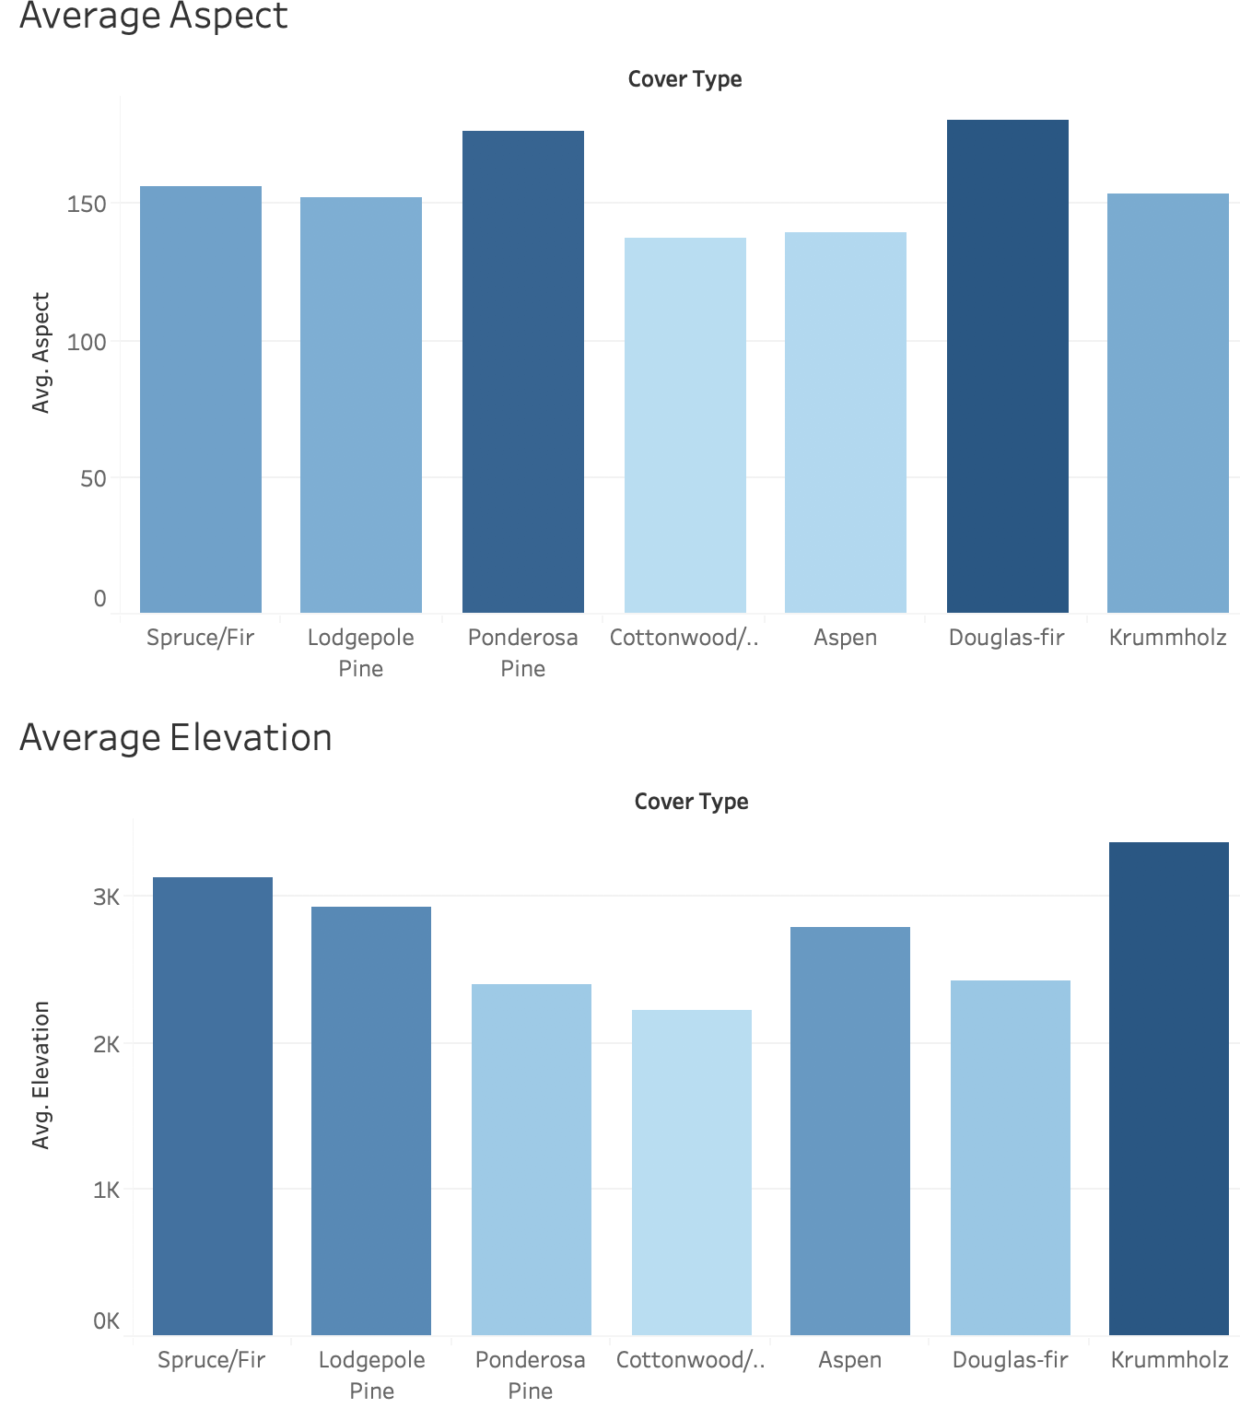
Data Exploration

Slide 8
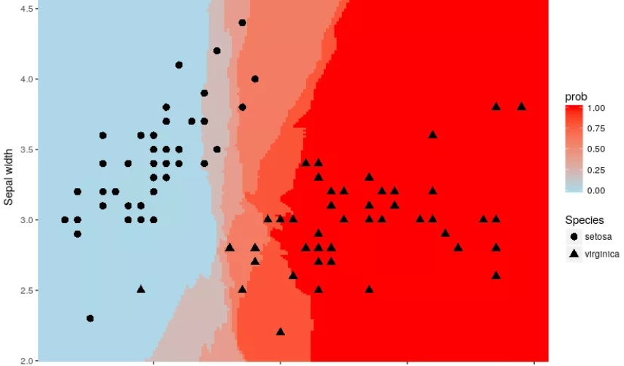
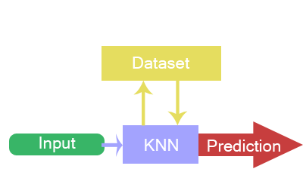
The Solution
K-Nearest Neighbors
In pattern recognition, the k-nearest neighbors algorithm is a non-parametric method used for classification and regression.

Slide 9
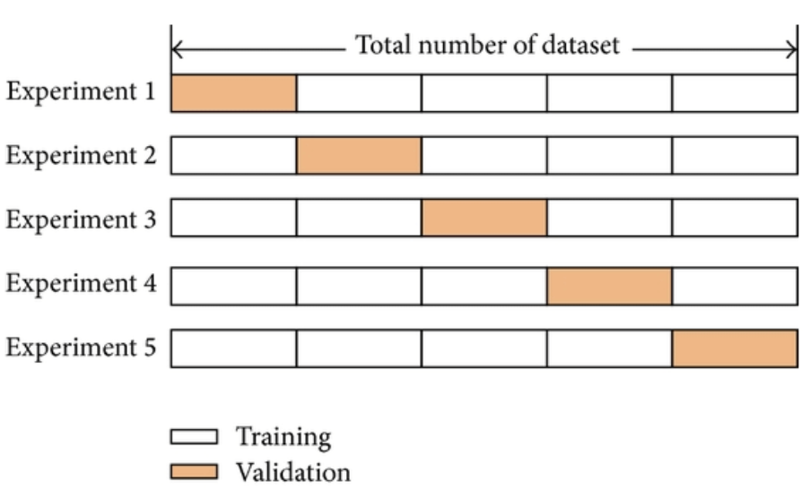
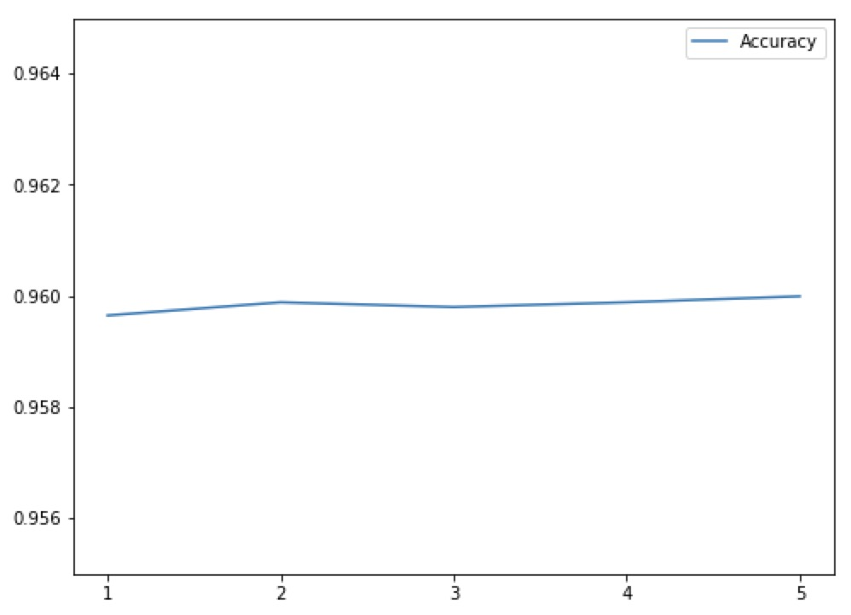
Results

Slide 10
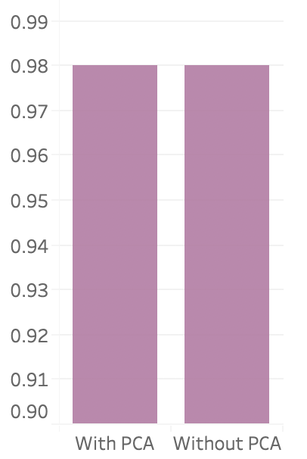
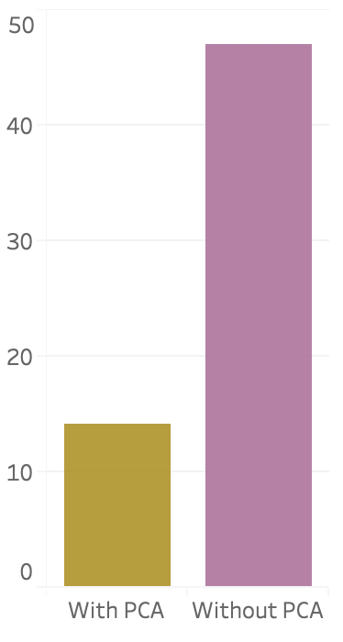
Results
Content Here
Accuracy
Time

Slide 11
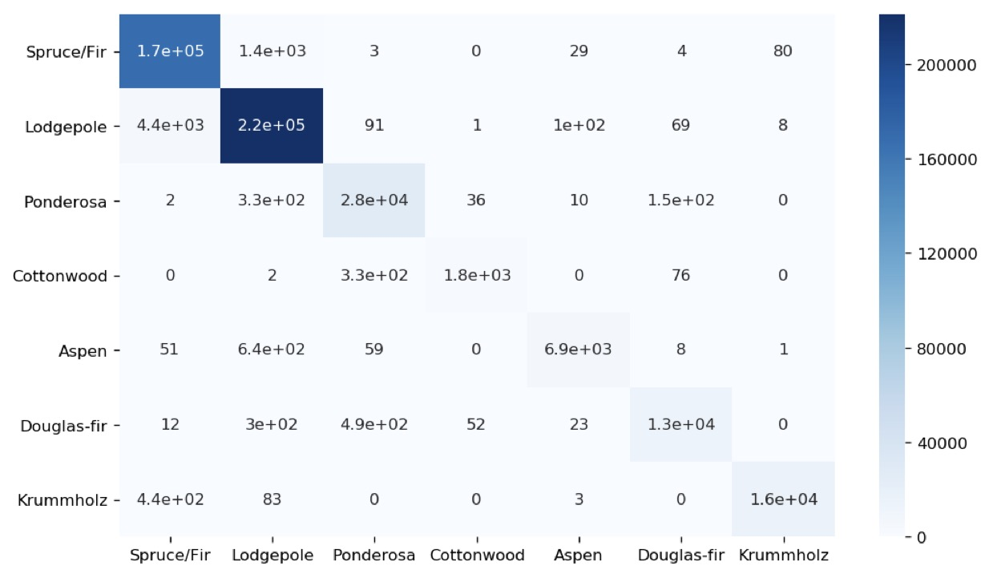
Results
Confusion
Matrix

Slide 12
Thank you!
Q & A

