Slide 1
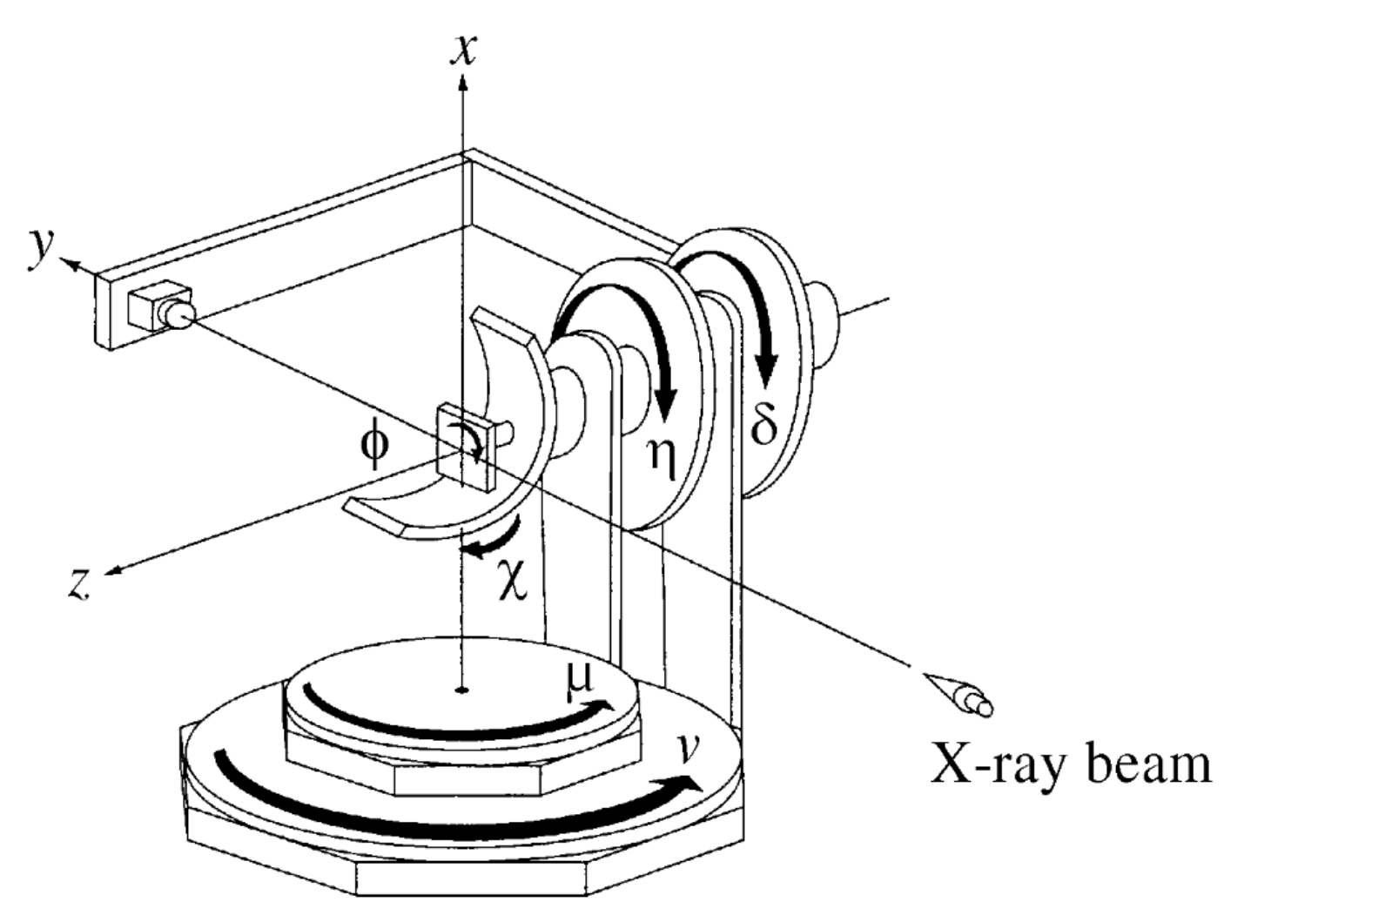
Instrument Information
6IDB_DetectorGeometry.xml
Psic circle definition in SPEC
Sample circles
1. Mu μ x+
2. Eta η z-
3. Chi χ y+
4. Phi ϕ z-
Detector circles
1. Nu ν x+
2. Delta δ z-
The laboratory coordinate system depends on the geometry calculation code.
The angle directions are defined when all the angles are at the zero position according to the laboratory coordination system.
Primary beam direction is also defined with the laboratory coordination. In this case it is [0 1 0], y direction
In plane reference direction, sample surface normal direction and projection direction is not relevant to calculate the HKL conversion.
Filter and monitor normalization is optional and they can be done using the scaler count channel name in the SPEC if they are available
PSIC geometry 4S+2D

Slide 2
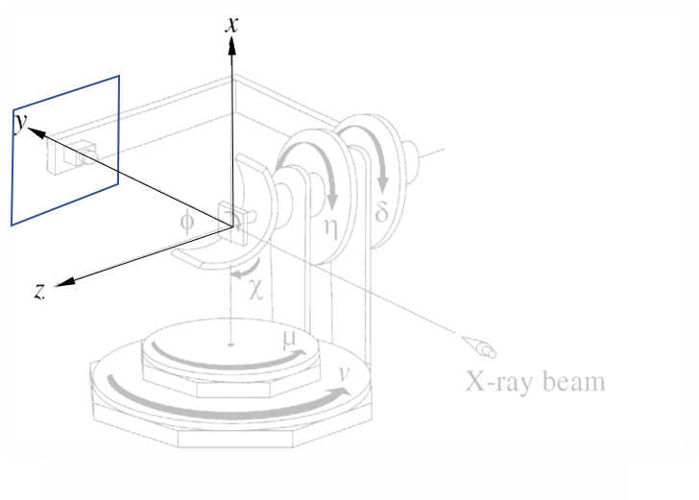
Detector Geometry Information
6IDB_Instrument.xml
Detector geometry information
Pixel direction 1. z-
Pixel direction 2. x-
The pixel directions are defined when detector angles are zero according to the laboratory coordination system.
‘Center channel pixel’ is defined with Primary beam position when detector angles are zero.
‘Distance’ is sample to the detector distance.
Filter and monitor normalization is optional and they can be done using the scaler count channel name in the SPEC if they are available
Pixel directions

Slide 3
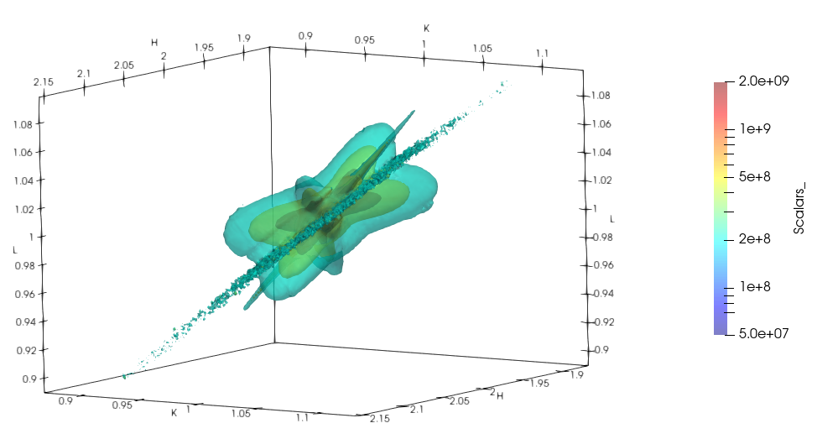
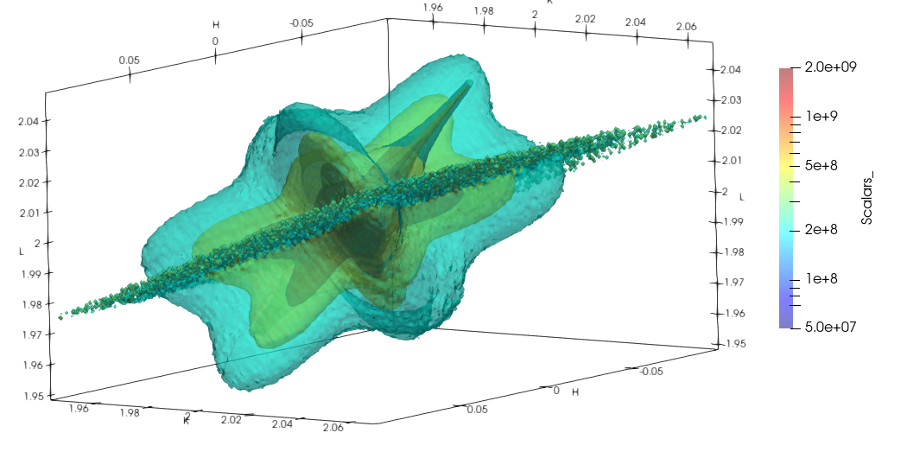
Example: Diffuse scattering of Pb(Mg_{1/3}Nb_{2/3})O₃–PbTiO₃ (PMN-PT)
Scan # 839 Rocking through (2 1 1)
‘image’ directory should be located in the same directory with spec file.
In ‘image’ directory there should be a folder with same name as spec file except the extension.
The folder which is the same name as spec file should contains folders of each scan. The name of the folder should be ‘S’ + scan number. For example, a folder of scan number 1 will be S001. In this folder should contain the image files with numbers corresponding to the spec scan points
The spec file should have the position of the angles for each scan data point. There should be columns for each diffractormeter angle.
Scan # 840 Rocking through (0 2 2)

