Slide 1
ATCGGGTCGATTTCGATTGTACCGTAAACTCTCTCGCGCGCGCGCGCGCGCATATA
ATCGGGTCGA- - -CGATTGTACCGTAAACTCTCTCGCGCGCGCGCGCGCGCA- - - -

Slide 2
ATCGGGTCGATTTCGATTGTACCGTAAACTCTCTCGCGCGCGCGCGCGCGCATATA
ATCGGGTCGA- - -CGATTGTACCGTAAACTCTCTCGCGCGCGCGCGCGCGCA- - - -

Slide 3
ATCGGGTCGATTTCGATTGTACCGTAAACTCTCTCGCGCGCGCGCGCGCGCATATA
ATCGGGTCGA- - -CGATTGTACCGTAAACTCTCTCGCGCGCGCGCGCGCGCA- - - -
2 Mb
windows

Slide 4
ATCGGGTCGATTTCGATTGTACCGTAAACTCTCTCGCGCGCGCGCGCGCGCATATA
ATCGGGTCGA- - -CGATTGTACCGTAAACTCTCTCGCGCGCGCGCGCGCGCA- - - -
2 Mb
windows
Predict recombination rate for each INDEL

Slide 5
ATCGGGTCGATTTCGATTGTACCGTAAACTCTCTCGCGCGCGCGCGCGCGCATATA
ATCGGGTCGA- - -CGATTGTACCGTAAACTCTCTCGCGCGCGCGCGCGCGCA- - - -
2 Mb
windows
And for positions 2.5 Kb up and downstream
Predict recombination rate for each INDEL

Slide 6
ATCGGGTCGATTTCGATTGTACCGTAAACTCTCTCGCGCGCGCGCGCGCGCATATA
ATCGGGTCGA- - -CGATTGTACCGTAAACTCTCTCGCGCGCGCGCGCGCGCA- - - -
2 Mb
windows
And for positions 2.5 Kb up and downstream
Predict recombination rate for each INDEL
Take mean

Slide 7
ATCGGGTCGATTTCGATTGTACCGTAAACTCTCTCGCGCGCGCGCGCGCGCATATA
ATCGGGTCGA- - -CGATTGTACCGTAAACTCTCTCGCGCGCGCGCGCGCGCA- - - -
2 Mb
windows
And for positions 2.5 Kb up and downstream
Predict recombination rate for each INDEL
Extract insertion SFS and deletion SFS
Take mean

Slide 8
ATCGGGTCGATTTCGATTGTACCGTAAACTCTCTCGCGCGCGCGCGCGCGCATATA
ATCGGGTCGA- - -CGATTGTACCGTAAACTCTCTCGCGCGCGCGCGCGCGCA- - - -
2 Mb
windows
And for positions 2.5 Kb up and downstream
Predict recombination rate for each INDEL
Extract insertion SFS and deletion SFS
Calculate stats per window
Take mean

Slide 9
EXON
EXON

Slide 10
2kb windows moving away from exons
EXON
EXON
0kb
2kb
4kb

Slide 11
2kb windows moving away from exons
EXON
EXON
0kb
2kb
4kb
SFS + SFS

Slide 12
2kb windows moving away from exons
EXON
EXON
0kb
2kb
4kb
SFS + SFS
Into the model

Slide 13
Increased recombination rate

Slide 14
Increased recombination rate
Increased deletion rate

Slide 15
Increased recombination rate
Increased deletion rate
Shorter chromosome

Slide 16
Increased recombination rate
Increased deletion rate
Shorter chromosome

Slide 17
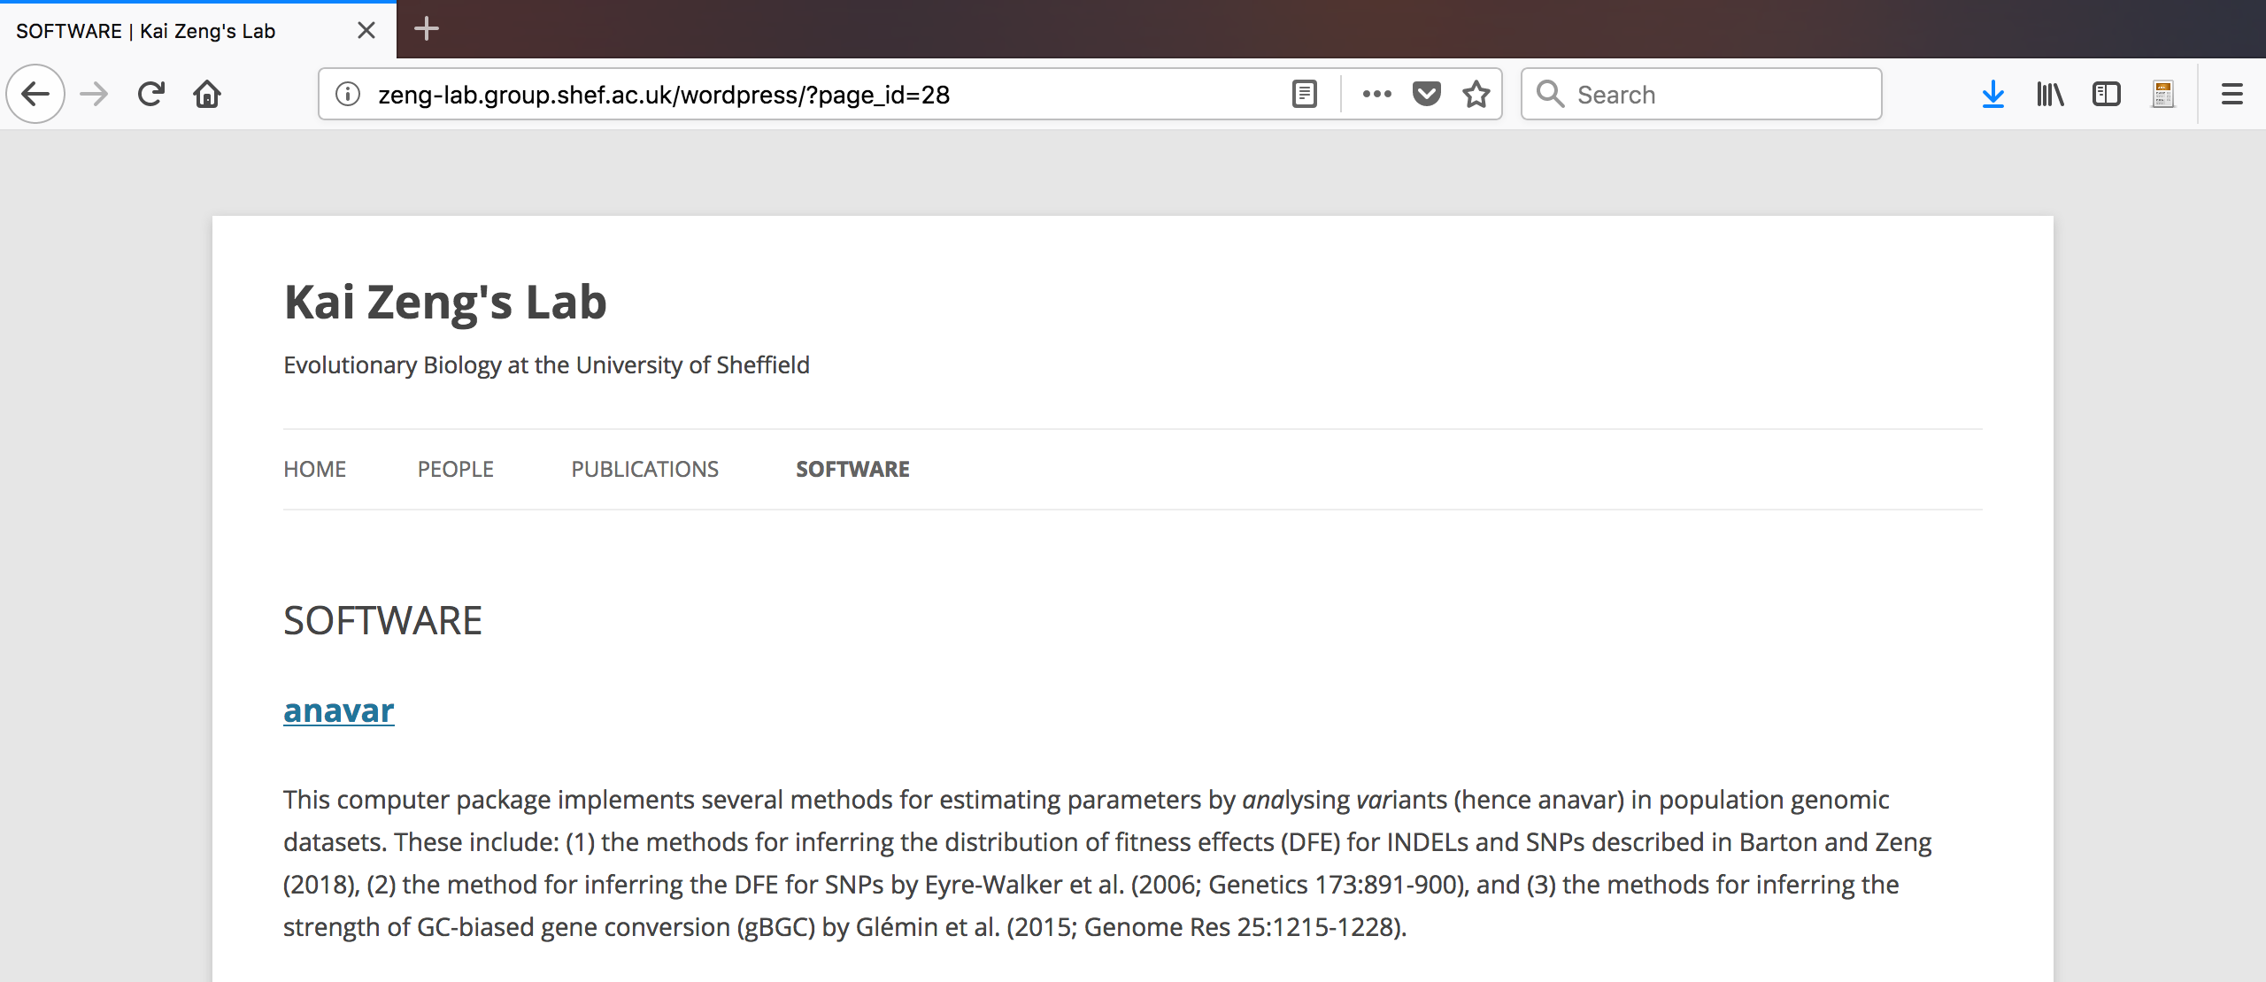
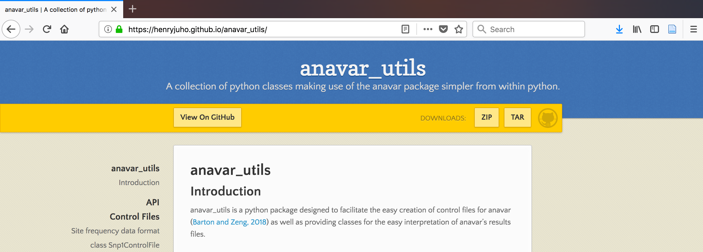
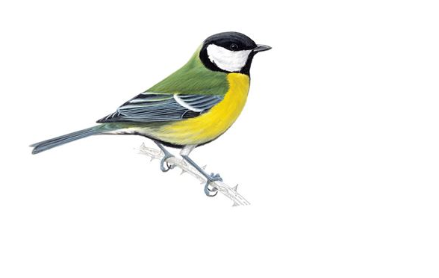
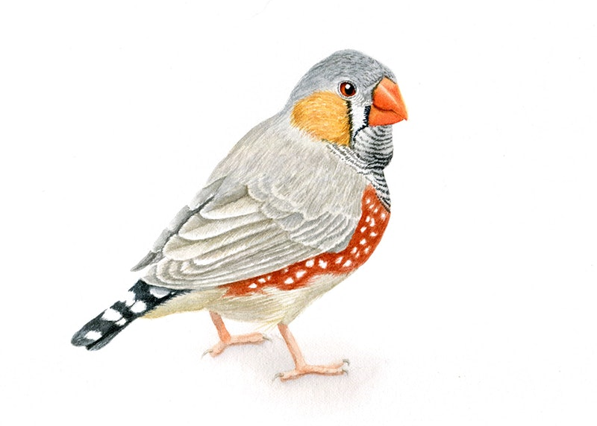
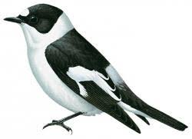

Slide 18
1
2
EXON
EXON

Slide 19
1
2
EXON
Regulatory
EXON

Slide 20
1
2
EXON
Regulatory
EXON

Slide 21
1
2
EXON
Regulatory
EXON
Selection

Slide 22
1
2
EXON
Regulatory
EXON
Selection

Slide 23
1
2
EXON
Regulatory
EXON
Selection

Slide 24
1
2
EXON
Regulatory
EXON
Selection
Selection

Slide 25
1
2
EXON
Regulatory
EXON
Selection
Selection

