Slide 1
SNP Calling and Filtering
Henry Barton

Slide 2
http://henryjuho.github.io/uspopgen/

Slide 3

Genomic Data

Slide 4
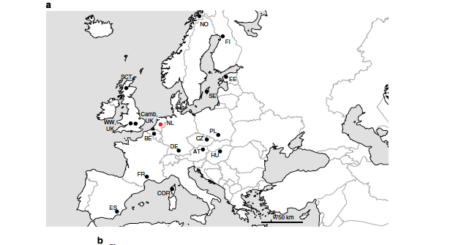

Slide 5
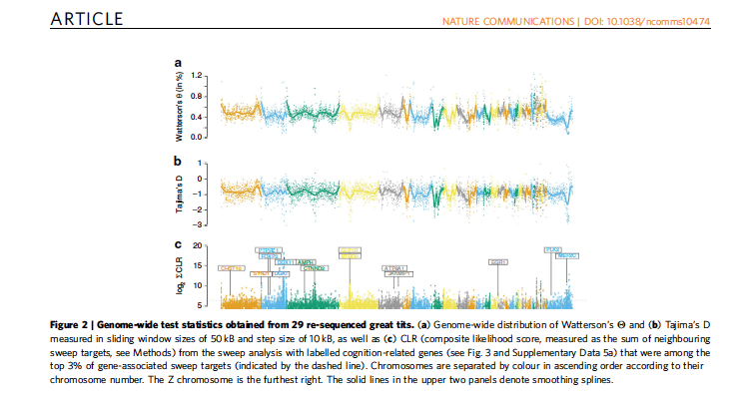

Slide 6
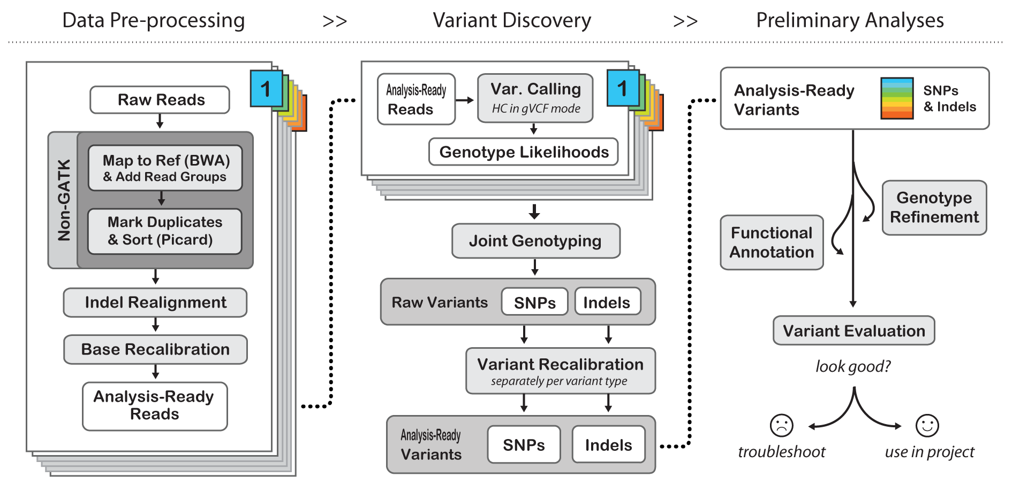
GATK Pipeline

Slide 7
Objectives
Call SNPs with GATK and samtools/bcftools
Become familiar with VCF format
Extract and filter SNPs
Compare VCF files between callers

Slide 8
http://henryjuho.github.io/uspopgen/

Slide 9
http://gatkforums.broadinstitute.org/gatk/discussion/4017/what-is-a-gvcf-and-how-is-it-different-from-a-regular-vcf

