Slide 1
Final Presentation: Statistical Analysis on Investment Performance of the S&P 500 Equity-Indexed Annuity (EIA)’s Index Strategies
Group Member and Presenter: Henry Wong
Stat 222: Statistics Master’s Capstone
Professor Victoria Stodden
April 30th, 2014

Slide 2
Research Questions Whose Mind are We Going to Change (about What)?
How do the distribution, the expected return, and the volatility of the investment performances change by increasing the investment holding period from 1-year to 10-year?
EIA investors, EIA industry, and academia.
Is there any particular day of month has higher or lower expected return and volatility than the other days?
EIA investors.
Does the statistically analysis provide a good benchmark for measuring opportunity cost and volatility for investing in the EIA index strategies?
Actuaries who do the pricing and hedging work for EIA products.
Can the chosen index strategies of the S&P 500 EIA outperform the S&P 500 index with 10-year holding period?
EIA investors and EIA industry.

Slide 3
Data and its Relevance to the Research Questions
Data: The S&P 500 Index from Yahoo Finance
Daily dates and adjusted closing prices from the beginning of 1951 to the end of 2013.
S&P 500 Equity-Indexed Annuity (EIA)
Investors invest an amount of money (premium) in return for protection against down markets and the potential for some investment growth.
The credited interest is linked to S&P 500 index and it depends on investment performance of an Index Strategy that investors choose at the contract effective date.
At each contract anniversary, any interest credited to the EIA is automatically locked in, so it becomes part of EIA’s new accumulated value.
This means that even if the index value declines in later years, the premium and any interest that has been credited to the EIA’s contract cannot be lost to future market downturns.

Slide 4
Mechanism of the EIA Index Strategies
We are focusing on the following two popular EIA index strategies.
1-Year Gain-Trigger with 5% Annual Rate
If the ending index value is greater than the beginning index value, 5% interest rate is credited to the account, otherwise, no interest credited.
1-Year Point-to-Point Index Strategy with 8% Annual Cap
The interest credited to the annuity is equal to the percentage change in the index, subject to an annual cap rate 8%.
e.g., if the index value increases by 12% in a year, 8% would be credited, not 12%. Also, if the index value decreases by 10% in a year, the account value would remain the same.

Slide 5
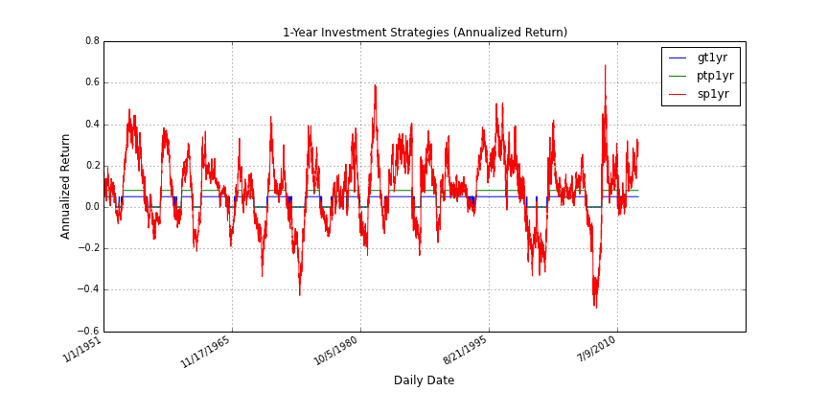
1-Year Investment Strategies Performance

Slide 6
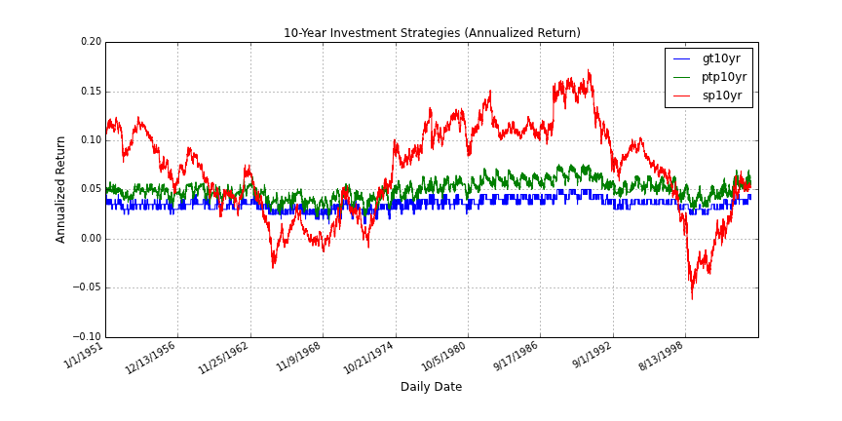
10-Year Investment Strategies Performance (Annualized Return)
Notice that the annualized return on S&P 500 is less volatile when the investment duration is increased.

Slide 7
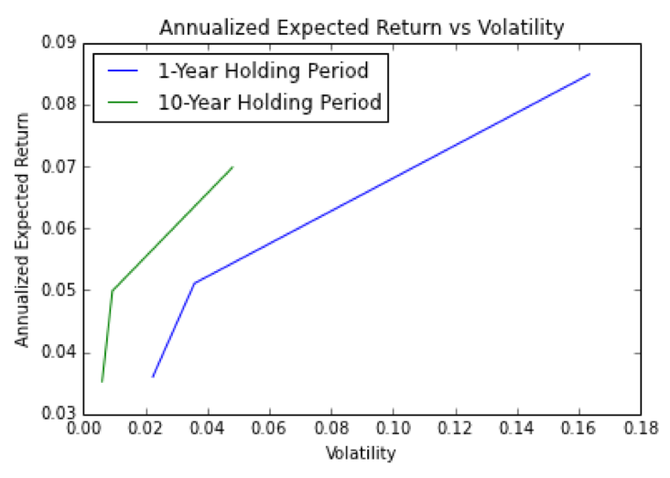
Annualized Expected Return vs Volatility By Investment Duration
S&P Index
When we increase investment duration, the expected value and the volatility of the annualized returns decrease.
Point-to-Point
The decrease in the volatility is greater than the decrease in the expected return.
Gain-Trigger

Slide 8
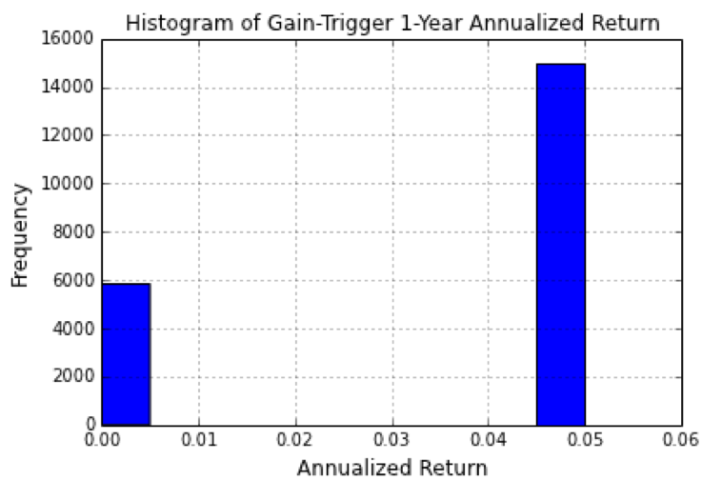
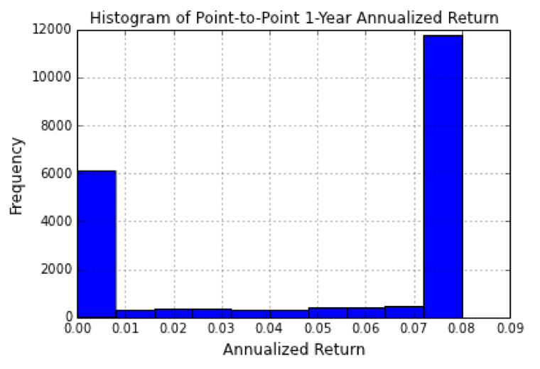
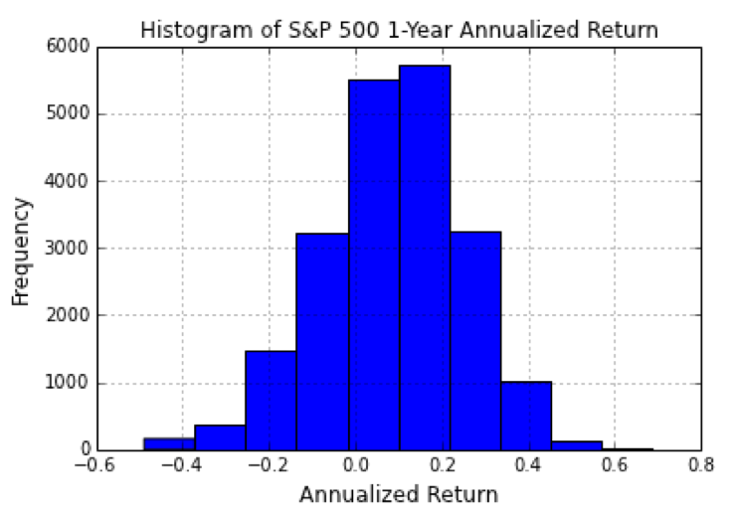
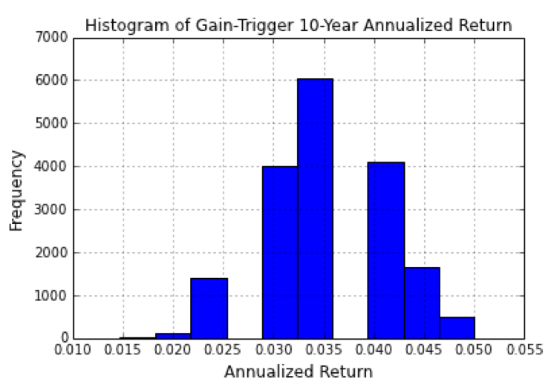
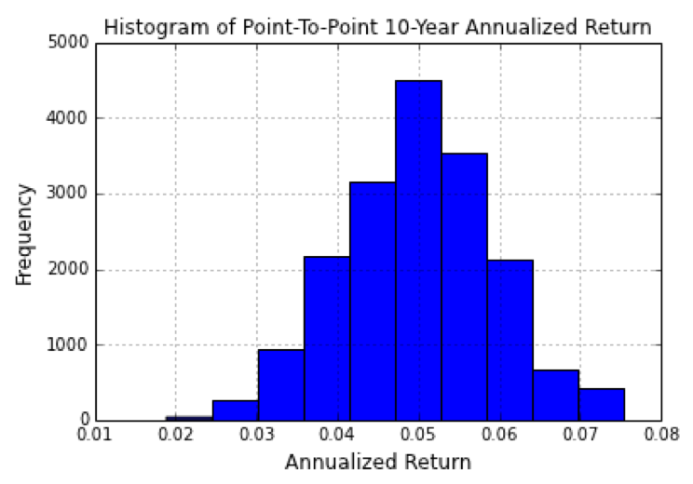
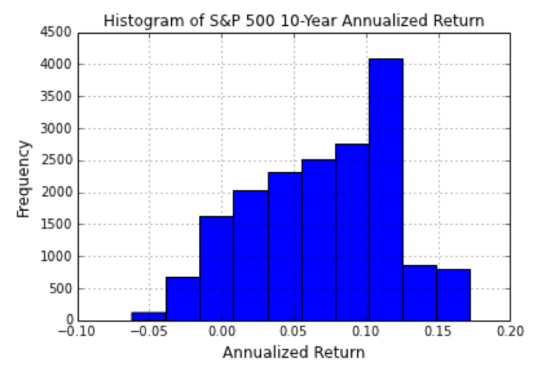
Distribution of Investment Performance By Investment Duration & Strategy
Gain-Trigger
Point-to-Point
S&P 500
1-Year
10-Year
More bell-shaped
More negatively-skewed

Slide 9
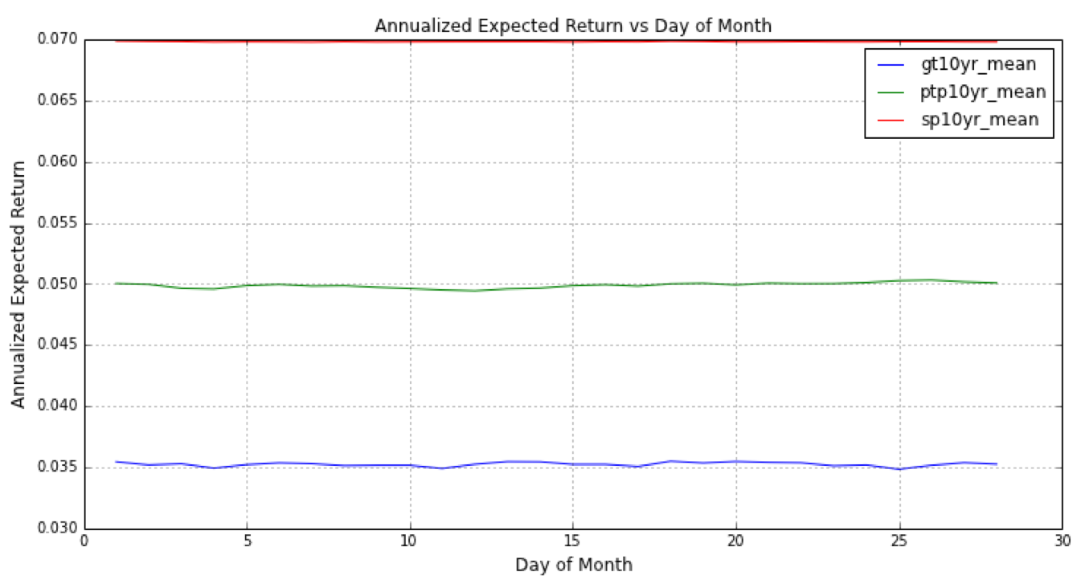
Annualized Expected Return vs Day of Month
Indifference with Day of Month
2% Opportunity Cost
3.5% Opportunity Cost

Slide 10
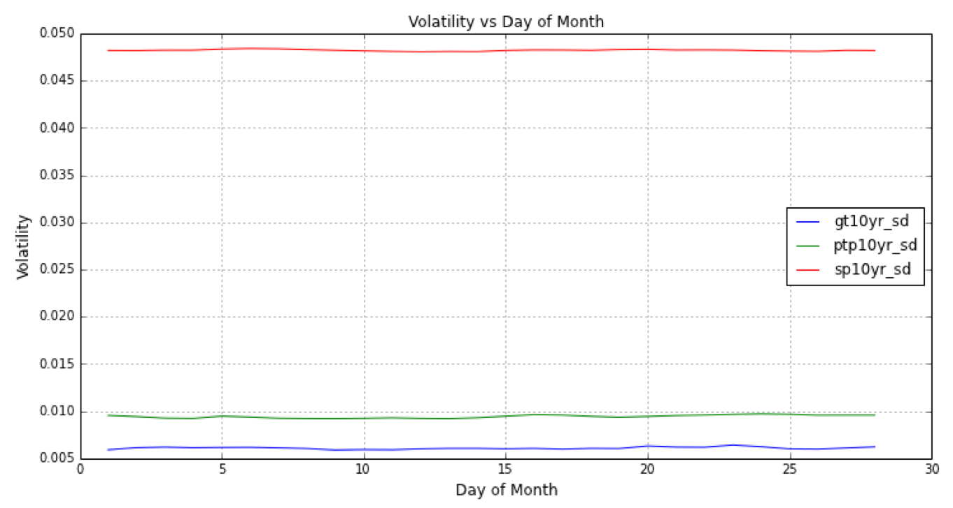
Volatility vs Day of Month
Indifference with Day of Month

Slide 11
Sharpe Ratio
Sharpe Ratio = E(R_{i} – R_{f}) / Std(R_{i} – R_{f})
where
E(R_{i} – R_{f}) is the expected value of the excess of investment return over the risk-free rate (US 10-year Treasury rate).
Std(R_{i} – R_{f}) is the standard deviation of the excess return.
Interpretation:
Sharpe ratio is the expected return on each unit risk taking. i.e. Price of risk.
Risk-averse investors prefer high Sharpe ratio.
Risk-neutral and risk-loving investors prefer high expected return.

Slide 12
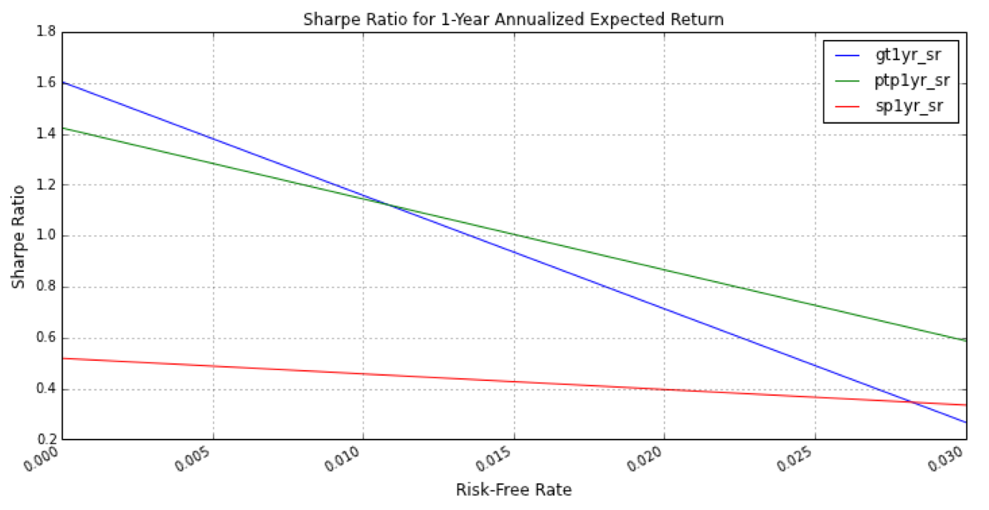
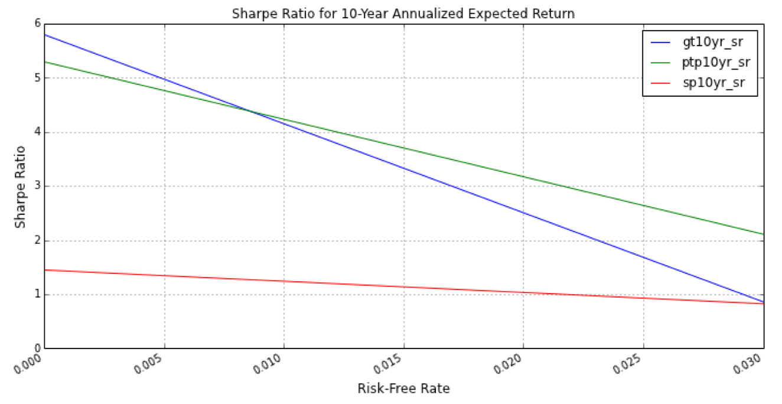
Sharpe Ratio by Investment Duration
Risk-averse investors prefer high Sharpe ratio, so they prefer investing on EIA Index Strategies up to 3% risk-free rate.
Sharpe ratio can be considered as a function of risk-free rate.
1-Year
10-Year

Slide 13
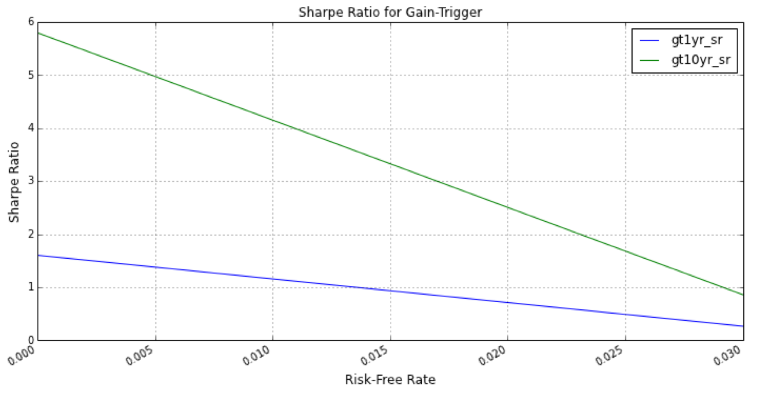
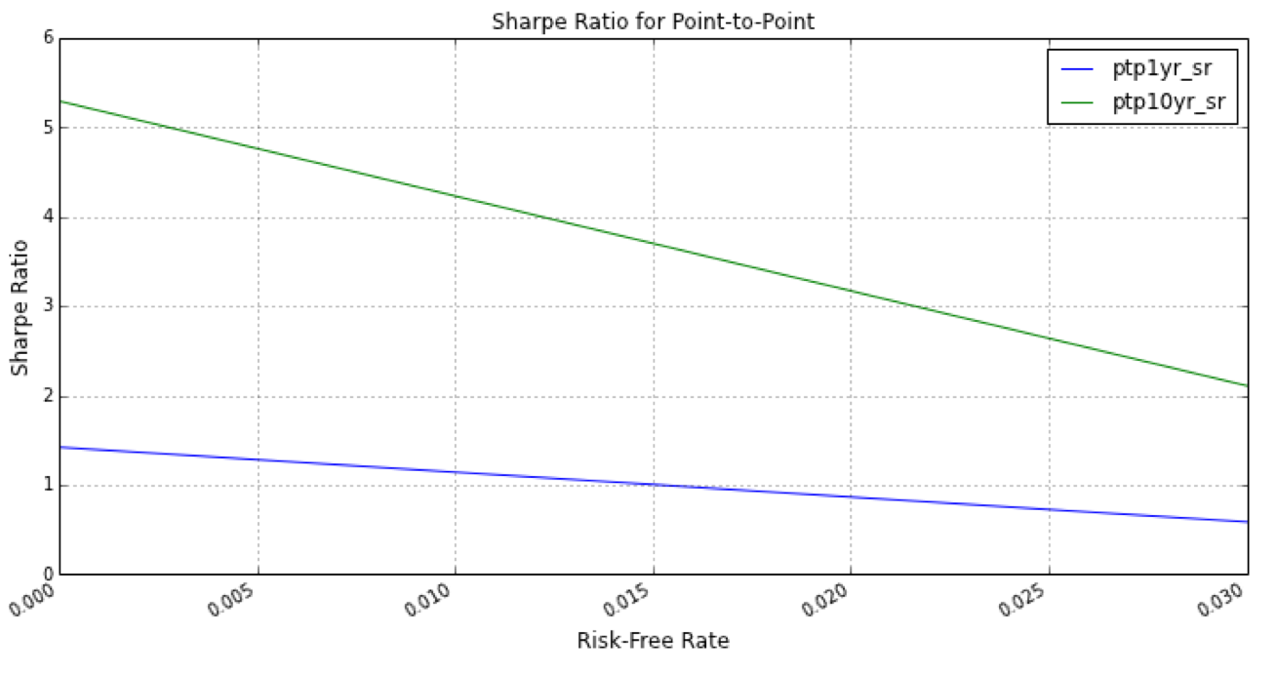
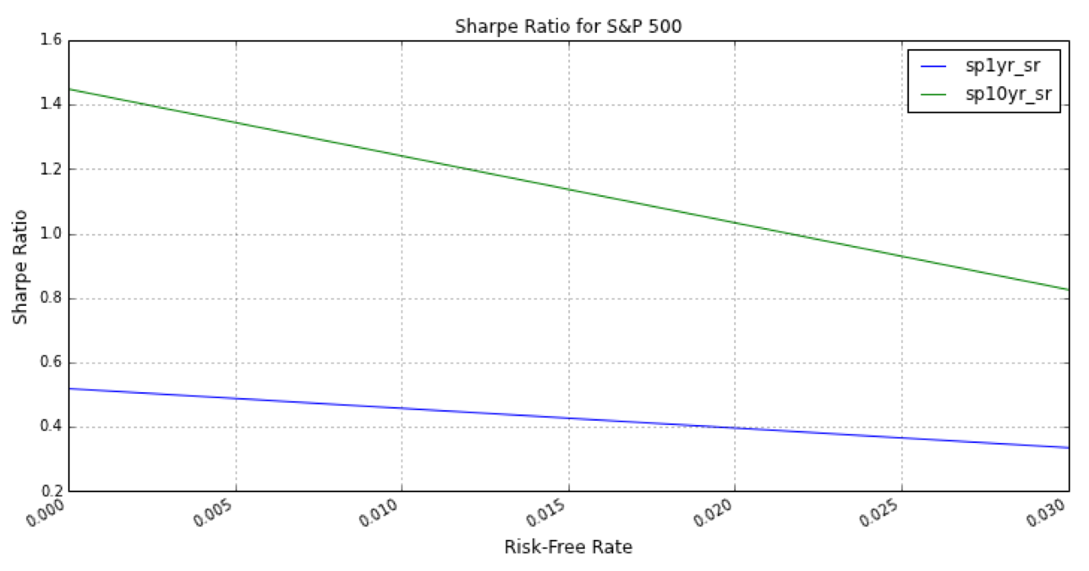
Sharpe Ratio by Investment Strategy
Sharpe ratio increases with investment duration.
Gain-Trigger
Point-to-Point
S&P 500

Slide 14
Key Findings (Whose Mind) are We Going to Change about What?
How do the distribution, the mean, and the volatility of the investment performances change by increasing the investment holding period from 1-year to 10-year? (EIA investors, EIA industry, and academia)
Distribution: More bell-sharped for the index strategies and more negatively-skewed for the S&P 500 index.
Mean and volatility of the investment performances decreases across the board.
The decrease in the mean of the investment performances is less than its volatility.
Is there any particular day of month has higher or lower expected return and volatility than the other days? (EIA investors)
No, the results are indifferent with the day of month.
Does the statistically analysis provide a good benchmark for measuring opportunity cost and volatility for investing in the EIA index strategies? (Actuaries)
Yes, on average, there are 3.5% and 2% of annual opportunity costs for investing in the Gain-Trigger and Point-to-Point strategy respectively.
The annual volatilities for investing in the Gain-Trigger and Point-to-Point are 4.2% and 3.8% respectively lower than one for the S&P 500.
Can the chosen index strategies of the S&P 500 EIA outperform the S&P 500 index with 10-year holding period? (EIA investors and EIA industry)
Yes for the risk-averse investors if annual risk-free rate is less than 3% (Sharpe ratio).
No for the risk-neutral and risk-loving investors (Positive opportunity costs for both EIA strategies).

Slide 15
Thank You!

