Slide 1
Secret mlds hw1-3
組員：賴言禮 陳新元 陳德昕 張家銘

Slide 2
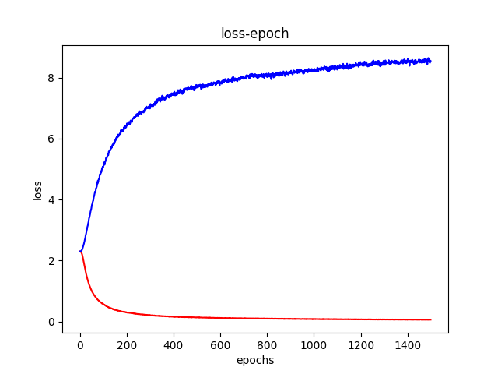
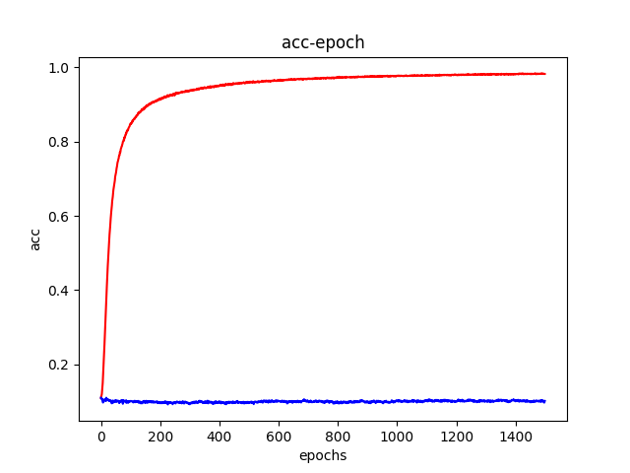
Can network fit random labels

Slide 3
Number of parameters vs generalization
1.train on MNIST
2.DNN with 5 hidden layers

Slide 4
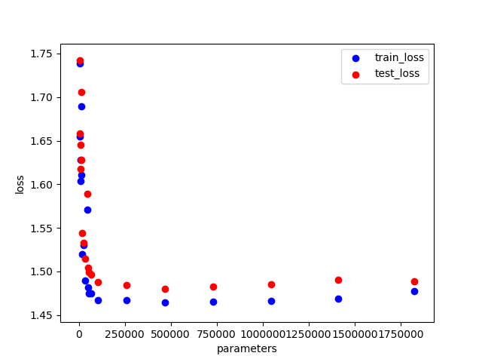
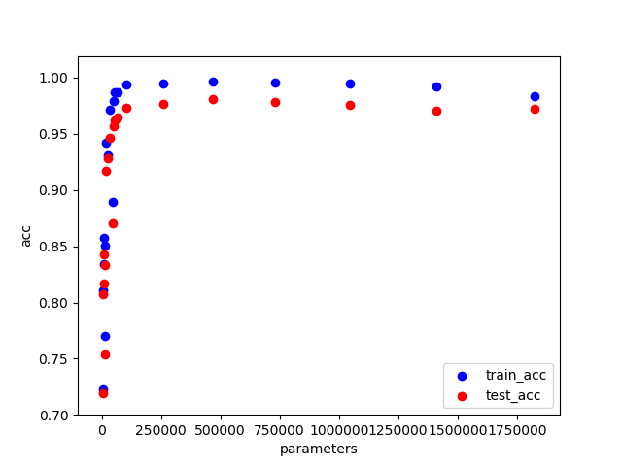

Slide 5
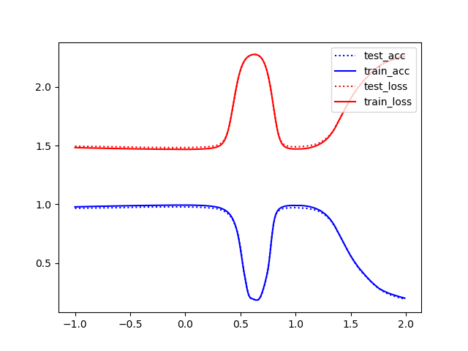

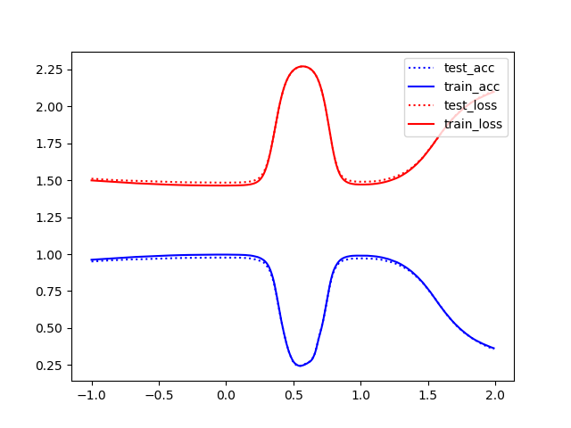
Visualize the line between two trained models
Same model different batch size
6 hidden layers
32 vs 4096
64 vs 4096
128 vs 4096

Slide 6
Same batch size different model
Hidden_6 784->300->200->200->200->200->100->50->10
Hidden_4 784->200->150->100->50->30->10
Hidden_2 784->50->30->20->10

Slide 7
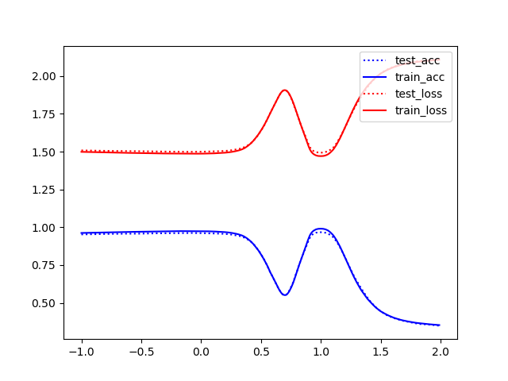
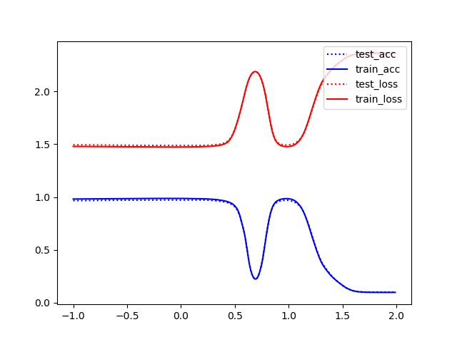
64 vs 4096
hidden_layer_2
hidden_layer_4
hidden_layer_6

Slide 8
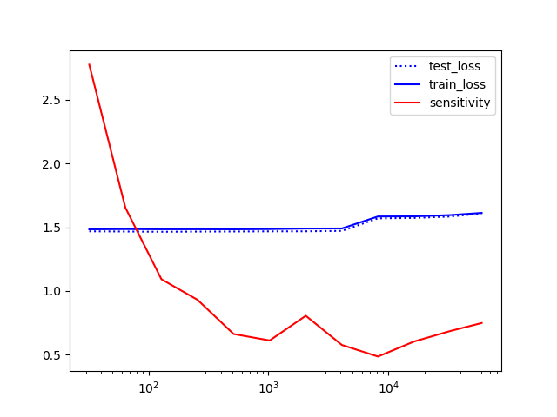
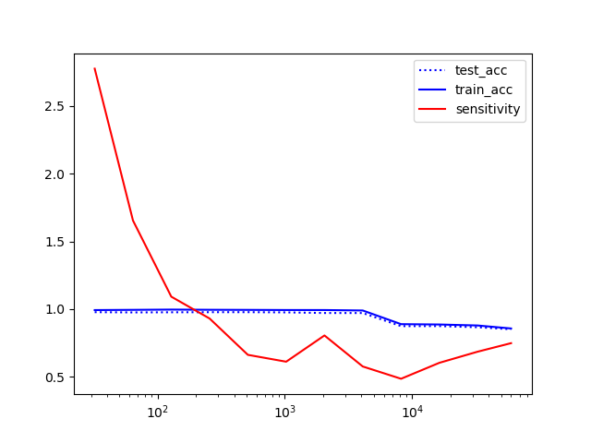
Batch size vs sensitivity

Slide 9
Flatness vs generalization

Slide 10
Model
Input layer:
784 x 80 ->
Hidden Layer:
80 x 80 -> 80 x 100 -> 100 x 60 ->
Output layer:
60 x 10
Total parameters:

Slide 11
Step1 – Train model
Implementation: Tensorflow
Epoch: 400
Lr : 0.005
Optimizer: Adam
Loss function: Cross Entropy
Activation: Relu & Softmax(last layer)
Batch size: 32~ 32768 (11 sample)

Slide 12
Step2 – Random sample
Convert the weight tensor into numpy array
Add noise to the numpy array
The scale of the noise is determine by the abs mean of the weight
Uses numpy.random.normal()
Sampled 200 points for each model
Calculate the maximum loss

Slide 13
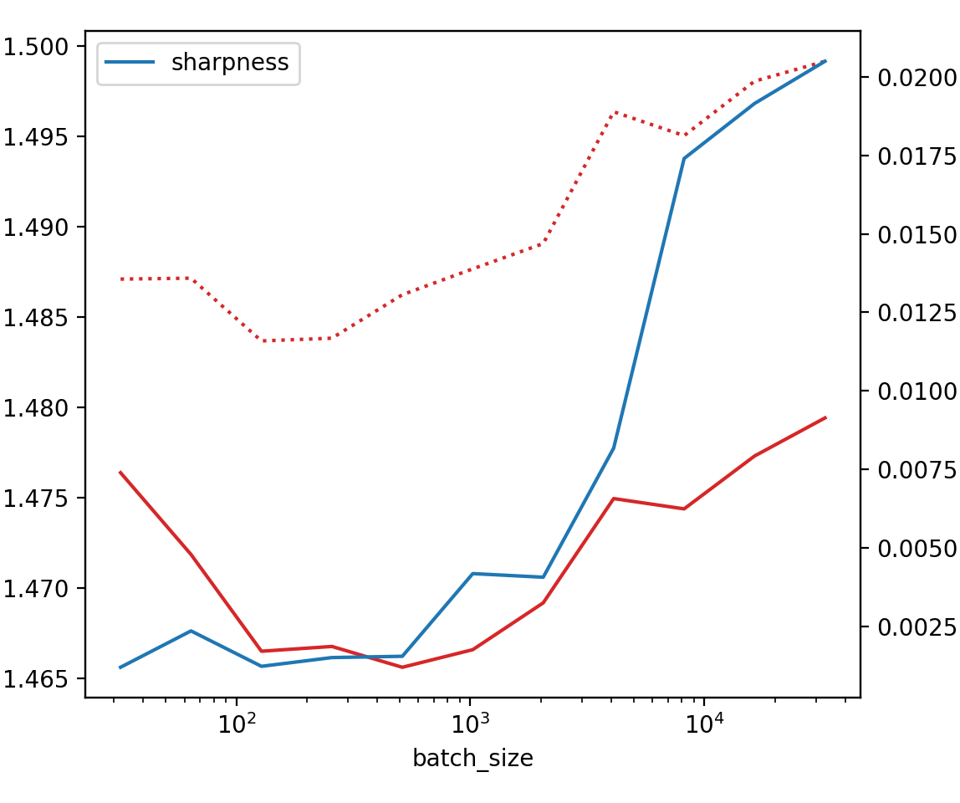
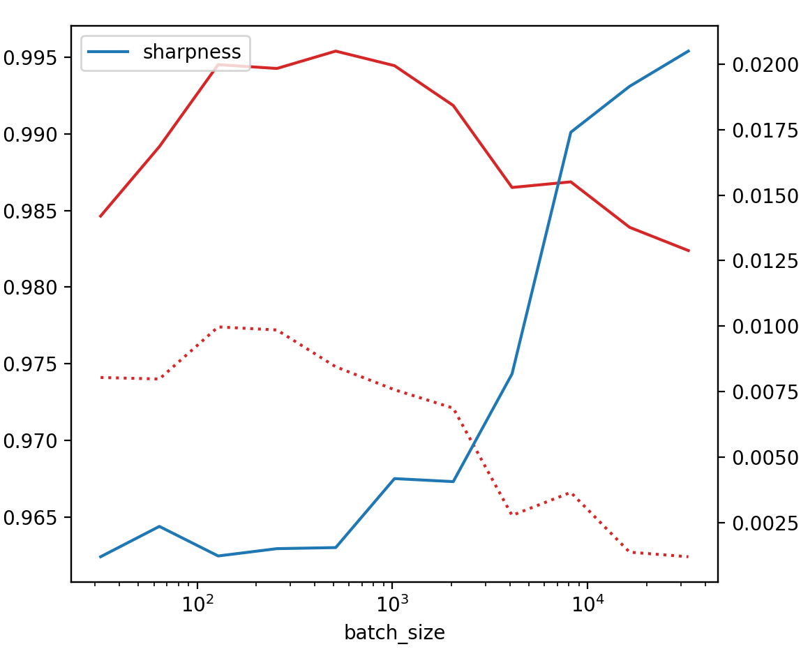
Result
Loss vs Sharpness
Accuracy vs Sharpness

Slide 14
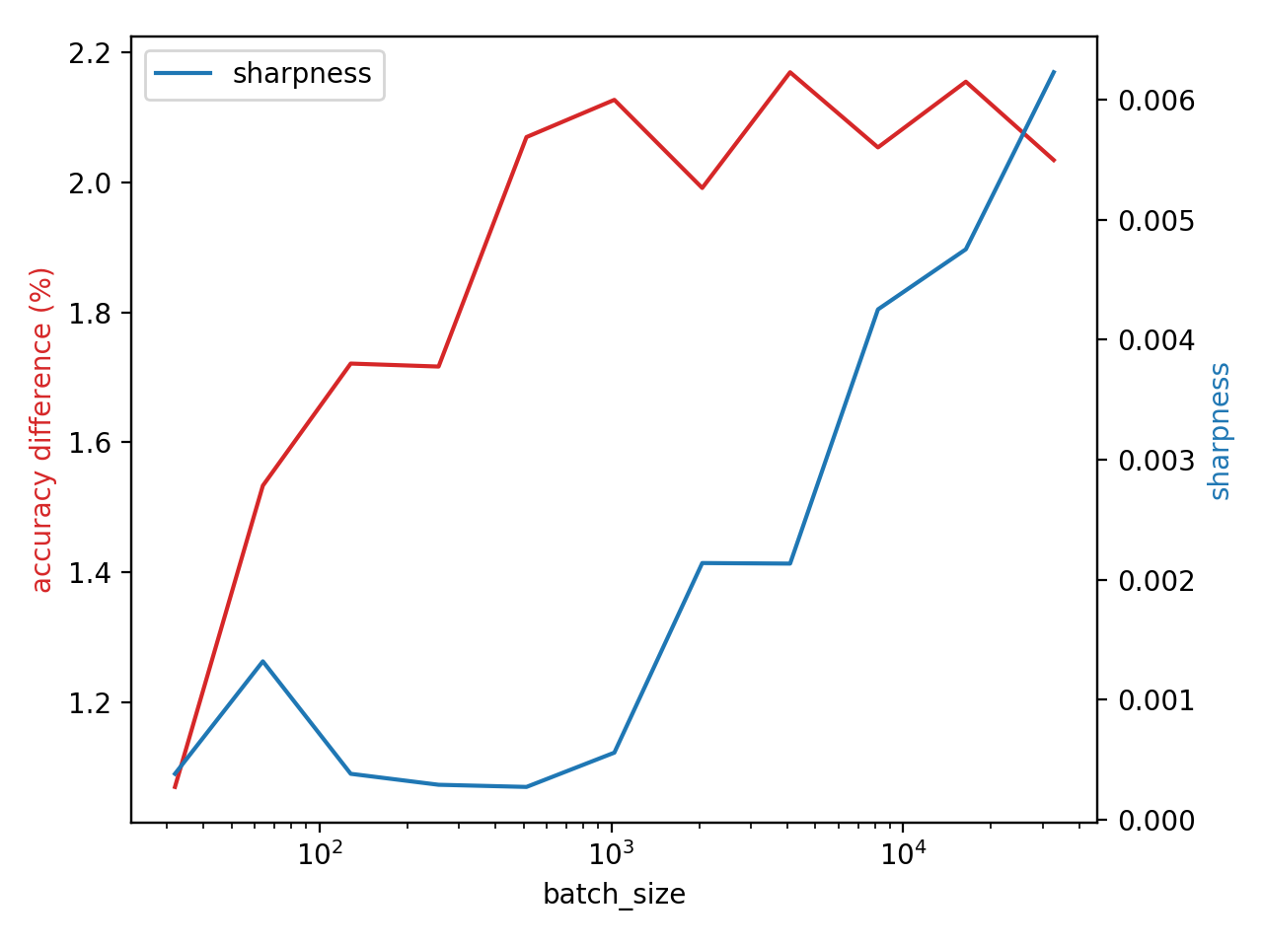
Result

Slide 15
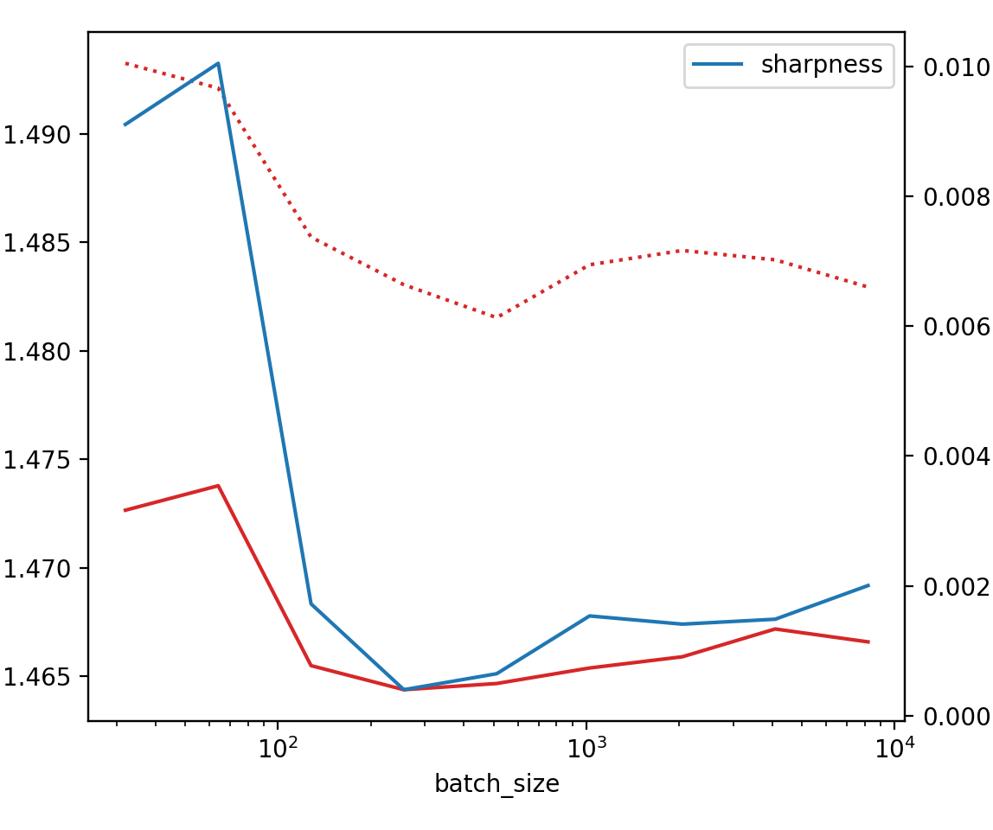
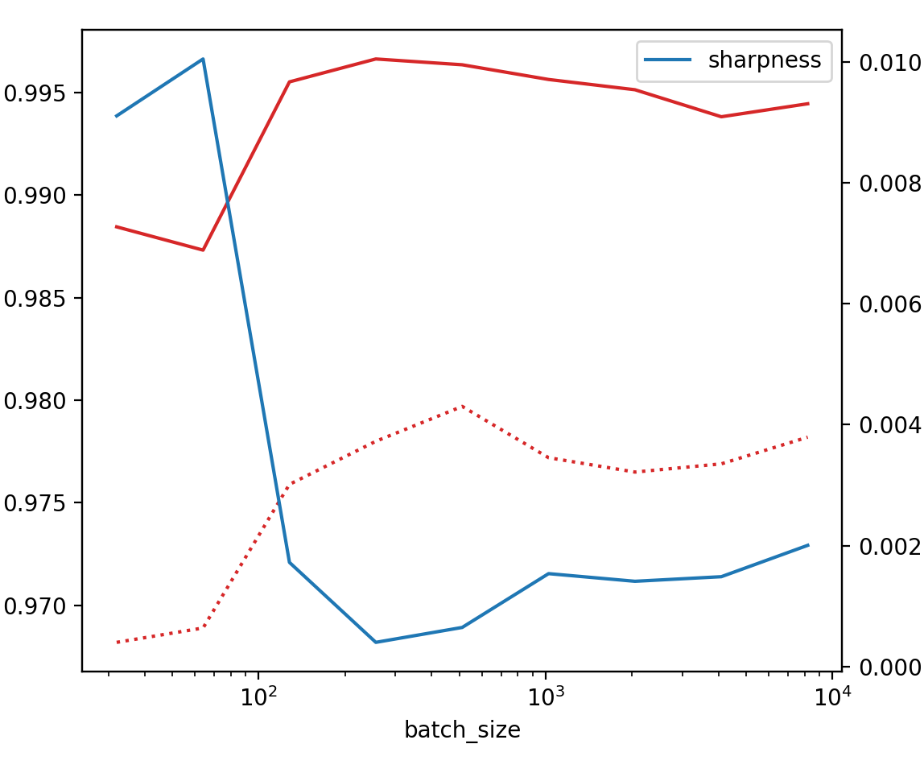
Result
Loss vs Sharpness
Accuracy vs Sharpness

