Slide 1
Mobile Apps ads.txt
Intern: Henry Lin
Mentors: Jud Spencer and Chris Ng

Slide 2
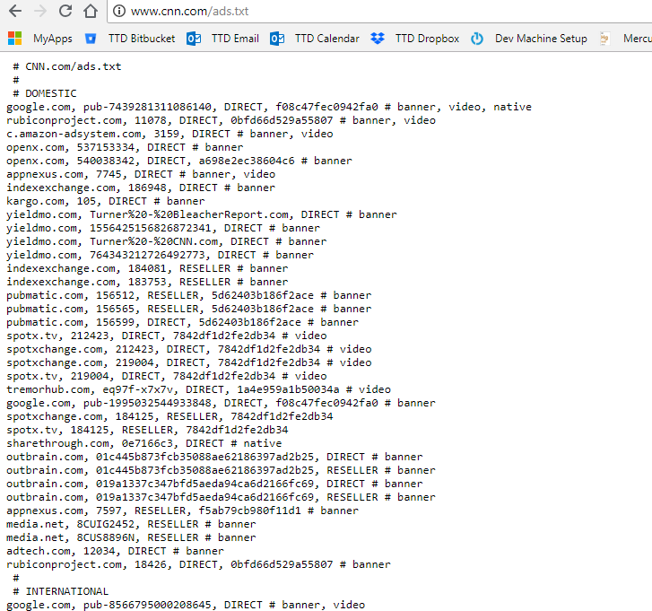
Introduced last year by IAB (Interactive Advertising Bureau).
Currently used by websites to protect against domain spoofers and unauthorized sellers.
Want to do the same for mobile apps.
Companies not as keen to include info in their App Stores

Slide 3
Google Play CSV
42matters App Data
DynamoDB Storage
Data Processing
Apple Store CSV
Tencent Store CSV

