Slide 1
Context
What is an object?
An object is one of the built in data types in JavaScript.
An object is a collection of properties and methods.
A property is a name:value pair, the value of which can be accessed by referencing the name the value is associated with, or by using a getter method.
The value of a property has it’s own data type, and can be another object (a nested object), a string, integer, etc…
The properties of an object can be changed directly by referencing the property, or by using a setter method.
The contents of an object are mutable, even if the object is declared using const. What is an array?
What is an array?
In JavaScript, an array is one of the built in object data types, and thus it has methods associated with it.
An array is a collection of items, with each item stored within the array having an associated index that
The items within an array can be any other data type, including other arrays or objects.
An array that contains another array can be called a 2-dimensional array.
Discuss the difference between an array and an object.
Both arrays and objects store collections of data, are mutable even when declared as constants, and can store a mix of data types.
The data stored within an array is referenced using a non-negative integer value, whereas within an object data is referenced using the name of the property the data is assigned to.
Both objects and arrays have built in methods, however arrays cannot have new methods added to them during and after creation whereas objects can.
While an array object can only be created by declaring an array, objects can either be created by declaring them or by the use of a class.
Notes:
In JavaScript, both objects and arrays are data types, however an array is an object data type, and is actually an object itself.
Objects and arrays are able to contain any datatypes including nested ones,. While the data does not have to be related, generally objects are considered to be collections of related information and the methods associated with one should be relevant to that information.
Objects and arrays are both ways in which a collection of data can be stored and accessed and for both of them the data is retrieved using a reference that points to where the data is located.
Given all their similarities there are some key differences between the two data types:
An array may only be referenced using a numerical index, whereas objects store their data as properties. An objects properties are comprised of a name:value pair, and may be accessed using the name of the property, the readability of the resulting code is better because of this.
Objects are also able to have new methods assigned to them during and after creation, whereas arrays are limited to the built in methods associated with the array object.
Where they significantly differ is in their methods of creation, while both are created by initialising them, objects can also be created through the use of a class.

Slide 2
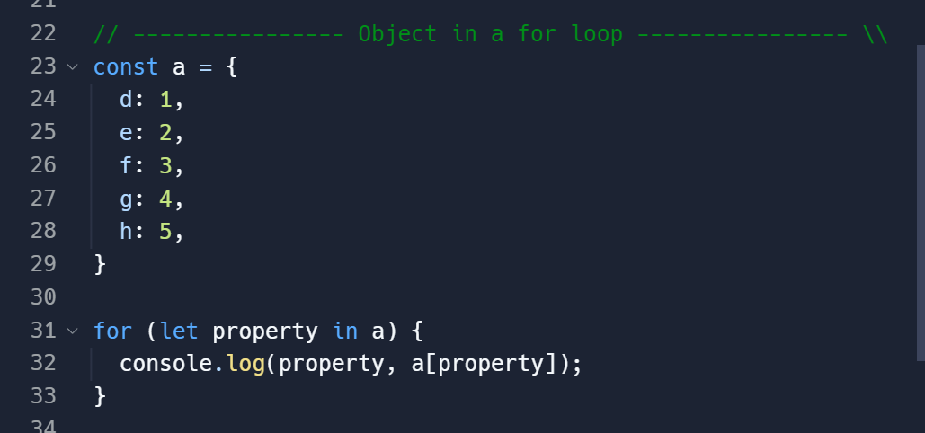
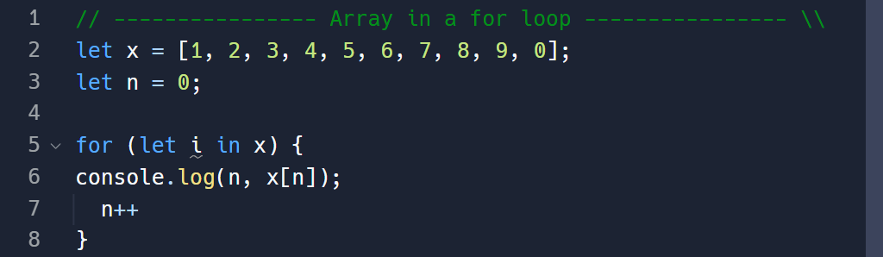
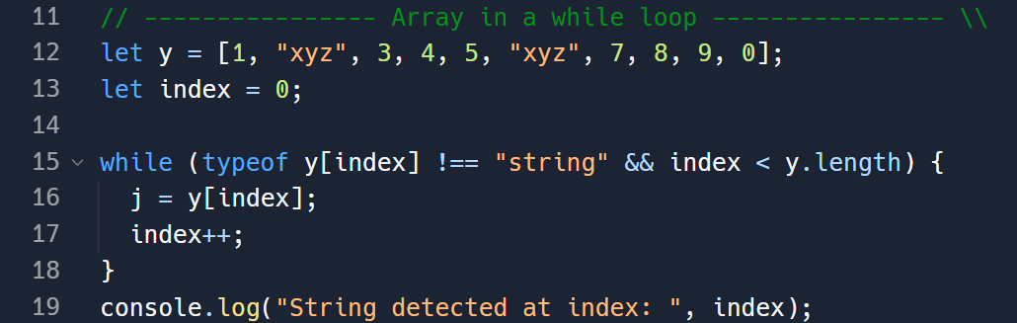
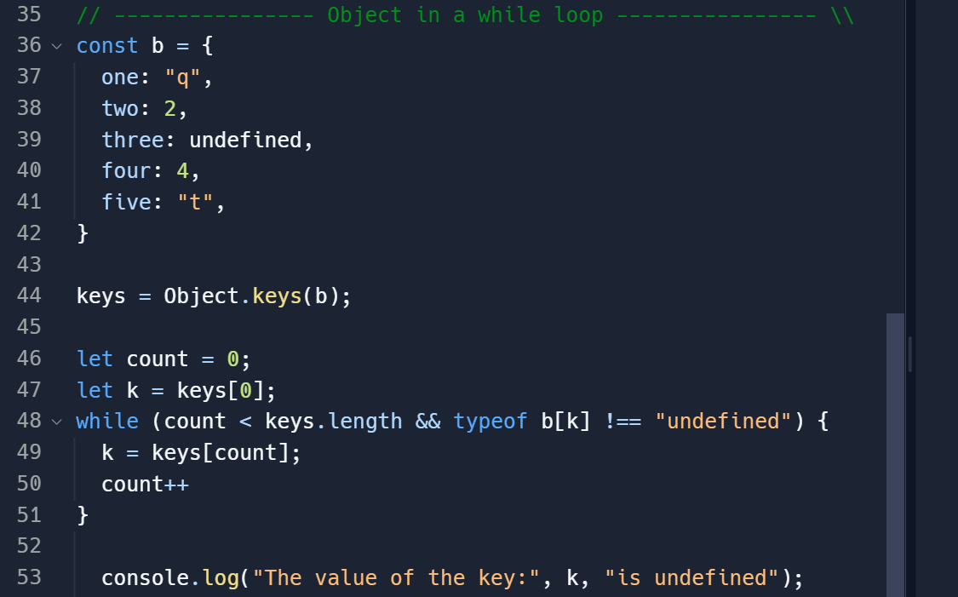
Use of Arrays and Objects
How can arrays be used in loops
A for loop:
An array can be used within a for loop:
To loop over each element within the array.
To modify the array a set number of times.
How can objects be used in loops
A for loop:
An object can be used within a for loop:
To loop over each property and method of that object.
To modify the object a set number of times.
A while loop:
An array can be used within a while loop:
To loop over each element of the array.
To search through the array for an item that meets a condition, or while a condition is met.
A while loop
An object can be used in a while loop:
To loop over each property or method of that object.
To search through the object until a property meets a condition, or while a condition is met.
To modify an object until a condition is met.
To call an objects method until a condition is met.
Notes:
Arrays can be used in both for and while loops.
In both instances it would be most common to loop over each element of the array.
When utilising an array with a for loop, it is common to do so using a for-in loop which iterates through the array with each element within it being passed into a variable with each iteration.
In the example here a variable named X has been declared and initialised with an array along with a the variable n which is initially set equal to zero. A for in loop has then been created wherein the variable i is to be used as the iterator, and the array to be iterated through is X.
Within the loop we are logging the value of n, and the value of the item within the array at the position n, and with each iteration we are incrementing the value of n by 1. The result of this loop is that the numbers 0 – 10 and the values within the array at those positions are logged to the console as pairs.
An array may also be used with a while loop in a similar fashion to a for loop, however a while loop also allows for the loop to only run whilst a condition is met.
In the example here an array called Y has been declared, along with a variable named index which has been initialised with a value of zero. The while loop has then been defined and will iterate as long as the current item in the array that is being iterated over is not a string, and as long as index is less than the number of items within the array.
Unlike a for loop, to iterate over an array with a while loop a variable must be declared to count through each element. In this case it is the variable named index.
This while loop will stop at the second item of the array as it is a string, the position of that string will consequentially be stored in index and a message will be logged to the console stating where the string was found.

Slide 3
Appendix
The primary challenge I faced in this task was going back to basics. In having to consider how to use an array or object in a way you would not normally use them, you are forced to think outside of the box to find a solution to a seemingly simple problem.
I also found it useful going back over the definitions of objects and arrays, and more specifically them within the confines of JavaScript to better understand their implementation within the language.
General:
https://developer.mozilla.org/en-US/docs/Glossary/Primitive
https://developer.mozilla.org/en-US/docs/Web/JavaScript/Inheritance_and_the_prototype_chain
https://www.edureka.co/blog/data-types-in-javascript/#:~:text=An%20array%20in%20JavaScript%20is,the%20index%20starts%20from%200.
https://medium.com/@zac_heisey/objects-vs-arrays-42601ff79421#:~:text=Objects%20represent%20a%20special%20data,store%20a%20list%20of%20values.
https://chat.openai.com/
https://developer.mozilla.org/en-US/docs/Web/JavaScript/Data_structures
Arrays:
https://developer.mozilla.org/en-US/docs/Web/JavaScript/Reference/Global_Objects/Array
https://stackoverflow.com/questions/61517204/what-do-we-mean-by-defining-a-const-array-in-js
Objects:
https://www.w3schools.com/js/js_objects.asp
https://www.techtarget.com/searchapparchitecture/definition/object
https://developer.mozilla.org/en-US/docs/Web/JavaScript/Reference/Global_Objects/Object
https://stackoverflow.com/questions/1568091/why-use-getters-and-setters-accessors
https://www.w3schools.com/js/js_classes.asp
https://developer.mozilla.org/en-US/docs/Web/JavaScript/Reference/Classes
https://www.codecademy.com/courses/introduction-to-javascript/lessons/objects/exercises/nested-objects

