Slide 1

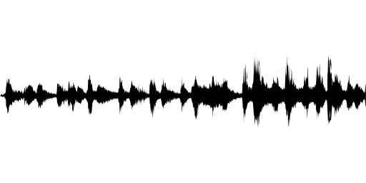
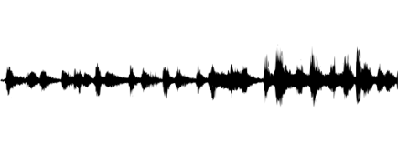
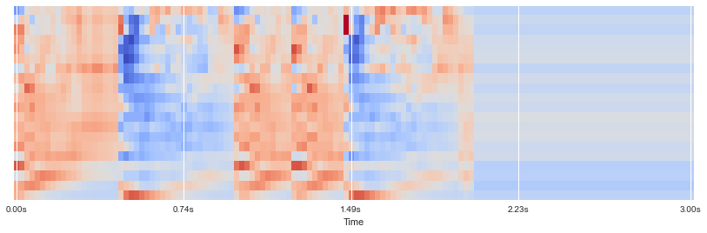
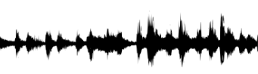
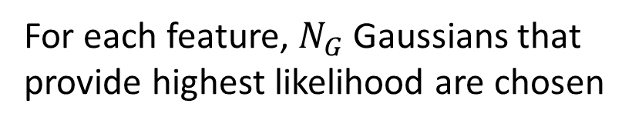
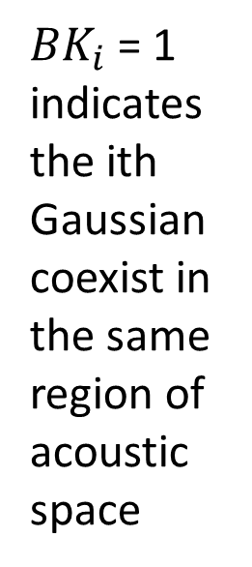
Real-time Speaker Recognizer
Offline and real-time speaker diarization system based on binary key modelling
Hao Pan Supervisor: Dr. Beta C.L. Yip
The University of Hong Kong, Faculty of Engineering, Department of Computer Science
Introduction
System Design
Speaker diarization is the process of segmenting an input audio stream into speaker-homogeneous segments
Answer: “Who spoke when?”
Speaker identities and number of speakers are unknown
Speaker diarization ≠ Speaker recognition:
Timestamps are important
No enrollment process: no speaker voiceprint
Applications:
Improve ASR accuracy
Improve speaker recognition in multi-speaker data
Source separation: e.g. doctor vs patient
Spoken document indexing and retrieval
Generic diarization scheme:
Problem of existing system:
Require Intensive computation & long processing time
Online clustering performance are much worse than offline clustering
Lack of real-time application
Many system are domain-specific
Acoustic features (MFCCs)
Speaker acoustic space
most complementary & discriminant Gaussians
Input audio
VAD (WebRTC)
KBM
MFCCs
(Acoustic features)
……
VAD-mask
Sliding Windows
……
Stop when getting N Gaussians
Gaussian
Pool
……
Select 1st Gaussian with max likelihood
Calculate cosine Dist with other Gaussians
Select Gaussian with biggest cosine distance
System flowchart
Features of segment
n features vectors
Cumulative Vector (CV)
Binary Key (BK)
Voice Activity Detection, Feature extraction
KBM Training
Count
Occurrences
1
0
15
1 for top 20% values in CV, 0 otherwise
1
${BK}_{i}$ = 1 indicates the ith Gaussian coexist in the same region of acoustic space
N Gaussian Components
In KBM
……
7
0
3
0
Feature Binarization
25
1
…
…
5
0
…
…
Clustering
For each feature, $N_{G}$ Gaussians that provide highest likelihood are chosen
17
1
Segment/cluster representation
Resegmentation
Offline Clustering (Agglomerative clustering):
The cluster initialization
Cluster
Online Clustering:
Visualization
Input audio
Feature extraction
Speech activity detection
Segmentation
Resegmentation
clustering
Segment/cluster representation
Discussion
Future Work
Real-time Version of the system:
VAD, Feature extraction, Feature binarization: Performed in online manner
KBM Training: Performed in offline manner, do not need to perform every time when data in.
Clustering: fast and naive online clustering first for new data, the result of offline clustering will be used to update the previous result when it complete
Resegmentation:
Objectives
In this project, we seek to develop a speaker recognizer system that
Language-independent, domain-robust, do not need prior training, and platform-independent
Be able to label the speakers in a recorded audio and visualize the results
Be able to generate outputs as the input is analyzed and correct the earlier output when necessary
Contact
References

Slide 4
Input audio
Feature extraction
Speech activity detection
Segmentation
Resegmentation
clustering
Segment/cluster representation

