Slide 1

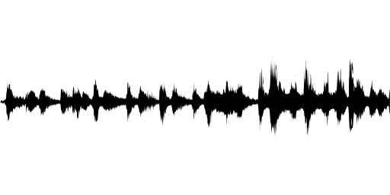
Real-time Speaker Recognizer
Offline and real-time speaker diarization system based on binary key modelling
Hao Pan 3035349015 Supervisor: Dr. Beta C.L. Yip
The University of Hong Kong, Faculty of Engineering, Department of Computer Science
Abstract
Methods and Materials
Click here to insert your Abstract text. Type it in or copy and paste from your Word document or other source.
This text box will automatically re-size to your text. To turn off that feature, right click inside this box and go to Format Shape, Text Box, Autofit, and select the “Do Not Autofit” radio button.
To change the font style of this text box: Click on the border once to highlight the entire text box, then select a different font or font size that suits you. This text is Calibri 28pt and is easily read up to 4 feet away on a 36x36 poster.
Click here to insert your Methods and Materials text. Type it in or copy and paste from your Word document or other source.
This text box will automatically re-size to your text. To turn off that feature, right click inside this box and go to Format Shape, Text Box, Autofit, and select the “Do Not Autofit” radio button.
To change the font style of this text box: Click on the border once to highlight the entire text box, then select a different font or font size that suits you. This text is Calibri 28pt and is easily read up to 4 feet away on a 36x36 poster.
Zoom out to 100% to preview what this will look like on your printed poster.
Chart 1. Label in 24pt Calibri.
Introduction
Results
Discussion
Speaker diarization is the process of segmenting an input audio stream into speaker-homogeneous segments
Answer: “Who spoke when?”
Speaker identities and number of speakers are unknown
Speaker diarization ≠ Speaker recognition:
Timestamps are important
No enrollment process: no speaker voiceprint
Applications:
Improve ASR system
Improve speaker recognition in multi-speaker data
Source separation: e.g. doctor vs patient
Spoken document indexing and retrieval
Generic diarization scheme:
Problem:
Intensive computation and long processing time
Online performance
Real-time application
Domain-specific
Click here to insert your Results text. Type it in or copy and paste from your Word document or other source.
This text box will automatically re-size to your text. To turn off that feature, right click inside this box and go to Format Shape, Text Box, Autofit, and select the “Do Not Autofit” radio button.
To change the font style of this text box: Click on the border once to highlight the entire text box, then select a different font or font size that suits you. This text is Calibri 28pt and is easily read up to 4 feet away on a 36x36 poster.
Zoom out to 100% to preview what this will look like on your printed poster.
Speaking of Results, yours will look better if you remember to run a spell-check on your poster! After you’ve added your content click on Review, Spelling, or press F7.
Click here to insert your Discussion text. Type it in or copy and paste from your Word document or other source.
This text box will automatically re-size to your text. To turn off that feature, right click inside this box and go to Format Shape, Text Box, Autofit, and select the “Do Not Autofit” radio button.
To change the font style of this text box: Click on the border once to highlight the entire text box, then select a different font or font size that suits you. This text is Calibri 28pt and is easily read up to 4 feet away on a 36x36 poster.
Zoom out to 100% to preview what this will look like on your printed poster.
Conclusions
Click here to insert your Conclusions text. Type it in or copy and paste from your Word document or other source.
This text box will automatically re-size to your text. To turn off that feature, right click inside this box and go to Format Shape, Text Box, Autofit, and select the “Do Not Autofit” radio button.
To change the font style of this text box: Click on the border once to highlight the entire text box, then select a different font or font size that suits you. This text is Calibri 28pt and is easily read up to 4 feet away on a 36x36 poster.
Zoom out to 100% to preview what this will look like on your printed poster.
Table 1. Label in 24pt Calibri.
 | Heading | Heading | Heading
Item | 800 | 790 | 4001
Item | 356 | 856 | 290
Item | 228 | 134 | 238
Item | 954 | 875 | 976
Item | 324 | 325 | 301
Item | 199 | 137 | 186
Input audio
Feature extraction
Speech activity detection
Segmentation
Resegmentation
clustering
Segment/cluster representation
Contact
References
<your name>
<your organization>
Email:
Website:
Phone:

Slide 4
Input audio
Feature extraction
Speech activity detection
Segmentation
Resegmentation
clustering
Segment/cluster representation

