Slide 1

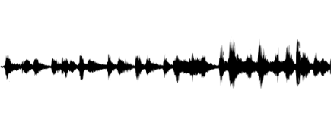
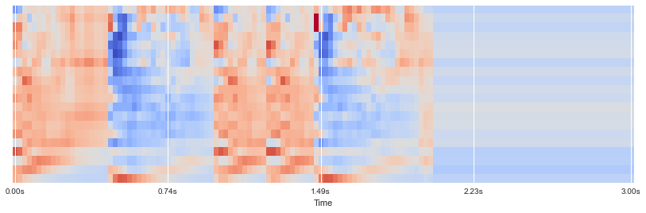
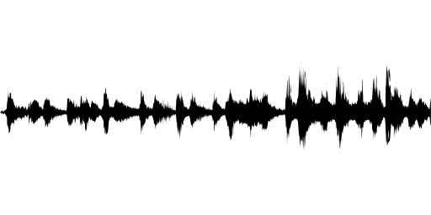
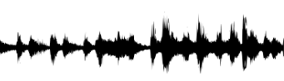
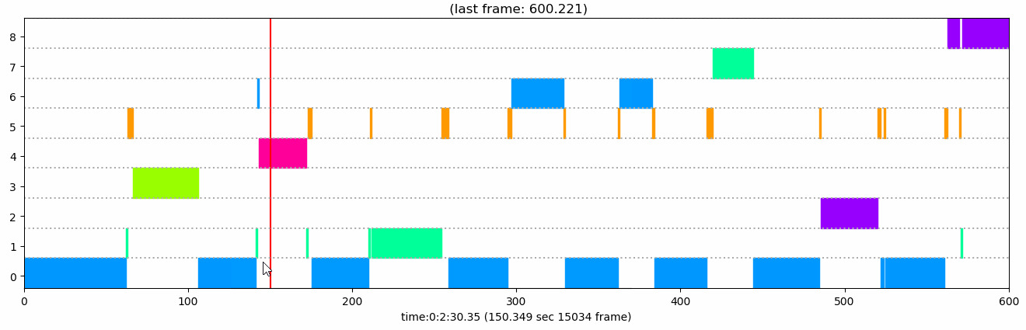

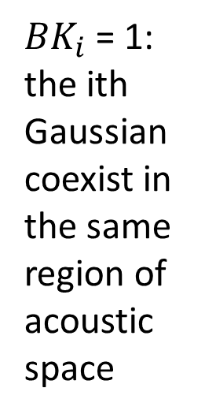


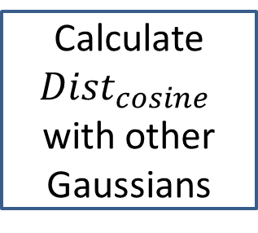
Real-time Speaker Recognizer
Offline and real-time speaker diarization system based on binary key modelling
Hao Pan Supervisor: Dr. Beta C.L. Yip
The University of Hong Kong, Faculty of Engineering, Department of Computer Science
Introduction
System Design
Speaker diarization is the process of segmenting an input audio stream into speaker-homogeneous segments
Answer: “Who spoke when?”
Speaker identities and number of speakers are unknown
Speaker diarization ≠ Speaker recognition:
Timestamps are important
No enrollment process: no speaker voiceprint
Applications:
Improve ASR accuracy
Improve speaker recognition in multi-speaker data
Source separation: e.g. doctor vs patient
Spoken document indexing and retrieval
Generic diarization scheme:
Problem of existing system:
Require Intensive computation & long processing time
Online clustering performance are much worse than offline clustering
Lack of real-time application
Many system are domain-specific
Input audio
Features (MFCCs)
Speaker acoustic space
KBM
most complementary & discriminant Gaussians
VAD (WebRTC)
MFCCs
(Acoustic features)
……
VAD-mask
Sliding Windows
……
Stop when getting N Gaussians
Gaussian
Pool
……
Select 1st Gaussian with max likelihood
Calculate ${Dist}_{cosine}$
with other Gaussians
Select Gaussian with biggest ${Dist}_{cosine}$
System flowchart
Features of utterance
n features vectors
Cumulative Vector (CV)
Binary Key (BK)
Voice Activity Detection, Feature extraction
KBM Training
0
1
0
Count
Occurrences
1
0
${BK}_{i}$ = 1: the ith Gaussian coexist in the same region of acoustic space
1
0
0
15
1 for top 20% values in CV, 0 otherwise
1
N Gaussian Components
In KBM
0
0
……
1
7
0
0
1
0
3
0
1
0
1
25
1
Feature Binarization
0
1
0
5
0
…
…
…
…
…
1
0
1
17
1
Clustering
For each feature, $N_{G}$ Gaussians that provide highest likelihood are chosen to have value 1
Segment/cluster representation
Resegmentation
Offline Clustering (Agglomerative clustering):
Cosine similarity between BKs/ CVs will be used to assign segments and compare clusters
Starts with $C_{init}$ Clusters. Clusters with highest similarity will then be merged until one cluster is left.
Elbow criterion is applied over the curve of within-class sum-of-squares / number of cluster to select best clustering from step 2
Online Clustering:
Assign the new segments to the clusters with smallest similarities of CVs
Input audio
Feature extraction
Speech activity detection
Segmentation
Visualization
Resegmentation
clustering
Segment/cluster representation
Discussion
Experiment Results
Real-time Version of the system:
VAD, Feature extraction, Feature binarization: Performed in online manner
KBM Training: Performed in offline manner. Use another thread to do the training and update the KBM; Need 10-15s data as buffer to get KBM.
Clustering: fast and naive online clustering first for new data, offline clustering will be used to update the previous result when it complete
Experiment on: Intel Core i5-4200U 2.30 GHz CPU With 8 GB RAM
Whole offline system: 0.03 – 0.05 xRT for recorded audio ranging from 20s to 5mins.
KBM Training: 0.02 – 0.03 xRT, the most time-consuming part in they system.
AHC Clustering is fast (0.005 xRT), so can be performed more frequently in Real-time version.
Objectives
In this project, we seek to develop a speaker recognizer system that:
Language-independent, domain-robust, do not need prior training, and platform-independent
Be able to label the speakers in a recorded audio and visualize the results
Be able to generate outputs as the input is analyzed and correct the earlier output when necessary
Contact
Future Work
The frequency to run KBM training and offline clustering need to be further determined
The relationship between of frequency to run KBM training and the accuracy need to be further analyzed
The system need to be further improved in terms of speed and audio processing for real-time streaming data

Slide 4
Input audio
Feature extraction
Speech activity detection
Segmentation
Resegmentation
clustering
Segment/cluster representation

