Slide 1

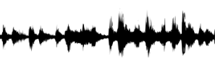
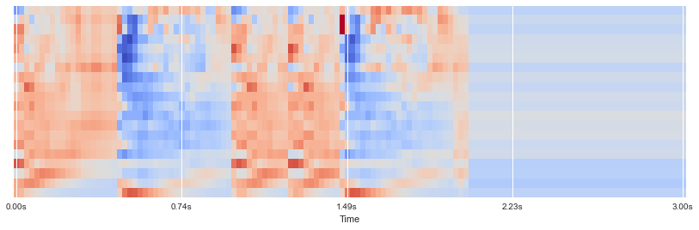
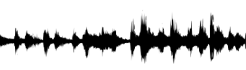
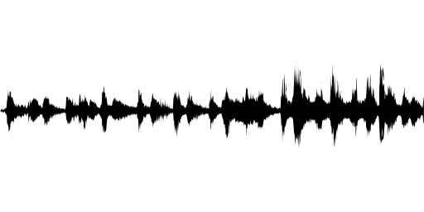
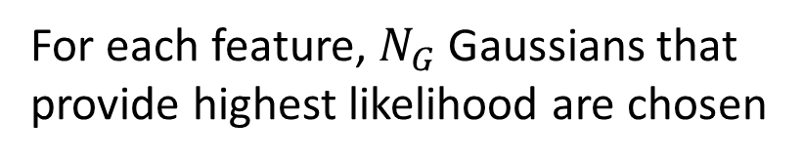
Real-time Speaker Recognizer
Offline and real-time speaker diarization system based on binary key modelling
Hao Pan Supervisor: Dr. Beta C.L. Yip
The University of Hong Kong, Faculty of Engineering, Department of Computer Science
Abstract
System Design
Speaker diarization has become more important in many speech processing tasks. Most state-of-the-art speaker diarization system nowadays decodes in an offline fashion and requires intensive computation and long processing time, which leads to the handicap for real-time applications. In this paper, we implemented the binary key speaker modelling approach and built a faster than real-time speaker diarization system that can label the speakers in recorded audio, with visualization and audio player panel. An advanced version of the system is also developed, which enable real-time processing with acceptable delay and can correct earlier outputs when necessary.
Keywords: Speaker diarization, binary key speaker modelling, speaker clustering, MFCC
Acoustic features (MFCCs)
Speaker acoustic space
most complementary & discriminant Gaussians
Input audio
VAD (WebRTC VAD)
KBM
MFCCs
(Acoustic features)
……
VAD-mask
Sliding Windows
……
Stop when getting N Gaussians
Gaussian
Pool
……
Select 1st Gaussian with max likelihood
Calculate cosine Dist with other Gaussians
Select Gaussian with biggest cosine distance
System flow chart
Features of segment
n features vectors
Cumulative Vector (CV)
Binary Key (BK)
Voice Activity Detection, Feature extraction
KBM Training
Count
Occurrences
1
0
15
1 for top 20% values in CV, 0 otherwise
1
Introduction
N Gaussian Components
In KBM
……
7
0
Speaker diarization is the process of segmenting an input audio stream into speaker-homogeneous segments
Answer: “Who spoke when?”
Speaker identities and number of speakers are unknown
Speaker diarization ≠ Speaker recognition:
Timestamps are important
No enrollment process: no speaker voiceprint
Applications:
Improve ASR accuracy
Improve speaker recognition in multi-speaker data
Source separation: e.g. doctor vs patient
Spoken document indexing and retrieval
Generic diarization scheme:
Problem:
Require Intensive computation & long processing time
Online clustering performance requires
Lack of Real-time application
Many system are domain-specific
Feature Binarization
3
0
25
1
…
…
5
0
…
…
Clustering
For each feature, $N_{G}$ Gaussians that provide highest likelihood are chosen
17
1
Segment/cluster representation
Resegmentation
Visualization
Speaker diarization has become more important in many speech processing tasks. Most state-of-the-art speaker diarization system nowadays decodes in an offline fashion and requires intensive computation and long processing time, which leads to the handicap for real-time
Input audio
Feature extraction
Speech activity detection
Segmentation
Discussion
Future Work
Click here to insert your Discussion text. Type it in or copy and paste from your Word document or other source.
This text box will automatically re-size to your text. To turn off that feature, right click inside this box and go to Format Shape, Text Box, Autofit, and select the “Do Not Autofit” radio button.
To change the font style of this text box: Click on the border once to highlight the entire text box, then select a different font or font size that suits you. This text is Calibri 28pt and is easily read up to 4 feet away on a 36x36 poster.
Zoom out to 100% to preview what this will look like on your printed poster.
Resegmentation
clustering
Segment/cluster representation
Conclusions
Click here to insert your Conclusions text. Type it in or copy and paste from your Word document or other source.
This text box will automatically re-size to your text. To turn off that feature, right click inside this box and go to Format Shape, Text Box, Autofit, and select the “Do Not Autofit” radio button.
To change the font style of this text box: Click on the border once to highlight the entire text box, then select a different font or font size that suits you. This text is Calibri 28pt and is easily read up to 4 feet away on a 36x36 poster.
Zoom out to 100% to preview what this will look like on your printed poster.
Contact
References
<your name>
<your organization>
Email:
Website:
Phone:
Binary key speaker modelling:
Faster than real-time
Without external training data
Domain-robust

Slide 4
Input audio
Feature extraction
Speech activity detection
Segmentation
Resegmentation
clustering
Segment/cluster representation

