Slide 1


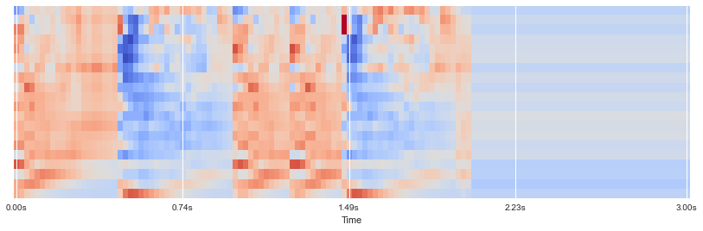
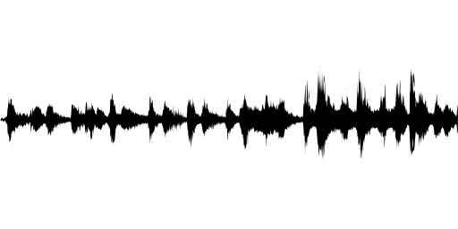
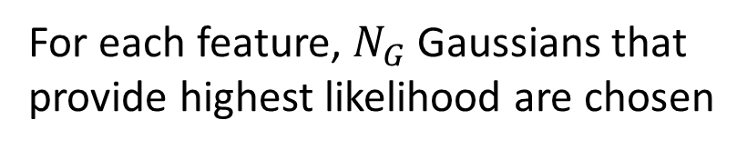
Real-time Speaker Recognizer
Offline and real-time speaker diarization system based on binary key modelling
Hao Pan 3035349015 Supervisor: Dr. Beta C.L. Yip
The University of Hong Kong, Faculty of Engineering, Department of Computer Science
Abstract
Speaker diarization system based on binary key
Speaker diarization has become more important in many speech processing tasks. Most state-of-the-art speaker diarization system decodes in an offline fashion and requires intensive computation and long processing time, which leads to the handicap for real-time applications. In this paper, we implemented the binary key speaker modelling approach and built a faster than real-time speaker diarization system that can label the speakers in recorded audio, with visualization and audio player panel. An advanced version of the system is also developed, which enable real-time processing with acceptable delay and correct earlier outputs when necessary.
Keywords: Speaker diarization, binary key speaker modelling, speaker clustering, MFCC
Feature vectors (MFCCs)
Sliding Windows
……
Gaussian
Pool
……
n features vectors
1
15
N Gaussian Components
……
Introduction
…
…
…
Speaker diarization is the process of segmenting an input audio stream into speaker-homogeneous segments
Answer: “Who spoke when?”
Speaker identities and number of speakers are unknown
Speaker diarization ≠ Speaker recognition:
Timestamps are important
No enrollment process: no speaker voiceprint
Applications:
Improve ASR system
Improve speaker recognition in multi-speaker data
Source separation: e.g. doctor vs patient
Spoken document indexing and retrieval
Generic diarization scheme:
Problem:
Intensive computation and long processing time
Online performance
Real-time application
Domain-specific
For each feature, $N_{G}$ Gaussians that provide highest likelihood are chosen
Discussion
Results
Click here to insert your Discussion text. Type it in or copy and paste from your Word document or other source.
This text box will automatically re-size to your text. To turn off that feature, right click inside this box and go to Format Shape, Text Box, Autofit, and select the “Do Not Autofit” radio button.
To change the font style of this text box: Click on the border once to highlight the entire text box, then select a different font or font size that suits you. This text is Calibri 28pt and is easily read up to 4 feet away on a 36x36 poster.
Zoom out to 100% to preview what this will look like on your printed poster.
Click here to insert your Results text. Type it in or copy and paste from your Word document or other source.
This text box will automatically re-size to your text. To turn off that feature, right click inside this box and go to Format Shape, Text Box, Autofit, and select the “Do Not Autofit” radio button.
To change the font style of this text box: Click on the border once to highlight the entire text box, then select a different font or font size that suits you. This text is Calibri 28pt and is easily read up to 4 feet away on a 36x36 poster.
Zoom out to 100% to preview what this will look like on your printed poster.
Speaking of Results, yours will look better if you remember to run a spell-check on your poster! After you’ve added your content click on Review, Spelling, or press F7.
Input audio
Feature extraction
Speech activity detection
Segmentation
Conclusions
Click here to insert your Conclusions text. Type it in or copy and paste from your Word document or other source.
This text box will automatically re-size to your text. To turn off that feature, right click inside this box and go to Format Shape, Text Box, Autofit, and select the “Do Not Autofit” radio button.
To change the font style of this text box: Click on the border once to highlight the entire text box, then select a different font or font size that suits you. This text is Calibri 28pt and is easily read up to 4 feet away on a 36x36 poster.
Zoom out to 100% to preview what this will look like on your printed poster.
Resegmentation
clustering
Segment/cluster representation
Contact
References
<your name>
<your organization>
Email:
Website:
Phone:

Slide 4
Input audio
Feature extraction
Speech activity detection
Segmentation
Resegmentation
clustering
Segment/cluster representation

