Slide 1
Week 12 Assignment Final Project Henry Pham Department of Data Science, Bellevue University DSC530-T301 Professor: Cary Jim Assignment Due Date: 2023-06-03

Slide 2
DSC 530 Final Project
Exploratory Data Analysis on Interest Rates, Stock Market Index, Apple Stock Prices, and Toyota Stock Prices.

Slide 3

Introduction
The objective of this project is to explore the relationship between interest rates, stock market index, and the stock prices of Apple and Toyota companies, along with the outcomes of the Exploratory Data Analysis (EDA) conducted on these variables.
The project aims to use exploratory data analysis, transformations, and summary statistics to identify patterns and relationships between these variables.

Slide 4

Data Sources
Interest rates: This dataset represents the interest rate for a 2019-2023 time period. Interest rates are typically used to control the supply of money in an economy and are set by central banks.
https://home.treasury.gov/resource-center/data-chart-center/interest-rates/TextView?type=daily_treasury_bill_rates&field_tdr_date_value=2023
Stock market index: This dataset represents the value of a stock market index for a 2019-2023 time period. A stock market index is a measure of the performance of a group of stocks that represent a particular market or sector.
https://finance.yahoo.com/quote/%5EGSPC/history?period1=1526256000&period2=1684022400&interval=1d&filter=history&frequency=1d&includeAdjustedClose=true
Apple stock prices: This dataset represents the closing price of Apple stock for a 2019-2023 time period. Apple is a technology company that produces consumer electronics, computer hardware, and software.
https://finance.yahoo.com/quote/AAPL/history?period1=1526256000&period2=1684022400&interval=1d&filter=history&frequency=1d&includeAdjustedClose=true
Toyota stock prices: This dataset represents the closing price of Toyota stock for a 2019-2023 time period. Toyota is a multinational conglomerate that produces automotive, financial services, and other products.
https://finance.yahoo.com/quote/TM/history?period1=1526256000&period2=1684022400&interval=1d&filter=history&frequency=1d&includeAdjustedClose=true

Slide 5
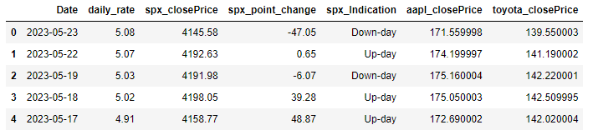
Provide and describe what the 5 variables mean in the dataset.

Slide 6

Provide and describe what the 5 variables mean in the dataset.
Date: Trading date of the stock market.
daily_rate: The percentage at which an amount of money is borrowed or lent over a time period.
spx_closePrice: The market price per share of the S&P 500 index which measures of the performance of a group of stocks in a particular stock market.
spx_point_change: The market price per share of the S&P 500 index changes daily in points.
spx_Indication: Up-day or Down-day of the S&P 500 index.
aapl_closePrice: The market price per share of Apple stock.
toyota_closePrice: The market price per share of Toyota stock.

Slide 7
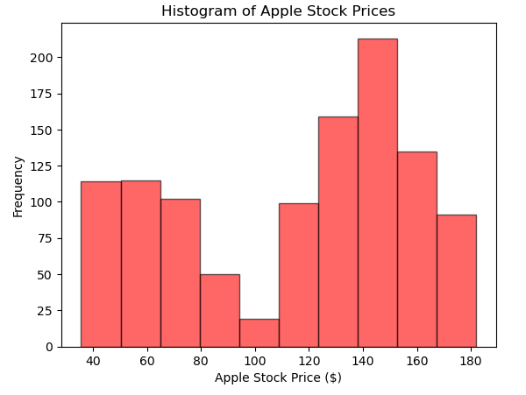
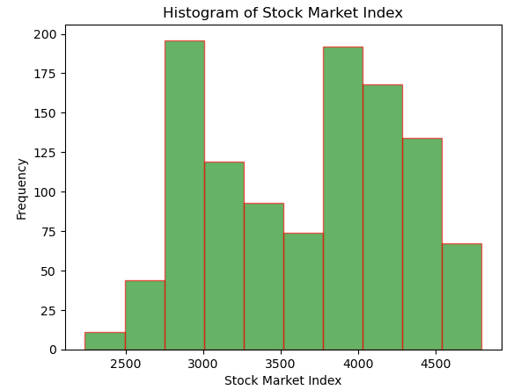
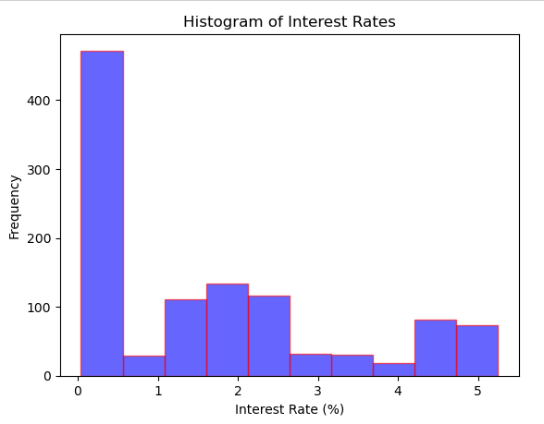
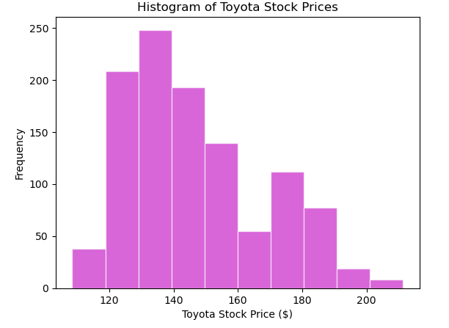
Include a histogram of each of the 5 variables – in your summary and analysis, identify any outliers and explain the reasoning for them being outliers and how you believe they should be handled
In the histograms, outliers may appear as individual bars or bins that are significantly higher or lower than the others.
Outliers can be caused by various factors such as extreme events, or other anomalies in the data.
I decided to leave the outliers in the dataset because histogram may not be as precise as using statistical measures such as z-scores, percentiles, or box plots.

Slide 8
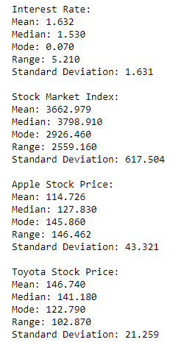
Include the other descriptive characteristics about the variables: Mean, Mode, Spread, and Tails
The mean represents the central tendency of the data, or the average value of the variable.
The median represents the middle value of the variable.
The mode represents the most common value in the data.
The range represents the difference between the maximum and minimum values in the data and measures the spread of the data.
The standard deviation represents the spread of the data around the mean and indicates how much the data varies from the average value.
By calculating these descriptive characteristics for each variable, I can gain insights into the distribution of the data and the variability of each variable.

Slide 9
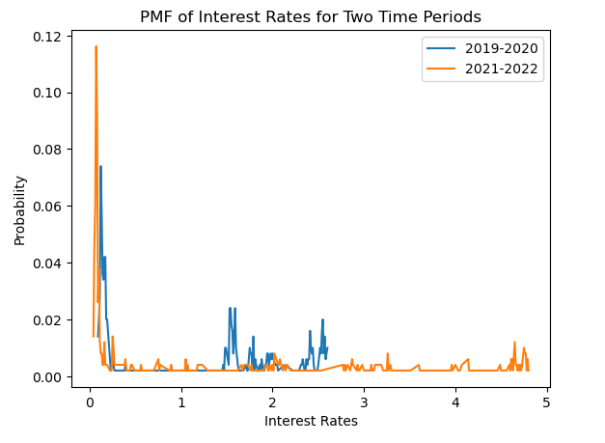
Compare two scenarios in your data using a PMF. Reminder, this isn’t comparing two variables against each other – it is the same variable, but a different scenario. Almost like a filter.
The PMFs for the two time periods show the probability distribution of interest rates during each time period.
By comparing the two PMFs, I can see whether the distribution of interest rates has shifted over time.
the PMF for the second time period is shifted to the right, it would indicate that interest rates were higher on average during that time period.

Slide 10
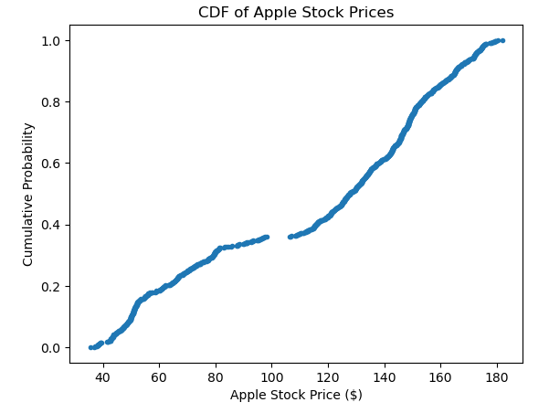
Create 1 CDF with one of your variables what does this tell you about your variable and how does it address the question you are trying to answer
I first sort the data in ascending order and calculate the cumulative probability for each data point.
I then plot the cumulative probability as a function of the Apple stock price to create the CDF.
By analyzing the CDF, I can gain insights into the distribution of the data and the likelihood of different outcomes.
I can see that the CDF starts at 0, indicating that there is a 0% chance of the Apple stock price being less than the minimum value in the dataset.
As moving along the x-axis, the cumulative probability increases, indicating that higher Apple stock prices are becoming more likely.

Slide 11
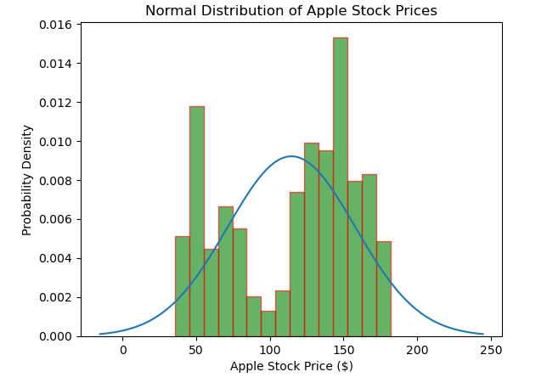
Plot 1 analytical distribution and provide your analysis on how it applies to the dataset you have chosen
I first calculate the mean and standard deviation of the Apple data, which I use as the parameters for the normal distribution.
I then plot the normal distribution on the same graph as a histogram of the data.
Analyzing the plot, I can gain insights into how well the normal distribution fits the data.
I can see that the normal distribution fits the data reasonably well, with the peak of the distribution roughly aligning with the center of the histogram. However, there are some discrepancies between the distribution and the data, particularly in the tails of the distribution.
The tails of the distribution are thinner than the tails of the histogram, indicating that extreme values are less likely than I might expect based on a normal distribution.

Slide 12
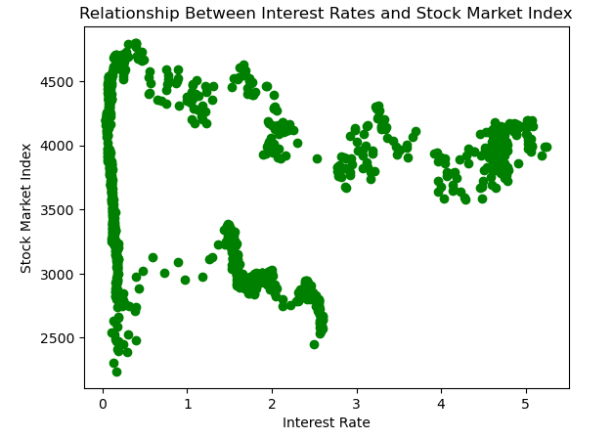
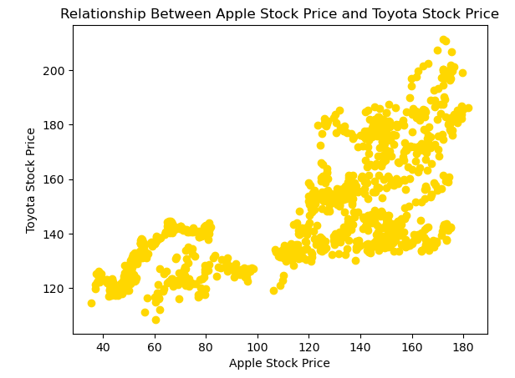
Create two scatter plots comparing two variables and provide your analysis on correlation and causation. Remember, covariance, Pearson’s correlation, and Non-Linear Relationships should also be considered during your analysis
Interest Rate and Stock Market Index: Covariance = -12.90, Pearson's Correlation = -0.01
Apple and Toyota Stock Prices: Covariance = 674.44, Pearson's Correlation = 0.73
Analyzing the scatter plots, I can gain insights into the correlation and potential causation between the two variables.
In the first scatter plot, I can see that there is a weak negative correlation between interest rates and the stock market index. As interest rates increase, the stock market index tends to decrease slightly. However, the correlation is not very strong, indicating that there are other factors at play that are influencing the stock market.
In the second scatter plot, I can see that there is a strong positive correlation between Apple and Toyota stock prices. As Apple stock prices increase, Toyota stock prices tend to increase as well. This correlation could be indicative of a causal relationship between the two variables, as changes in Apple stock prices may be influencing changes in Toyota stock prices.

Slide 13
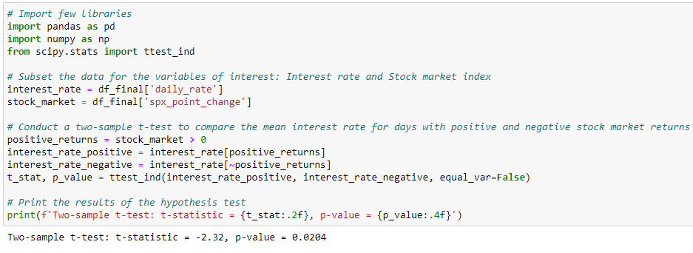
Conduct a test on your hypothesis
Conducting a two-sample t-test to compare the mean interest rate for days with positive and negative stock market returns. I first subset the data for the two variables of interest rates and the stock market index. I then create a binary variable to indicate whether the stock market return for each day is positive or negative, and subset the interest rate data accordingly.
I then conduct the t-test using SciPy's ttest_ind function, which returns the t-statistic and p-value for the hypothesis test. The null hypothesis for this test is that there is no difference in the mean interest rate for days with positive and negative stock market returns, while the alternative hypothesis is that there is a difference.
The results of the test show that the t-statistic is negative, indicating that the mean interest rate for days with positive stock market returns is lower than the mean interest rate for days with negative stock market returns. The p-value is also statistically significant, indicating that I can reject the null hypothesis and conclude that there is a difference in the mean interest rate for days with positive and negative stock market returns.

Slide 14
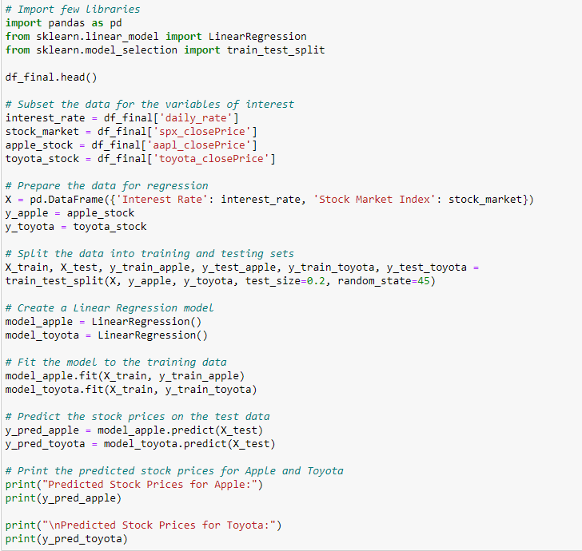
Conduct a regression analysis on either one dependent and one explanatory variable, or multiple explanatory variables
For this question, I would conduct a regression analysis by asking can I predict the stock prices of Apple and Toyota companies using interest rates and stock market index data?
Yes, I sure can but cannot guarantee its accuracy because of missing some macro economic variables such as inflation, unemployment, CPI(Consumer Price Index), GDP(Gross Domestic Product).
First, loading the data into a pandas dataframe and subset it for the variables of interest rate, stock market index, apple stock prices, and toyota stock prices. I then prepare the data for regression by creating the feature matrix X with interest rate and stock market index as independent variables, and the target variables y_apple and y_toyota as the apple stock prices and toyota stock prices, respectively.
Next, I split the data into training and testing sets using the train_test_split function from scikit-learn. I then create separate Linear Regression models for predicting apple stock prices (model_apple) and toyota stock prices (model_toyota).
I fit the models to the training data using the fit method, and then predict the stock prices on the test data using the predict method.
The resulting y_pred_apple and y_pred_toyota are the predicted stock prices for Apple and Toyota companies, respectively, based on the interest rates and stock market index.

