Slide 1
Simple Computer Vision Project: Classifying Mushroom Species
CPSC386
Henry Roeth

Slide 2
What Is The Goal?
Identify a specific image recognition problem.
Collect a dataset of more than 3 classes with at least 200 labeled images.
Train a model using transfer learning on a pre-trained base.
Monitor performance.

Slide 3
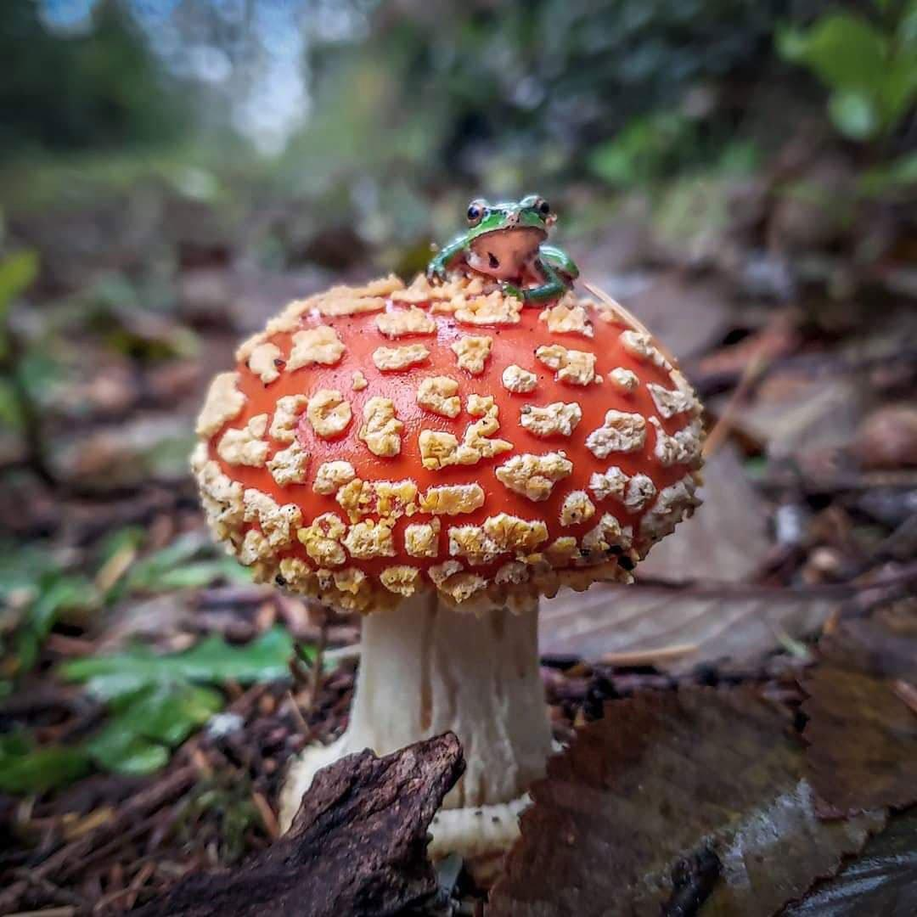
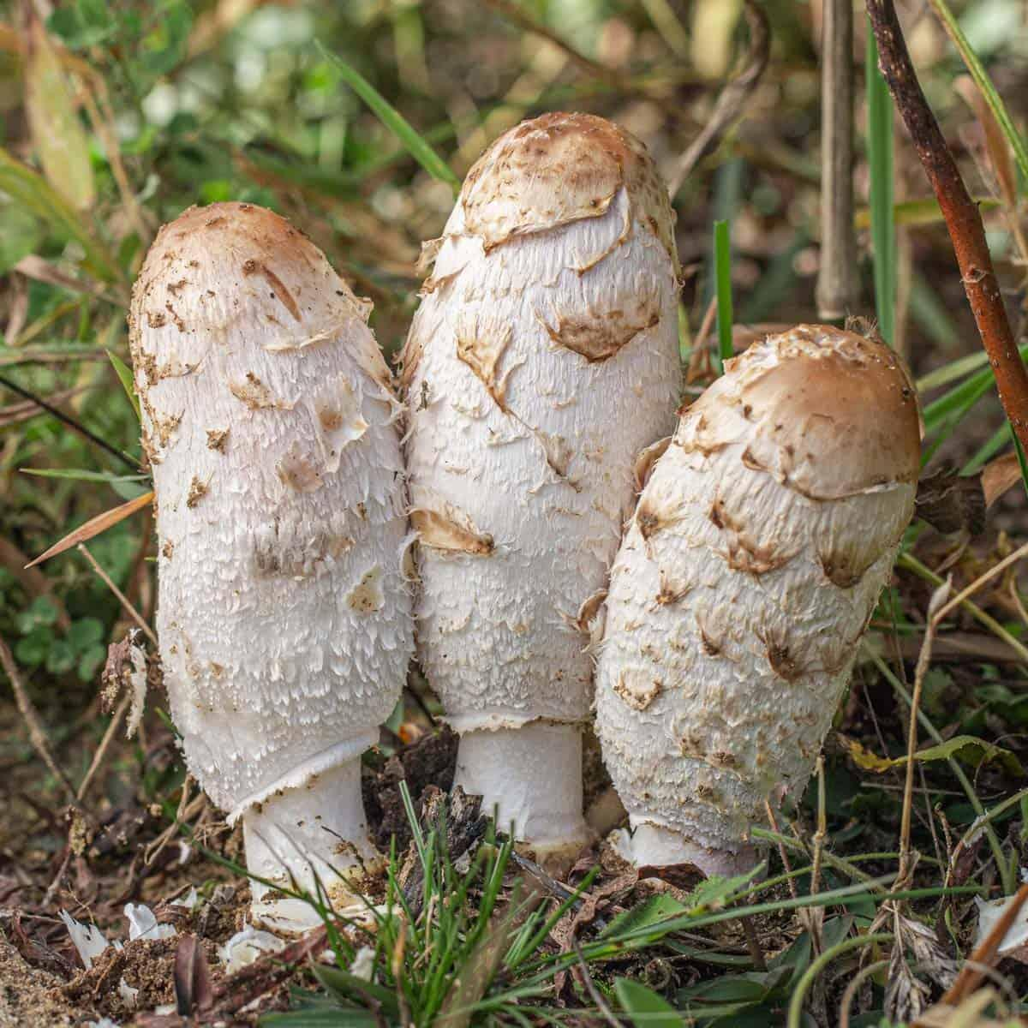
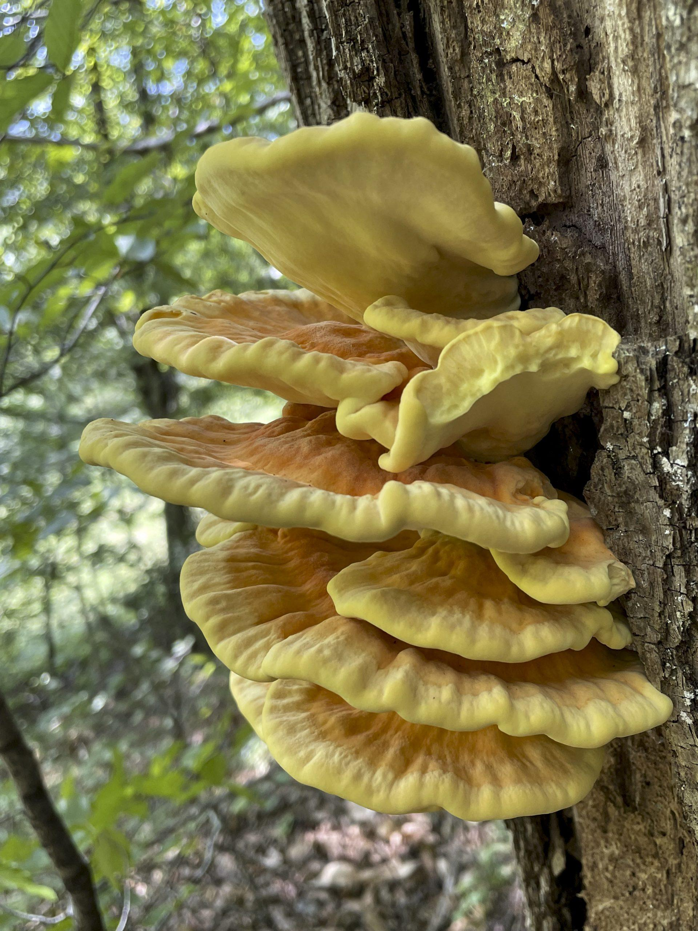
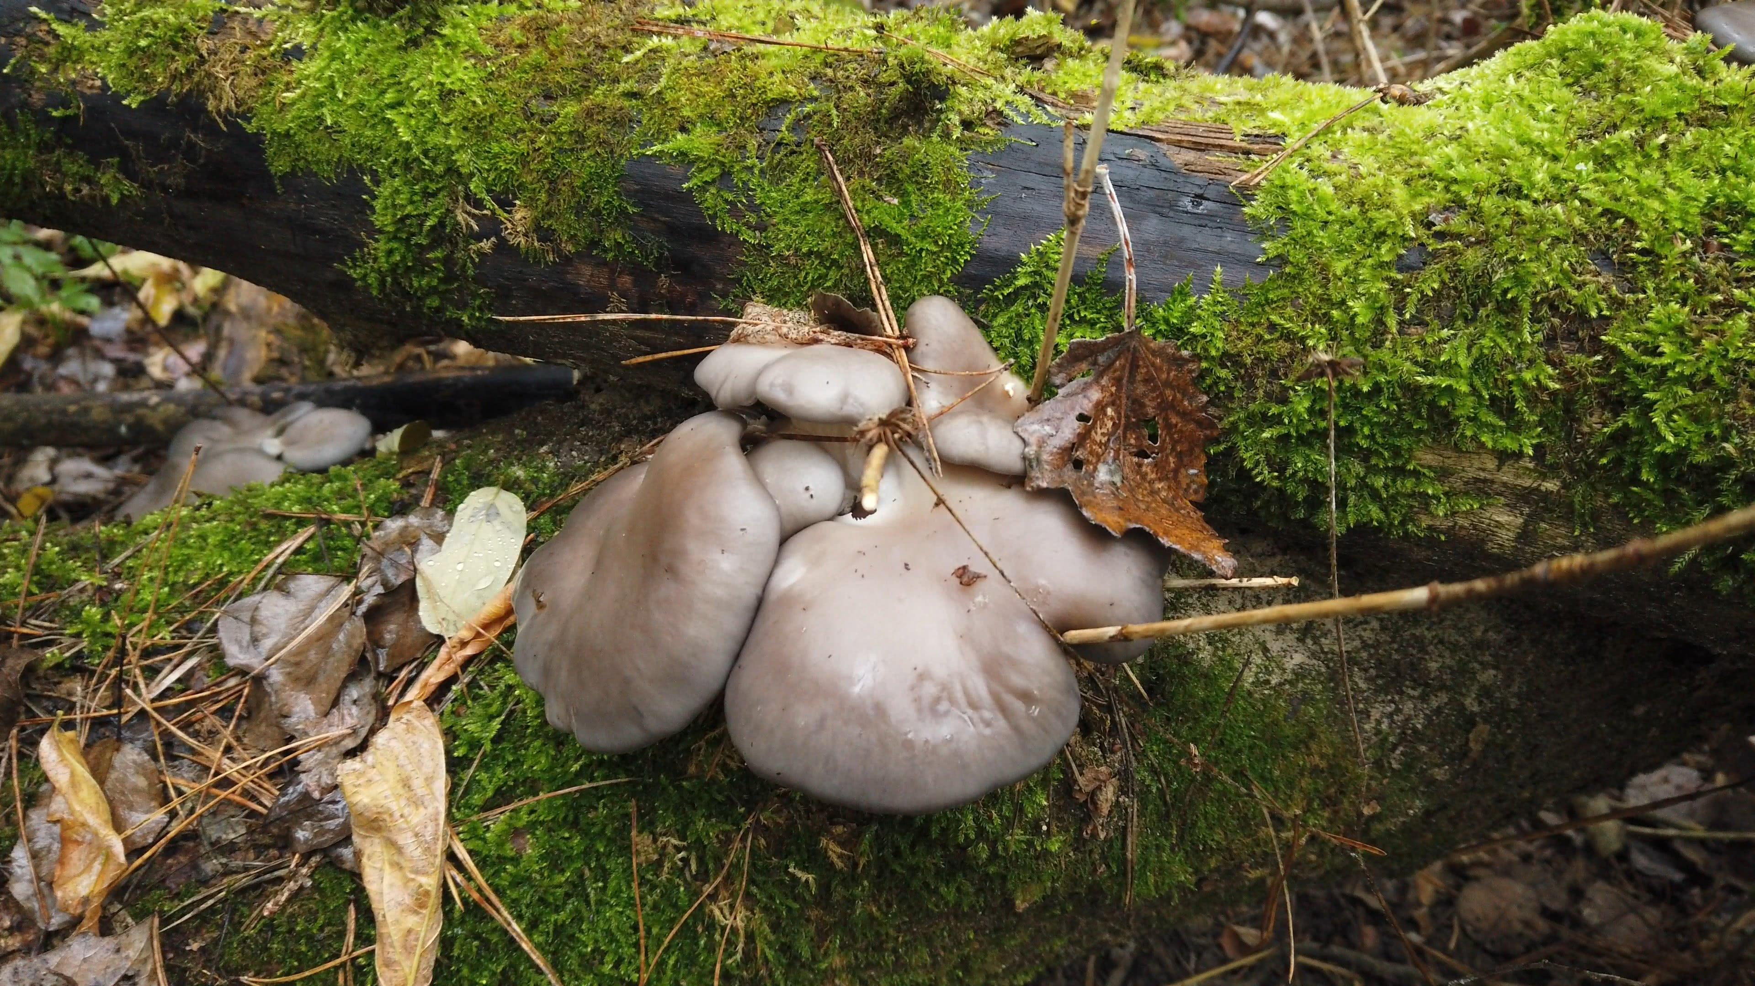
Identifying Mushroom Species
Amanita muscaria
Coprinus comatus
Laetiporus sulphureus
Pleurotus ostreatus

Slide 4

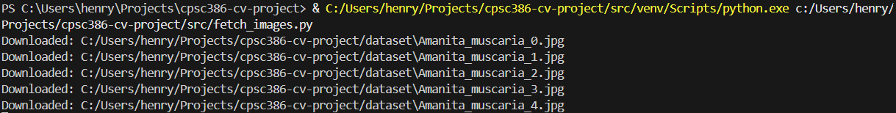
Collecting My Dataset
I generated a Pexels API key
Simple Python script using `requests` module with key

Slide 5
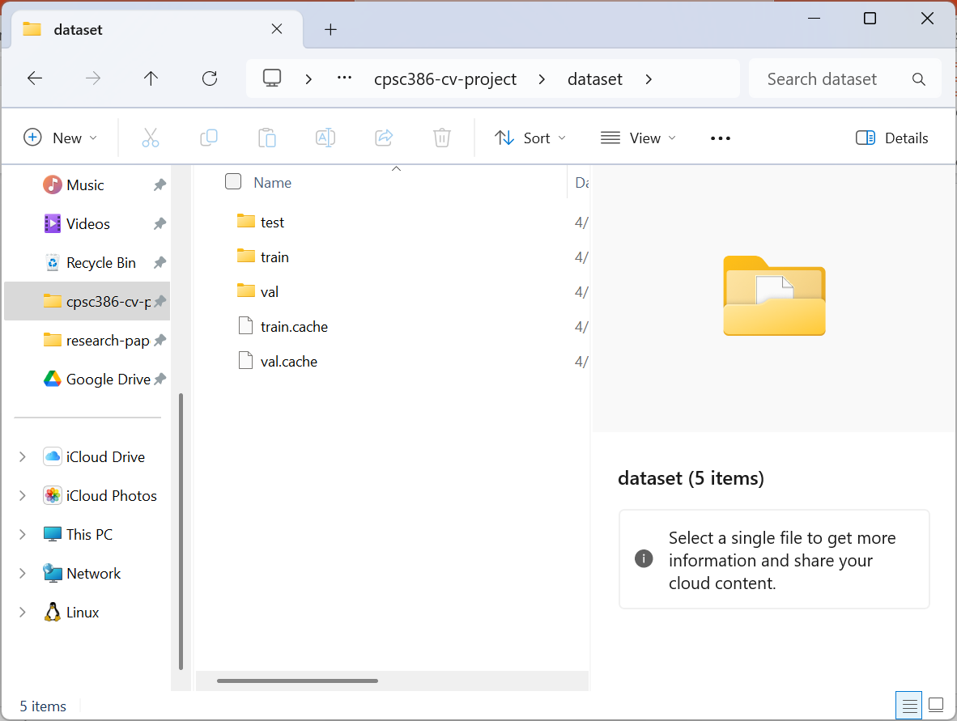
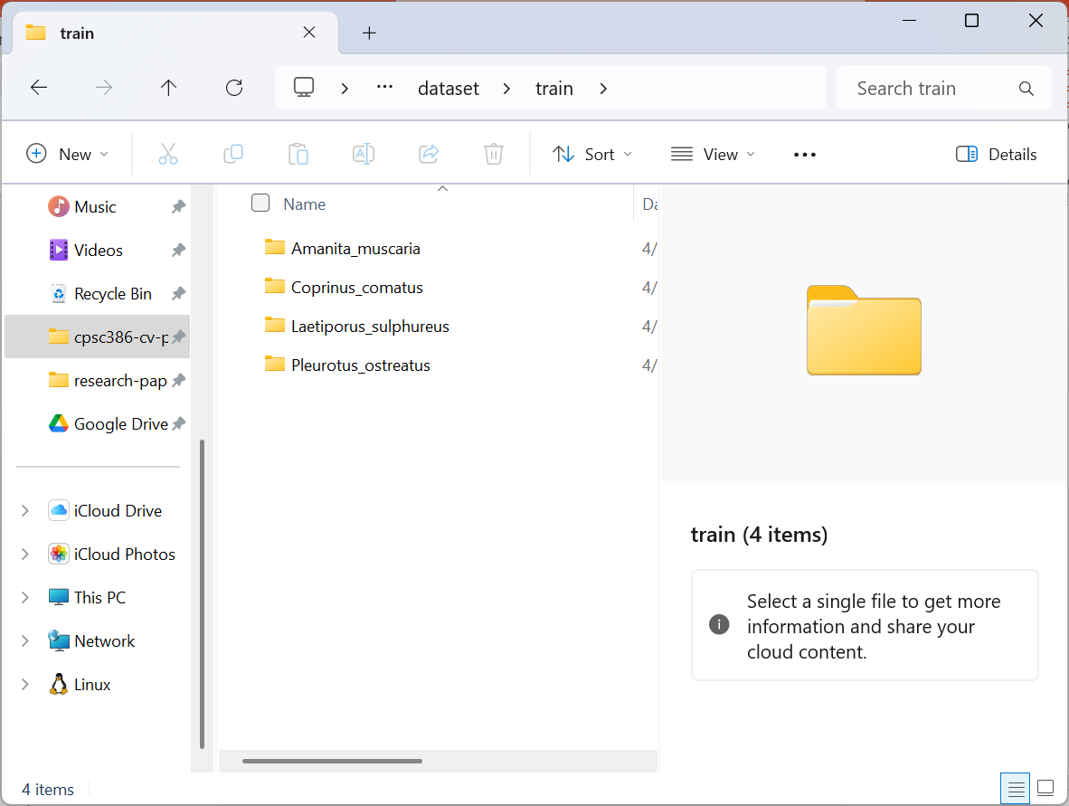
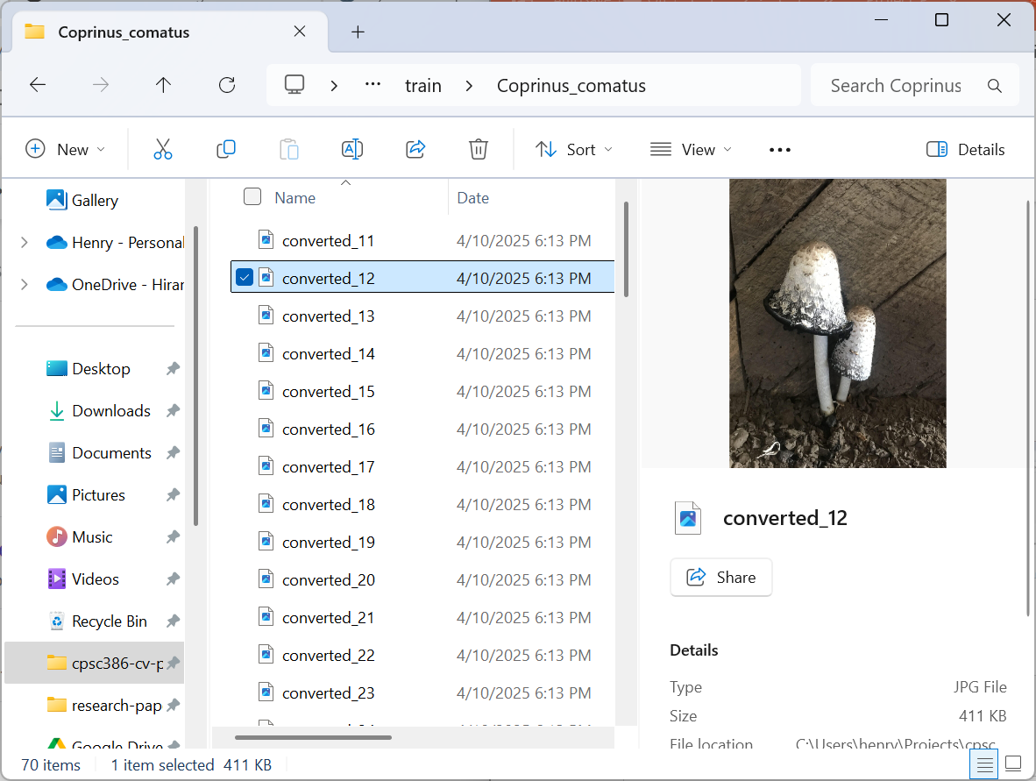
Structuring My Dataset

