Slide 1
Computer Vision Project: Classifying Mushrooms
CPSC386
Henry Roeth

Slide 2
What Is The Goal?
Identify a specific image recognition problem
Collect a dataset of more than 3 classes with at least 200 labeled images
Train a model using transfer learning on a pre-trained base
Monitor performance
Test accuracy

Slide 3
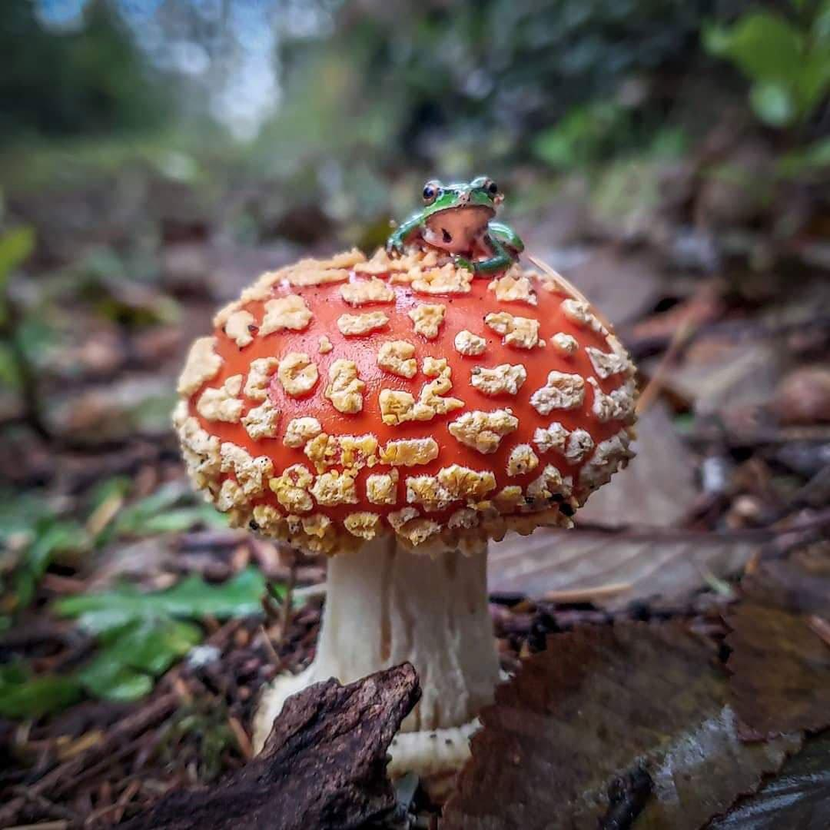
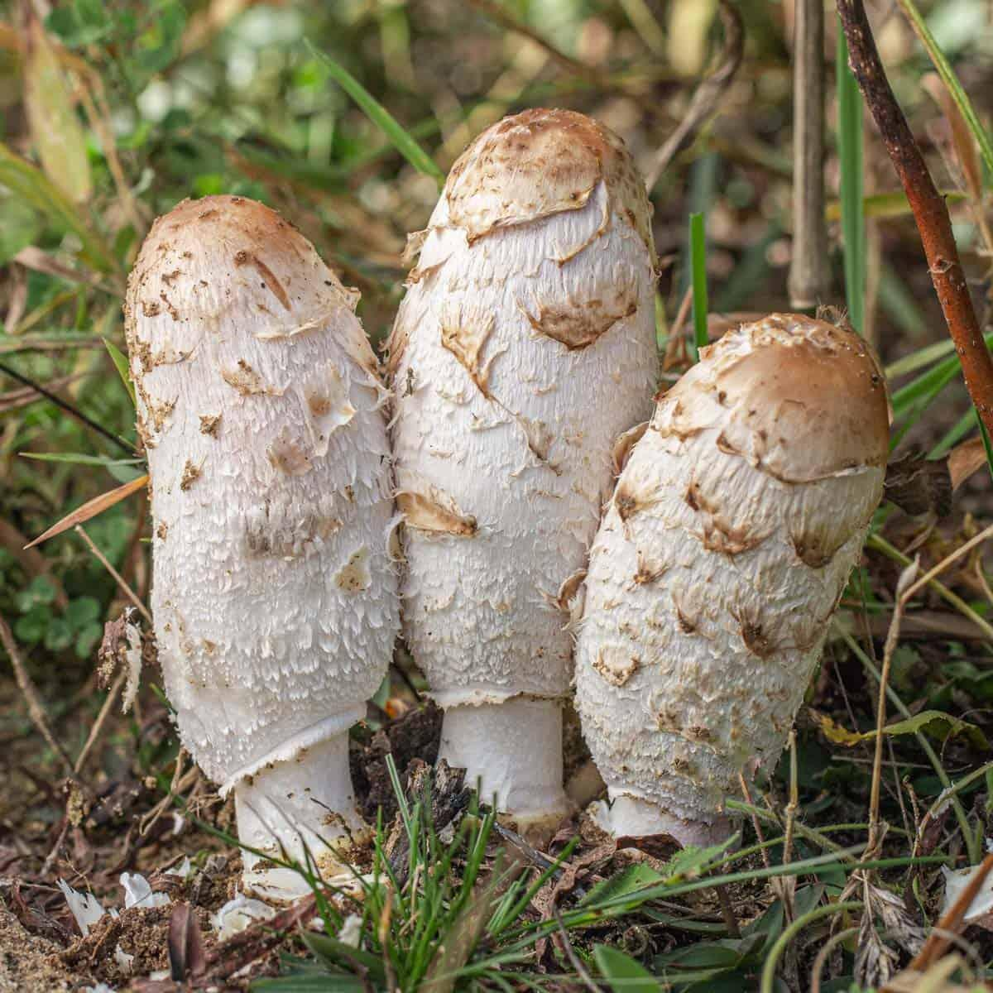
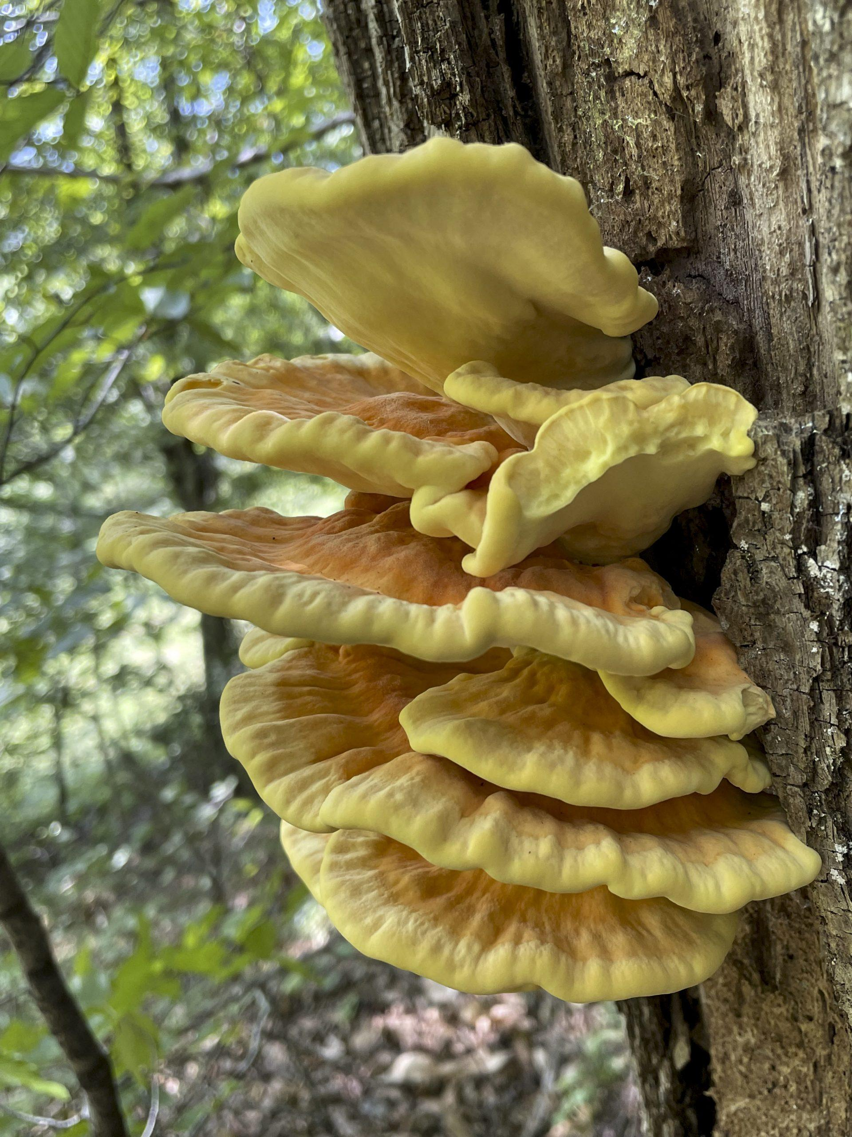
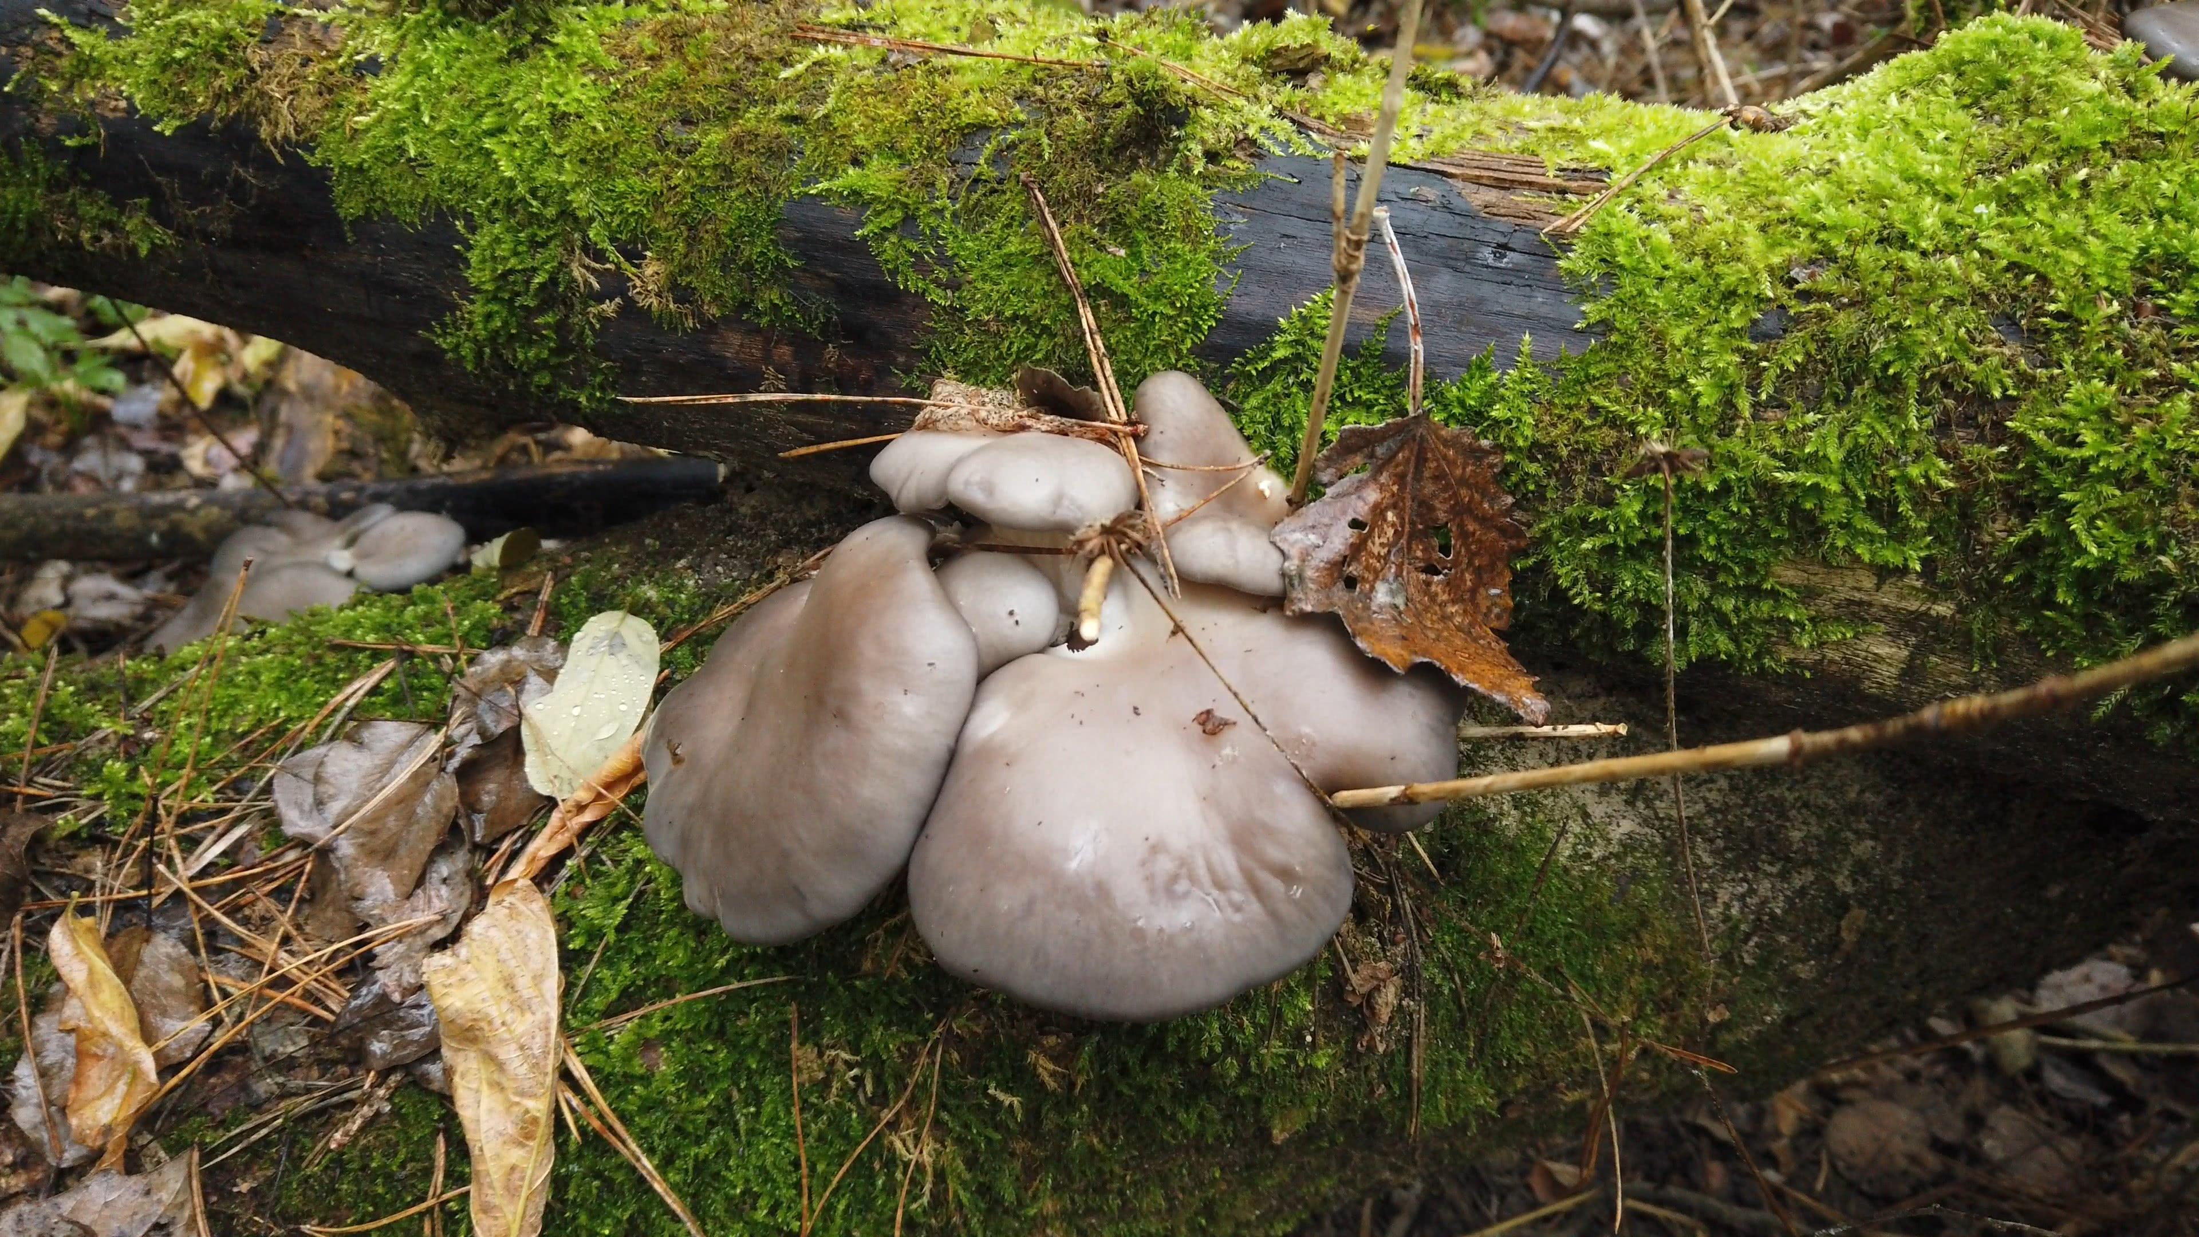
Classifying Different Mushroom Species
Amanita muscaria
Coprinus comatus
Laetiporus sulphureus
Pleurotus ostreatus

Slide 4

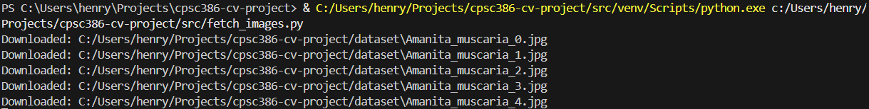
Collecting My Dataset
Generated a Pexels API key
Simple Python script using `requests` module and key
Downloaded 400 images (100 for each class)

Slide 5

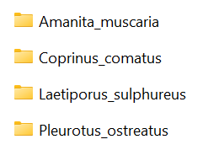
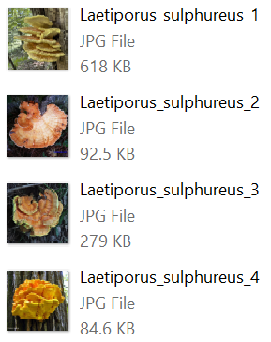
Structuring My Dataset
Organized my images into training, validation, and testing folders (70-20-10 split)

Slide 6
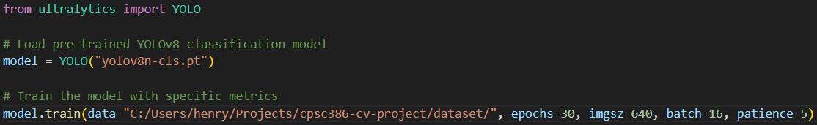

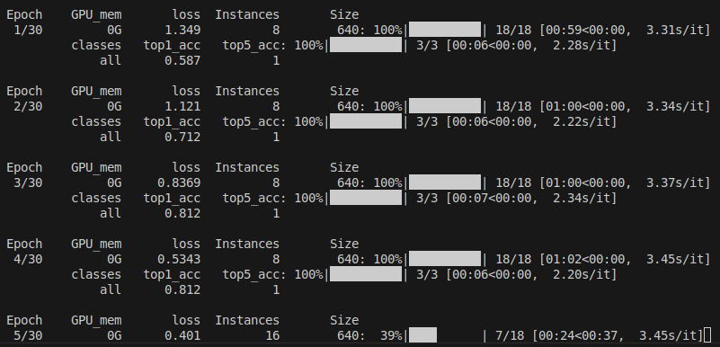
Model Training
YOLO (You Only Look Once)
Pre-trained model = yolov8n-cls.pt
Epochs = 30 epochs
Image resizing = 640 pixels
Batch size = 16 samples
Patience = 5 epochs

Slide 7
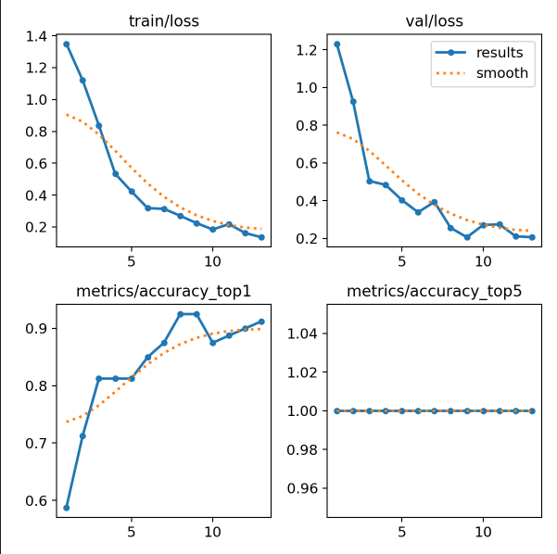
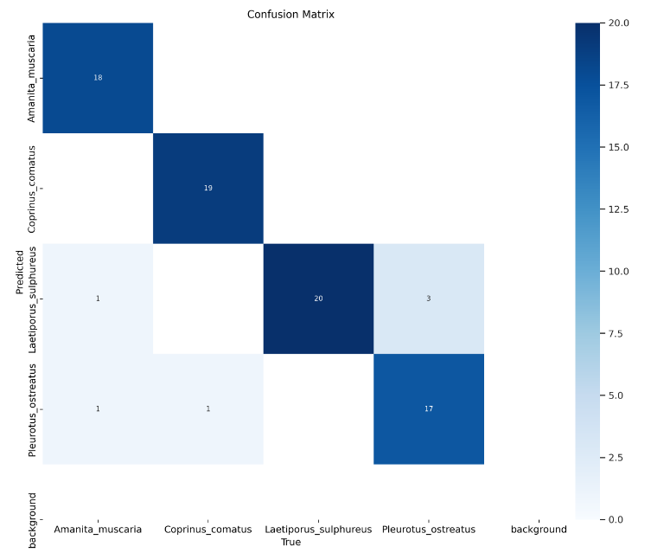
Model Performance

Slide 8
Resources
Requests Library Documentation:
https://realpython.com/python-requests/
Pexels API Documentation: https://www.pexels.com/api/documentation/
Ultralytics Library Documentation: https://docs.ultralytics.com/tasks/classify/#how-do-i-train-a- yolo11-model-for-image-classification
Project Repo: https://github.com/henryroeth/cpsc386-cv-project

Slide 9
Model Testing Demo

