Slide 1
IRC II: Weeks 1-5 Progress Report
Organizing Research Papers Using Text Embeddings and Clustering
By: Henry Roeth

Slide 2
Setting Up My Environment
I first created a project folder on my laptop and backed it up to a GitHub repository at:
https://github.com/henryroeth/research-paper-organizer
I then created a virtual Python environment in Visual Studio Code and began installing dependencies

Slide 3
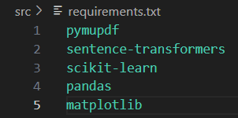
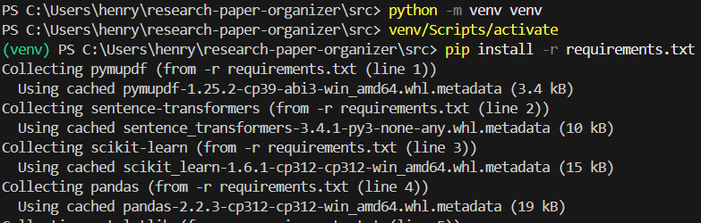
Setting Up My Environment
`pymupdf` - Extract data from PDFs
`sentence-transformers` - Capture the semantics of sentences
`scikit-learn` - All-purpose machine learning
`pandas` - Data analysis
`matplotlib` - Data visualization

Slide 4
Downloading a Dataset
I created a Python script that uses the arXiv API to fetch 1000 research papers about Physics, Biology, and Literature
I then randomly downloaded 500 PDFs based on relevance and availability

Slide 5
Performing Analysis

